Slide 1
CS4459
Cyber Attacks & Defense Lab (CANDL)
LEC #1 – Low Level Data Encoding
Jan 28, 2025

Slide 2


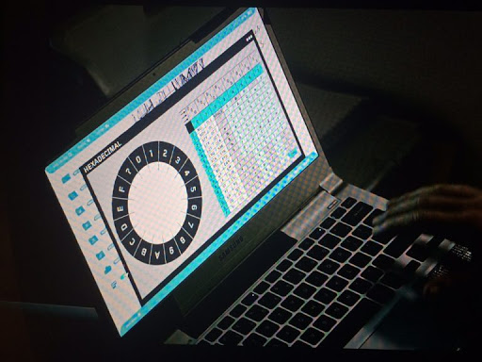

How Did JPL Connect to
Mark Watney?
At Sol 6: Mark Watney left alone in the Mars at due unexpected thunderstorm at Mars
Sol 10: Mark tried to revive long deactivated PathFinder lander to reconnect back the Earth
Revived Pathfinder lander could connect back to the earth but
  Limited bandwidth, lengthy communication delays,
  No support for proper I/O
Sol 83: Mark devised a protocol an ascii byte at a time (1 byte per 4 seconds)
*Sol : Day on Mars
Notes:
https://youtu.be/NttUBB98zg4?t=82

Slide 3
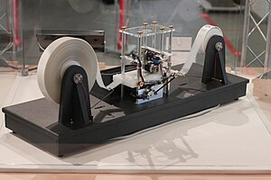
Low-Level Data Encoding
Two’s complement encoding
Endianness
Primitive Types
ASCII
String
Image source: https://en.wikipedia.org/wiki/Turing_machine

Slide 4
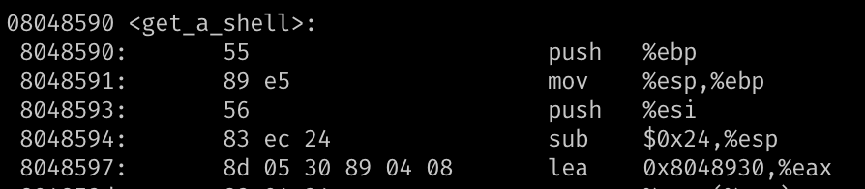
Integer Representations
Unsigned representation (%u)
  8-bit → A byte -> char
Signed
  2’s complement → 1 bit for signedness (%d)
Hexadecimal representation
  0x0 ~ 0xF → 4-bits
  0xB5 → 8-bits (int8_t) → a char
= 214
= 0xD6
Notes:
https://www.electronics-tutorials.ws/binary/signed-binary-numbers.html

Slide 5
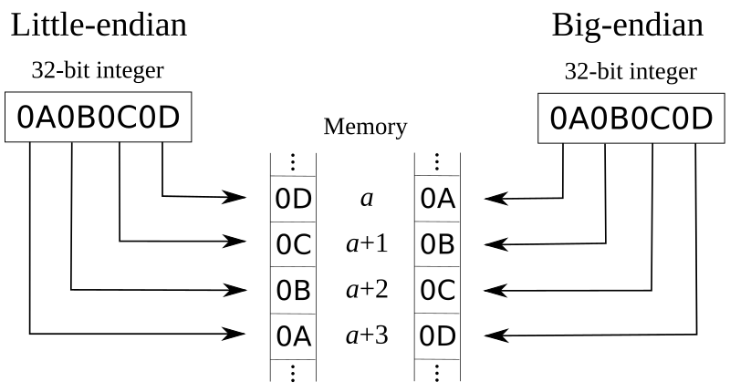
Endianness: Little vs. Big
How the hardware architecture layouts array of bytes
Intel → Little endian
Network
→ Big endian

Slide 6
Bitwise Operations – Truth Table
& (AND)
1 if both are 1
| (OR)
1 if either of one is 1
^ (XOR)
1 if two values are different
AND | 0 | 1
0 | 0 | 0
1 | 0 | 1
OR | 0 | 1
0 | 0 | 1
1 | 1 | 1
XOR | 0 | 1
0 | 0 | 1
1 | 1 | 0
Do not confuse with Logical operators: || , &&

Slide 7
Bitwise Operations - Examples
AND
  1 & 2 = ?
    00000001
    00000010
    = 00000000 = 0
  0x32 & 0x47 = ?
    00110010
    01000111
    = 00000010 = 2
OR
  1 | 2 = ?
    00000001
    00000010
    = 00000011 = 3
  0x32 & 0x47 = ?
    00110010
    01000111
    = 01110111 = 0x77
XOR
  1 ^ 2 = ?
    00000001
    00000010
    = 00000011 = 3
  0x32 ^ 0x47 = ?
    00110010
    01000111
    = 01110101 = 0x75

Slide 8
Bitwise Operations – Reversible XOR
XOR is a reversible operator
  A ^ B = C
  C ^ B = ?
    C = (A^B)
    C ^ B = (A ^ B) ^ B = A ^ (B ^ B)
  # XOR-ing the same value, zero
  B^B = 0
  # A’s 0s will be zero
  # A’s 1s will be one
  A ^ 0 = A
XOR and SWAP
Suppose you have
int a,b;
Swap – temp variable
  int t = a;
  a = b;
  b = t;
Swap – XOR
  a = a^b
  b = a^b ⬄ (a^b)^b => a
  a = a^b ⬄ (a^b)^a => b

Slide 9
Bitwise Operations - AND
Use it to get the least significant bits (byte)
movsbl: move int8_t (char) → int (integer)
  0x0804868c <+44>: movsbl (%eax,%ecx,1),%eax
  0x08048690 <+48>: add $0x20,%eax
  0x08048693 <+51>: and $0xff,%eax
  %eax = [%eax + %ecx * 1]; // read 1 byte (movsbl)
  %eax += 0x20;
  %eax &= 0xff
  int a;
  a += 0x20;
  a &= 0xff; // retain only a byte
Notes:
todo: update example

Slide 10
Bitwise Operations - AND
  int a; a += 0x20; a &= 0xff;
  An unsigned character value could be in the range from 0 to 255
  The code adds 32(0x20) to the character value.
  What if the original value is 255?
    255 + 32 = 287 = 0x11f ← not a character
  287 & 0xff?
    0x11f & 0xff
    0x1f!
0x011f = 00000001 00011111
0x00ff = 00000000 11111111
------------------
> 00000000 00011111
& (AND)

Slide 11
<stdint.h>
Be explicit on
  Data types
    Value or pointer
  Data width: a byte (8-bit), four bytes (32-bit), eight bytes (64-bit)
    2^4 = 16, 2^5 = 32 ….
    2^10 = 1024 ≈ 1K, 2 ^ 20 = 1024 X 1024 ≈ 1M …
      Q: 2^32 ?
  Signedness
Beware of side effects
  overflow, underflow …
Use <stdint.h>
#include <stdint.h>
int32_t a; // 4 bytes
uint8_t b; // 1 byte
…
int8ptr_t c; // 4 bytes
int32ptr_t d; // 4 bytes
…

Slide 12
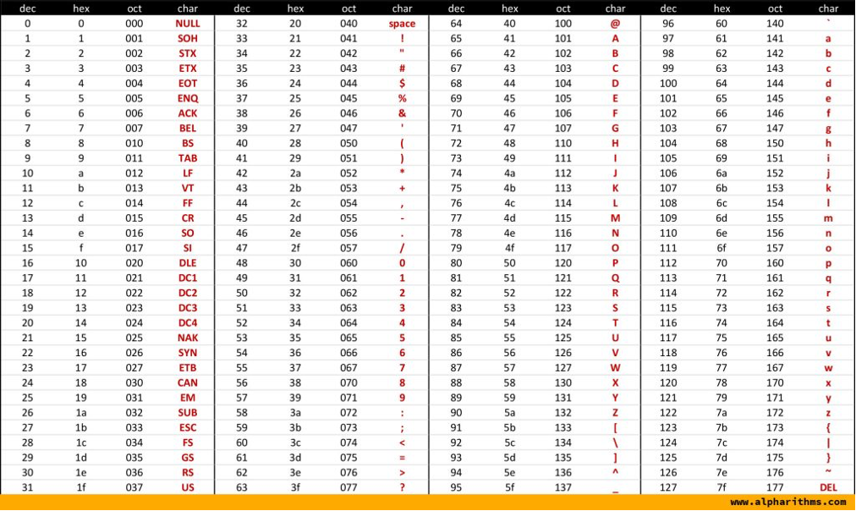
ASCII Table
A byte to represent a character
0 ~ 255 (0x0 ~ 0xFF) (unsigned) characters
  Limited → Unicode
String terminated by 0x0 (NUL)
Alpha + Digit region starts from 0x30 (48)

Slide 13
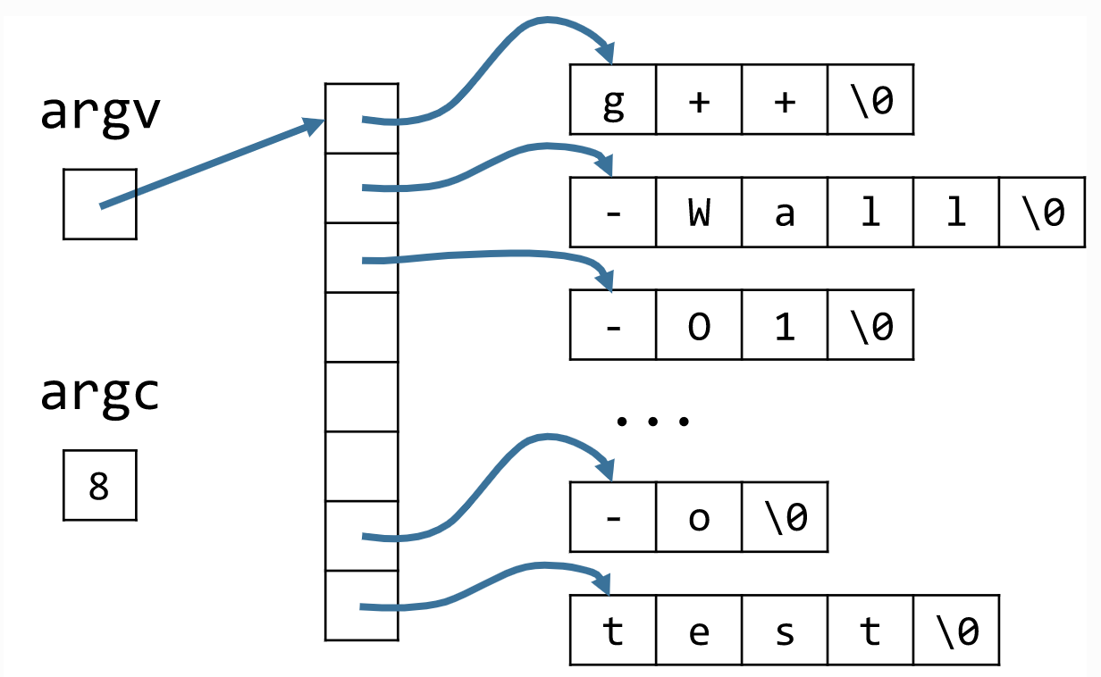
C-Style Strings
String is ‘NULL’ (\0) terminated
char str[6] = { 'h', 'e', 'l', 'l', 'o', '\0' };
Command line arguments
g++ -wall –O1 …. –o test

Slide 14
(Naïve) string functions
int strlen(char* str);
int strcpy(char* dst, char* src);
int strlen (char* str) {
  int l= 0;
  while (str(l) != ‘\0’) {
  l++;
  }
  return l;
}
int strcpy (char* dst, char* src) {
  int l= 0;
  do {
  dst[l] = src[l];
  l++;
  } while (src(l) != ‘\0’)
  return l;
}
How about ‘strcmp’?
Notes:
strcmp return value man strcmp

