Slide 1
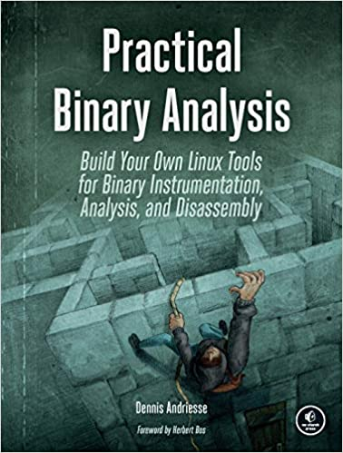
Practical Binary Analysis
Chapters NOT relevant
  Ch. 3 on PE binary: Important but the course do not cover
  Ch. 10, Ch. 11, Ch. 12 are too specific
We will spend some time on
  Static binary re-writing

Slide 2
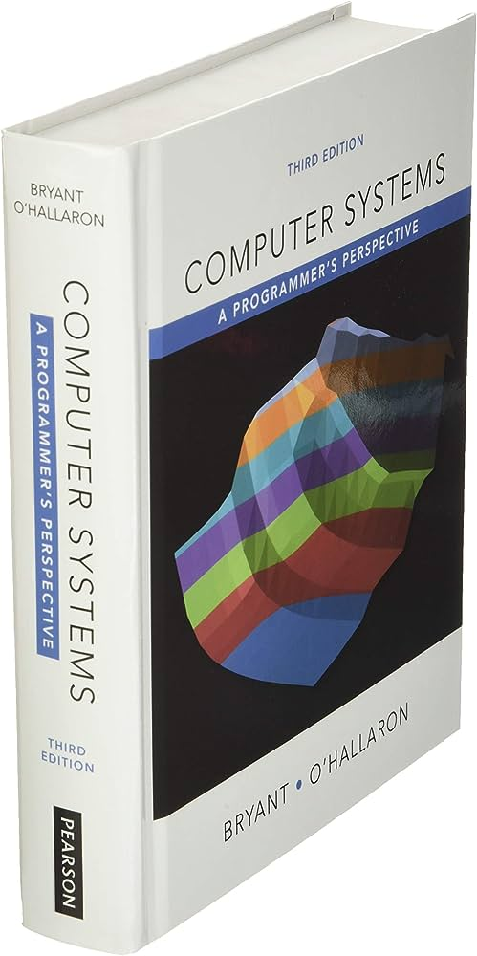
Computer Systems: A Programmer's Perspective
A good reference for x86 / Intel Assembly programming
Chapter 3.1 ~ 3.11 for Intel Machine Language
Chapter 1 and Chapter 2 for background knowledge

Slide 3
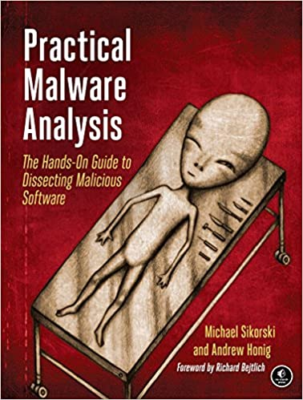

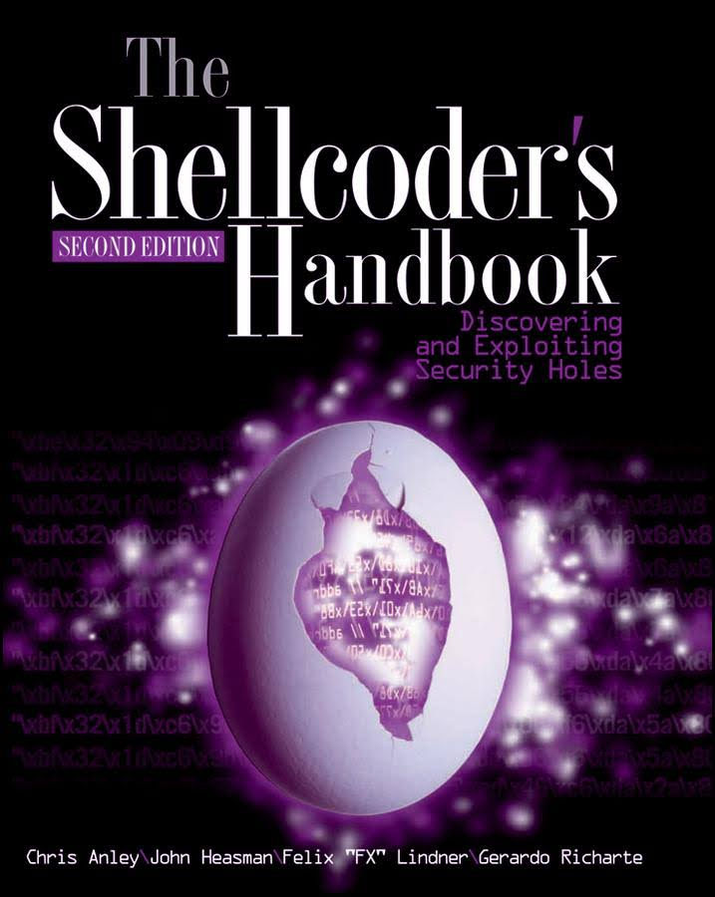
More Useful Resources

Slide 4
Code Generation Process

Slide 5
Code, Machine language, and Assembly language
You write a code in a programming language (say in C)
Compiler (gcc or clang) translate program to the machine language
  Object file is a collection of machine codes
  Basically, 0s and 1s
Assembly (language): decorated version of machine language
  With instruction name, variable names
  Human readable translation of machine language

Slide 6
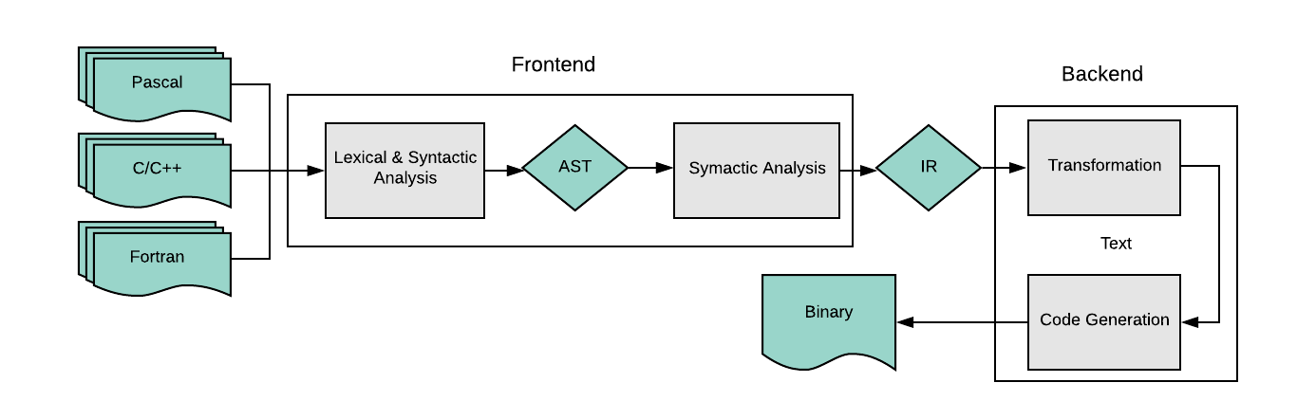
Code Generation
Compiler, Linker, Loader

Slide 7
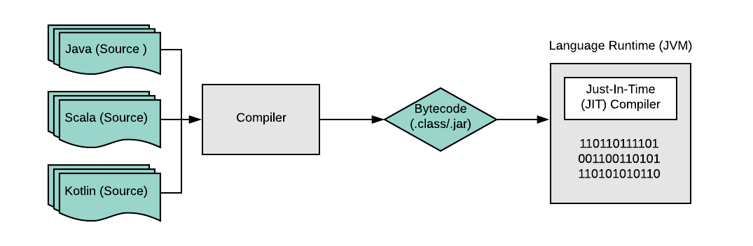
Just-In-Time (JIT) Compilation
Dynamic languages

Slide 8
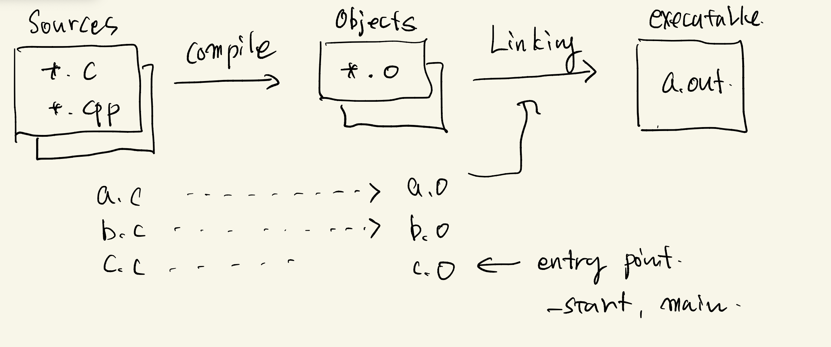
Code, Machine Language, and Assembly Language
Basic Concepts
  Source code
  Object file, object linking, binary
  Assembly, assembler
  Disassembly
  Decompilation
  From later classes
    ELF format
    Loading
    Dynamic linking

Slide 9
Code, Machine language, and Assembly language
Prog.c
Compiler
Prog.o
Compilation
Prog.S
Assembler
Prog.o
Assembly
Prog.S'
Disassembler
Prog.o
Disassembly

Slide 10
Code, Machine language, and Assembly language
gcc -c –S Prog.c
gcc –c -S
  Compilation to assembly
gcc
  Assembly to machine language
Prog.c
Compiler
Prog.S
Prog.o
Assembler
objdump –d Prog.o
We use the term
‘Machine language’ and
‘Assembly language’ interchangeably
disassembler
Prog.S'
Disassemblers + assembler
  objdump, IDA pro, Radare2, Ghidra, GDB ….
You can dis-assemble object file and compare with the original assembly
Notes:
KJEE: brief history

Slide 11
Code, Machine language, and Assembly language
You write a code in a programming language (say in C)
Compiler (gcc or clang) translate program to the object files
  Object file is a collection of machine codes translation + header information
  Basically, 0s and 1s
Assembly (language): decorated version of machine language
  With instruction name, variable names
  Human readable translation of machine language
  Assembler translates Assembly into object files (or machine codes)

Slide 12
ELF Object File Format: Code + Data
How code (and data) stored as a file?
  ELF (Executable and Linkable Format) for Linux
    Use ‘readelf’ command!
Segments and sections
  Kernel sees segments, maps them into virtual address space using mmap
  Linker sees section, combines them into a executable or shared library
One unified format for
  Executables (ET_EXEC)
    Contains code and data in a form that can be copied directly into memory and then executed
    Must have segments
  Relocatable object file (ET_REL, *.o)
    Contains code and data in a form that can be combined with other relocatable object files to form executable object file
    Must have sections
  Shared dynamic libraries (ET_DYN, *.so)
    Special type of relocatable object file that can be loaded into memory and linked dynamically, at either load-time or run-time
    Both section and segments
  Coredump file
Notes:
Maybe want to work through as
https://blog.k3170makan.com/2018/09/introduction-to-elf-format-elf-header.html

Slide 13
Loading Executable Object Files
Executable Object File
Kernel virtual memory
Memory
invisible to user code
0
ELF header
User stack
(created at runtime)
Program header table
(required for executables)
%esp
(stack
pointer)
.init section
.text section
Memory-mapped region for
shared libraries
.rodata section
.data section
.bss section
brk
.symtab
Run-time heap
(created by malloc)
.debug
Read/write data segment
(.data, .bss)
Loaded
from
the
executable
file
.line
.strtab
Read-only code segment
(.init, .text, .rodata)
Section header table
(required for relocatables)
0x400000
Unused
0
Notes:
…
Large heap in the high addresses (mmap)

Slide 14
ELF Object File Format (cont.)
Elf header
  Word size, byte ordering, file type (.o, exec, .so), machine type, etc.
Segment header table
  Page size, virtual addresses memory segments (sections), segment sizes.
.text section
  Code
.rodata section
  Read only data: jump tables, string constants, ...
.data section
  Initialized global variables
.bss section
  Uninitialized global variables
  “Block Started by Symbol”
  “Better Save Space”
  Has section header but occupies no space
0
ELF header
Segment header table
(required for executables)
.text section
.rodata section
.data section
.bss section

Slide 15
ELF Object File Format (cont.)
.symtab section
  Symbol table
  Procedure (function) and static variable names
  Section names and locations
.rel.text section
  Relocation info for .text section
  Addresses of instructions that will need to be modified in the executable
  Instructions for modifying.
.rel.data section
  Relocation info for .data section
  Addresses of pointer data that will need to be modified in the merged executable
.debug section
  Info for symbolic debugging (gcc -g)
Section header table
  Offsets and sizes of each section
0
ELF header
Segment header table
(required for executables)
.text section
.rodata section
.data section
.bss section
.symtab section
.rel.txt section
.rel.data section
.debug section
Section header table

Slide 16
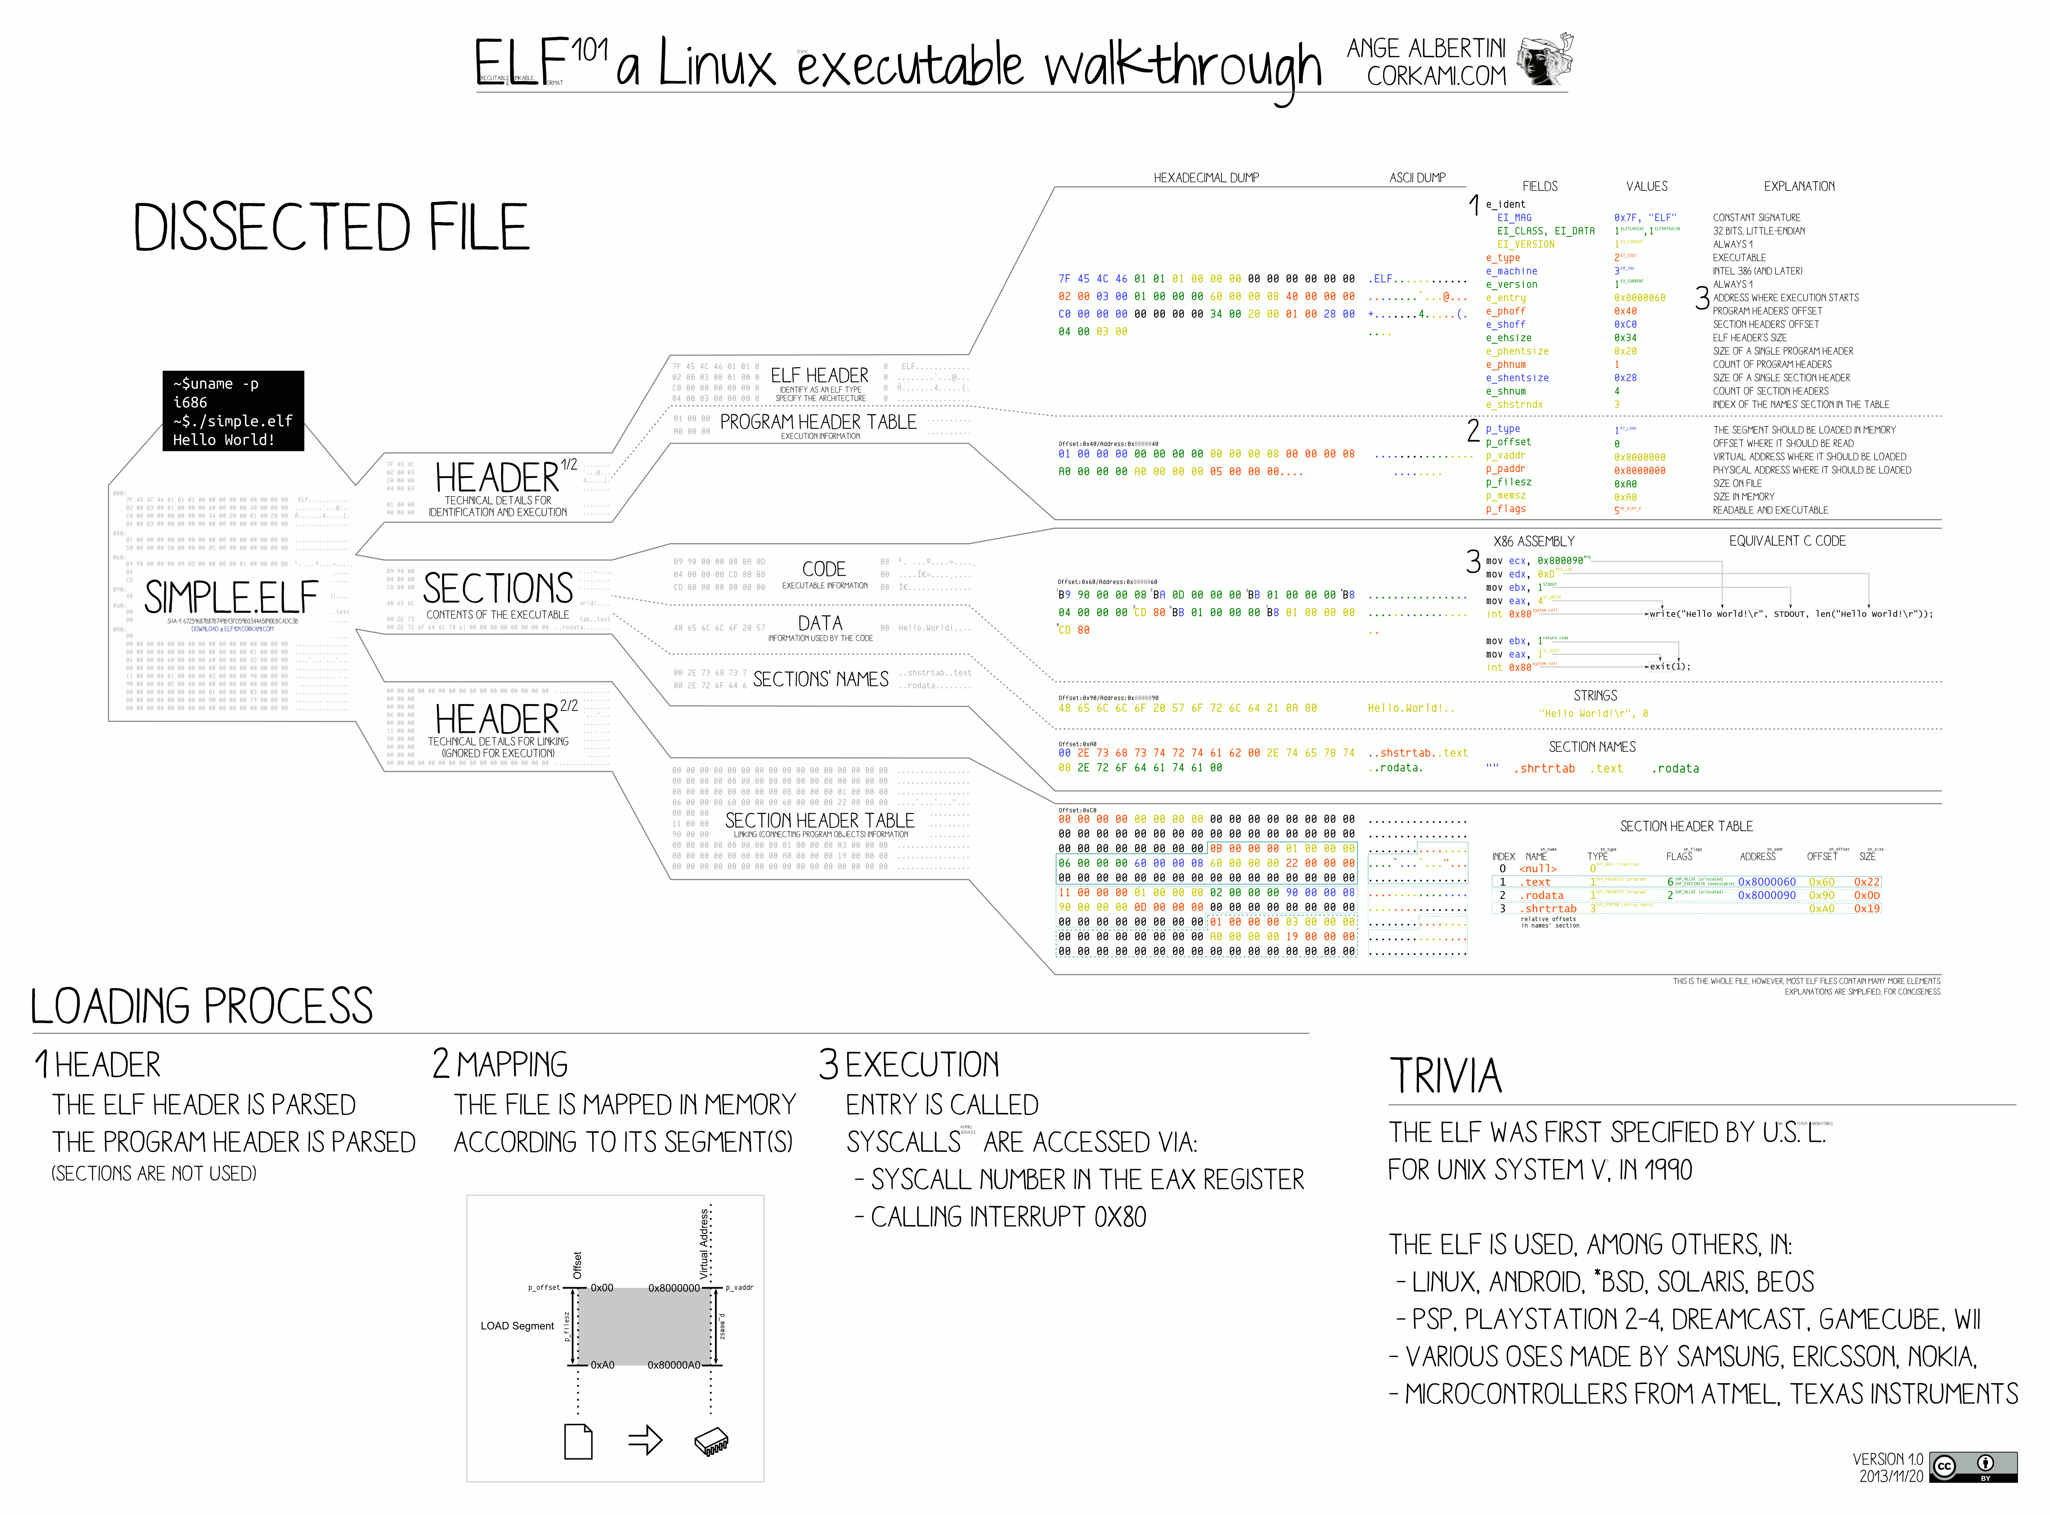





# File header
readelf -Wh ld-2.31.so
# program/segment header
readelf -Wl libc.so
# Section header
readelf -WS ld-2.31.so

Slide 17
x86 Assembly

Slide 18
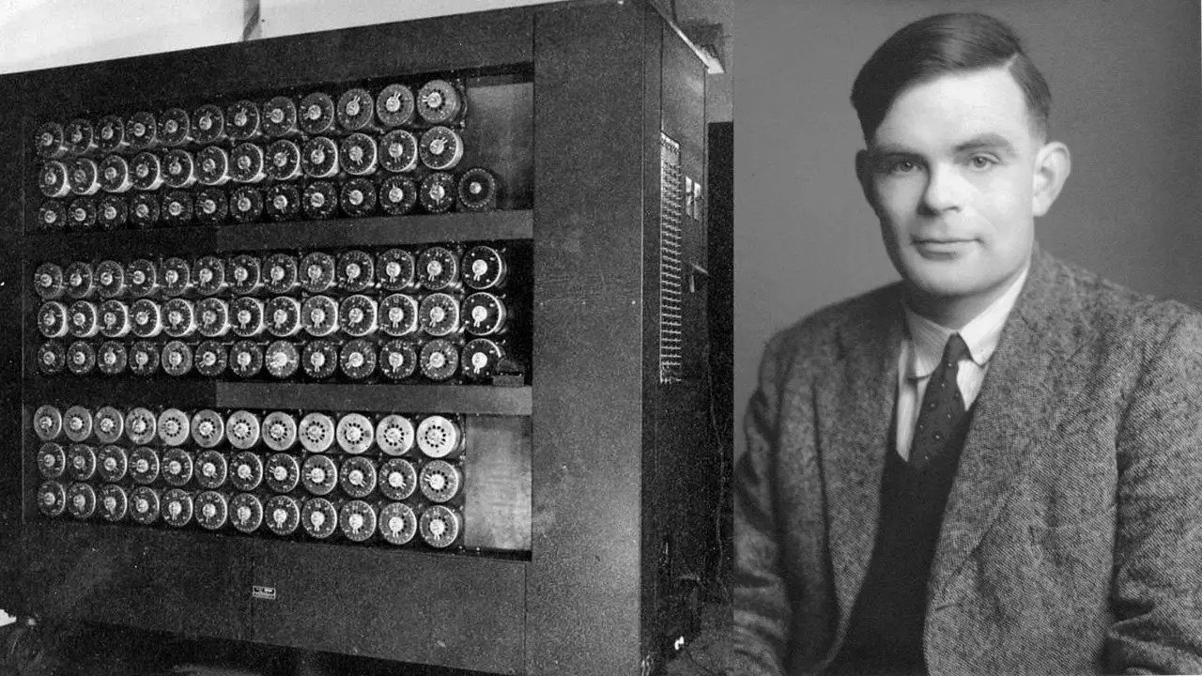
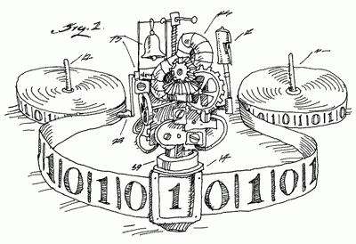
Turing Machine
A mathematical abstraction/model
  Defining classes of mathematical problems that can be solved by the universal machine
‘Turing-complete’ or ‘computational universal’
  Programing language or instruction set being
    Capable of emulating Turing machine
Image source: https://www.felienne.com/archives/2974

Slide 19
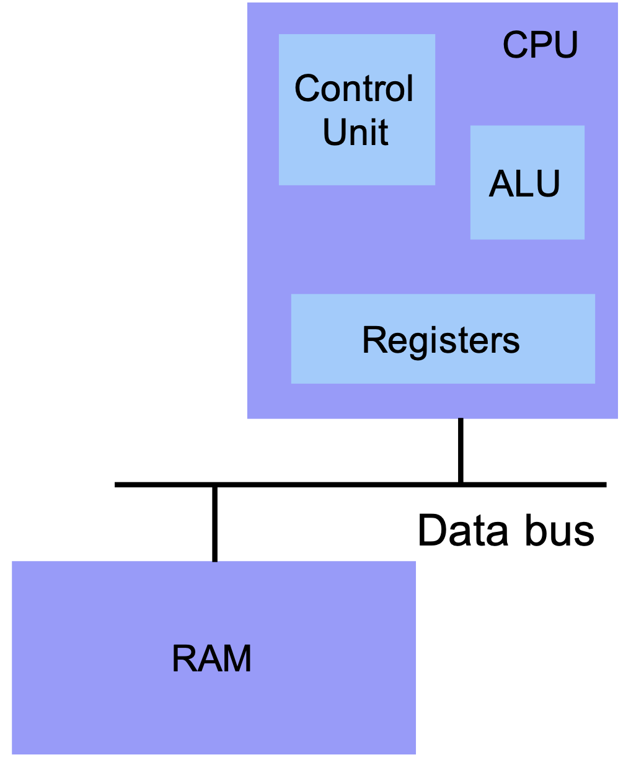
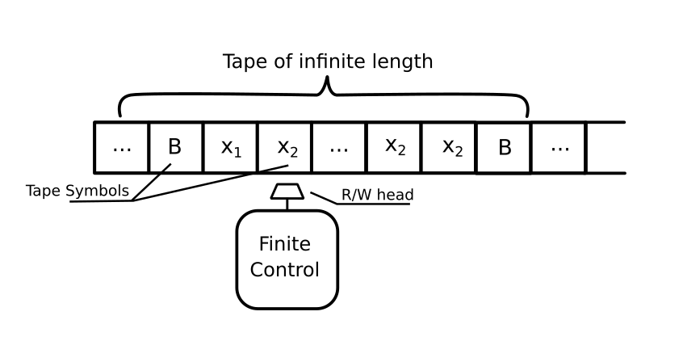
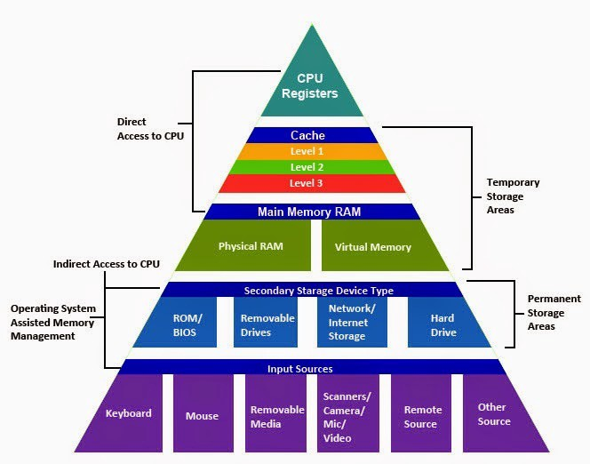
Von Neumann Architecture
Registers
Small amount of storage on the CPU
  Much faster than RAM
  Top of the storage hierarchy
    How about CPU caches?
Above RAM, disk, ...
Turing machine
Notes:
https://iq.opengenus.org/general-introduction-to-turing-machine/

Slide 20
Intel Code Table
http://www.jegerlehner.ch/intel/

Slide 21
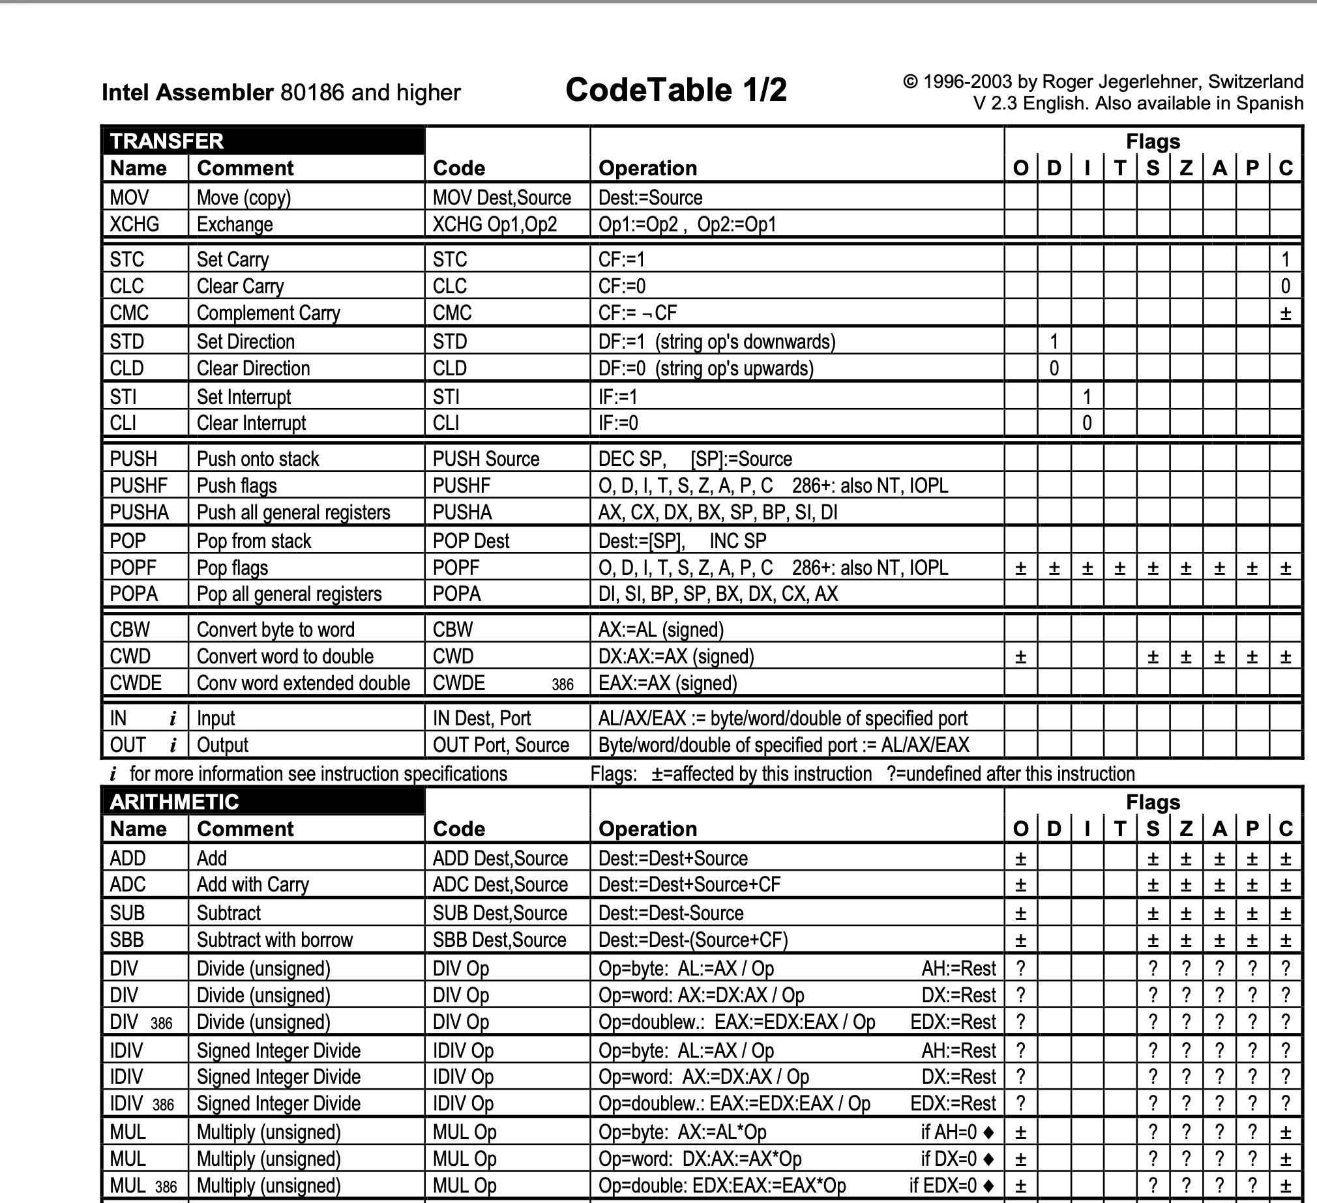
Opcode Summary
Linked in class schedule
http://www.jegerlehner.ch/intel/

Slide 22
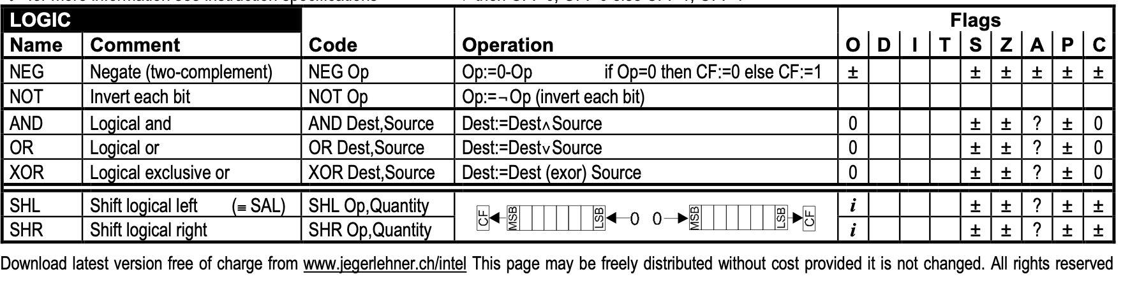
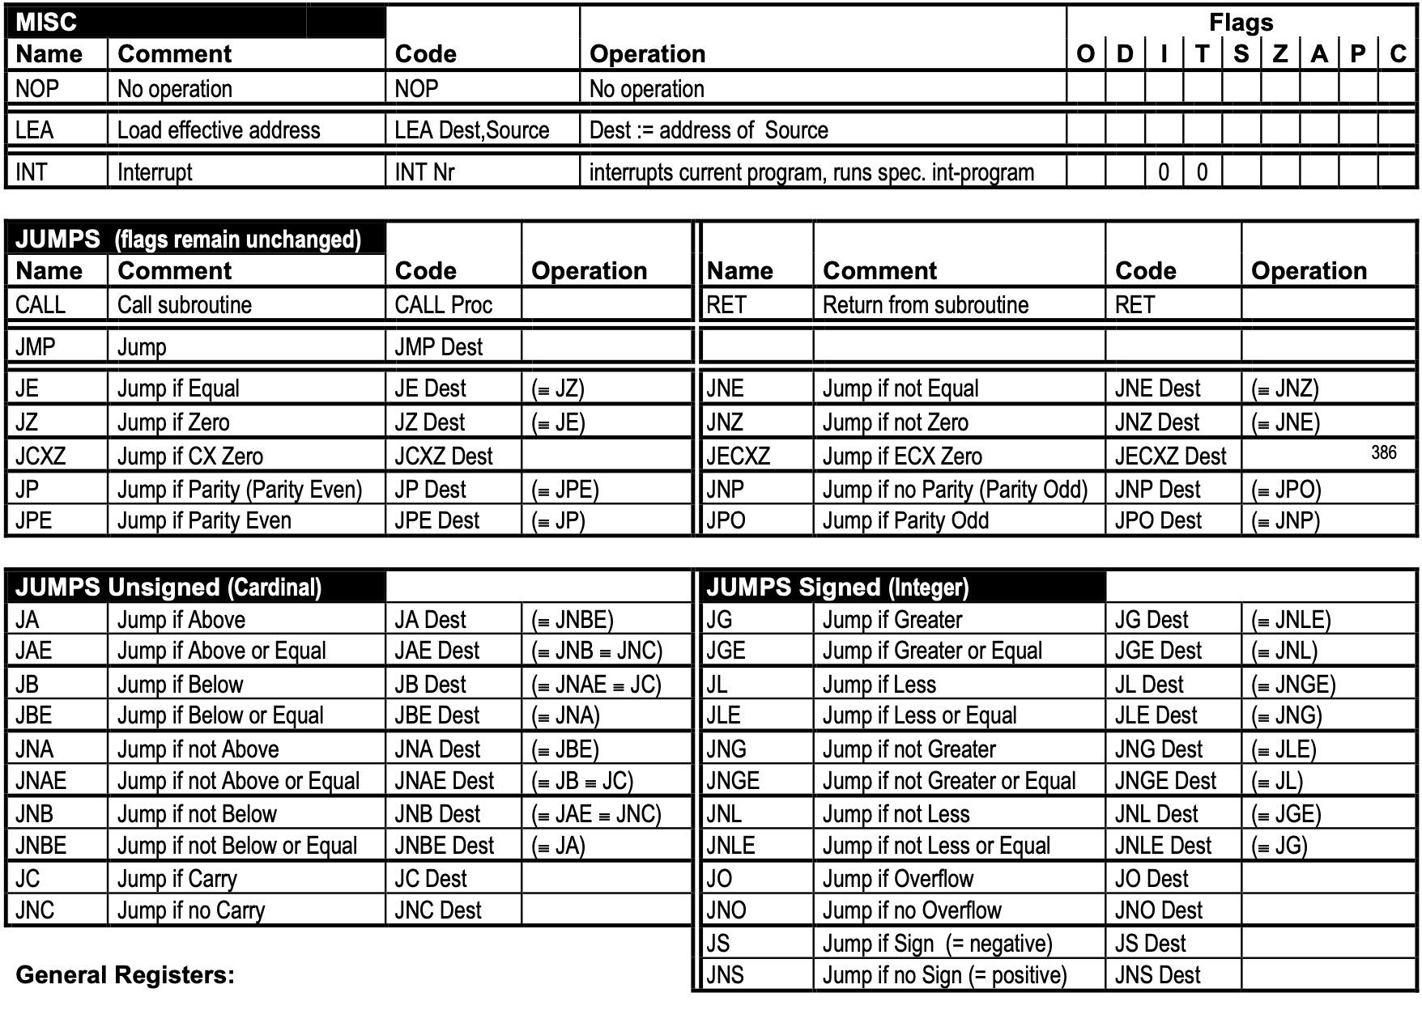
Opcode Summary
Linked in class schedule
http://www.jegerlehner.ch/intel/

Slide 23
Instruction: Opcode + Operands
You can consider as Command + Arguments
Opcode to
  Move data, do arithmetic, control devices, change CPU context ..
Operands
  Immediate value
  Integer (or float number) constants
  Register
    8 general purpose registers for 32-bit architecture
    +8 for 64-bit architecture (r9 – r15)
  Memory
    Index, base, offset format
Opcode
Operands
[ebx + 2 edi] + 0x1234 # Intel syntax
0x1234 (%ebx, %edi, 2) # AT&T syntax
Notes:
How to efficiently address larger memory space (than addressable bits) was a big challenge → that is why we still see somewhat strange way of construct memory address along with now obsolete segment registers.
Memory addressing used to be a big source of performance degradation
https://www.quora.com/Did-Bill-Gates-really-say-that-640KB-memory-is-enough-for-everyone

Slide 24
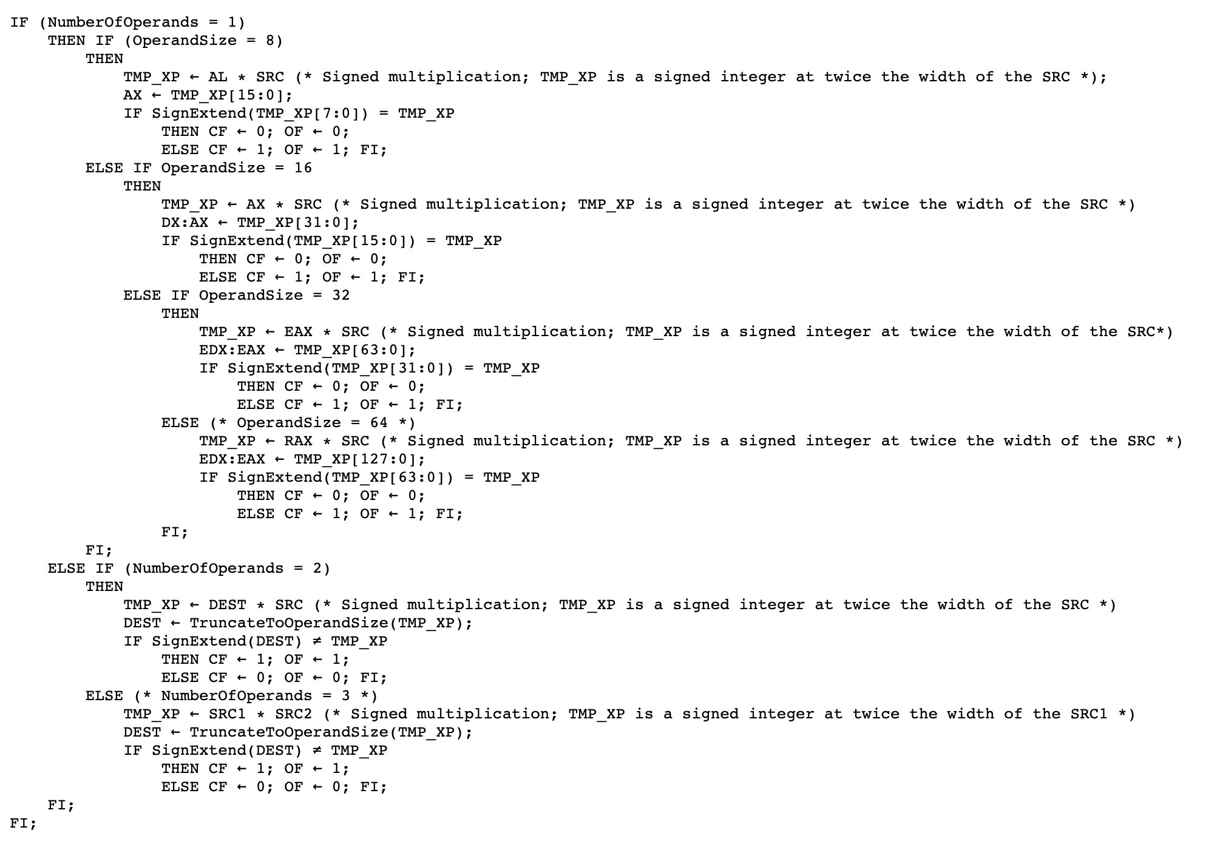
Intel Instruction Format
Opcode + [opr1] [opr2] [opr3]
  An instruction can have 0 ~ 3 operands
    E.g., IMUL instruction
Supported data movements
  Immediate -> Register / Memory
  Register <-> Register
  Register <-> Memory
  Memory <-> Memory
Watch out!
https://www.felixcloutier.com/x86/imul
Notes:
https://docs.oracle.com/cd/E19120-01/open.solaris/817-5477/ennby/index.html#:~:text=An%20x86%20instruction%20can%20have,%2C%20source-%3Edestination).

Slide 25
AT&T vs. Intel Syntax Comparison
AT&T/GNU Syntax
Intel Syntax
[instruction] [source] [destination]
mov %eax, %ebx
Registers (32 bit)
  %eax, %ebx, %ecx, %edx, %esi, %edi, %esp, %ebp ← prefixed with ‘%’
Immediate Values
  $0x41424344 ← prefixed with ‘$’
Memory addressing
  0x1234 (%ebx, %edi, 2)
[instruction] [destination] [source]
  mov eax, ebx
Registers (32 bit)
  eax, ebx, ecx, edx, esi, edi, esp, ebp
Immediate Values
  0x41424344
Memory addressing
  [ebx + 2 edi] + 0x1234

Slide 26
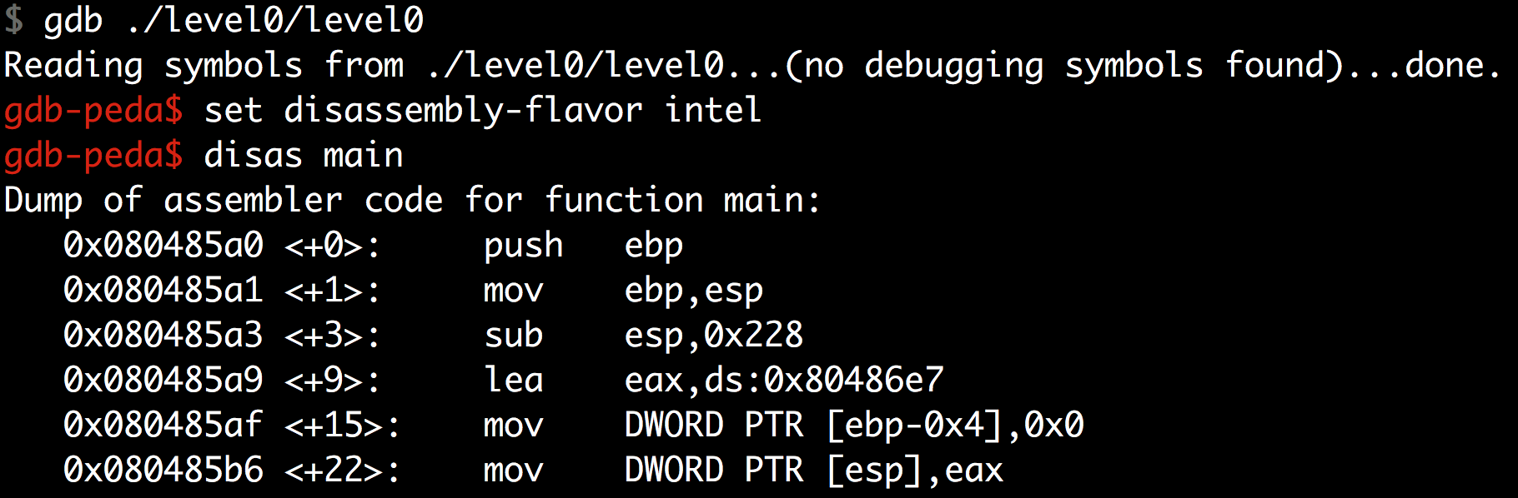
Intel Syntax
If you wish to use Intel syntax, see this.
  https://imada.sdu.dk/Employees/kslarsen-bak/Courses/dm18-2007-spring/Litteratur/IntelnATT.htm
In gdb: set disassembly-flavor intel

Slide 27
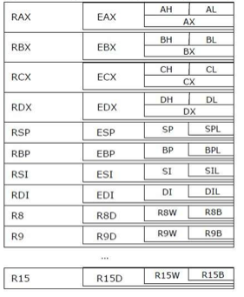
Intel IA32 Registers (i386, 32-bit)
64
32
16
8
0
?L ⬅ lower 8 bits: %al, %bl, %cl, %dl, %sil…
?H ⬅ higher 8 bits: %ah, %bh, %ch, %dh
?X ⬅ lower 16 bits: %ax, %bx, …, 80286
E?X ⬅ extended to 32 bits: %eax, %ebx, …, IA32
R?X, R9 ~ R15
⬅ .. to 64 bits: %rax, %rbx, …, AMD64
General Purpose Registers (GPRs)
Notes:
KJEE: Replace figure and take XMM out

Slide 28
Intel AMD64 Registers (x86_64, 64-bit)
64
32
16
8
0
?L ⬅ lower 8 bits: %al, %bl, %cl, %dl, %sil…
?H ⬅ higher 8 bits: %ah, %bh, %ch, %dh
?X ⬅ lower 16 bits: %ax, %bx, …, 80286
E?X ⬅ extended to 32 bits: %eax, %ebx, …, IA32
R?X, R9 ~ R15
⬅ .. to 64 bits: %rax, %rbx, …, AMD64
General Purpose Registers
Notes:
KJEE: Replace figure and take XMM out

Slide 29
Intel Architecture Evolution
Intel 8086 (1978), 16-bit processor
  Register width is 16-bit:
  %ax, %bx, %cx, %dx, %si, %di, %bp, %sp, %ip
  8-bit addressable:
  %ah, %al, %bh, %bl, … , %sil, %dil
Intel 80386 (1985), 32-bit processor
  %eax, %ebx, %ecx, %edx, %esi, %edi, %ebp, %esp, %eip
Intel Pentium 4 64-bit (Prescott, 2004)
  %rax, %rbx, %rcx, %rdx, %rsi, %rdi, %rbp, %rsp, %rip
  %r8 -- %r15
Notes:
eip, ip are software invisible (hidden)
rip is exposed …(readdressible)

Slide 30
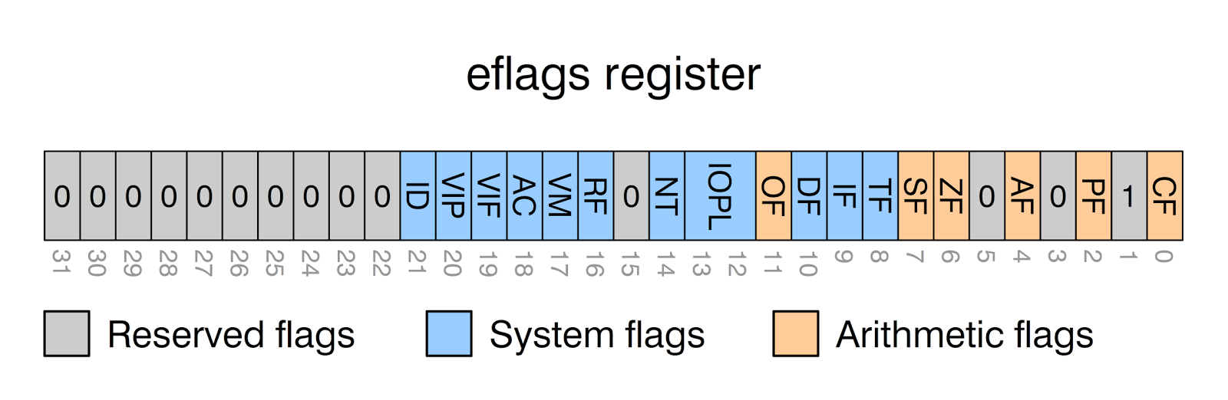
Condition Register (EFLAGS Register)
32-bit (4 bytes) storage to store the execution result of the previous instruction
Condition Register | Desc
ZF (Zero Flag) | The result of an arithmetic operation is “Zero”
SF (Sign Flag) | Or Negative Flag, the result of an arithmetic operation is “Negative” (The most significant bit is set)
OF (Overflow Flag) | The result would not fit in the number of bits
CF (Carry Flag) | The result has arithmetic carry
PF (Parity Flag) | The numbers of set bits is odd or even

Slide 31
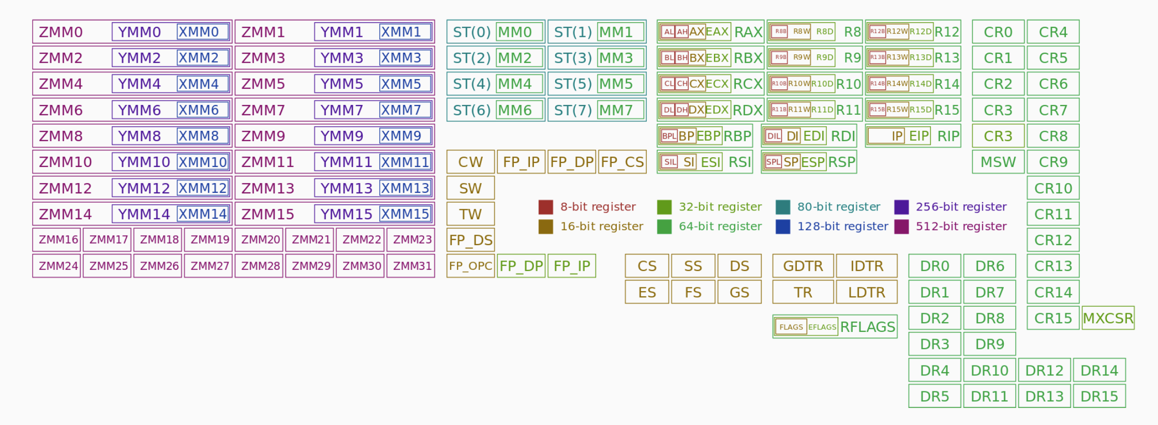
Full Story…

Slide 32
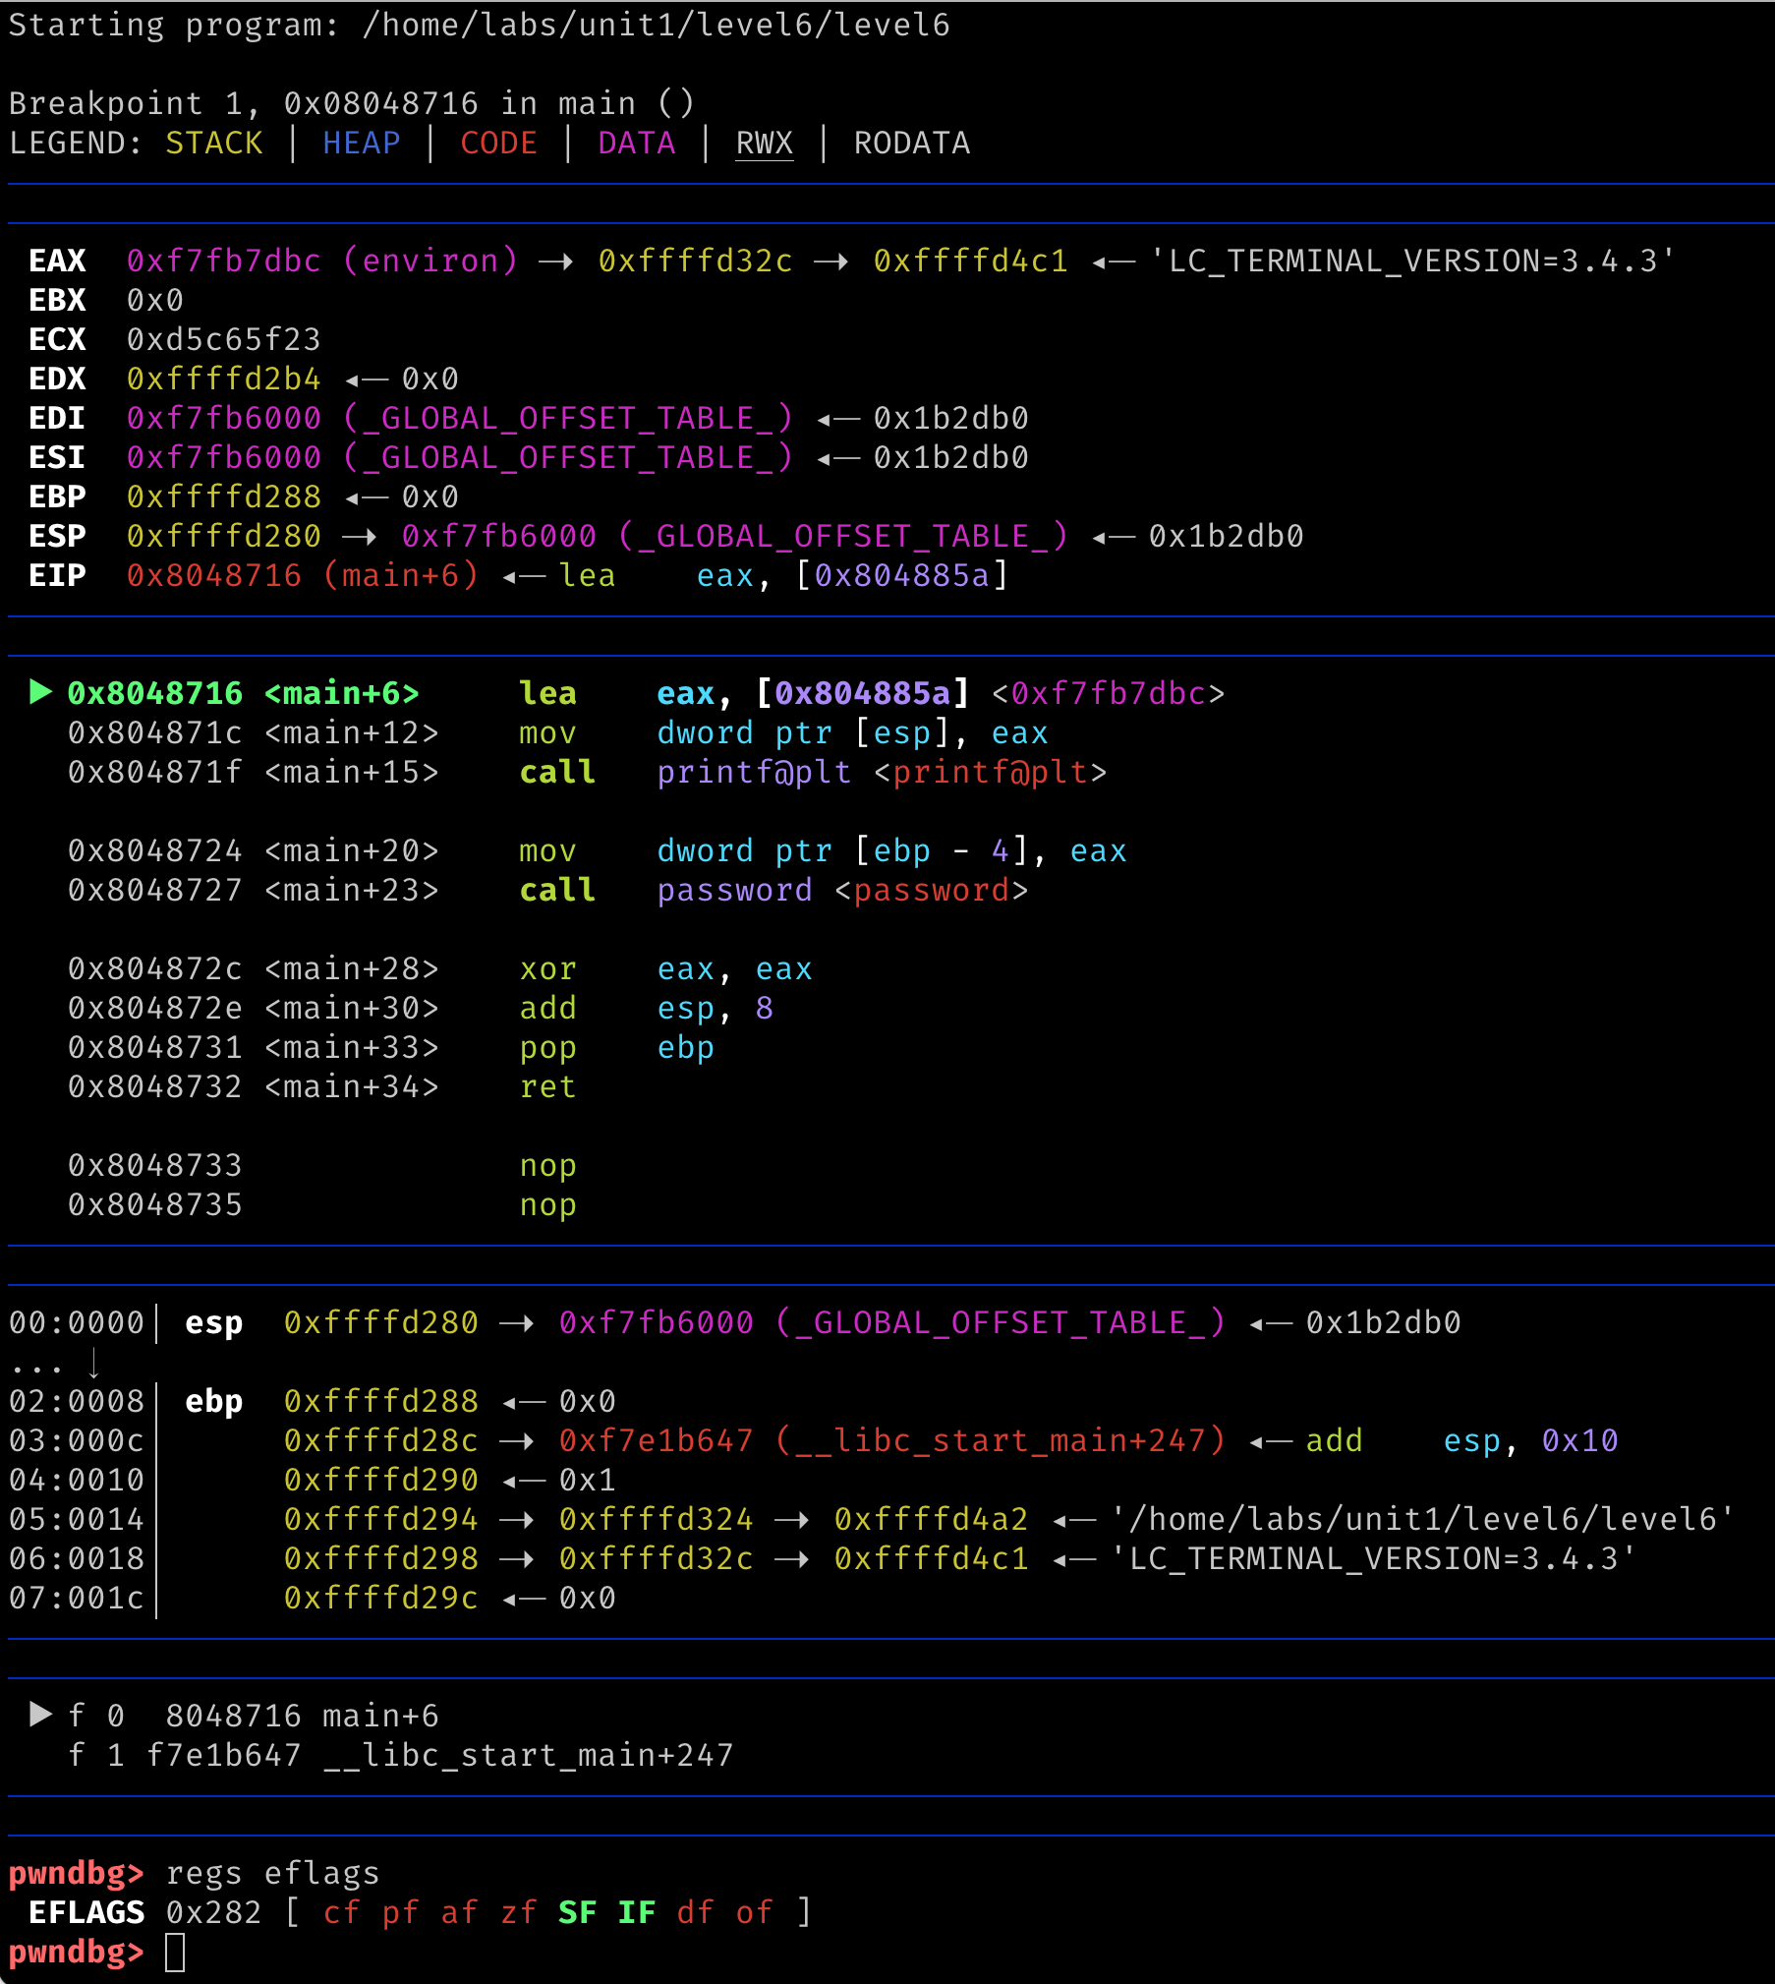
GDB (pwndbg)
Recommended for the class,
but will up to you

Slide 33
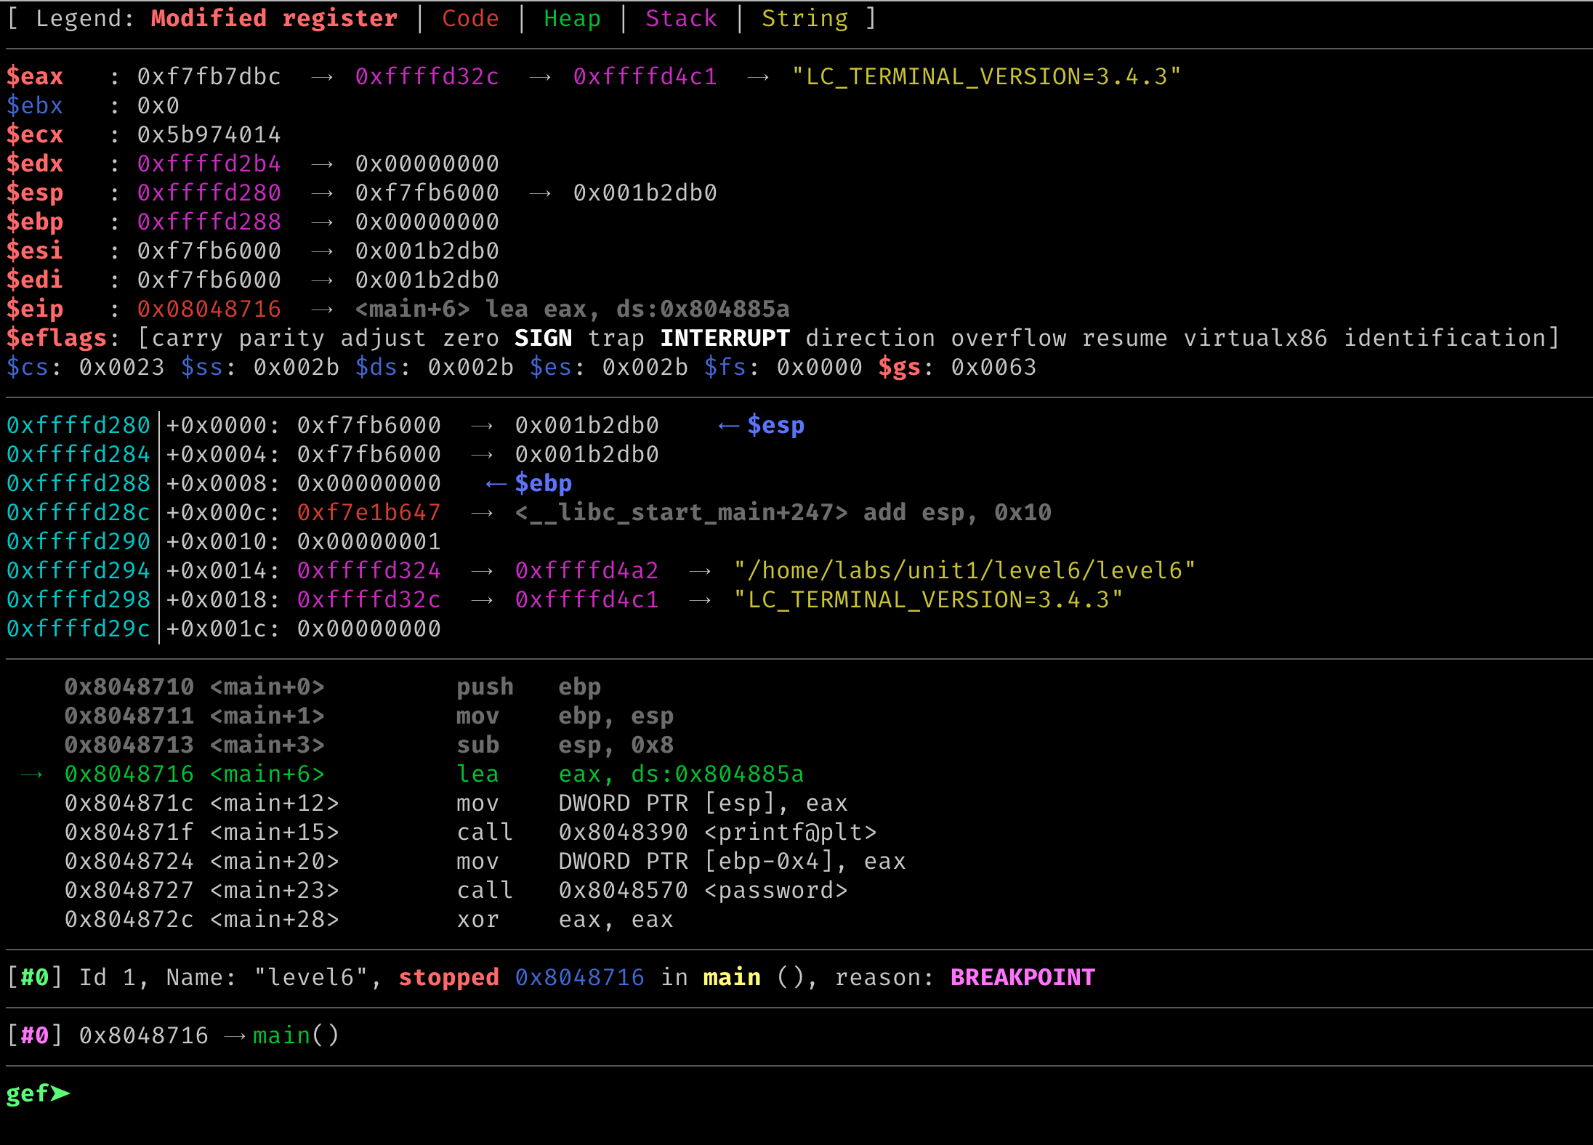
GDB (gef)

Slide 34
Intel Memory Referencing
Segment registers are mostly obsolete
No longer used for address calculation
Special use cases (will learn)
Memory address :=
Base + Index * Scale + Disp
Segment
Registers
Base
    [ebx + 2 edi] + 0x1234 # Intel syntax
    0x1234 (%ebx, %edi, 2) # AT&T syntax
Index
Scale
Displacement
IA32 Memory addressing
Notes:
http://www.cs.iit.edu/~cs561/cs350/addressing/addsclm.html#:~:text=Similar%20to%20index%20mode%2C%20except,base%20register%20plus%20the%20constant.
Some animation?

Slide 35
LEA Instruction
LEA instruction (Load Effective Address)
What would the instruction store in %rax?
lea 0x5656(%rax,%rbx,4),%rax # AT&T
Or
lea rax,[rax+rbx*4 + 0x5656] # Intel
rax := rax+ rbx * 4 + 0x5656

Slide 36
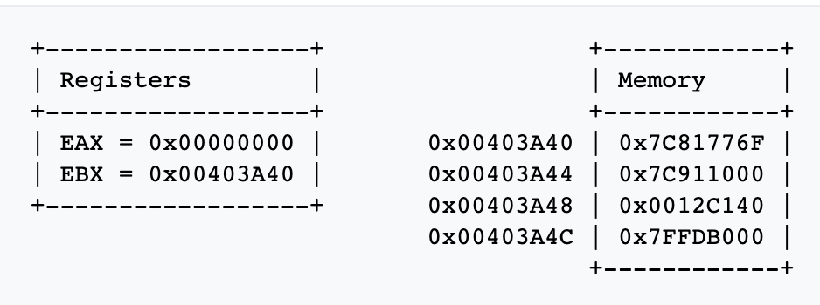
Quiz
LEA instruction (Load Effective Address)
What would the instruction store in %eax?
lea 0x8(%ebx), %eax
Or
lea eax, [ebx + 0x8]
Notes:
https://www.aldeid.com/wiki/X86-assembly/Instructions/lea
0x7C81776F + 0x8

Slide 37
Pointer Registers
Return EIP
%EBP
Saved EBP
foo()
Base Pointer (or Frame Pointer)
  %EBP, %RBP
Stack Pointer
  %ESP, %RSP
Instruction Pointer (or Program Counter)
  %EIP, %RIP
%ESP
We will talk more about functions and stack operation later …
Notes:
KJEE: We may animate this ..

Slide 38
Pointer Registers
Return EIP
Saved EBP
foo()
Base Pointer (or Frame Pointer)
  %EBP, %RBP
Stack Pointer
  %ESP, %RSP
Instruction Pointer (or Program Counter)
  %EIP, %RIP
Grows downward
Return EIP
%EBP
Saved EBP
bar()
%ESP
Notes:
KJEE: We may animate this ..

Slide 39
Pointer Registers
Return EIP
Saved EBP
foo()
Base Pointer (or Frame Pointer)
  %EBP, %RBP
Stack Pointer
  %ESP, %RSP
Instruction Pointer (or Program Counter)
  %EIP, %RIP
Grows downward
Return EIP
Saved EBP
bar()
Return EIP
%EBP
Saved EBP
foobar()
%ESP
We will talk more about functions and stack operation later …
Notes:
KJEE: We may animate this ..

Slide 40
Data Movement and Arithmetic Instructions

Slide 41
Data Movements
Move values (constant assignment)
  movl $0x41414141, %eax ← %eax := 0x41414141;
  movb $32, %al ← %al := 32;
Accessing memory
  movl -0x4(%ebp), %eax ← %eax :=%ebp - 4
  movq (%rdx,%rcx,4), %rbx ← %rbx := %rdx + %rcx * 4
More data movements
movs, movsb, movsw, movsd, movsq
  Move from string to string (next class)
Notes:
b → byte
l → long (32-bits, 4 bytes)
q -> quadword (64-bits)
W -> word (16-bits, 2 bytes)

Slide 42
Arithmetic and Logical Instructions
logical instructions
  or, and, xor, nor …
  andi, ori, xori …
Arithmetic instructions
  add, sub, mul, div, divu …
  addi, subi, muli …
Notes:
l → long

Slide 43
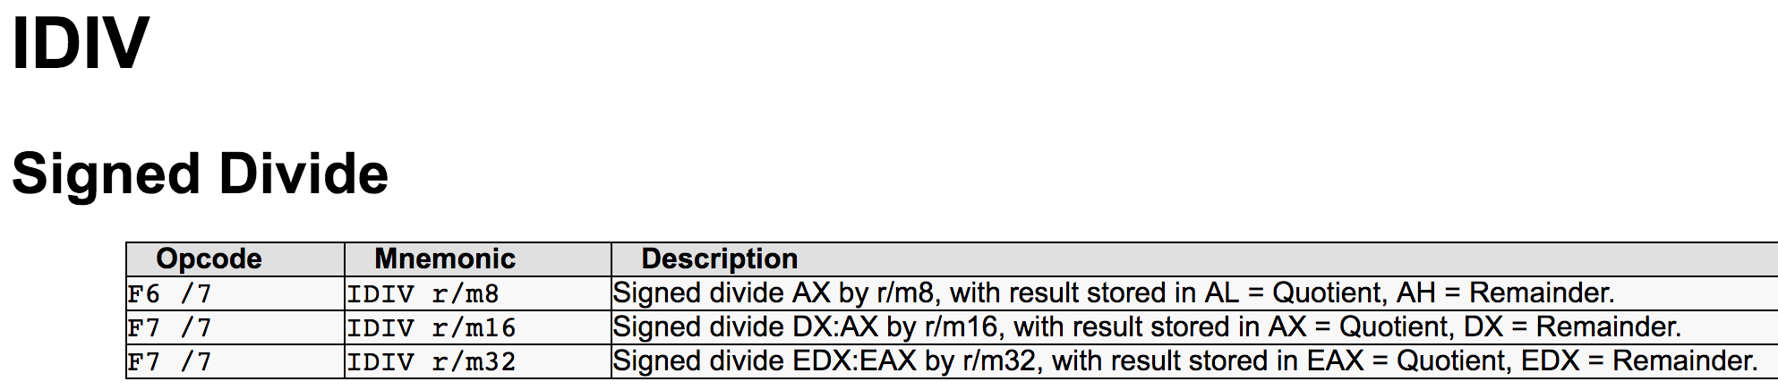
Integer Division Operation
idiv [value]
  Use 64bit integer (EDX:EAX)
  Calls cdq/cltd instruction first (asserting using EDX:EAX as one 64bit integer)
  Divide EDX:EAX with [value]
  Store Quotient at EAX, Remainder in EDX

Slide 44
Integer Division Operation
idiv [value]
  Use 64bit integer (EDX:EAX)
  Calls cdq/cltd instruction first (asserting using EDX:EAX as one 64bit integer)
  Divide EDX:EAX with [value]
  Store Quotient at EAX, Remainder in EDX
Example – in level9, check(int value)
Comparing the remainder of array[i] / value to zero…
  if(array[i] % value == 0)
  0x08048670 <+32>: mov 0x8(%ebp),%eax ← eax is arg1
  0x08048673 <+35>: mov -0x8(%ebp),%ecx ← ecx is loop index
  0x08048676 <+38>: cltd ← use edx:eax, int64
  0x08048677 <+39>: idivl 0x804a02c(,%ecx,4) ← divide array[ecx]/eax
  0x0804867e <+46>: cmp $0x0,%edx ← Remainder…

Slide 45
Idioms
xor %eax, %eax
  Or sub %eax, %eax
  eax = eax ⊗ eax => eax: = 0;
lea 0x10(ecx,ecx,4) %eax
=> eax := 5 * ecx + 16
add $1, %eax
xadd $1, %eax # atomic operation
Notes:
animation

Slide 46
Control Instruction
Comparison
  cmp $0x1234, %eax ← Result stored in $EFLAGS
Jump
  je 0x8048442 <main+94> ← Equal or zero
  jne 0x8048442 <main+94> ← Not equal or non-zero
  jle 0x8048442 <main+94> ← Less or equal, signed
  jbe 0x8048442 <main+94> ← Below or equal, unsigned
  jge 0x8048442 <main+94> ← Greater or equal, signed
  jae 0x8048442 <main+94> ← Above or equal, unsigned

Slide 47
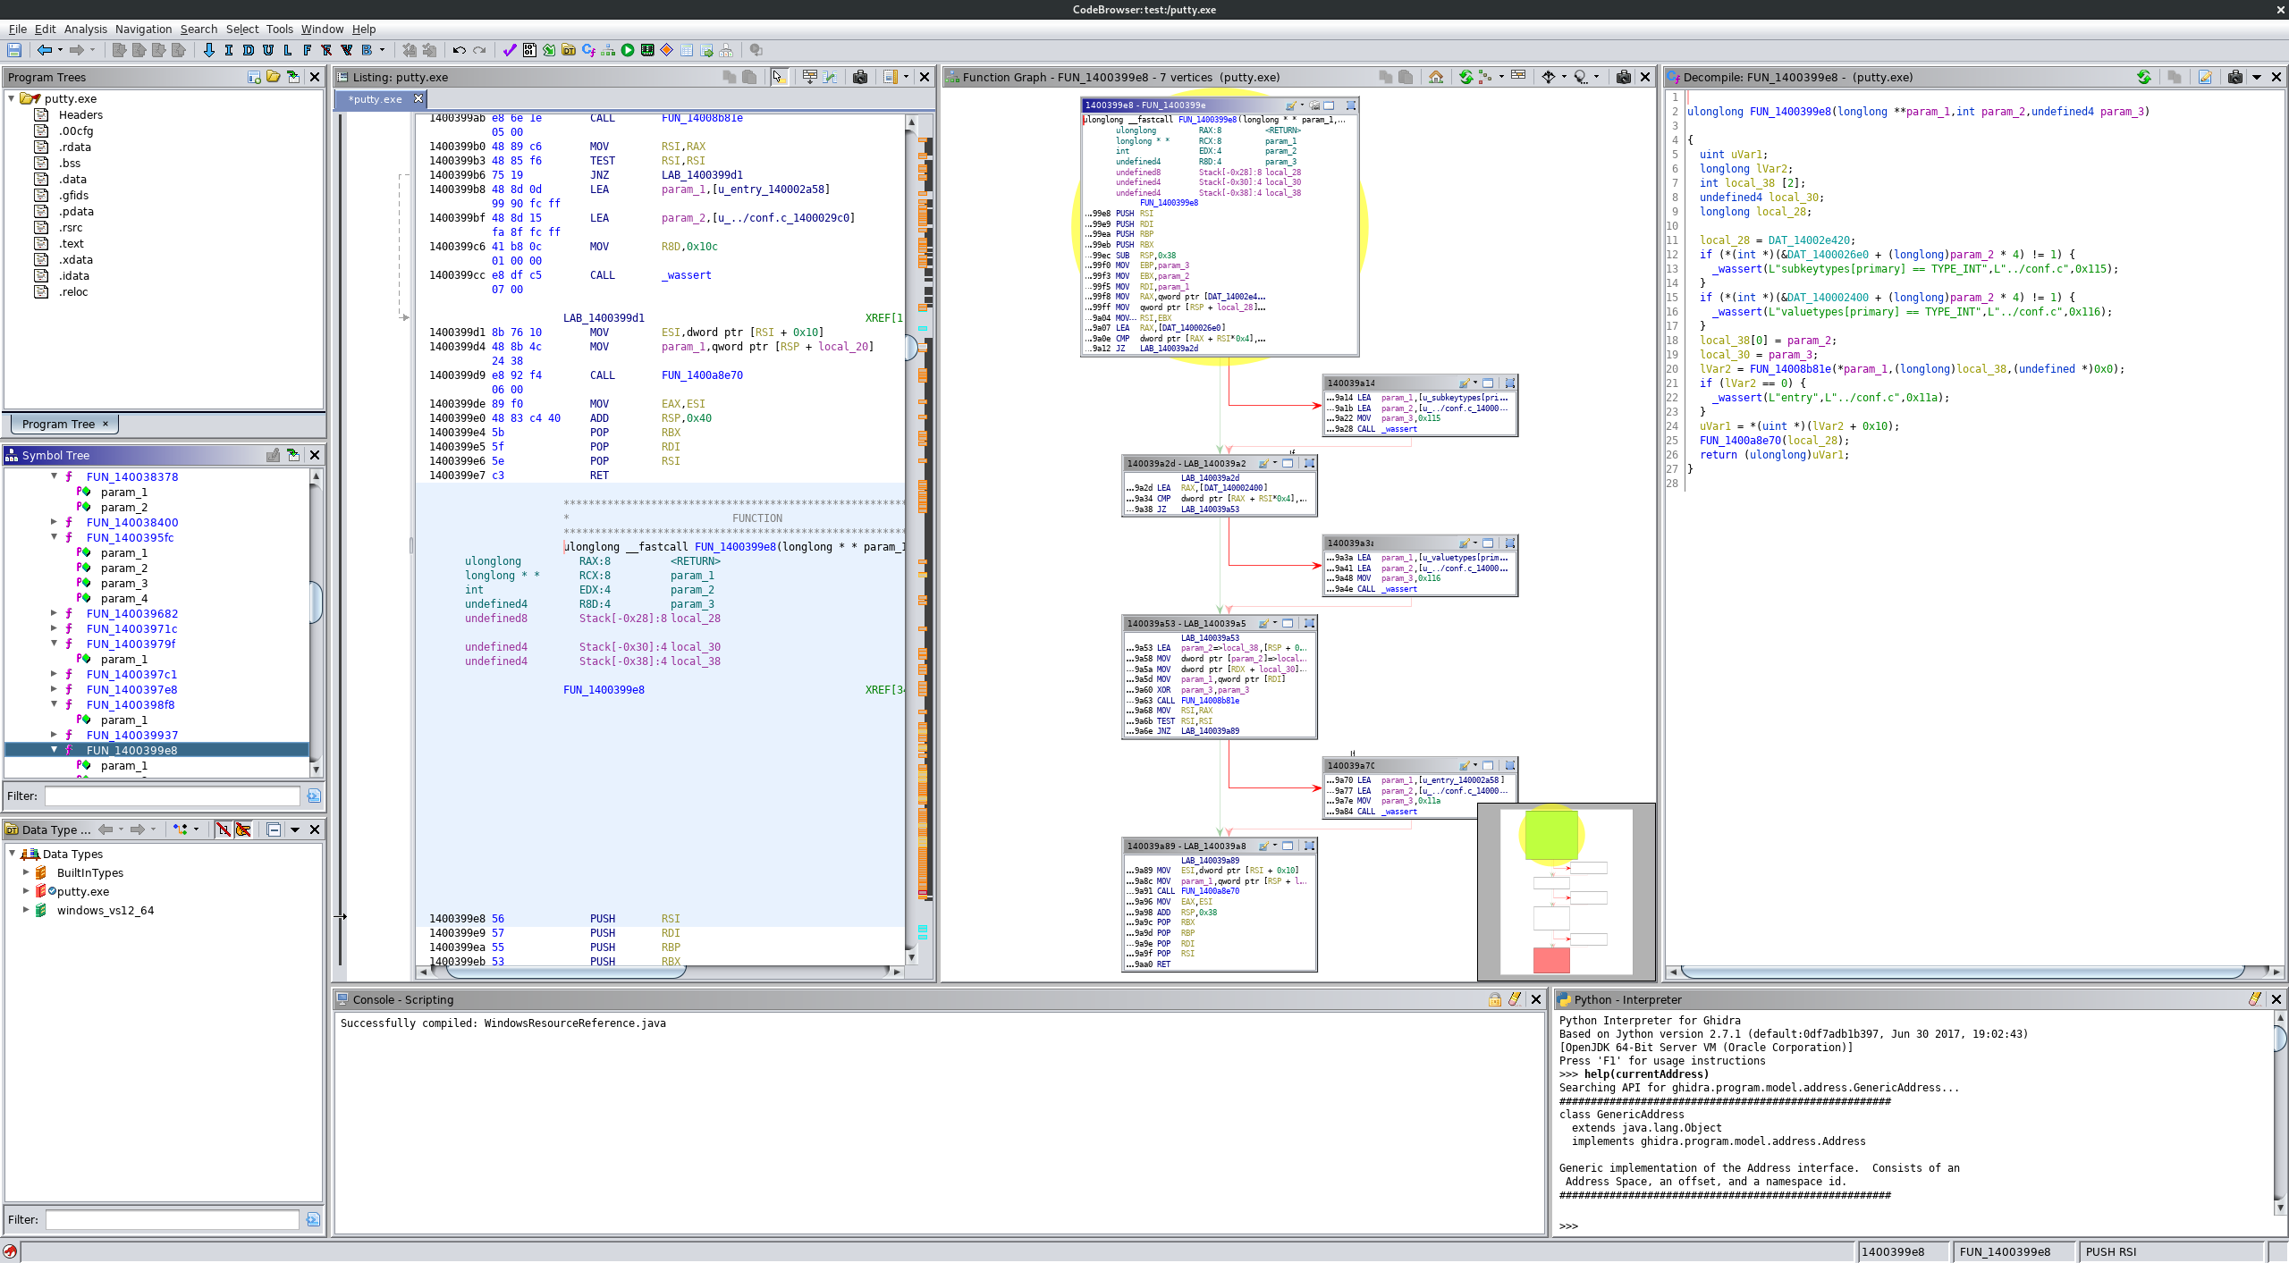
Control Instruction
Notes:
TODO: IDA pro,GDB images

Slide 48
Functions
Turing machine does not define the function
  Modern computer architecture has built on Turing model
    Does not require to have a notion for “function”
Lambda calculus works on functions
  Church – Turing Theorem
    ➔ Turing machine == Lambda calculus (equally capable)
    ➔ C program == LISP program (equally capable)
    ➔ Java program == Scala program (equally capable)
Function helps programmers
  Logical units for program
  Scoping variables (E.g., Globals vs. Locals, Locals vs. Locals)
Notes:
This slide maybe a redundant, or distraction…

Slide 49
Function Support
Pointer registers
  %ebp: stack base pointer
  %esp: stack pointer
Instructions
  push, pop ← stack operation support
  call, ret ← function call support
  enter,leave ← stack frame management

Slide 50
Stack Support with %ebp, %esp
%ebp: Base Pointer
  Use it for accessing
  Local variables – negative index
    mov %eax, -0x4(%ebp)
    lea -0x20c(%ebp), %edx
  Arguments from the caller – positive Index
    mov 0x8(%ebp), %eax
%esp: Stack Pointer
  Use it for passing argument to callee
  mov 0x8(%ebp), (%esp)
  mov –0x4(%ebp), (%esp)

Slide 51
Stack Instructions
4 bytes (32-bit)
%ebp : 0xdeadbeef
push %ebp
  Store the value of %ebp at the top of the stack (%esp gets -4)
  mov %ebp, (%esp)
  sub $4, %esp
pop %ebp
  Move the value at the stack top to %ebp (%esp gets +4)
  mov (%esp), %ebp
  add $4, %esp
%esp
Return EIP
Grows downward
Notes:
This is an important slide …
popa, pusha

Slide 52
Stack Instructions
%ebp : 0xdeadbeef
push %ebp
  Store the value of %ebp at the top of the stack (%esp gets -4)
  mov %ebp, (%esp)
  sub $4, %esp
pop %ebp
  Move the value at the stack top to %ebp (%esp gets +4)
  mov (%esp), %ebp
  add $4, %esp
Return EIP
Grows downward
%esp
0xdeadbeef
Notes:
This is an important slide …
popa, pusha

Slide 53
Stack Instructions
push %ebp
  Store the value of %ebp at the top of the stack (%esp gets -4)
  mov %ebp, (%esp)
  sub $4, %esp
pop %ebp
  Move the value at the stack top to %ebp (%esp gets +4)
  mov (%esp), %ebp
  add $4, %esp
Return EIP
Grows downward
%esp
Saved EBP
Notes:
This is an important slide …
popa, pusha

Slide 54
Stack Instructions
%ebp
push %ebp
  Store the value of %ebp at the top of the stack (%esp gets -4)
  mov %ebp, (%esp)
  sub $4, %esp
pop %ebp
  Move the value at the stack top to %ebp (%esp gets +4)
  mov (%esp), %ebp
  add $4, %esp
%esp
Return EIP
Grows downward
Notes:
This is an important slide …
popa, pusha

Slide 55
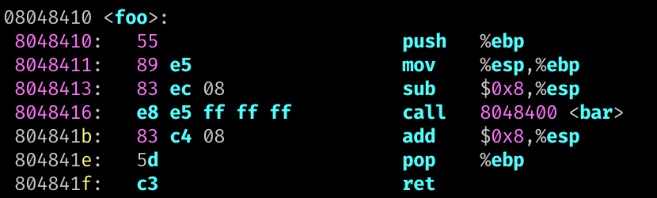
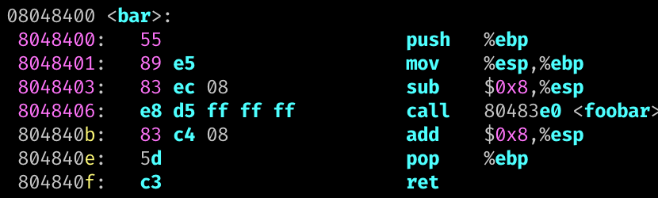
call and ret
call foo
  Pushes %eip to the stack and jump to foo
  push %eip # next instruction
  jmp foo
ret
  Pops to %eip from stack
  pop %eip # Invalid operation
Grows downward
0x804841b
Notes:
Only special instruction can update %eip

Slide 56
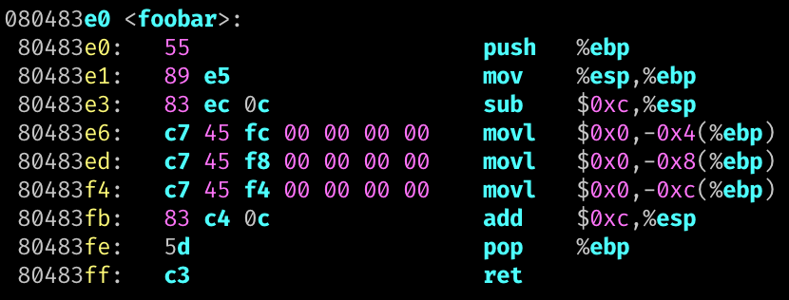
Multiple Function Calls
foo();
0x804841b
Saved EBP
bar();
0x804840b
%ebp
Saved EBP
Local A
foobar();
Local B
%esp
Local C

Slide 57

Function Prologue and Epilogue
Stack frame managements
  alias instructions: enter, leave
Allocation / de-allocation for local variables
Prologue → ’enter’
Allocate locals
De-allocate locals
Epilogue. → ‘leave‘

Slide 58
Calling Convention
Defines caller / callee responsibilities at machine language level
Different calling conventions
  cdecl for IA32
  x86-64 for AMD64
How does your code call printf() from a library?
  Loader/linker will first find the address of printf()
  Q1: How can pass function arguments?
    Stack or Register?
  Q2: How to order function argument?
  Q3: How to pass the return value?
    %eax (%rax)

Slide 59
IA32 (32-bit) Stack Operations
ARG2
%ebp+c
Grow
Callee
ARG1
%ebp+8
Relative to
  Stack pointer: %esp (%rsp)
  Base (frame) pointer: %ebp (%ebp)
Local variables (negative indexing over %ebp)
  mov -0x8(%ebp), %eax -- value at %ebp-0x8
  lea -0x24(%ebp), %eax -- address at %ebp-0x24
Function arguments from caller (positive indexing over %ebp)
  mov 0x8(%ebp), %eax -- 1st arg
  mov 0xc(%ebp), %eax -- 2nd arg
Prepare function arguments to callee (positive indexing over the stack)
  mov %eax, (%esp) -- 1st arg
  mov $0x4, 0x4(%esp) -- 2nd arg
Return IP
%ebp
Saved EBP
Local A
%ebp-4
Local B
%ebp-8
%esp
%ebp-c
Local C

Slide 60
IA32 (32-bit) Stack Operations
ARG2
%ebp+c
Grow
Callee
ARG1
%ebp+8
Relative to
  Stack pointer: %esp (%rsp)
  Base (frame) pointer: %ebp (%ebp)
Local variables (negative indexing over %ebp)
  mov -0x8(%ebp), %eax -- value at %ebp-0x8
  lea -0x24(%ebp), %eax -- address at %ebp-0x24
Function arguments from caller (positive indexing over %ebp)
  mov 0x8(%ebp), %eax -- 1st arg
  mov 0xc(%ebp), %eax -- 2nd arg
Prepare function arguments to callee (positive indexing over the stack)
  mov %eax, (%esp) -- 1st arg
  mov $0x4, 0x4(%esp) -- 2nd arg
Return IP
%ebp
Saved EBP
Local A
%ebp-4
Local B
%ebp-8
%esp
%ebp-c
Local C

Slide 61
IA32 (32-bit) Stack Operations
ARG2
%ebp+c
Grow
ARG1
%ebp+8
Relative to
  Stack pointer: %esp (%rsp)
  Base (frame) pointer: %ebp (%ebp)
Local variables (negative indexing over %ebp)
  mov -0x8(%ebp), %eax -- value at %ebp-0x8
  lea -0x24(%ebp), %eax -- address at %ebp-0x24
Function arguments from caller (positive indexing over %ebp)
  mov 0x8(%ebp), %eax -- 1st arg
  mov 0xc(%ebp), %eax -- 2nd arg
Prepare function arguments to callee (positive indexing over the stack)
  mov %eax, (%esp) -- 1st arg
  mov $0x4, 0x4(%esp) -- 2nd arg
Return IP
%ebp
Saved EBP
Local A
%ebp-4
Local B
%ebp-8
%esp
%ebp-c
Local C
Caller

Slide 62
IA32 (32-bit) Stack Operations
ARG2
%ebp+c
Grow
Callee
ARG1
%ebp+8
Relative to
  Stack pointer: %esp (%rsp)
  Base (frame) pointer: %ebp (%ebp)
Local variables (negative indexing over %ebp)
  mov -0x8(%ebp), %eax -- value at %ebp-0x8
  lea -0x24(%ebp), %eax -- address at %ebp-0x24
Function arguments from caller (positive indexing over %ebp)
  mov 0x8(%ebp), %eax -- 1st arg
  mov 0xc(%ebp), %eax -- 2nd arg
Prepare function arguments to callee (positive indexing over the stack)
  mov %eax, (%esp) -- 1st arg
  mov $0x4, 0x4(%esp) -- 2nd arg
Return IP
%ebp
Saved EBP
Local A
%ebp-4
Local B
%ebp-8
%esp
%ebp-c
Local C
Caller

Slide 63
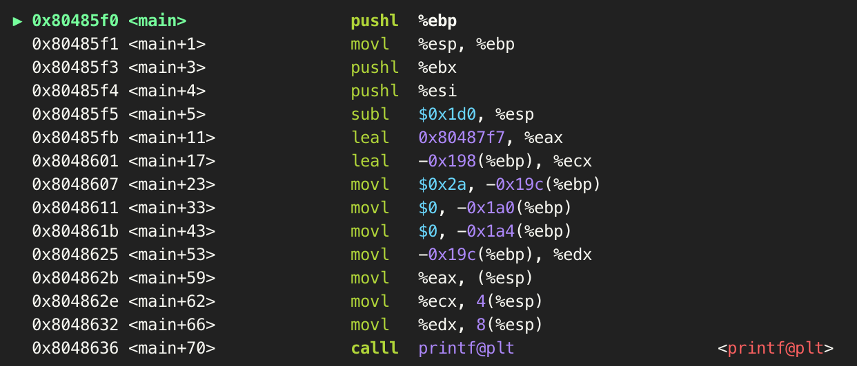
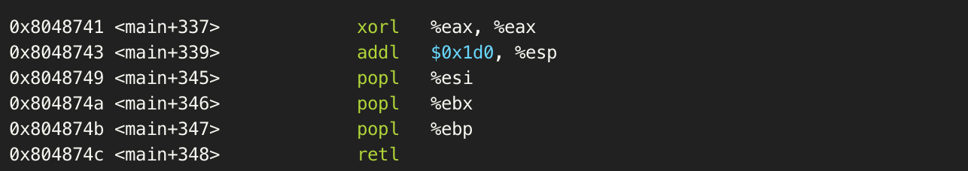
IA32: Call, ret, Function Prologue, Epilogue
Return IP
Saved EBP
call <target>
  push %EIP; JUMP <target>
ret
  jmp (%esp); sub 4 (%esp)
  pop %eip
Local A
Prologue
….
ARG 2
ARG 1
Return IP
%ebp
Saved EBP
Epilogue
Local A
Local B
Local B
%esp

Slide 64
Calling Convention: IA32 vs. AMD64
IA32 (32 bit) – pushes argument on the stack (for callee)
  Focus on +8 for the index for %ebp at the callee…
AMD64 (64 bit) – use registers to pass argument to callee
  Register order (1st, 2nd, 3rd, 4th, 5th, 6th, etc.)
  Callee also uses these registers to get arguments
  0x4*n (%esp) : n-th argument
  (%esp) : 1st arg accessed by callee via 0x8 (%ebp)
  0x4(%esp) : 2nd arg accessed by callee via 0xc (%ebp)
  0x8(%esp) : 3rd arg accessed by callee via 0x10(%ebp)
    %rdi, %rsi, %rdx, %rcx, %r8, %r9, (use stack for more arguments)

Slide 65
printf()
printf() in x86
  lea 0x8048727,%eax
  mov -0x8(%ebp),%ecx
  mov -0xc(%ebp),%edx
  mov %eax,(%esp)
  mov %ecx,0x4(%esp)
  mov %edx,0x8(%esp)
  call 0x8048370 <printf@plt>
printf() in amd64
  movabs $0x400905,%rdi
  mov -0x8(%rbp),%rsi
  mov -0x10(%rbp),%rdx
  callq 0x400500 <printf@plt>
1st
1st
2nd
2nd
3rd
3rd
printf(*0x8048727, ebp_8, ebp_c)
printf(*0x400905, rbp_8, rbp_10)

Slide 66
AMD64 (64-bit) Stack
Stores local variables (negative access over %rbp)
  mov -0x8(%rbp), %rax
  lea -0x24(%rbp), %rax
Function arguments from registers (not stack)
  mov %rdi, %rax
  mov %rsi, %rax
Function arguments to callee
  mov %rax, %rdi
  mov $0x4, %rsi
  mov $0x40006, %rdx

Slide 67
Variables (virtually in our mind..)
Local variables access – a negative indexing over %ebp
  mov -0x144(%ebp), %eax
  mov %eax, -0x208(%ebp)
  mov %al, -0x210(%ebp, %ecx, 1)
Global variables – accessed by an address
  lea 0x8048440, %ebx
  mov (%ebx), %eax
  mov %al, 0x8048440(,%ecx, 1)
Stack arguments – accessed by a non-negative index over %esp
  mov %eax, (%esp) <- index 0 over %esp, 1st argument
  mov %eax, 0x4(%esp) <- index 4 over %esp, 2nd argument
  mov %eax, 0x8(%esp) <- index 8 over %esp, 3rd argument
  …

Slide 68
Stack
MY_ARG2
Grow
MY_ARG1
Return IP
CPU Stack (grows downward)
  Starts with %ebp
  Ends with %esp
Negative indexing over %esp
  Local variables
Positive indexing over %ebp
  Function arguments from caller
Positive indexing over %esp
  Function arguments to callee
Saved EBP
%ebp
Local A
ebp-8
Local B
ebp-c
Local C
ebp-10
ARG 2
esp+4
ARG 1
esp
%esp

Slide 69
Stack Usage Example
MY_ARG2
MY_ARG1
Return Addr
Saved EBP
%ebp
pushl $0x80485a0
  Push means adding an item to the stack top
Local A
ebp-8
Local B
ebp-c
Local C
ebp-10
%esp

Slide 70
Stack Usage Example
MY_ARG2
MY_ARG1
Return Addr
Saved EBP
%ebp
pushl $0x80485a0
  Push means adding an item to the stack top
Local A
ebp-8
Local B
ebp-c
Local C
ebp-10
0x80485a0
%esp

Slide 71
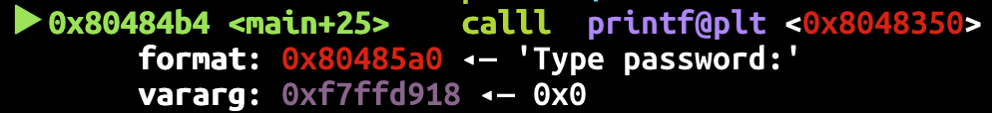
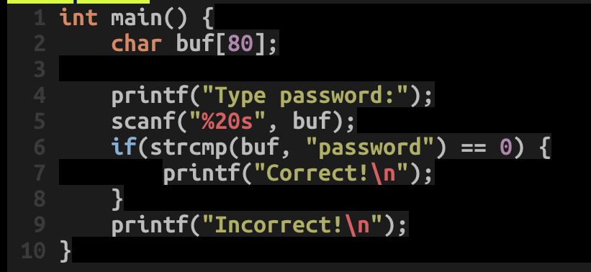
Pwndbg: shows func arguments
Shows arguments when calling a function
So it’s
  printf(“Type password:”);

Slide 72
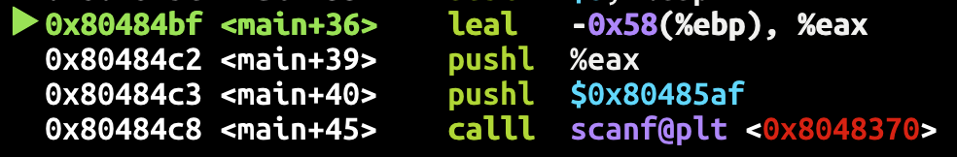
Local Buffer Variable
scanf(“%20s”, buf)

Slide 73
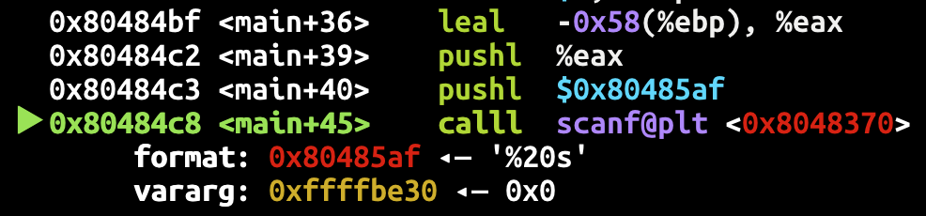
Local Buffer Variable
MY_ARG2
MY_ARG1
Return Addr
Saved EBP
%ebp
scanf(“%20s”, buf)
-0x58(%ebp), negative indexing over %ebp
  A local variable
buf
ebp-0x58
lea –0x58(%ebp)
0x80485af
%esp

Slide 74
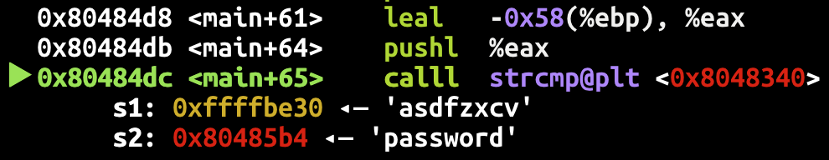
Handing Conditional Branch (if)
strcmp(buf, “password”)
-0x58(%ebp) stores our input, and it is compared to ‘password’

Slide 75
Handing Conditional Branch (if)
if (strcmp(buf, “password”) == 0)
test performs logical comparison (and, or, etc),
cmp performs arithmetic comparison (above, below, greater, less..)
jne: jump if not equal, equal here means zero
The green checkmark provided by pwndbg indicates it’s taken!
  Meaning that the return value is non-zero

Slide 76
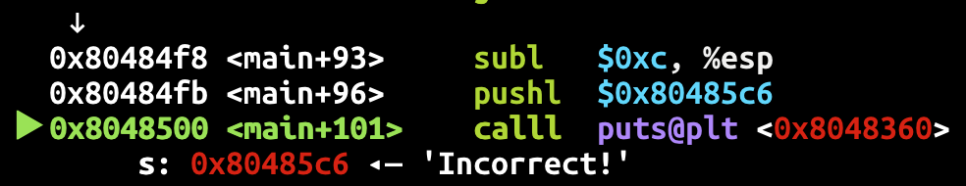
After jump..
Incorrect…

Slide 77
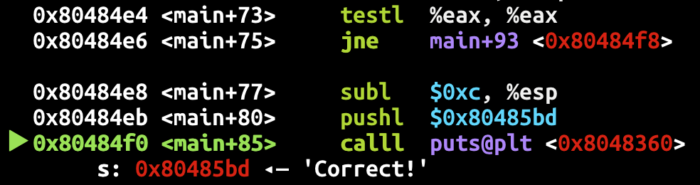
If jne fails (strings are equal)
Correct!

