Slide 1
CS4459
Cyber Attacks & Defense Lab (CANDL)
LEC #1 – Class Overview and Reverse Engineering Intro
Jan 21, 2025

Slide 2
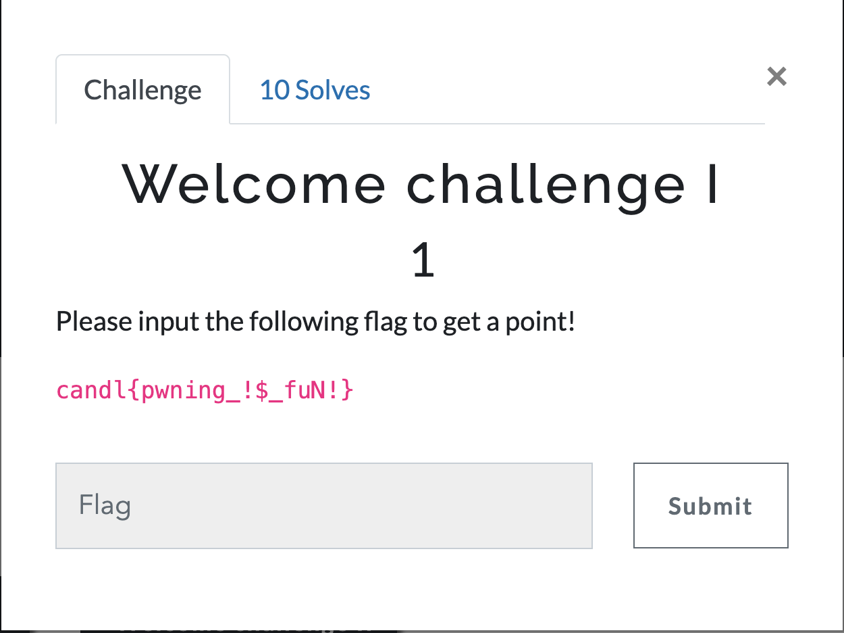
Welcome to CS4459 CANDL
Join class Discord
  https://discord.gg/BgB5qgS8
Sign up for CTF scoring server
  https://ctf.syssec.org
  Use your email and UTD NetID
Solve your first challenge

Slide 3
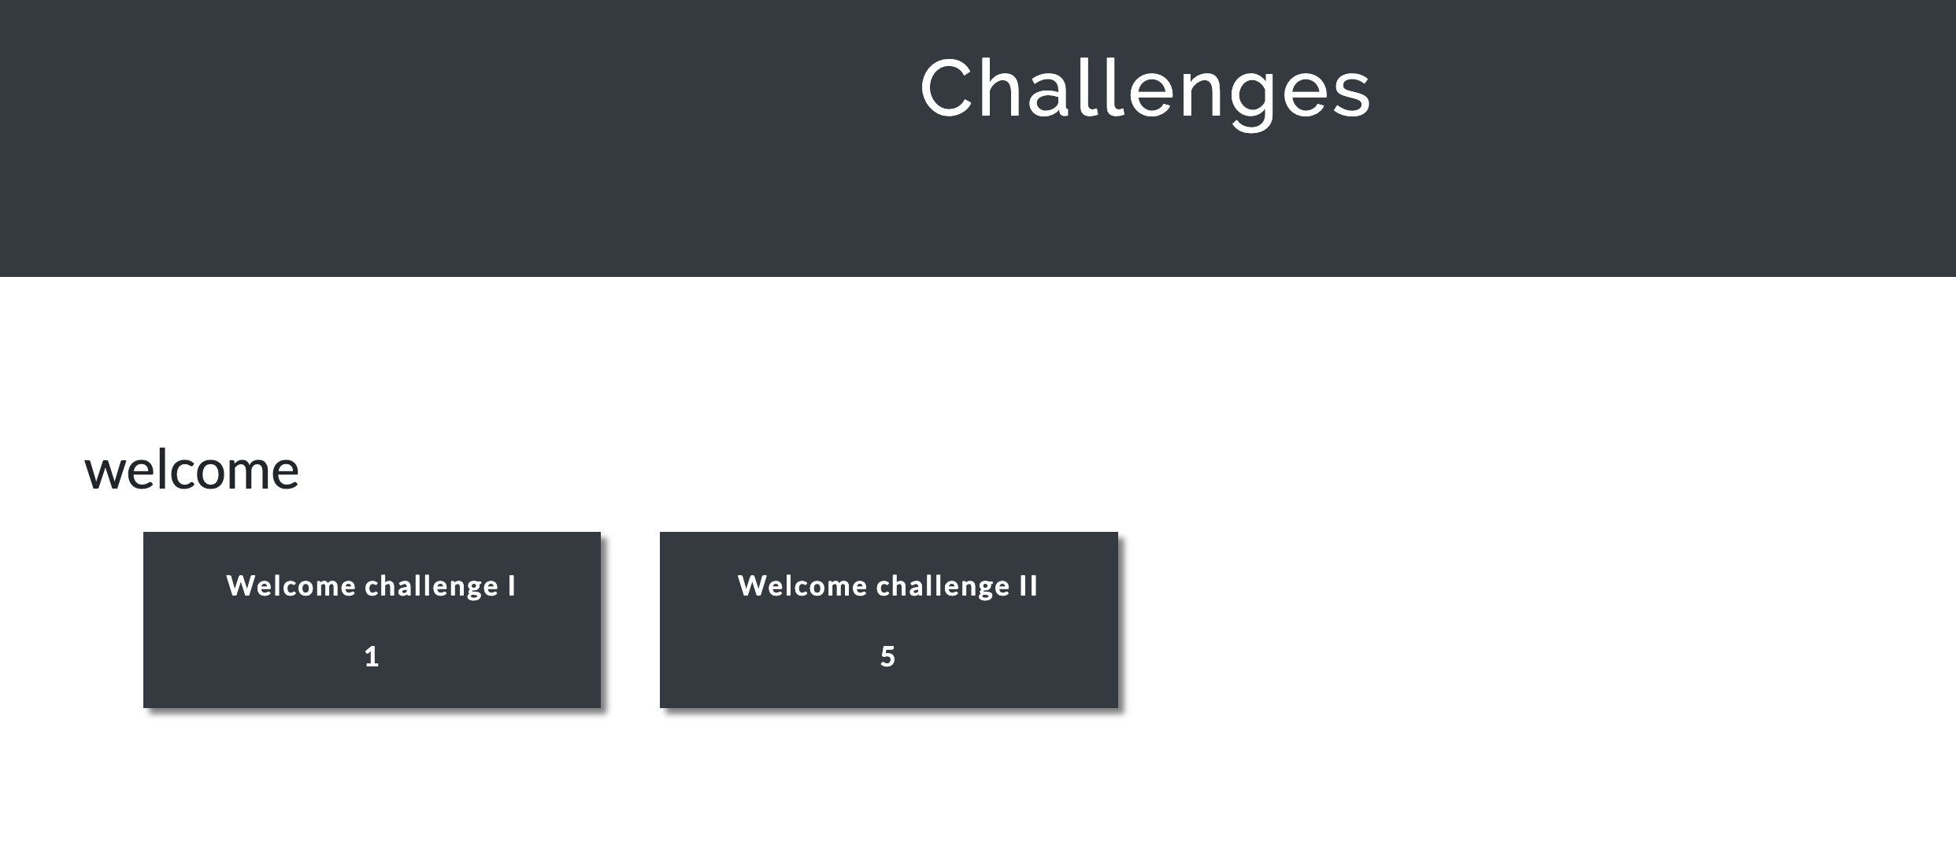
TODO: Register Yourself on Scoring Server
Sign into: https://ctf.syssec.org
  Update your ssh public key
  Connect “ctf-vm1.utdallas.edu”
Please submit the flag for the ‘Welcome challenges’

Slide 4
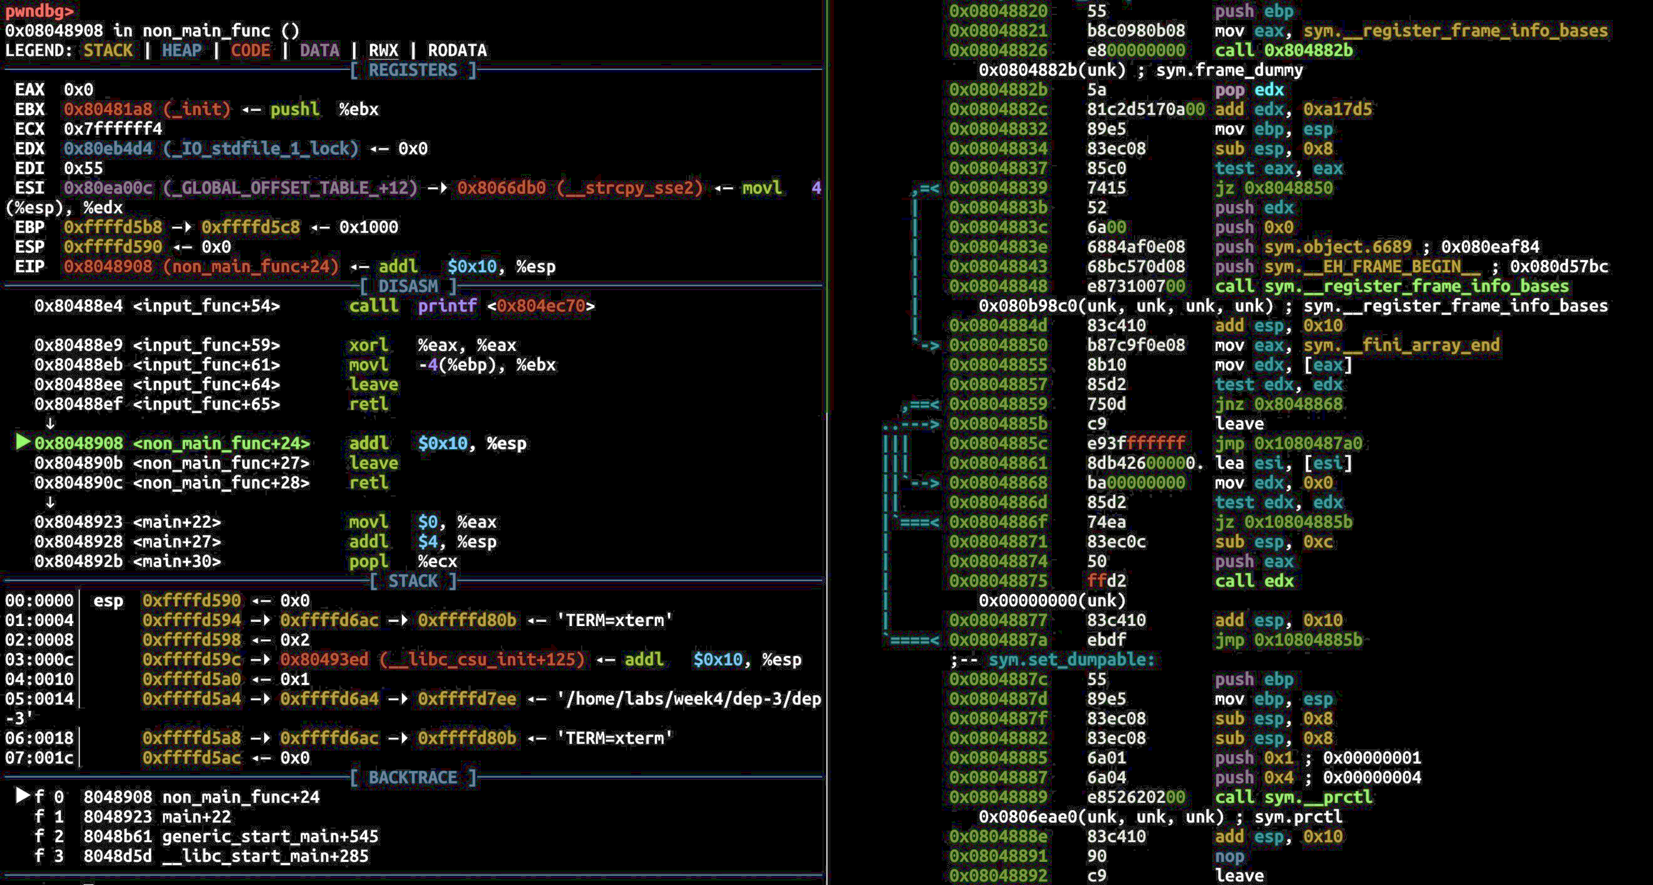
Course Description
Goal: Learn how cyber attacks work at the assembly level
  Understand how attacks work to counter them
Lecture & exercise
  Learn high-level concepts of attacks in the lecture
  Practice attacks with exercise
Topics
  Reverse engineering
  Binary analysis
  Exploit writing
  Patching vulnerabilities
  etc.

Slide 5
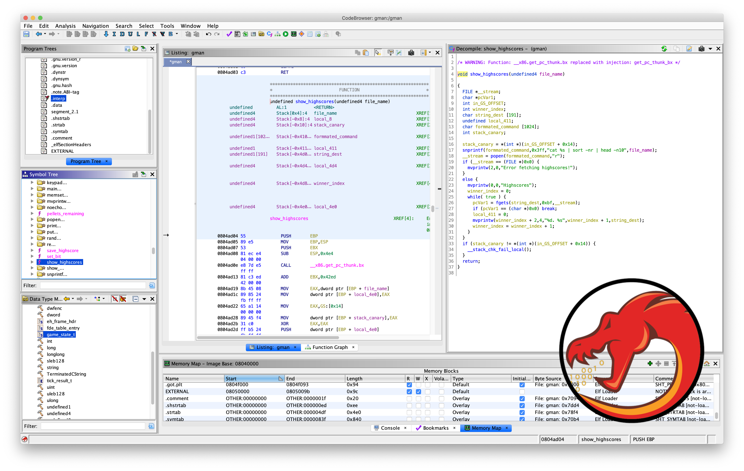
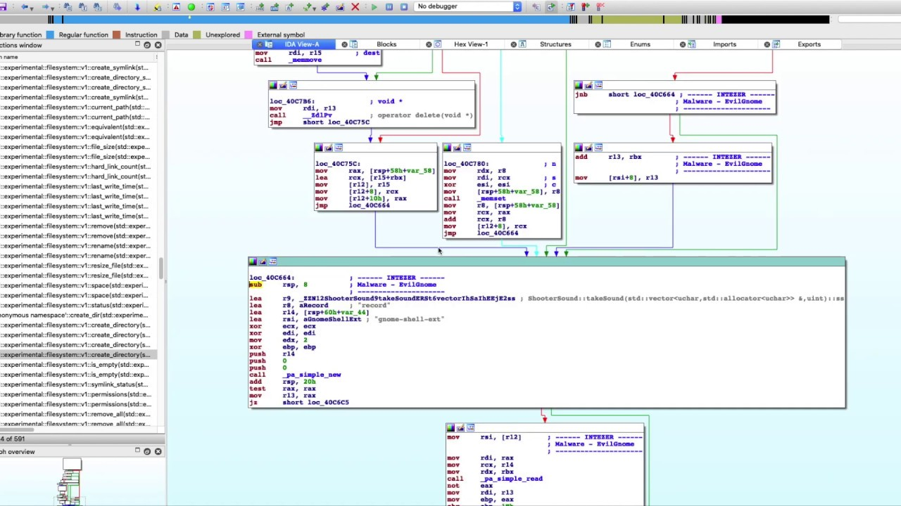
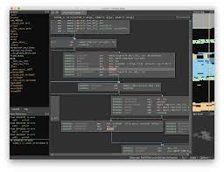
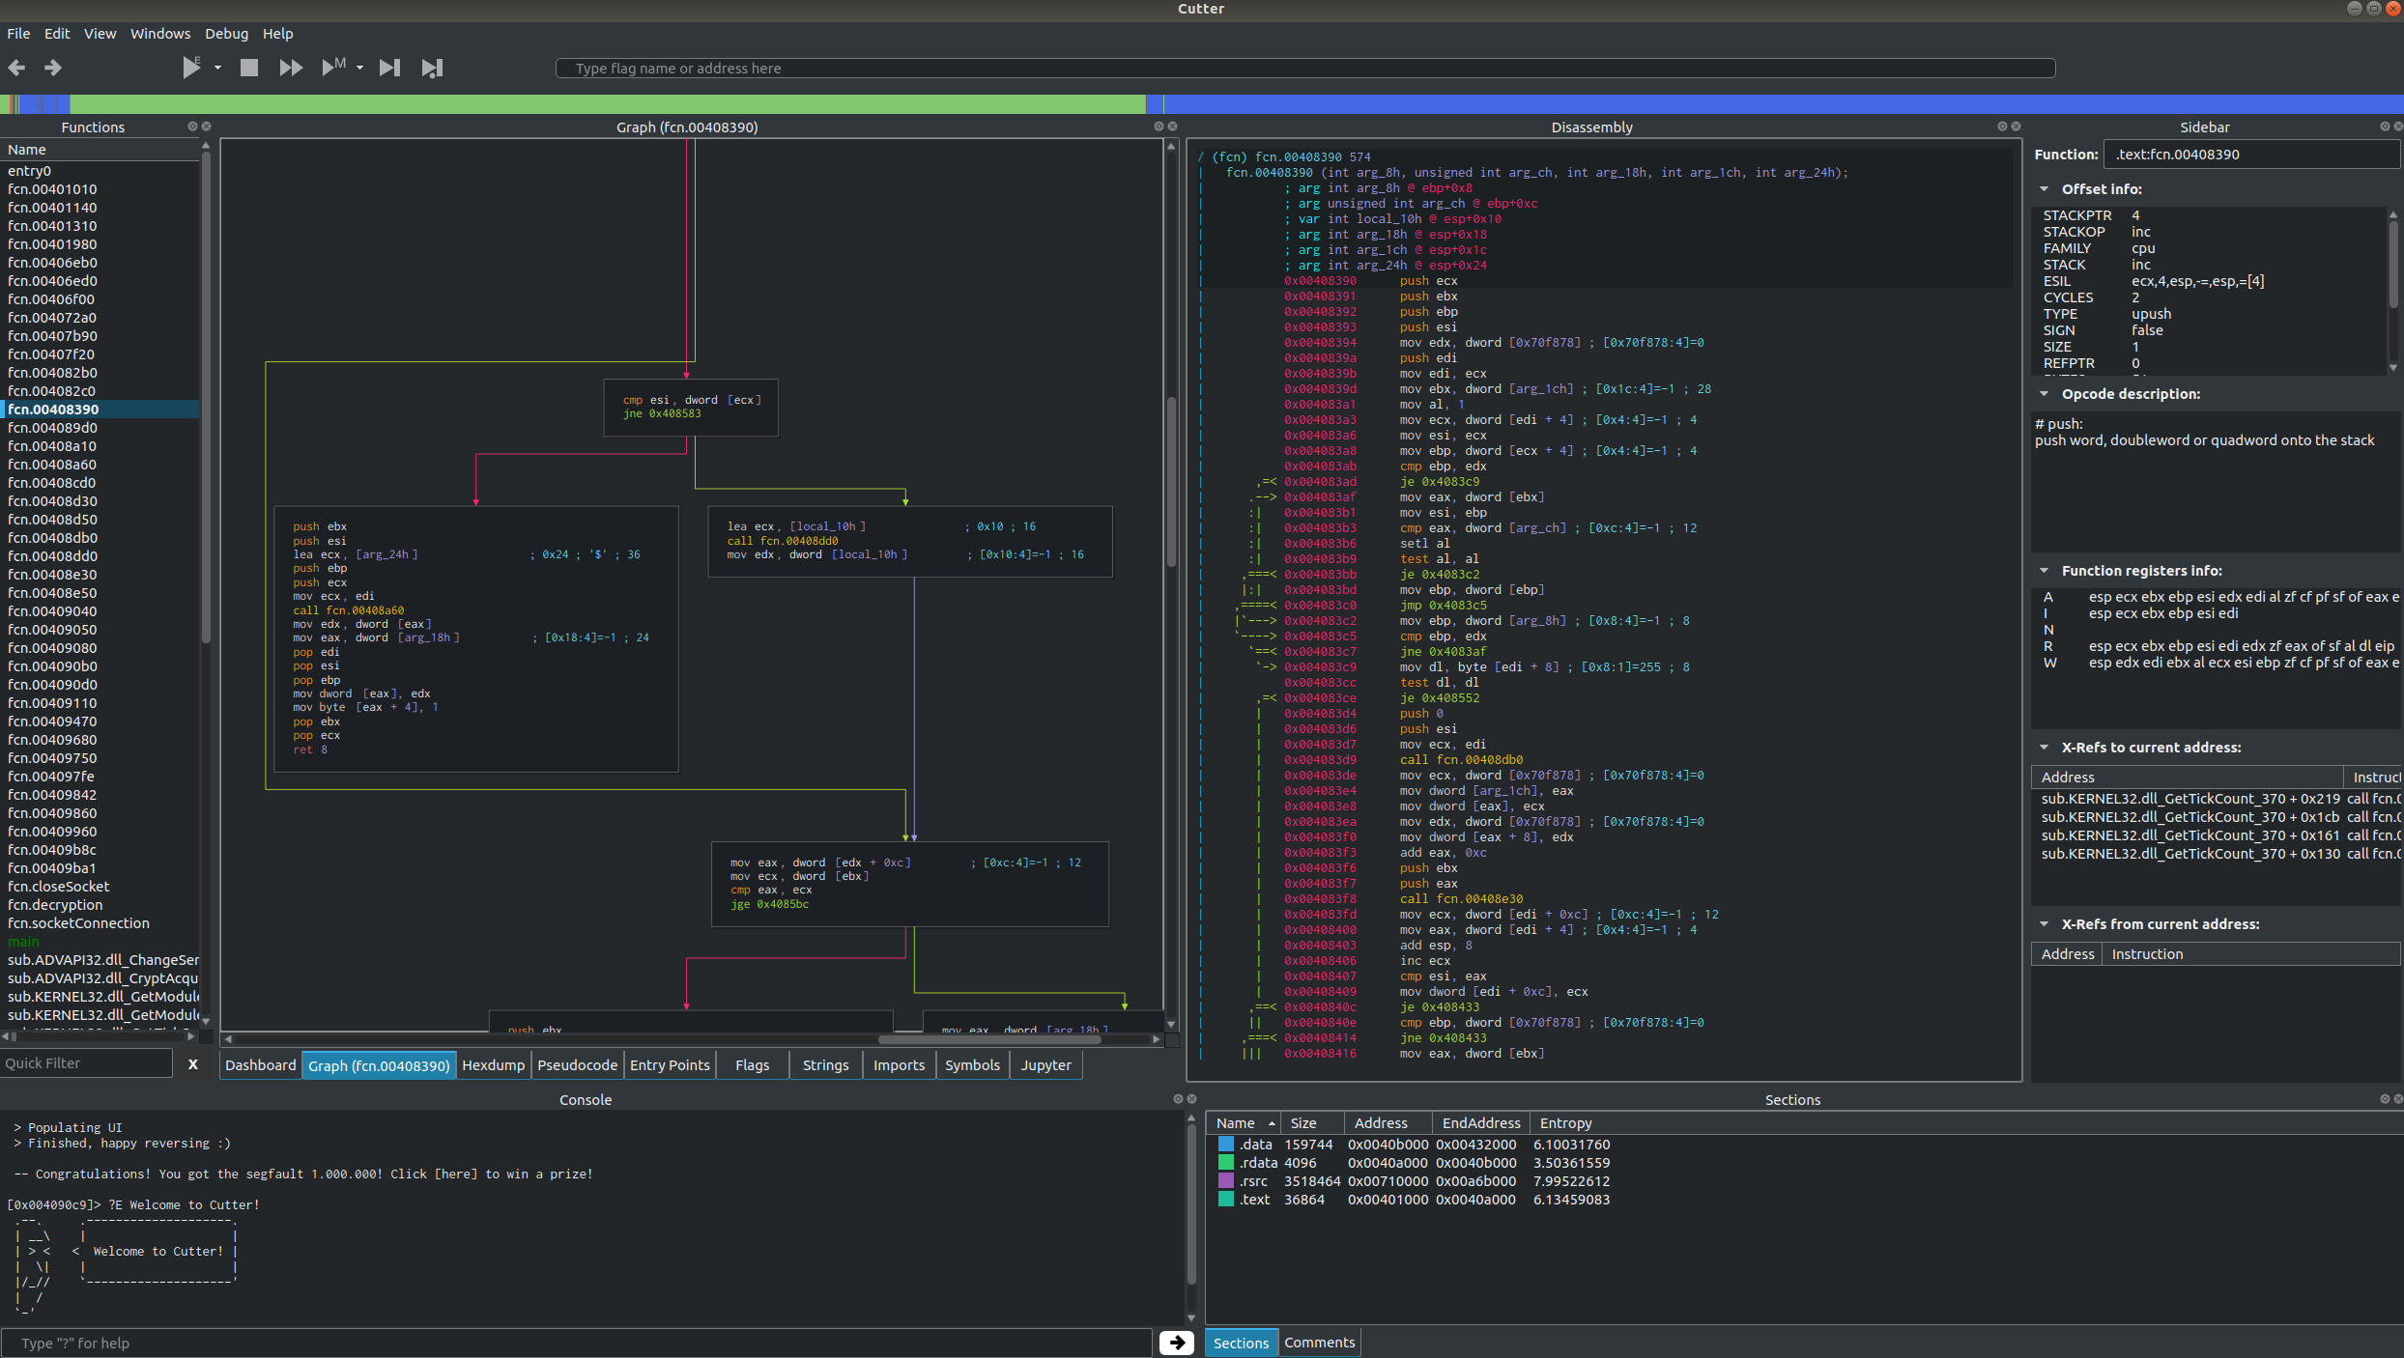

Slide 6
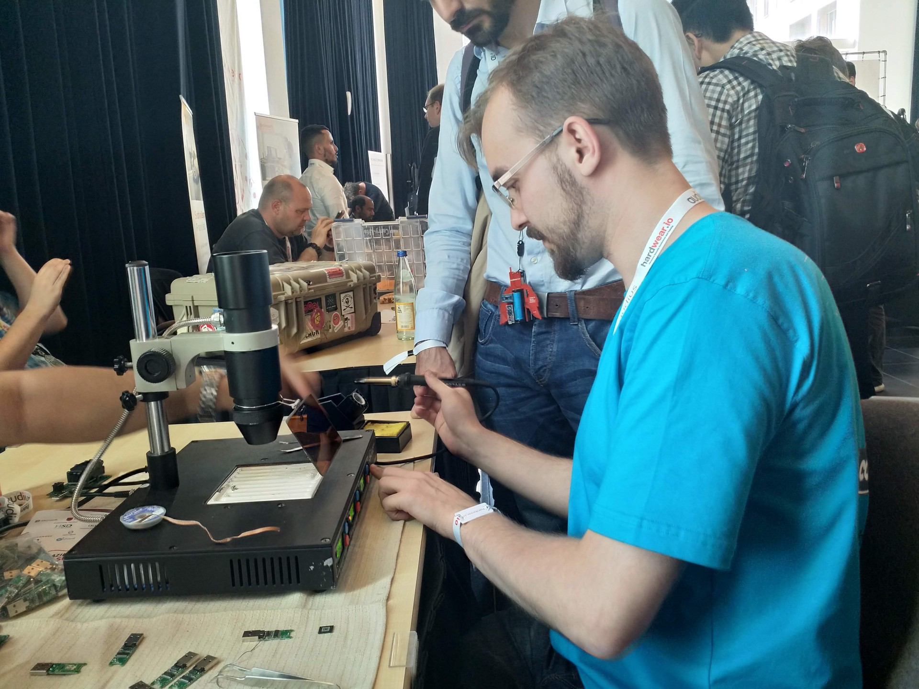
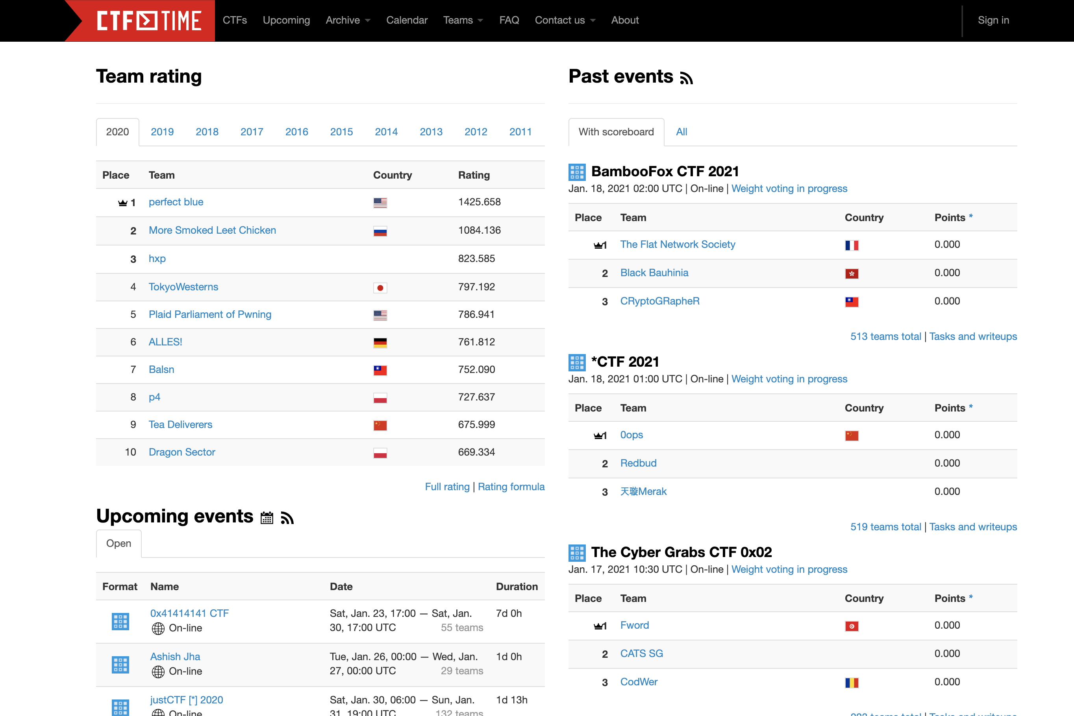
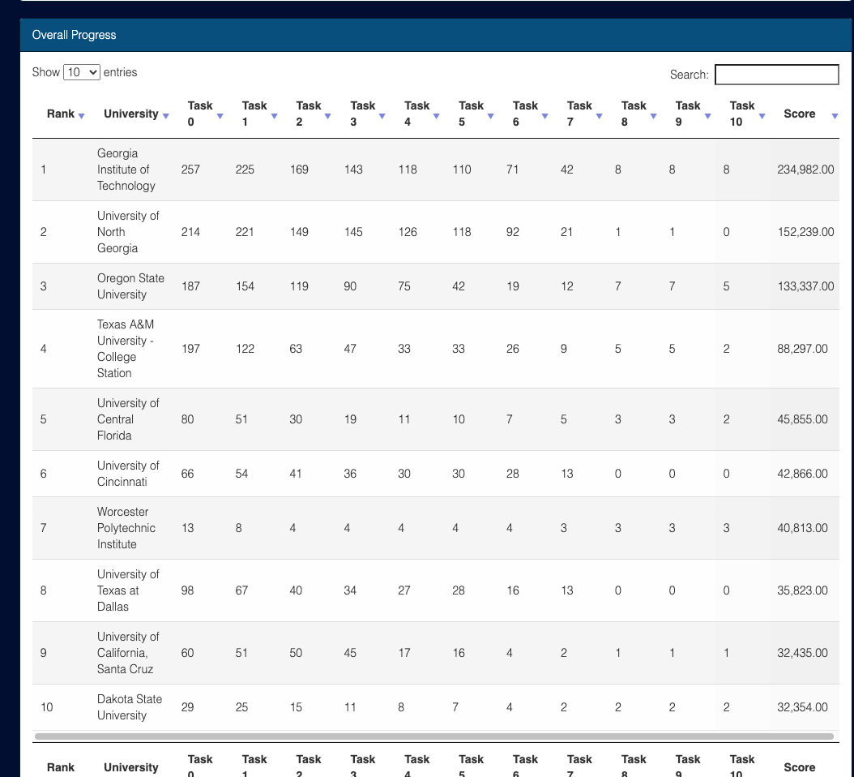

Play CTFs!
Participate in Cybersecurity Competitions
Notes:
replace

Slide 7
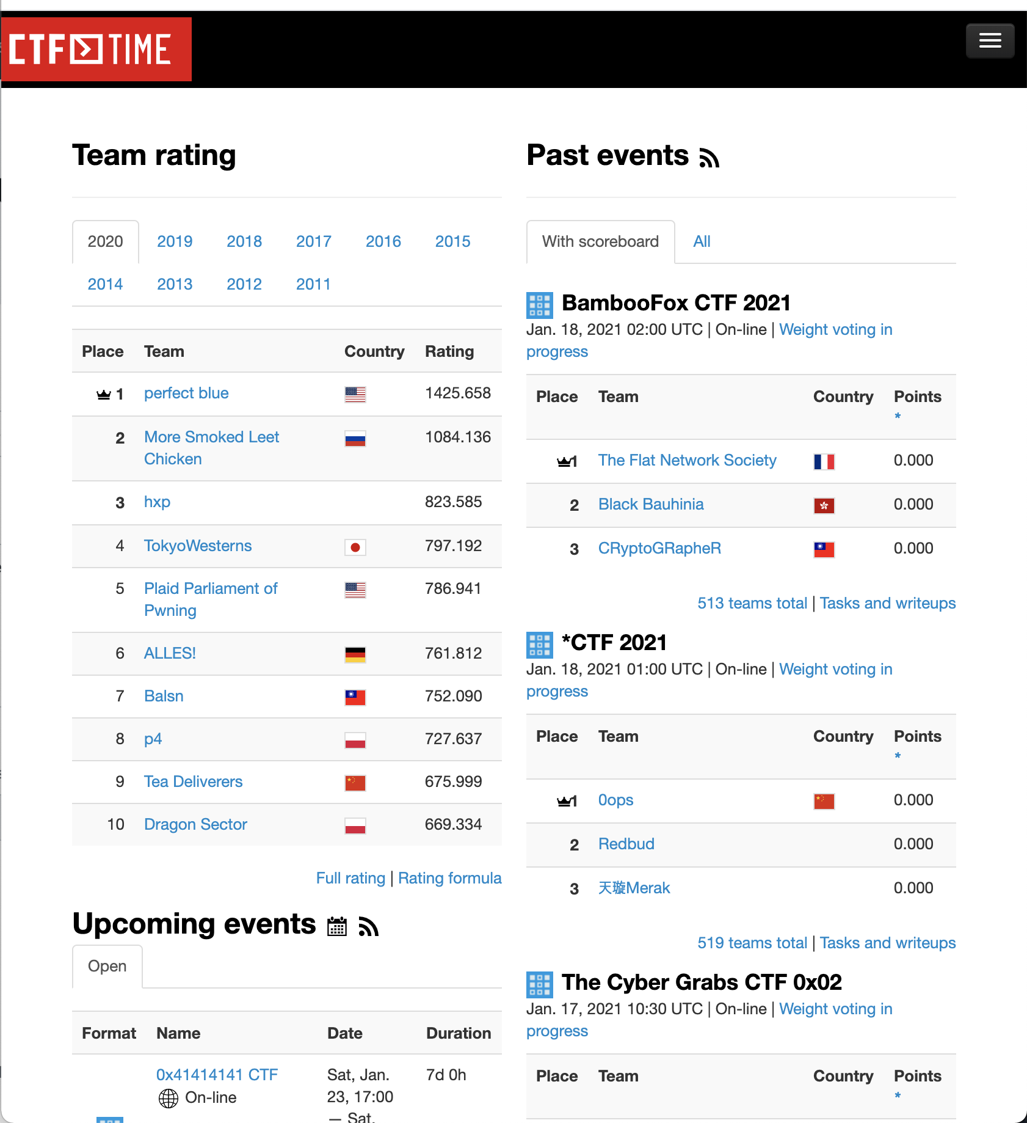
Capture-the-Flag (CTF)
Many CTF events in various topics
  https://ctftime.org
  IoT, Industrial Control Systems ….
Covers diverse topics
  Binary reversing, Pwning, Crypto, steganography …
  You need a team to play CTF
Good for your resume/job application
Fun to play and hang out with funny, smart people

Slide 8
Course Resources
Class website: https://cs4459.syssec.org
Scoring server: https://ctf.syssec.org
  Make sure to update your public key
Class Discord channel: https://discord.gg/BgB5qgS8
CTF Linux server: ctf-vm1.utdallas.edu
Notes:
https://www.digitalocean.com/community/tutorials/ssh-essentials-working-with-ssh-servers-clients-and-keys

Slide 9
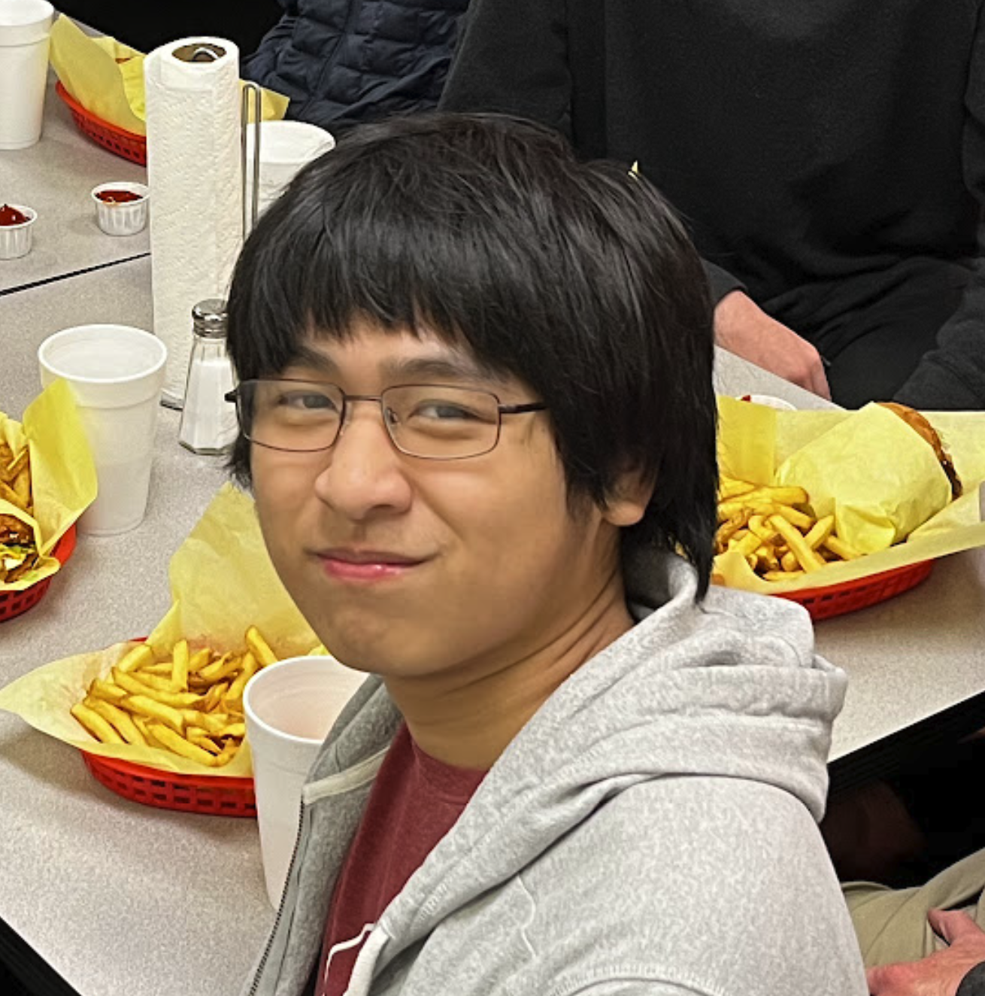
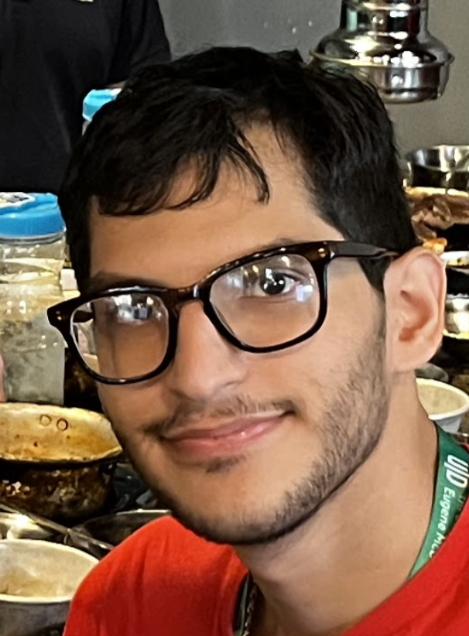
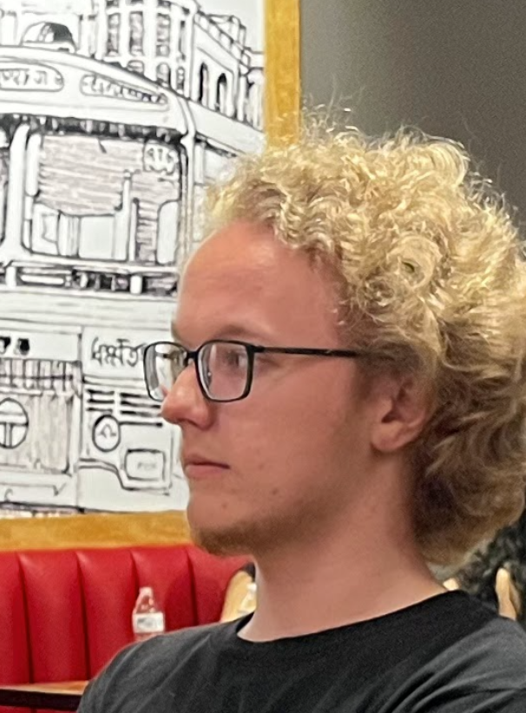
TAs
Max Zheng
Joel Jacobo
Simon Klancher

Slide 10
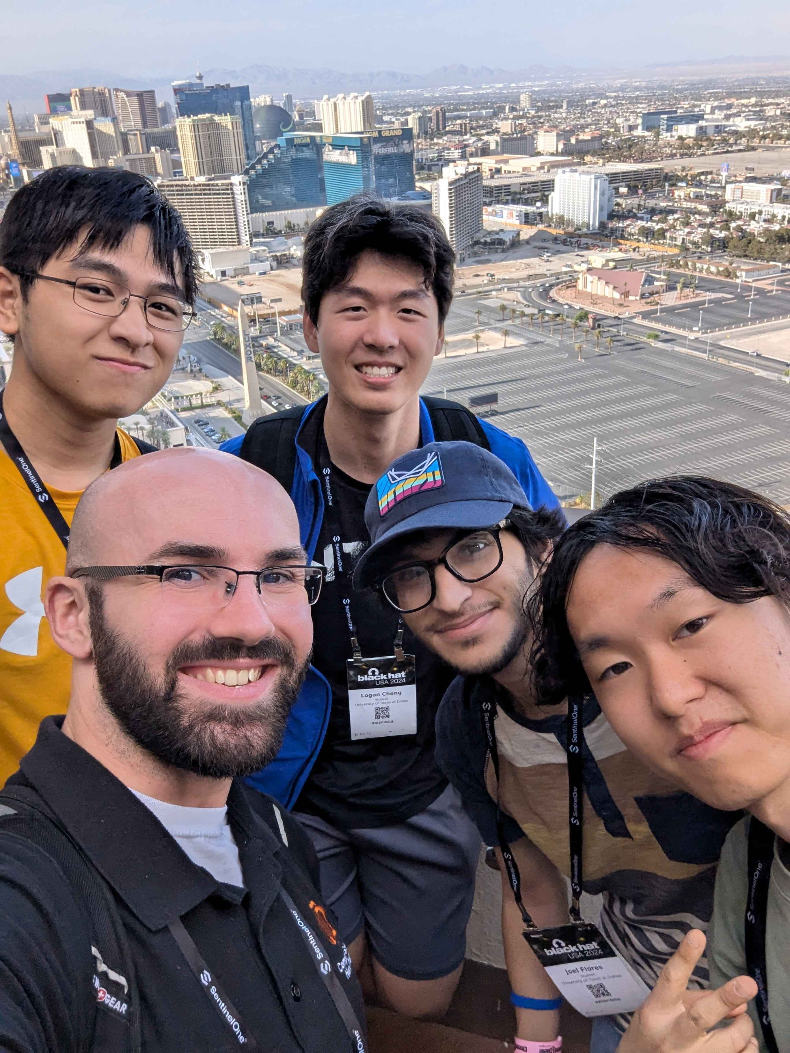
TA Emeritus
Josh Wiedemeier

Slide 11
Course Meeting Time
Lecture / exercise
  Tue / Thr 4:00 pm – 6:15 pm
  In-person, LAB based course: 1 hour lecture + hands-on
    Time budget between lecture and hands-on can be flexible
  Students can stay until 6:30 pm
Instructor office hour
  Friday 1:00 ~ 3:00 PM
  In-person: ECSS 3.226 (or 3.221)
Communication
  Contact an TAs via Discord for technical questions / discussions
  Email to instructor or head TA

Slide 12
Course Attendance
Students need to attend all classes
  Penalize absence or tardiness with no proper reasons
  Need to inform the instructor via email, a day in advance

Slide 13
Class Operation
The course will be heavily hands-on
80 students enrolled to the course
  Instructor can't simply cover all
  Take advantage of TAs as much as you can
TA times are also limited
  TAs will provide hands-on guidance
  TAs cannot (or not allowed to) do assignment for you
  Please respect their time and effort
You can discuss technical questions/issues with you peers and TAs
  Logistical issues with me or head TA

Slide 14
Course Schedule
Units | topic | Points
unit1 | Rev. Intro | 170
unit2 | Buffer overflow | ???
unit3 | Shellcoding | ???
unit4 | Stack cookies, DEP, ASLR | ???
unit5 | ROP | ???
unit6 | AR / AW & Format string | ???
unit7 | Advanced topics Python bytecode reversing | ???
unit8 | Heap overflow | ???
 | In-class CTF | ???
14 weeks schedule
  Intro – rev engineering and shellcode writing (week 1-3)
  Exploit writing (Week 4 - 13)
  Advanced topics and in-class CTF (Week 13 - 14)
  https://cs4459.syssec.org/cal.html
Each class will
  50~60 min lecture & tutorial + in-class exercise
  Proportion may vary depends on topics and schedule
The schedule and contents are mostly fixed, but is subject to changes

Slide 15
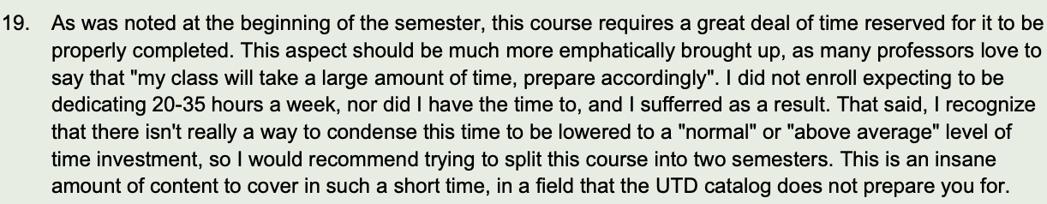
Beware What You Are Getting Into
System-heavy, many low-level struggles
  Intel assembly, 8 units + inclass CTF
  System attacks and defenses
  …
The course will be challenging, heavily hands-on
One student from the past
Notes:
the course was in a beta status, 1.5 x more materials last year.

Slide 16
Labs & Assignments
8 lab sessions, each with 10+ challenges
  1.5 ~ 2 weeks will be given
Each student solves the problem and submit to
  https://ctf.syssec.org
In class challenges + take home challenges
  We will go over tutorials for 1 ~ 2 challenges from the class

Slide 17
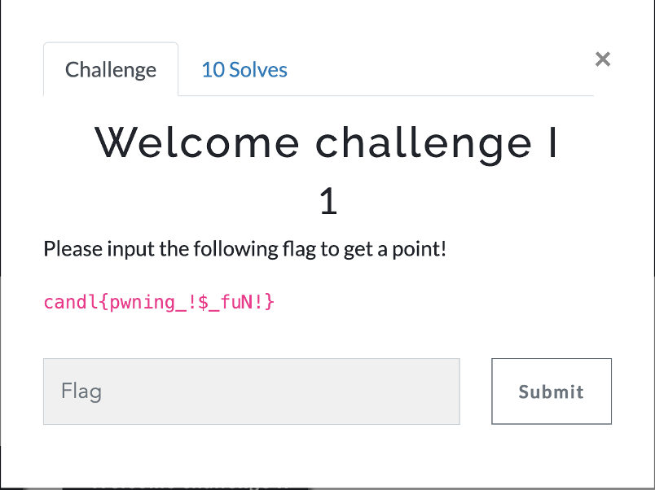
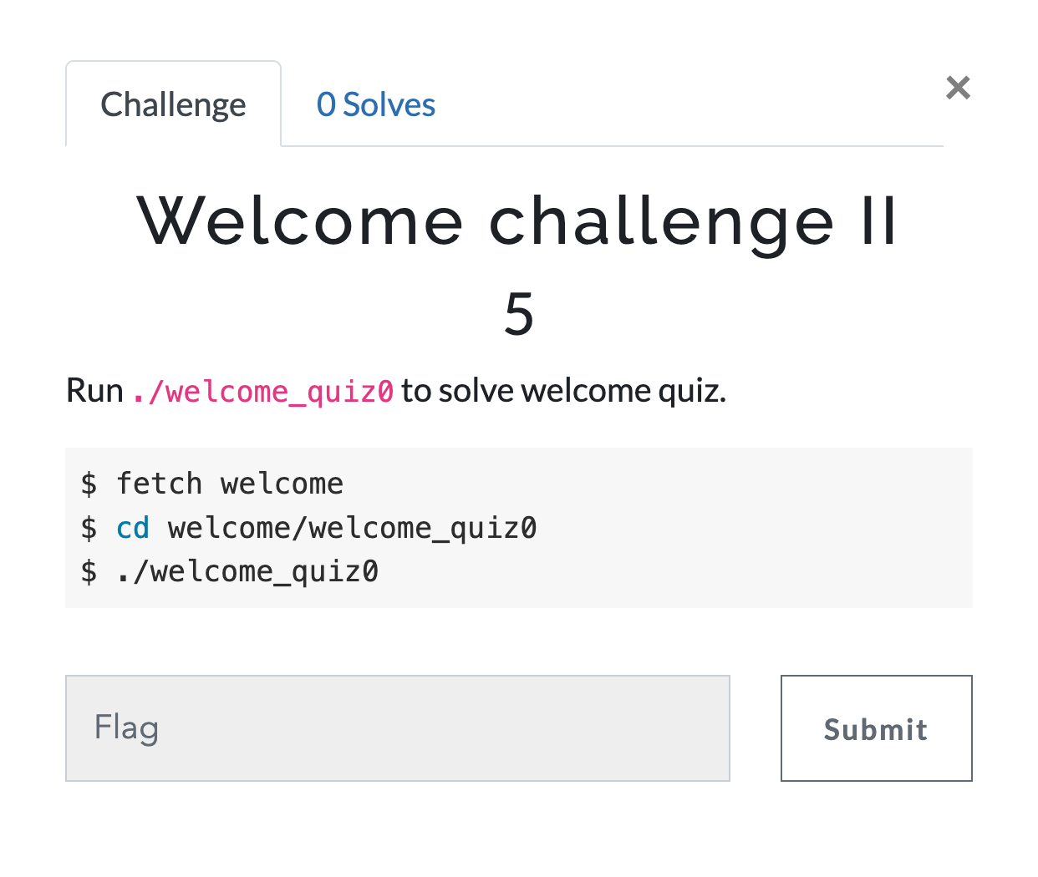
Challenges
~10 challenges per each unit
In-class hands-on will cover 2~3 challenges
Scoring server
  Register yourself at https://ctf.syssec.org/
  Set the “Login Name” as your NetID
  After the registration, please click and solve “Login Check”
    For sanity check
All the flags are
  candl{your_answer_here}

Slide 18
Assignment Rules
Please submit at least one challenge per each unit
  Otherwise, you will get F
From Unit 2, you will be asked to submit write-up (exploit script) for each challenge
  Usually, write-up due on a day after flag due.
DO NOT SHARE YOUR CODE WITH OTHER STUDENTS
  You are encouraged to discuss with others about the assignments, but do not ask/give the code to the others
  Describe how you solve the challenge
  Do not copy other students’ write-up
  Mention your collaborators in the write-up
  Do not post challenges + your write-up online
Notes:
Please do not publish your challenges + your solutions online

Slide 19
Assignment Rules
Please refer the Student Code of Conduct
We will detect and report Plagiarism
  Getting F or zero point for an entire unit’s assignment
  Can be reported to deal’s office
I do research on code/text comparison to measure similarity

Slide 20
Tips for Solving Challenges
Discuss!
  Use Discord, ask for help!
  In principle, NO DM to discuss challenges
Come to the class and follow tutorials
Solve challenges In-order
Ask questions
Be aware of your time budget
  Start early!

Slide 21
Grading
85 % lab challenges + In-class CTF
  In-class CTF as the course final
15% Class participation and external challenges
  In-class quizzes
  (Bonus) External Capture-The-Flag competitions (https://ctftime.org/)
Example grading scheme (graduate students will have a higher bar, +5%)
  A- ~ A+: 87 % ≤ Score
  B- ~ B+: 77 % ≤ Score < 87%
  C- ~ C+: 67 % ≤ Score < 77%
  D- ~ D+: 50% ≤ Score ＜ 67%
  F: Score ≤ 50% or misses an entire week’s lab
Notes:
20% NSA Codebreaker challenge
Task 1 – 5, 4% each, Task 6a and 6b are reserved for extra credits, 2% each.
https://codebreaker.ltsnet.net/home

Slide 22
Grading
Base points for grading
  Summation of all challenge points (not including bonus ones)
We do curve only for better grade
  Curve will not downgrade you
Grade range is obscured intentionally

Slide 23
Where to Begin
Basic skills
  C, x86 ASM
  HEX encoding / decoding, boolean algebra, ASCII
  shell (sh, bash, zsh), RegEx, etc.
  Scripting (Python)
Basic tools
  gdb, pwntools, assembly, text editors (vim), etc.
Join the community & Participate CTF events

Slide 24
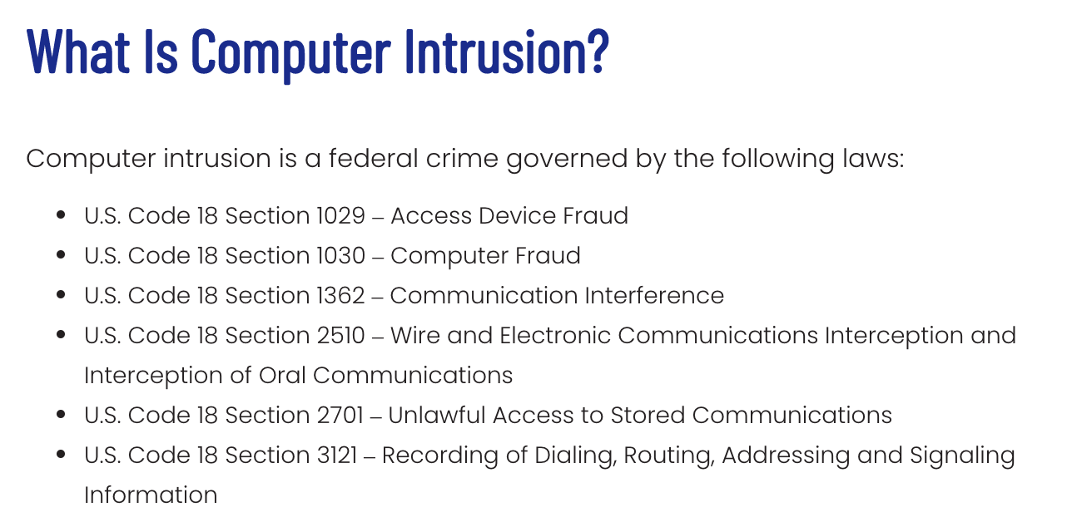
Ethical Hacking
DO NOT ATTACK OTHER’s SYSTEM
  If you found vulnerabilities in CTF VMs or https://ctf.syssec.org
    Please let me know; I reserved some extra credits for this
Attack your own and isolated environment
  Your home directory
  Challenge server
  DO NOT DoS the server…
Follow the law and regulations
  Computer Intrusion under federal law
  Bug bounty policies
// Don't do this
while(1)
fork();
// We are watching you…

Slide 25
Learning Objectives
Basic tools and environment
X86 assembly basics
  32bit and 64bit
  Function calls
  Do not use decompilers: e.g, Ghidra, IDA Pro
Low-level data encoding

Slide 26
Connect to Unit 1
Connect ssh (UNIX-like)
  ssh <user_netid>@ctf-vm1.utdallas.edu
Fetch the challenge
  fetch unit1

Slide 27
GDB: Debugger
Start a new process or attached to running process
Can read assembly of a program (disassembly)
  disass main
Can read the status of a program such as registers and memory
  x/w $eax (print the value of eax as 32-bit integer)
  x/s 0x804858f (read the string value at the address 0x804858f)
  x/w 0x804858f (read the integer value at the address 0x804858f)
Can set a breakpoint
  b main (break if main function is called)
  b *main+53 (break before running the instruction at main+53)

Slide 28
GDB: Debugger
Execute a program
  r
Controlling the execution after a break
  c (continue to a next breakpoint)
  ni (run an instruction, do not get into the function)
  si (run an instruction, get into the function)

Slide 29
GDB Plugins
PEDA: Old/outdated
GEF: light-weighted, works better for cross-platform (Intel vs. ARM)
Pwndbg: comprehensive, works well for class challenges
$HOME/.gdbinit

Slide 30
Unit1-level0
Demo

Slide 31
Unit 1 – Basic Reverse Engineering
Prepare students access to CTF environment
Understanding assembly code in a binary program
  Translating x86 assembly into a readable C-like pseudocode (mentally)
Intel assembly (32-bit → 64-bit)
Low-level data encoding
Tools
  Vim: editor
  GDB + pwndbg : debugger
  tmux, ptrace …

Slide 32
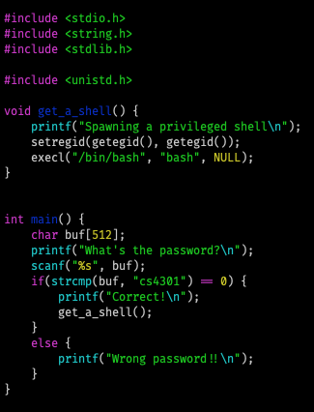

Assignment Structures
Your goal is to read `flag`
  Special permission required

Slide 33
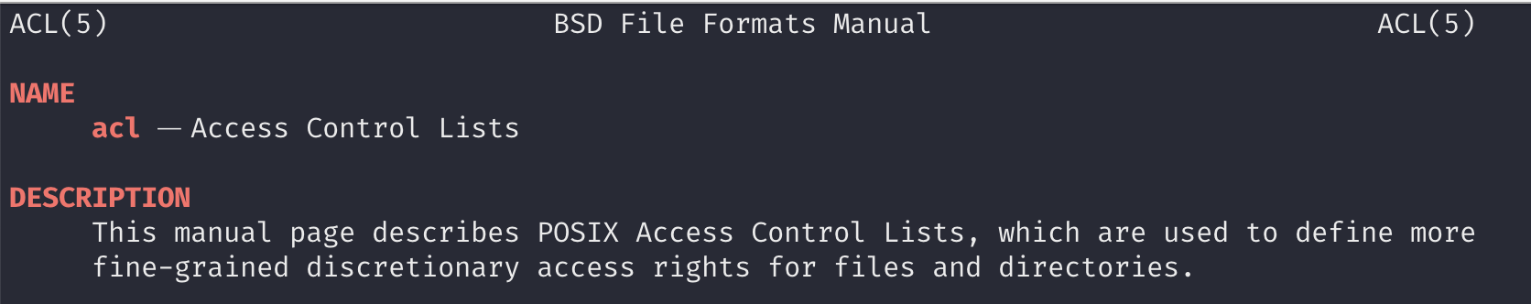
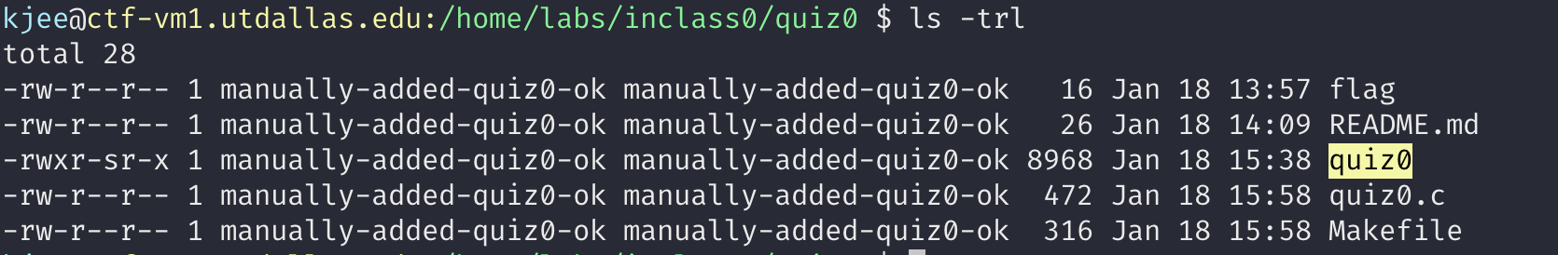
*nix Access Control
$ man acl

Slide 34
Unit1 Tips
Class will AT&T format (vs. Intel format)
  $HOME/.gdbinit
Do not use decompilers (e.g., Ghidra or IDA Pro)
  It may help you now, but will make hurt you eventually
  Spend more time to read assembly

Slide 35
Commands and Tools

Slide 36
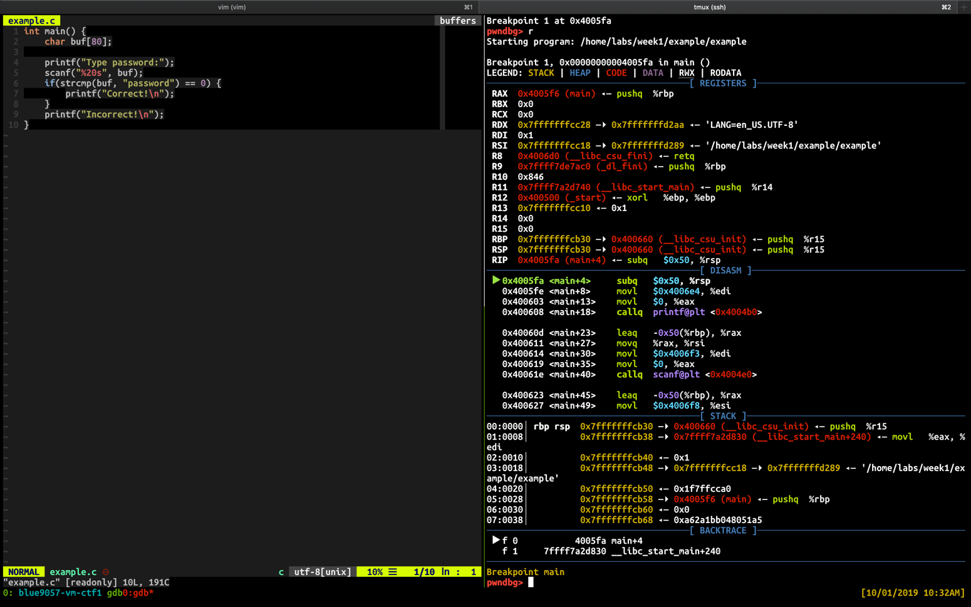
Console Debugging Example
Use tmux to split the window
  Left: vim
  Right: gdb

Slide 37
TMUX tips
CTRL +c : create a new window
CTRL +[0-9] (a number) : select the window with that number
CTRL + → ←↓↑ (arrows) : move to the pane
CTRL + % : split the pane vertically
CTRL + “ : split the pane horizontally

Slide 38
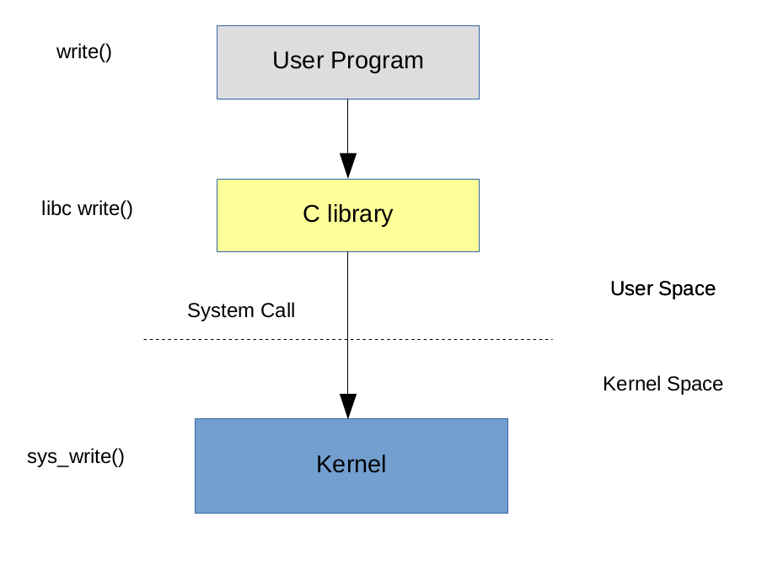
ltrace, strace
Function calls are from
  Program itself, libraries,
  system kernel
ltrace
  Tracking library calls
strace
  Tracking system calls

Slide 39
’xxd’: HEX Dump from a File
HEX output
  xxd <file>
Skip first n entries
  xxd –s <n> <file>
Limit output to n entries
  xxd –l <n> <file>
Reverse HEX dump into binary
  xxd –r

Slide 40
Other Useful Commands
objdump
readelf
strings
many more …

Slide 41
/proc, lsof
/proc
  virtual filesystem that maps the runtime processes and kernel
  pwnlib.util.proc
lsof
  List *Open* Files
  Many resources are represented as a file object (file descriptor)
    Netlink, Socket, Unix Domain Socket, TTY …
  You can as questions like
    Q: Who is accessing the file?
    Q: Who is listening to the network port?
    … and many more

Slide 42
pwntools

Slide 43
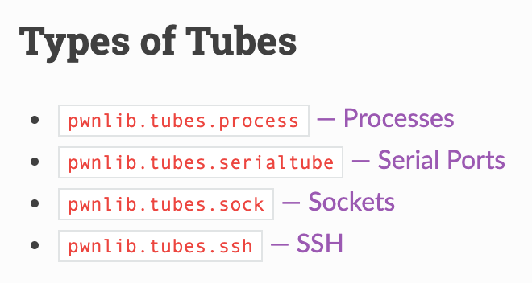
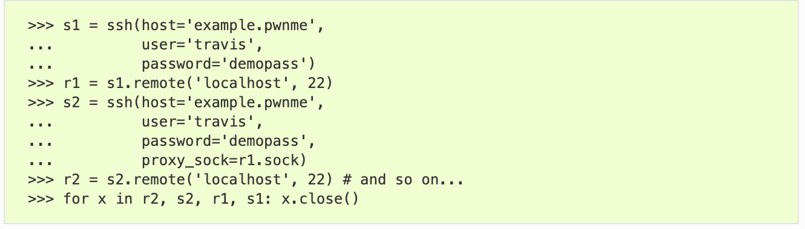
pwntools: pwnlib.tubes
Communication interface for process, network, socket, serial, tty …
  send(), sendline(), ….
  recv(), recvline(), recvuntil() ….
  interactive()

Slide 44
pwntools: process tube
process invoke + interactions
Batch
GDB attach
Interactive
context(arch='i386')
p = process('./7-stack-cookie', )
p.recvuntil(b"How many bytes do you want to read?")
p.sendline("1")
p.recvuntil(b"bytes: \n")
p.sendline(b"A")
p.interactive()

Slide 45
pwntools: remote
nc (netcat)
  ’cat’ for network, establish a pipe between server and client
pwntools remote class
# It works with ipv4 by default
l = listen(1234)
l.spawn_process('/bin/sh’)
r = remote('127.0.0.1', l.lport)
r.sendline(b'echo Goodbye’)
r.recvline() b'Goodbye\n'

Slide 46
pwnlib.util.packing
Simplifies access to the standard struct.pack and struct.unpack
>>> a = p32(-5, sign='signed', endian='big')
>>> a
b'\xff\xff\xff\xfb'
>>> u = make_unpacker(32, signed='unsigned')
>>> u(a)
4227858431

Slide 47
pwntools: Tips
logging support for tubes
>>> p = process('./7-stack-cookie', level='debug')
Set the right context
  arch: i386, amd64, arm, aarch64
  terminal: x-terminal-emulator, tmux
>>> context(arch='i386', terminal='tmux')

Slide 48
bytes, int, int[], str …
python3 is picky on its data types.
bytes ←→ str
bytes ←→ int
>>> open("flag.txt", "rb").read() + "hello, world!"
Error
>>> b = open("flag.txt", "rb").read()
>>> s = b.decode('ascii')
>>> bytes(s, 'ascii')
>>> bytes(s, 'utf-8')
>>> int.from_bytes(b'\x01\x02\x03\x04', "little")
>>> list(b'\x01\x02\x03\x04')
>>> bytes([1,2,3,4,5])
>>> bytes(bytearray(b'\x01\x02\x03\x04’)). # immutable vs. mutable
>>> int(0xdeadbeef).to_bytes(4, 'little')

Slide 49
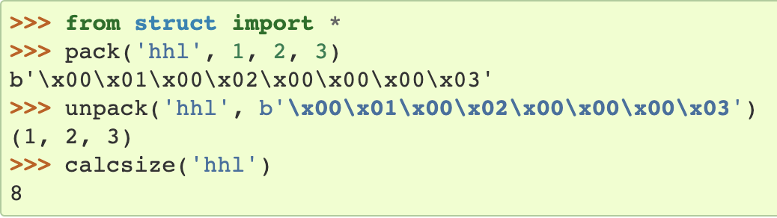
Python struct Module
Python Data Encoding / Decoding (Packing / Unpacking)
Python byte array encoding
‘12ABab’
‘\x30\x31\x41\x42\x61\x62’
Python struct module --- Interpret bytes as packed binary data
  Support conversion between Python values and C structs
  Need to care about Endianness (byte order), size, and alignment
l
h
h
https://docs.python.org/3/library/struct.html
Notes:
python3 is more explicit on differtiating string, unicode, byte array

Slide 50
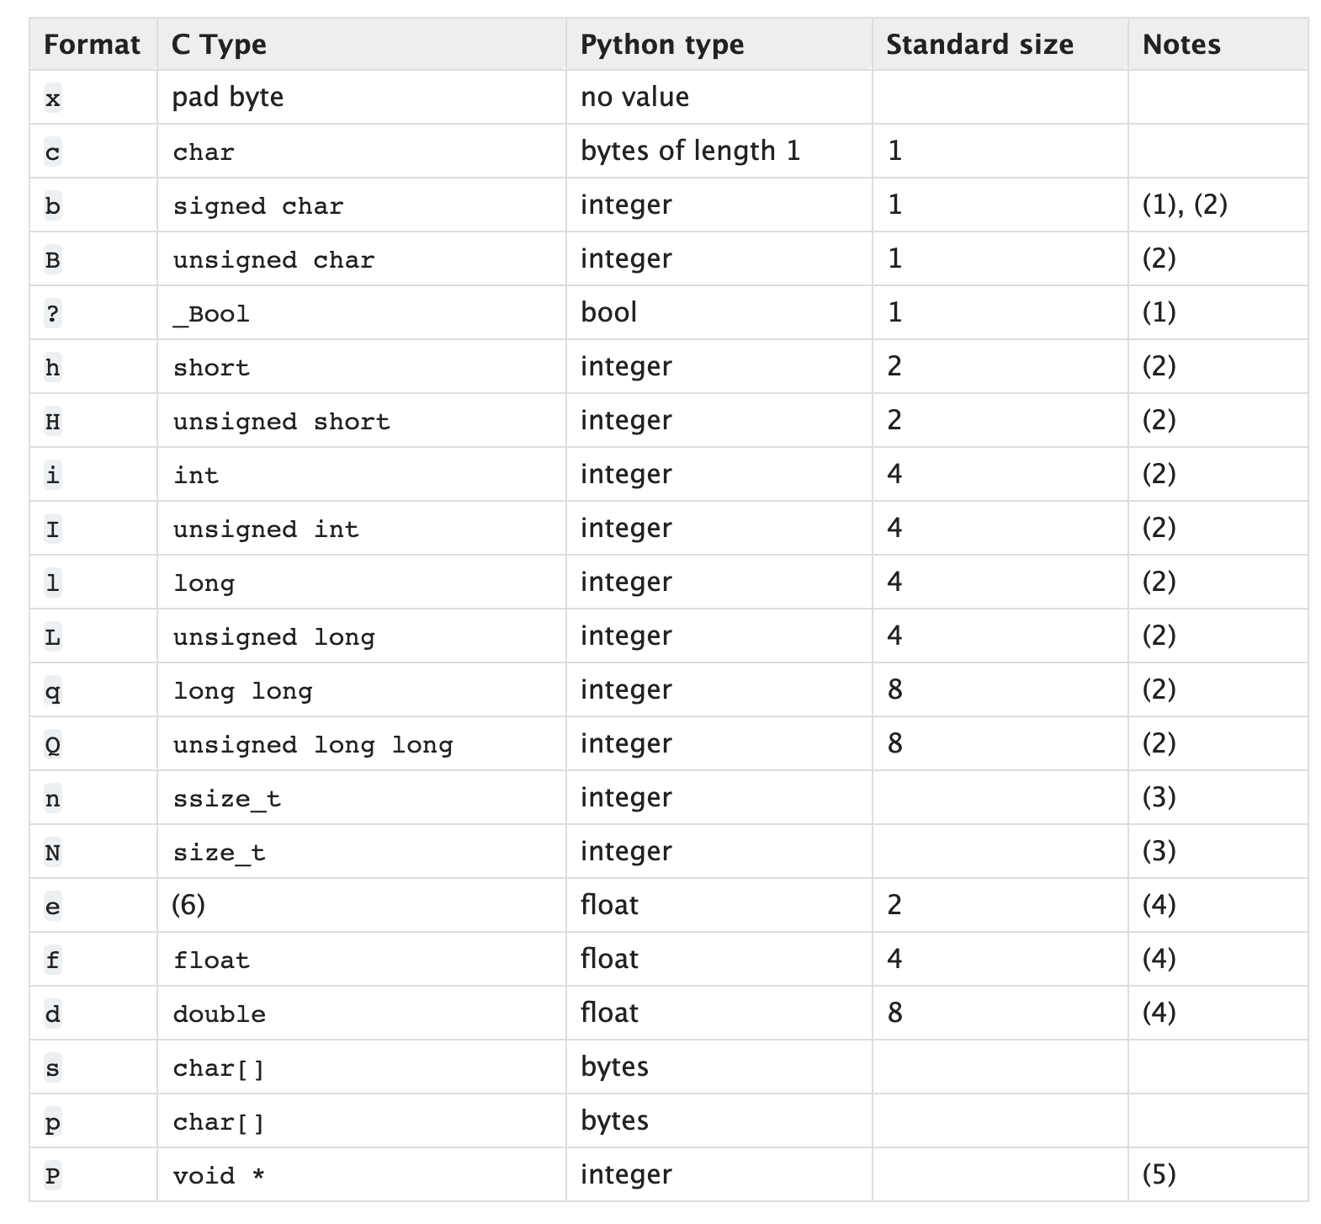
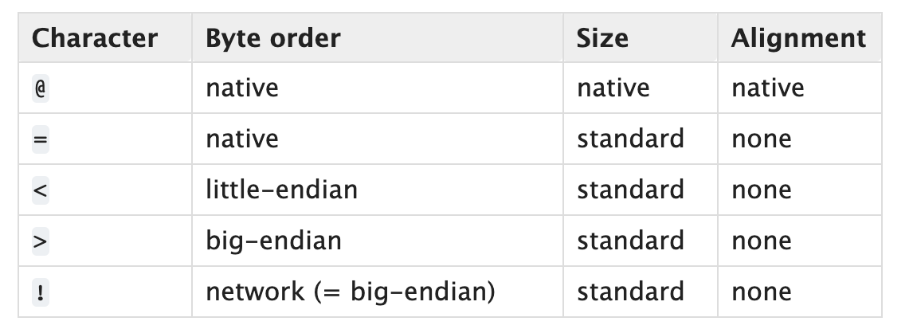
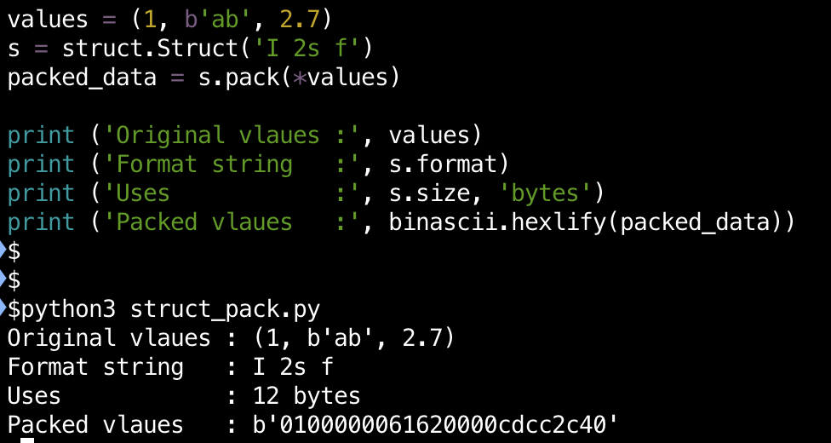
Python struct Module
Default
https://docs.python.org/3/library/struct.html
https://docs.python.org/3/library/struct.html
Notes:
https://pymotw.com/2/struct/
https://docs.python.org/3/library/struct.html
If the first character is not one of these, '@' is assumed.

Slide 51
pwntools: Resources
Official document
  https://github.com/Gallopsled/pwntools#readme
Tutorial
  https://github.com/Gallopsled/pwntools-tutorial/blob/master/utility.md
And many more …

Slide 52
Pwntools
p = process(‘./program_name’) # execute a program named as arg
p.send(“asdf”) # send ‘asdf’ as an input
p.sendline(“asdf”) # send ‘asdf\n’ as an input (newline!)
p.recv(0x100) # recv upto 100 bytes
p.recv(timeout=0.1) # recv for 0.1 second
p.recvline() # recv a line
p.recvuntil(‘:’) # recv until output meets ‘:’
p.interactive() # connect input/output to keyboard/console…

Slide 53
Pwntools
e = ELF(‘./program_name’) # open an ELF program named as arg
e.symbol[‘get_a_shell’] # get the address of get_a_shell()
gdb.attach(p) # spawn a gdb server attached to p
  -> you may attach your gdb by running the command shown on the screen
c = Core(‘./core’) # open a core file
c.stack.find(buf) # find the address of buffer in stack

Slide 54
Backup

Slide 55
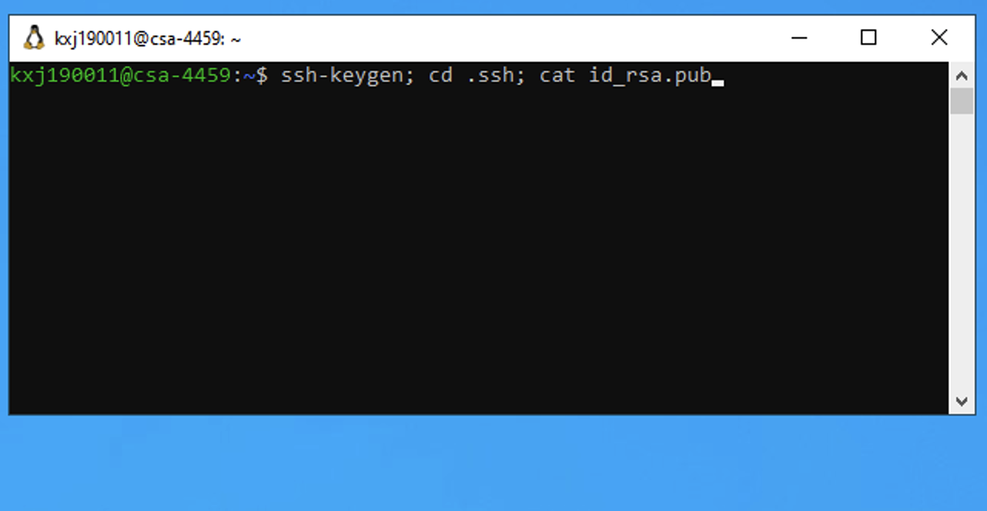
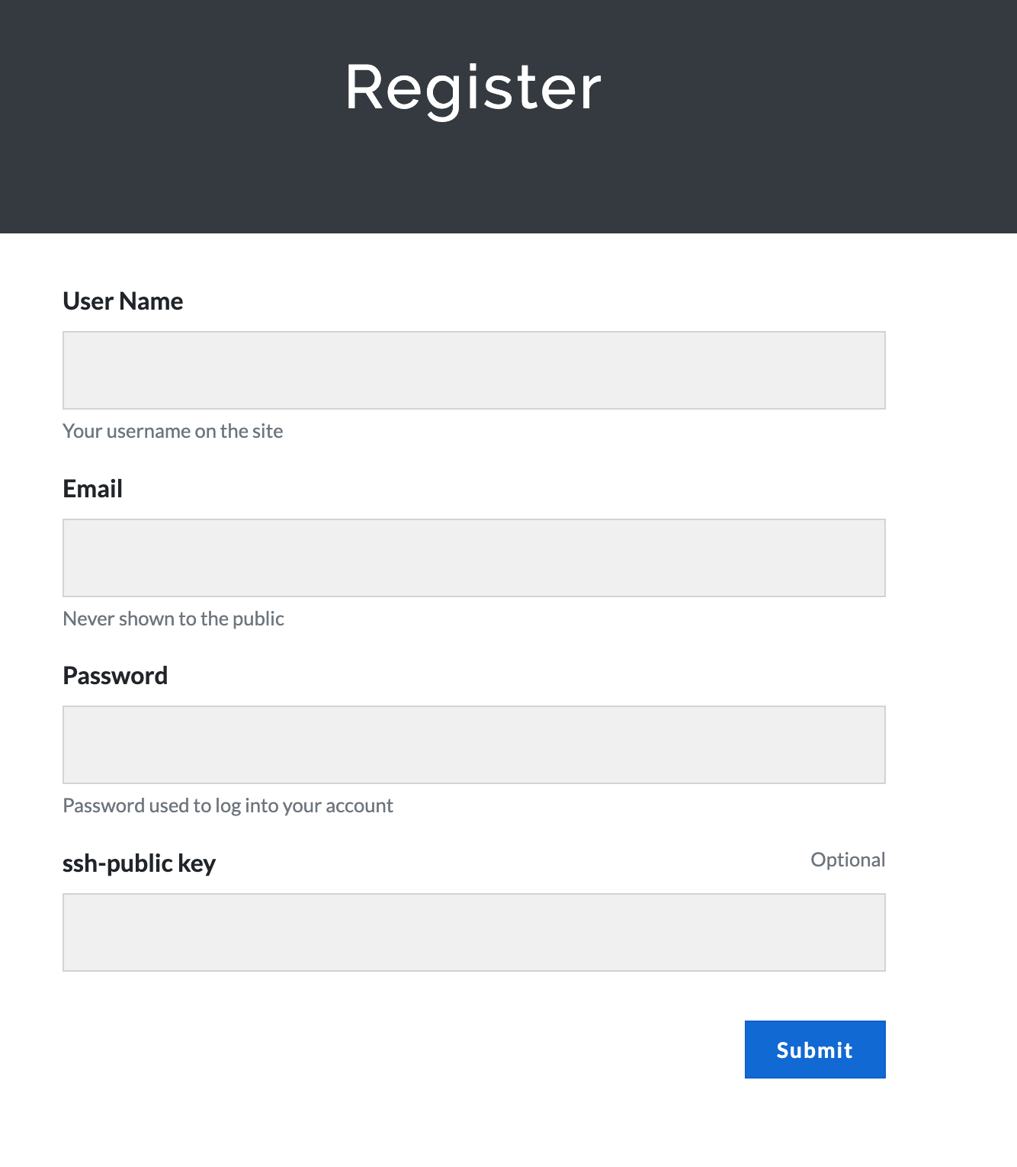
TODO-2: Connect Windows VM
Create public/private key pair from Windows VM
  Use Remote Desktop Application to connect to your Windows VM
From your Windows VM “ssh” into CTF server
Windows terminal applications
  Putty
  Windows Subsystem for Linux (WSL)
  ssh <user-netid>@ctf-vm1.utdallas.edu

Slide 56




Class Lab Settings
Remote Desktop
ssh
CTF-VM
Remote Desktop
ssh
ssh
Remote Desktop

Slide 57
Linux Capabilities / SELinux

