Slide 1
pwntools

Slide 2
pwntools
tubes
Interaction
  send*(), recv*()
packing

Slide 3
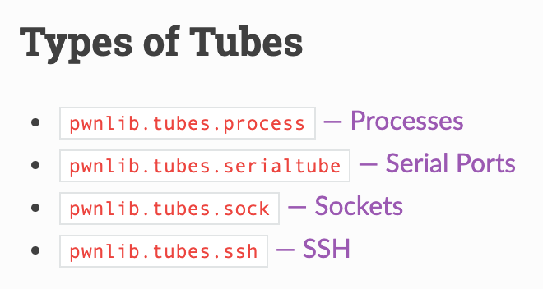
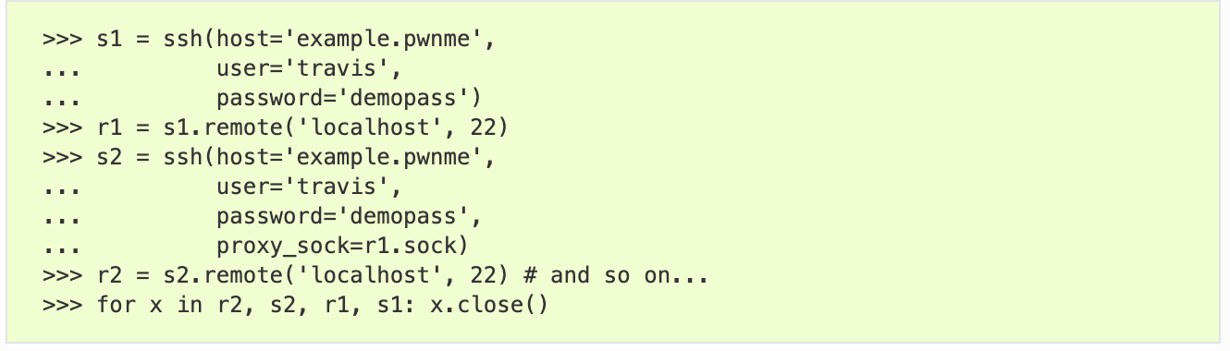
pwntools: pwnlib.tubes
Communication interface for process, network, socket, serial, tty …
  send(), sendline(), ….
  recv(), recvline(), recvuntil() ….
  interactive()

Slide 4
pwntools: process tube
process invoke + interactions
Batch
GDB attach
Interactive
from pwn import *
context(arch='i386') # or arch='amd64'
p = process('./7-stack-cookie', )
p.recvuntil(b"How many bytes do you want to read?")
p.sendline("1")
p.recvuntil(b"bytes: \n")
p.sendline(b"A")
p.interactive()

Slide 5
pwntools: remote
nc (netcat)
  ’cat’ for network, establish a pipe between server and client
pwntools remote class
# It works with ipv4 by default
l = listen(1234)
l.spawn_process('/bin/sh’)
r = remote('127.0.0.1', l.lport)
r.sendline(b'echo Goodbye’)
r.recvline() b'Goodbye\n'

Slide 6
Sending / Receiving Data
Receiving data
  recv(n) - Receive any number of available bytes
  recvline() - Receive data until a newline is encountered
  recvuntil(delim) - Receive data until a delimiter is found
  recvregex(pattern) - Receive data until a regex pattern is satisfied
  recvrepeat(timeout) - Keep receiving data until a timeout occurs
  clean() - Discard all buffered data
Sending data
  send(data) - Sends data
  sendline(line) - Sends data plus a newline

Slide 7
pwnlib.util.packing
Simplifies access to the standard struct.pack and struct.unpack
>>> a = p32(-5, sign='signed', endian='big')
>>> a
b'\xff\xff\xff\xfb'
>>> u = make_unpacker(32, signed='unsigned')
>>> u(a)
4227858431

Slide 8
pwntools: Tips
logging support for tubes
>>> p = process('./7-stack-cookie', level='debug')
Set the right context
  arch: i386, amd64, arm, aarch64
  terminal: x-terminal-emulator, tmux
>>> context(arch='i386', terminal='tmux')

Slide 9
bytes, int, int[], str …
python3 is picky on its data types.
bytes ←→ str
bytes ←→ int
Error
>>> open("flag.txt", "rb").read() + "hello, world!"
>>> b = open("flag.txt", "rb").read()
>>> s = b.decode('ascii')
>>> bytes(s, 'ascii')
>>> bytes(s, 'utf-8')
>>> int.from_bytes(b'\x01\x02\x03\x04', "little")
>>> list(b'\x01\x02\x03\x04')
>>> bytes([1,2,3,4])
>>> bytes(bytearray(b'\x01\x02\x03\x04'))

Slide 10
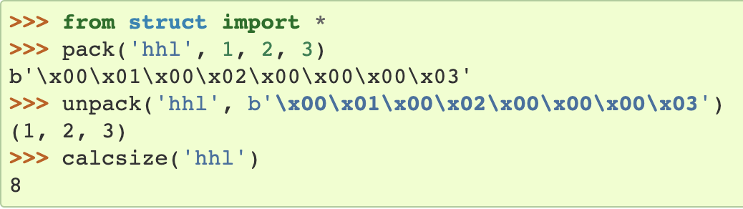
Python struct Module
Python Data Encoding / Decoding (Packing / Unpacking)
Python byte array encoding
‘12ABab’
‘\x30\x31\x41\x42\x61\x62’
Python struct module --- Interpret bytes as packed binary data
  Support conversion between Python values and C structs
  Need to care about Endianness (byte order), size, and alignment
l
h
h
https://docs.python.org/3/library/struct.html
Notes:
python3 is more explicit on differtiating string, unicode, byte array

Slide 11
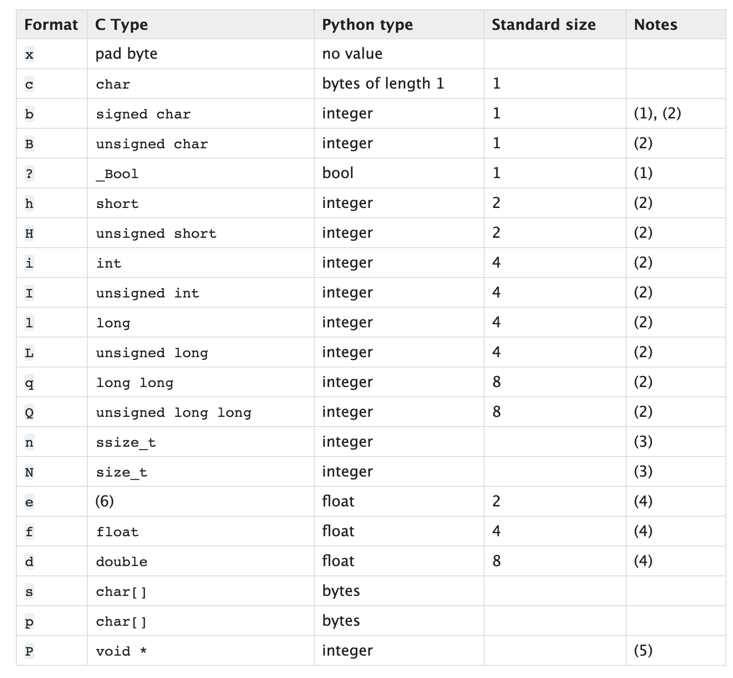
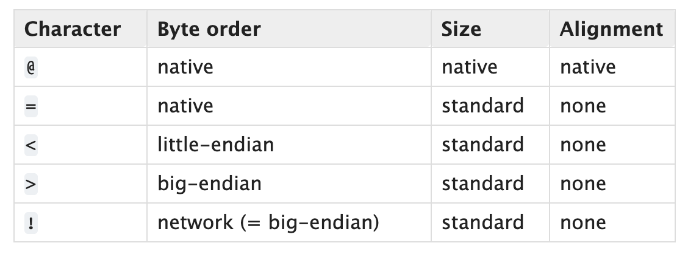
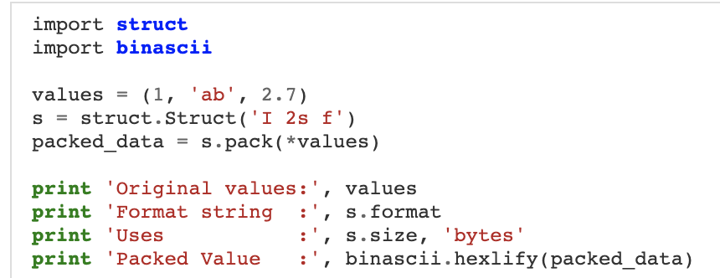
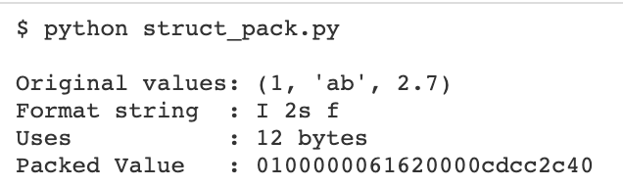
Python struct Module
Default
https://docs.python.org/3/library/struct.html
https://docs.python.org/3/library/struct.html
Notes:
https://pymotw.com/2/struct/
https://docs.python.org/3/library/struct.html
If the first character is not one of these, '@' is assumed.

Slide 12
pwntools: Resources
Official document
  https://github.com/Gallopsled/pwntools#readme
Tutorial
  https://github.com/Gallopsled/pwntools-tutorial/blob/master/utility.md
And many more …

