Slide 1
CS4459.001
Cyber Attacks & Defense Lab
Buffer Overflow #1
Jan 30, 2025

Slide 2
Unit1 Best Peers
@Ethan Maher (eam200004)
@Aman Verma (axv190078)

Slide 3
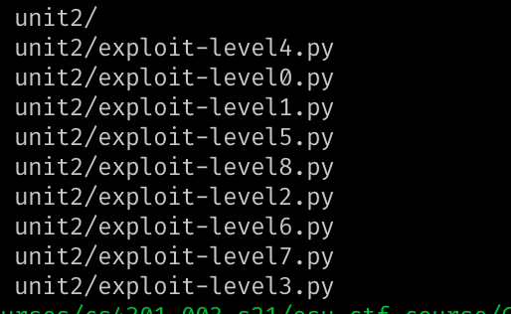
Unit 2 Out
Due: Feb 11, Midnight
  Write-up due on Feb 12
Write-ups
  As a python code to run the solution
  pwntools
Submission menu
  zip or tar.gz
#!/usr/bin/env python
from pwn import *
p = process("./bof-level1")
print(p.recv())
p.sendline("A" * 32)
p.interactive()

Slide 4
Unit2 Challenges
challenge | Desc
bof0 (32-bit, 10pt) | Overwrite locals
bof1 (64-bit, 10pt)
bof3 (32-bit, 10pt) | Overwrite locals & return
bof3 (64-bit, 10pt)
bof4 (32-bit, 15pt) | global variable
bof5 (32-bit, 15pt) | Frame pointer
bof6 (64-bit, 15pt)
bof7 (32-bit, 20pt) | More frame pointer
bof8 (64-bit, 20pt)
bof9 (32-bit, 30pt) | weird return
bof10 (64-bit, 15pt) | function pointer
And more to come …
Focus on function and stack operation
  Calling conventions
Intel architectures
  32-bit vs. 64-bit
  Differences?
Notes:
calling conventions differ for 32-bit vs. 64-bit

Slide 5
Unit 2: Objectives
Understand how stack works in Linux x86/AMD64 ABIs
  ABI (Application Binary Interface)
Understand why buffer/stack overflow
Identify a buffer overflow vulnerability in the program
Exploit a buffer overflow vulnerability to hijack the control of the program

Slide 6
Function Support and Calling Convention

Slide 7
Function Support
Function is the only language primitive with CPU-level support
  Turing machine does not require the function
Lambda calculus works on functions
  Church – Turing theorem
    ➔ Turing machine == Lambda calculus (equally capable)
    ➔ Java program == Scala program (equally capable)
  Function promoted to first-class citizen
Function helps programmers
  Modularize code and define logical building blocks
  Namespace
Notes:
This slide maybe a redundant, or distraction…

Slide 8
Function Support
Pointer registers
  %ebp (or %rbp): stack base pointer
  %esp (or %rsp): stack pointer
  %eip (or %rip): Instruction pointer (or program counter)
Instructions
  push, pop ← stack operation support
  call, ret ← function call support
  enter,leave ← stack frame management
Notes:
enter: prolog

Slide 9
Function Support
Pointer registers
  %ebp (or %rbp): stack base pointer
  %esp (or %rsp): stack pointer
Instructions
  push, pop ← stack operation support
  call, ret ← function call support
  enter,leave ← stack frame management
push %ebp
mov %esp, %ebp
mov %ebp, %esp
pop %ebp
Notes:
enter: prolog

Slide 10
Stack Instructions
4 bytes (32-bit)
%ebp : 0xdeadbeef
push %ebp
  Store the value of %ebp at the top of the stack (%esp gets -4)
  mov %ebp, (%esp)
  sub $4, %esp
pop %ebp
  Move the value at the stack top to %ebp (%esp gets +4)
  mov (%esp), %ebp
  add $4, %esp
%esp
Return EIP
Grows downward
Notes:
This is an important slide …
popa, pusha

Slide 11
Stack Instructions
%ebp : 0xdeadbeef
push %ebp
  Store the value of %ebp at the top of the stack (%esp gets -4)
  sub $4, %esp
  mov %ebp, (%esp)
pop %ebp
  Move the value at the stack top to %ebp (%esp gets +4)
  mov (%esp), %ebp
  add $4, %esp
Return EIP
Grows downward
%esp
0xdeadbeef
Notes:
This is an important slide …
popa, pusha

Slide 12
Stack Instructions
push %ebp
  Store the value of %ebp at the top of the stack (%esp gets -4)
  mov %ebp, (%esp)
  sub $4, %esp
pop %ebp
  Move the value at the stack top to %ebp
  then, %esp += 4
  mov (%esp), %ebp
  add $4, %esp
Return EIP
Grows downward
%esp
Saved EBP
Notes:
This is an important slide …
popa, pusha

Slide 13
Stack Instructions
%ebp
push %ebp
  Store the value of %ebp at the top of the stack (%esp gets -4)
  mov %ebp, (%esp)
  sub $4, %esp
pop %ebp
  Move the value at the stack top to %ebp
  then, %esp += 4
  mov (%esp), %ebp
  add $4, %esp
%esp
Return EIP
Grows downward
Notes:
This is an important slide …
popa, pusha

Slide 14
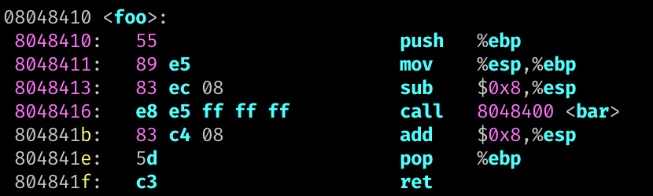
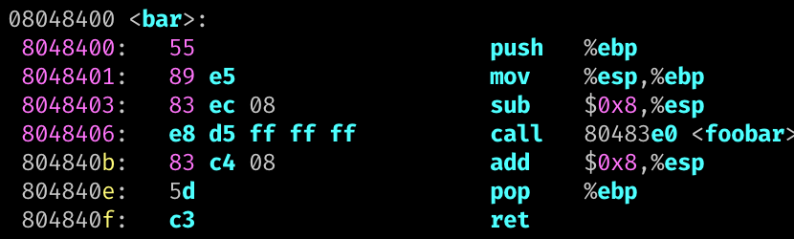
call and ret
call foo
  Pushes %eip to the stack and jump to foo
  push %eip # next instruction
  jmp foo
ret
  Pops to %eip from stack
  pop %eip*
Grows downward
0x804841b
*Unsupported operation.
Notes:
Only special instruction can update %eip

Slide 15
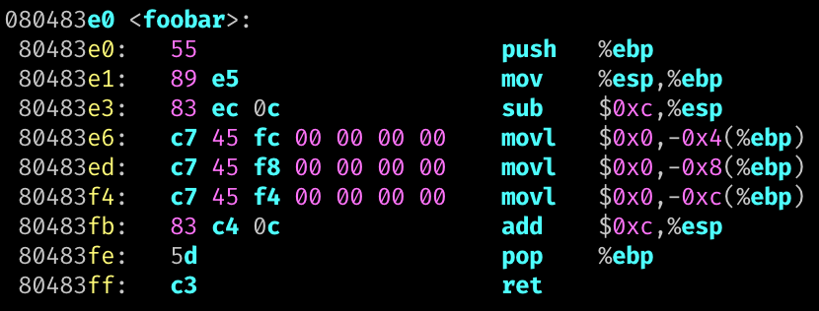
Multiple Function Calls
foo();
0x804841b
Saved EBP
bar();
0x804840b
%ebp
Saved EBP
Local A
foobar();
Local B
%esp
Local C
Notes:
Each stack frame conveys corresponding function call contexts

Slide 16
Calling Convention
Defines caller / callee responsibilities at machine language level
Different calling conventions exists
  cdecl for IA32
  x86-64 for AMD64
Who call printf()? and who has printf();
  Loader/linker will first find the address of printf()
  Q1: How can pass function arguments?
  Q2: How to order function argument?
  Q3: How to get the return value?
    A single value stored to $eax or $rax

Slide 17
IA32 Stack Operations
ARG2
%ebp+c
Grow
Callee
ARG1
%ebp+8
Return IP
Relative to
  Stack pointer: %esp (%rsp)
  Base (frame) pointer: %ebp (%ebp)
Local variables (negative indexing over %ebp)
  mov -0x8(%ebp), %eax -- value at ebp-0x8
  lea -0x24(%ebp), %eax -- address at ebp-0x24
Function arguments from caller (positive indexing over %ebp)
  mov 0x8(%ebp), %eax -- 1st arg
  mov 0xc(%ebp), %eax -- 2nd arg
Prepare function arguments to callee (positive indexing over the stack)
  mov %eax, (%esp) -- 1st arg
  mov $0x4, 0x4(%esp) -- 2nd arg
%ebp
Saved EBP
Local A
%ebp-4
Local B
%ebp-8
%esp
%ebp-c
Local C

Slide 18
IA32 Stack Operations
ARG2
%ebp+c
Grow
Callee
ARG1
%ebp+8
Return IP
Relative to
  Stack pointer: %esp (%rsp)
  Base (frame) pointer: %ebp (%ebp)
Local variables (negative indexing over %ebp)
  mov -0x8(%ebp), %eax -- value at ebp-0x8
  lea -0x24(%ebp), %eax -- address at ebp-0x24
Function arguments from caller (positive indexing over %ebp)
  mov 0x8(%ebp), %eax -- 1st arg
  mov 0xc(%ebp), %eax -- 2nd arg
Prepare function arguments to callee (positive indexing over the stack)
  mov %eax, (%esp) -- 1st arg
  mov $0x4, 0x4(%esp) -- 2nd arg
%ebp
Saved EBP
Local A
%ebp-4
Local B
%ebp-8
Local C
%ebp-c
….
Caller
ARG 2
%esp+4
%esp
ARG 1
%esp

Slide 19

IA32: Call, Ret, Function Prologue, Epilogue
Return IP
Saved EBP
call <target>
  push %EIP; JUMP <target>
ret
  jmp (%esp); sub 4 (%esp)
  pop %eip
Local A
Prologue
….
ARG 2
ARG 1
Return IP
Epilogue
%ebp
Saved EBP
mov %ebp, %esp
pop %ebp
Local A
Local B
Local B
%esp

Slide 20
Calling Convention: IA32 vs. AMD64
IA32 (32 bit) – pushes argument on the stack (for callee)
  0x4*n (%esp) : n-th argument
  (%esp) : 1st arg accessed by callee via 0x8(%ebp)
  0x4 (%esp) : 2nd arg accessed by callee via 0xc(%ebp)
  0x8 (%esp) : 3rd arg accessed by callee via 0x10(%ebp)
  Focus on +8 for the index for %ebp at the callee…
AMD64 (64 bit) – use registers to pass argument to callee
  Register order (1st, 2nd, 3rd, 4th, 5th, 6th, etc.)
    %rdi, %rsi, %rdx, %rcx, %r8, %r9, …
    (use stack for more arguments)
  Callee also uses these registers to get arguments

Slide 21
printf();
printf() in x86
  lea 0x8048727,%eax
  mov -0x8(%ebp),%ecx
  mov -0xc(%ebp),%edx
  mov %eax,(%esp)
  mov %ecx,0x4(%esp)
  mov %edx,0x8(%esp)
  call 0x8048370 <printf@plt>
printf() in amd64
  movabs $0x400905,%rdi
  mov -0x8(%rbp),%rsi
  mov -0x10(%rbp),%rdx
  callq 0x400500 <printf@plt>
1st
1st
2nd
2nd
3rd
3rd
1st
2nd
3rd
printf(0x8048727, ebp_8, ebp_c);
printf(0x400905, rbp_8, rbp_10);

Slide 22
IA32 Stack Operation
Stores local variables (negative access over %ebp)
  mov -0x4(%ebp), %eax
  lea -0x8(%ebp), %eax
Copying function arguments to registers (positive access over %ebp)
  movl 8(%ebp), %edx
  movl 0xc(%ebp), %eax
Setting function arguments for callee by caller
  pushl %eax
  pushl 0xc(%ebp)
  pushl 8(%ebp)

Slide 23
AMD64 Stack Operation
Reading local variables (negative access over %rbp)
  mov -0x8(%rbp), %rax
  lea -0x24(%rbp), %rax
Copying function arguments to registers
  mov %rdi, %rax
  mov %rsi, %rax
Setting function arguments for callee by caller
  mov %rax, %rdi
  mov $0x4, %rsi
  mov $0x40006, %rdx

Slide 24
bof-level0: Function call
%ebp
Points to somewhere up…
NO ARG…
%esp
In bof-level0, main() calls receive_input()
  call 0x8048570 <receive_input>
  0x0804866b <+11>: xor %eax,%eax
Head of receive_input
  0x08048570 <+0>: push %ebp
  0x08048571 <+1>: mov %esp,%ebp
  0x08048573 <+3>: push %esi
  0x08048574 <+4>: sub $0x54,%esp

Slide 25
bof-level0: Function call
%ebp
Points to somewhere up…
NO ARG…
%esp
In bof-level0, main() calls receive_input()
  call 0x8048570 <receive_input>
  0x0804866b <+11>: xor %eax,%eax
Head of receive_input
  0x08048570 <+0>: push %ebp
  0x08048571 <+1>: mov %esp,%ebp
  0x08048573 <+3>: push %esi
  0x08048574 <+4>: sub $0x54,%esp

Slide 26
bof-level0: Function call
%ebp
Points to somewhere up…
NO ARG…
Return Addr
0x804866b
%esp
In bof-level0, main() calls receive_input()
  call 0x8048570 <receive_input>
  0x0804866b <+11>: xor %eax,%eax
Head of receive_input
  0x08048570 <+0>: push %ebp
  0x08048571 <+1>: mov %esp,%ebp
  0x08048573 <+3>: push %esi
  0x08048574 <+4>: sub $0x54,%esp
Call: push the address to return to the stack, then jump!

Slide 27
bof-level0: Function call
%ebp
Points to somewhere up…
NO ARG…
Return Addr
0x804866b
%esp
In bof-level0, main() calls receive_input()
  call 0x8048570 <receive_input>
  0x0804866b <+11>: xor %eax,%eax
Head of receive_input
  0x08048570 <+0>: push %ebp
  0x08048571 <+1>: mov %esp,%ebp
  0x08048573 <+3>: push %esi
  0x08048574 <+4>: sub $0x54,%esp

Slide 28
bof-level0: Function call
%ebp
Points to somewhere up…
NO ARG…
Return Addr
0x804866b
Saved EBP
%esp
In bof-level0, main() calls receive_input()
  call 0x8048570 <receive_input>
  0x0804866b <+11>: xor %eax,%eax
Head of receive_input
  0x08048570 <+0>: push %ebp
  0x08048571 <+1>: mov %esp,%ebp
  0x08048573 <+3>: push %esi
  0x08048574 <+4>: sub $0x54,%esp

Slide 29
bof-level0: Function call
%ebp
Points to somewhere up…
NO ARG…
Return Addr
0x804866b
Saved EBP
%esp
In bof-level0, main() calls receive_input()
  call 0x8048570 <receive_input>
  0x0804866b <+11>: xor %eax,%eax
Head of receive_input
  0x08048570 <+0>: push %ebp
  0x08048571 <+1>: mov %esp,%ebp
  0x08048573 <+3>: push %esi
  0x08048574 <+4>: sub $0x54,%esp

Slide 30
bof-level0: Function call
Points to somewhere up…
NO ARG…
Return Addr
0x804866b
%ebp
Saved EBP
%esp
In bof-level0, main() calls receive_input()
  call 0x8048570 <receive_input>
  0x0804866b <+11>: xor %eax,%eax
Head of receive_input
  0x08048570 <+0>: push %ebp
  0x08048571 <+1>: mov %esp,%ebp
  0x08048573 <+3>: push %esi
  0x08048574 <+4>: sub $0x54,%esp

Slide 31
bof-level0: Function call
Previous Base Pointer…
NO ARG…
Return Addr
0x804866b
%ebp
Saved EBP
%esp
In bof-level0, main() calls receive_input()
  call 0x8048570 <receive_input>
  0x0804866b <+11>: xor %eax,%eax
Head of receive_input
  0x08048570 <+0>: push %ebp
  0x08048571 <+1>: mov %esp,%ebp
  0x08048573 <+3>: push %esi
  0x08048574 <+4>: sub $0x54,%esp

Slide 32
bof-level0: Function call
Points to somewhere up…
NO ARG…
Return Addr
0x804866b
Saved EBP
%ebp
In bof-level0, main() calls receive_input()
  call 0x8048570 <receive_input>
  0x0804866b <+11>: xor %eax,%eax
Head of receive_input
  0x08048570 <+0>: push %ebp
  0x08048571 <+1>: mov %esp,%ebp
  0x08048573 <+3>: push %esi
  0x08048574 <+4>: sub $0x54,%esp
Saved ESI
%esp

Slide 33
bof-level0: Function call
Points to somewhere up…
NO ARG…
Return Addr
0x804866b
Saved EBP
%ebp
In bof-level0, main() calls receive_input()
  call 0x8048570 <receive_input>
  0x0804866b <+11>: xor %eax,%eax
Head of receive_input
  0x08048570 <+0>: push %ebp
  0x08048571 <+1>: mov %esp,%ebp
  0x08048573 <+3>: push %esi
  0x08048574 <+4>: sub $0x54,%esp
Saved ESI
%esp

Slide 34
bof-level0: Function call
Points to somewhere up…
NO ARG…
Return Addr
0x804866b
Saved EBP
%ebp
In bof-level0, main() calls receive_input()
  call 0x8048570 <receive_input>
  0x0804866b <+11>: xor %eax,%eax
Head of receive_input
  0x08048570 <+0>: push %ebp
  0x08048571 <+1>: mov %esp,%ebp
  0x08048573 <+3>: push %esi
  0x08048574 <+4>: sub $0x54,%esp
Saved ESI
%esp

Slide 35
bof-level0: Function call
Points to somewhere up…
NO ARG…
Return Addr
0x804866b
Saved EBP
%ebp
Call printf?
movl $0x41414141,-0x8(%ebp)
movl $0x42424242,-0xc(%ebp)
mov -0x8(%ebp),%ecx
mov -0xc(%ebp),%edx
mov %eax,(%esp)
mov %ecx,0x4(%esp)
mov %edx,0x8(%esp)
call 0x8048370 <printf@plt>
Saved ESI
%esp

Slide 36
bof-level0: Function call
Points to somewhere up…
NO ARG…
Return Addr
0x804866b
Saved EBP
%ebp
Call printf?
movl $0x41414141,-0x8(%ebp)
movl $0x42424242,-0xc(%ebp)
mov -0x8(%ebp),%ecx
mov -0xc(%ebp),%edx
mov %eax,(%esp)
mov %ecx,0x4(%esp)
mov %edx,0x8(%esp)
call 0x8048370 <printf@plt>
Saved ESI
0x41414141
%esp

Slide 37
bof-level0: Function call
Points to somewhere up…
NO ARG…
Return Addr
0x804866b
Saved EBP
%ebp
Call printf?
movl $0x41414141,-0x8(%ebp)
movl $0x42424242,-0xc(%ebp)
mov -0x8(%ebp),%ecx
mov -0xc(%ebp),%edx
mov %eax,(%esp)
mov %ecx,0x4(%esp)
mov %edx,0x8(%esp)
call 0x8048370 <printf@plt>
Saved ESI
0x41414141
0x42424242
%esp

Slide 38
bof-level0: Function call
Points to somewhere up…
NO ARG…
Return Addr
0x804866b
Saved EBP
%ebp
Call printf?
movl $0x41414141,-0x8(%ebp)
movl $0x42424242,-0xc(%ebp)
mov -0x8(%ebp),%ecx
mov -0xc(%ebp),%edx
mov %eax,(%esp)
mov %ecx,0x4(%esp)
mov %edx,0x8(%esp)
call 0x8048370 <printf@plt>
Saved ESI
0x41414141
0x42424242
ARG1: 41414141
%esp

Slide 39
bof-level0: Function call
Points to somewhere up…
NO ARG…
Return Addr
0x804866b
Saved EBP
%ebp
Call printf?
movl $0x41414141,-0x8(%ebp)
movl $0x42424242,-0xc(%ebp)
mov -0x8(%ebp),%ecx
mov -0xc(%ebp),%edx
mov %eax,(%esp)
mov %ecx,0x4(%esp)
mov %edx,0x8(%esp)
call 0x8048370 <printf@plt>
Saved ESI
0x41414141
0x42424242
ARG2: 42424242
ARG1: 41414141
%esp

Slide 40
bof-level0: Function call
Points to somewhere up…
NO ARG…
Return Addr
0x804866b
Saved EBP
%ebp
Call printf?
movl $0x41414141,-0x8(%ebp)
movl $0x42424242,-0xc(%ebp)
mov -0x8(%ebp),%ecx
mov -0xc(%ebp),%edx
mov %eax,(%esp)
mov %ecx,0x4(%esp)
mov %edx,0x8(%esp)
call 0x8048370 <printf@plt>
Saved ESI
0x41414141
0x42424242
ARG3: string..
ARG2: 42424242
ARG1: 41414141
%esp

Slide 41
bof-level0: Function Return
Points to somewhere up…
NO ARG…
Return Addr
0x804866b
Saved EBP
%ebp
Function return of receive_input()
add $0x54,%esp
pop %esi
pop %ebp
ret
Saved ESI
0x41414141
0x42424242
ARG3: string..
ARG2: 42424242
ARG1: 41414141
%esp

Slide 42
bof-level0: Function Return
Points to somewhere up…
NO ARG…
Return Addr
0x804866b
Saved EBP
%ebp
Function return of receive_input()
add $0x54,%esp
pop %esi
pop %ebp
ret
Saved ESI
0x41414141
0x42424242
ARG3: string..
ARG2: 42424242
ARG1: 41414141
%esp

Slide 43
bof-level0: Function Return
Points to somewhere up…
NO ARG…
Return Addr
0x804866b
Saved EBP
%ebp
Function return of receive_input()
add $0x54,%esp
pop %esi
pop %ebp
ret
Saved ESI
%esp
0x41414141
0x42424242
ARG3: string..
ARG2: 42424242
ARG1: 41414141

Slide 44
bof-level0: Function Return
Points to somewhere up…
NO ARG…
Return Addr
0x804866b
Saved EBP
%ebp
Function return of receive_input
add $0x54,%esp
pop %esi
pop %ebp
ret
Saved ESI
%esp
0x41414141
0x42424242
ARG3: string..
ARG2: 42424242
ARG1: 41414141

Slide 45
bof-level0: Function Return
Points to somewhere up…
NO ARG…
Return Addr
0x804866b
Saved EBP
%ebp
Function return of receive_input
add $0x54,%esp
pop %esi
pop %ebp
ret
%esp
Saved ESI
0x41414141
0x42424242
ARG3: string..
ARG2: 42424242
ARG1: 41414141

Slide 46
bof-level0: Function Return
Points to somewhere up…
NO ARG…
Return Addr
0x804866b
Saved EBP
%ebp
Function return of receive_input
add $0x54,%esp
pop %esi
pop %ebp
ret
%esp
Saved ESI
0x41414141
0x42424242
ARG3: string..
ARG2: 42424242
ARG1: 41414141

Slide 47
bof-level0: Function Return
%ebp
Points to somewhere up…
NO ARG…
Return Addr
0x804866b
%esp
Saved EBP
Function return of receive_input()
add $0x54,%esp
pop %esi
pop %ebp
ret
Saved ESI
0x41414141
0x42424242
ARG3: string..
ARG2: 42424242
ARG1: 41414141

Slide 48
bof-level0: Function Return
%ebp
Points to somewhere up…
NO ARG…
Return Addr
0x804866b
%esp
Saved EBP
Function return of receive_input()
add $0x54,%esp
pop %esi
pop %ebp
ret
ret: pop %eip, change instruction ptr..
Saved ESI
0x41414141
0x42424242
ARG3: string..
ARG2: 42424242
ARG1: 41414141

Slide 49
bof-level0: Function Return
%ebp
Points to somewhere up…
NO ARG…
%esp
Return Addr
0x804866b
Saved EBP
Function return of receive_input()
add $0x54,%esp
pop %esi
pop %ebp
ret
Saved ESI
0x41414141
0x42424242
ARG3: string..
ARG2: 42424242
ARG1: 41414141

Slide 50
bof-level0: Function Return
%ebp
Points to somewhere up…
%ebp
Points to somewhere up…
NO ARG…
NO ARG…
%esp
%esp
Return Addr
0x804866b
Saved EBP
Saved ESI
0x41414141
0x42424242
ARG3: string..
ARG2: 42424242
ARG1: 41414141

Slide 51
Buffer Overflow
Points to somewhere up…
NO ARG…
Return Addr
0x804866b
Saved EBP
%ebp
Writing values over the variables
In the figure right,
  -0x8(%ebp) stores 0x41414141
  -0xc(%ebp) stroes 0x42424242
  -0x10(%ebp) is a buffer, size 4 byte.
Program gets input from you via
  fgets(buffer, 128, stdin);
  Read 128 bytes..
What if you type in “1111aaaabbbb”?
Saved ESI
0x41414141
0x42424242
Buffer..
Buffer at ebp-0x10
ARG1: 41414141
%esp

Slide 52
Buffer Overflow
Points to somewhere up…
NO ARG…
Return Addr
0x804866b
Saved EBP
%ebp
4-byte buffer…
What if you type “1111aaaabbbb”?
Saved ESI
0x41414141
0x42424242
Buffer..
Buffer at ebp-0x10
ARG1: 0x41414141
%esp

Slide 53
Buffer Overflow
Points to somewhere up…
NO ARG…
Return Addr
0x804866b
Saved EBP
%ebp
4 byte buffer…
What if you type “1111aaaabbbb”?
Saved ESI
0x41414141
0x42424242
0x31313131
Buffer at ebp-0x10
ARG1: 41414141
%esp

Slide 54
Buffer Overflow
Points to somewhere up…
NO ARG…
Return Addr
0x804866b
Saved EBP
%ebp
4 byte buffer…
What if you type “1111aaaabbbb”?
Saved ESI
0x41414141
0x61616161
0x31313131
Buffer at ebp-0x10
ARG1: 41414141
%esp

Slide 55
Buffer Overflow
Points to somewhere up…
NO ARG…
Return Addr
0x804866b
Saved EBP
%ebp
4 byte buffer…
What if you type “1111aaaabbbb”?
Saved ESI
0x62626262
0x61616161
0x31313131
Buffer at ebp-0x10
ARG1: 41414141
%esp

Slide 56
Buffer Overflow
Points to somewhere up…
NO ARG…
Return Addr
0x804866b
Saved EBP
%ebp
4 byte buffer…
What if you type “1111aaaabbbb”?
You can change variables!
Saved ESI
0x62626262
0x61616161
0x31313131
Buffer at ebp-0x10
ARG1: 41414141
%esp

Slide 57
Return Address
Points to somewhere up…
NO ARG…
Return Addr
0x804866b
Saved EBP
%ebp
Store the execution points after the call
  0x08048666 <+6>: call 0x8048570 <receive_input>
  0x0804866b <+11>: xor %eax,%eax
Should store 0x804866b on calling receive_input…
Saved ESI
0x62626262
0x61616161
0x31313131
Buffer at ebp-0x10
ARG1: 41414141
%esp

Slide 58
Buffer Overflow
Points to somewhere up…
NO ARG…
Return Addr
0x804866b
Saved EBP
%ebp
4 byte buffer…
What if you type “1111aaaabbbbccccddddeeee”?
Saved ESI
0x62626262
0x61616161
0x31313131
Buffer at ebp-0x10
ARG1: 41414141
%esp

Slide 59
Buffer Overflow
Points to somewhere up…
NO ARG…
Return Addr
0x804866b
Saved EBP
%ebp
4 byte buffer…
What if you type “1111aaaabbbbccccddddeeee”?
0x63636363
0x62626262
0x61616161
0x31313131
Buffer at ebp-0x10
ARG1: 41414141
%esp

Slide 60
Buffer Overflow
Points to somewhere up…
NO ARG…
Return Addr
0x804866b
0x64646464
%ebp
4 byte buffer…
What if you type “1111aaaabbbbccccddddeeee”?
0x63636363
0x62626262
0x61616161
0x31313131
Buffer at ebp-0x10
ARG1: 41414141
%esp

Slide 61
Buffer Overflow
Points to somewhere up…
NO ARG…
0x65656565
0x64646464
%ebp
4 byte buffer…
What if you type “1111aaaabbbbccccddddeeee”?
0x63636363
0x62626262
0x61616161
0x31313131
Buffer at ebp-0x10
ARG1: 41414141
%esp

Slide 62
Buffer Overflow
Points to somewhere up…
NO ARG…
0x65656565
0x64646464
%ebp
4 byte buffer…
What if you type “1111aaaabbbbccccddddeeee”?
Overwrites the return address!
0x63636363
0x62626262
0x61616161
0x31313131
Buffer at ebp-0x10
ARG1: 41414141
%esp

Slide 63
Buffer Overflow
Points to somewhere up…
NO ARG…
0x65656565
0x64646464
%ebp
4 byte buffer…
What if you type “1111aaaabbbbccccddddeeee”?
Overwrites the return address!
Can you set that as the address of
  get_a_shell()?
0x63636363
0x62626262
0x61616161
0x31313131
Buffer at ebp-0x10
ARG1: 41414141
%esp

Slide 64
Buffer Overflow
Points to somewhere up…
NO ARG…
get_a_shell()
0x64646464
%ebp
4 byte buffer…
What if you type “1111aaaabbbbccccddddeeee”?
Overwrites the return address!
Can you set that as the address of
  get_a_shell()?
0x63636363
0x62626262
0x61616161
0x31313131
Buffer at ebp-0x10
ARG1: 41414141
%esp

Slide 65
Buffer Overflow
Points to somewhere up…
NO ARG…
get_a_shell()
0x64646464
%ebp
Function return of receive_input
add $0x54,%esp
pop %esi
pop %ebp
ret
0x63636363
0x62626262
0x61616161
0x31313131
Buffer at ebp-0x10
ARG1: 41414141
%esp

Slide 66
Buffer Overflow
Points to somewhere up…
NO ARG…
get_a_shell()
0x64646464
%ebp
Function return of receive_input
add $0x54,%esp
pop %esi
pop %ebp
ret
0x63636363
%esp
0x62626262
0x61616161
0x31313131
Buffer at ebp-0x10
ARG1: 41414141

Slide 67
Buffer Overflow
Points to somewhere up…
NO ARG…
get_a_shell()
0x64646464
%esp
%ebp
Function return of receive_input
add $0x54,%esp
pop %esi
pop %ebp
ret
0x63636363
0x62626262
0x61616161
0x31313131
Buffer at ebp-0x10
ARG1: 41414141

Slide 68
Buffer Overflow
Points to somewhere up…
%ebp: 0x64646464, INVALID
NO ARG…
%esp
get_a_shell()
0x64646464
Function return of receive_input
add $0x54,%esp
pop %esi
pop %ebp
ret
0x63636363
0x62626262
0x61616161
0x31313131
Buffer at ebp-0x10
Run get_a_shell()!
ARG1: 41414141

Slide 69
Buffer Overflow
Points to somewhere up…
%ebp: 0x64646464, INVALID
NO ARG…
get_a_shell()
%esp
0x64646464
Function return of receive_input
add $0x54,%esp
pop %esi
pop %ebp
ret
0x63636363
0x62626262
0x61616161
0x31313131
Buffer at ebp-0x10
ARG1: 41414141

Slide 70
Frame Pointer Attack

Slide 71
Frame Pointer Attack
NO ARG…
get_a_shell()
RET_ADDR
0x64646464
Saved %ebp
%ebp
The %ebp register
  %esp points to one end of a function’s stack
  %ebp points to the other end of a function’s stack
A function’s Stack Frame
  Starts with %ebp
  Ends with %esp
0x63636363
0x62626262
0x61616161
0x31313131
Buffer at %ebp-0x10
ARG1: 41414141
%esp

Slide 72
Frame Pointer Attack
NO ARG…
get_a_shell()
RET_ADDR
0x64646464
Saved %ebp
%ebp
What if an attacker …
  Can overwrite saved %ebp
  But cannot overwrite return address?
    say 4(%ebp)
0x63636363
0x62626262
0x61616161
0x31313131
Buffer at ebp-0x10
ARG1: 41414141
%esp

Slide 73
Frame Pointer Attack
NO ARG…
get_a_shell()
RET_ADDR
0x64646464
%ebp
What if an attacker …
  Can overwrite saved %ebp
  But cannot overwrite return address?
0x63636363
0x62626262
0x61616161
0x31313131
Buffer at ebp-0x10
ARG1: 41414141
%esp

Slide 74
Frame Pointer Attack
NO ARG…
get_a_shell()
RET_ADDR
0x64646464
%ebp
What if an attacker …
  Can overwrite saved %ebp
  But cannot overwrite return address?
Function epilogue
  leave
    mov %ebp, %esp
    pop %ebp
  ret
0x63636363
0x62626262
0x61616161
0x31313131
Buffer at ebp-0x10
ARG1: 41414141
%esp

Slide 75
Frame Pointer Attack
NO ARG…
get_a_shell()
RET_ADDR
0x64646464
%ebp
What if an attacker …
  Can overwrite saved %ebp
  But cannot overwrite return address?
Function epilogue
  leave
    mov %ebp, %esp
    pop %ebp
  ret
0x63636363
0x62626262
0x61616161
0x31313131
Buffer at ebp-0x10
ARG1: 41414141
%esp

Slide 76
Frame Pointer Attack
NO ARG…
get_a_shell()
RET_ADDR
0x64646464
%esp
%ebp
What if an attacker …
  Can overwrite saved %ebp
  But cannot overwrite return address?
Function epilogue
  leave
    mov %ebp, %esp
    pop %ebp
  ret
0x63636363
0x62626262
0x61616161
0x31313131
Buffer at ebp-0x10
ARG1: 41414141

Slide 77
Frame Pointer Attack
NO ARG…
get_a_shell()
RET_ADDR
0x64646464
%esp
%ebp
What if an attacker …
  Can overwrite saved %ebp
  But cannot overwrite return address?
Function epilogue
  leave
    mov %ebp, %esp
    pop %ebp
  ret
0x63636363
0x62626262
0x61616161
0x31313131
Buffer at ebp-0x10
ARG1: 41414141

Slide 78
Frame Pointer Attack
%ebp
0x64646464
NO ARG…
get_a_shell()
RET_ADDR
%esp
0x64646464
What if an attacker can…
  Overwrite saved %ebp
  But cannot overwrite return address?
Function epilogue
  leave
    mov %ebp, %esp
    pop %ebp
  ret
0x63636363
0x62626262
0x61616161
0x31313131
Buffer at ebp-0x10
ARG1: 41414141

Slide 79
Frame Pointer Attack
%ebp
0x64646464
NO ARG…
get_a_shell()
RET_ADDR
%esp
0x64646464
What if an attacker can…
  Overwrite saved %ebp
  But cannot overwrite return address?
Function epilogue
  leave
    mov %ebp, %esp
    pop %ebp
  ret
0x63636363
0x62626262
0x61616161
0x31313131
Buffer at ebp-0x10
ARG1: 41414141

Slide 80
Frame Pointer Attack
%ebp
0x64646464
NO ARG…
%esp
get_a_shell()
RET_ADDR
0x64646464
What if an attacker can…
  Overwrite saved %ebp
  But cannot overwrite return address?
Function epilogue
  leave
    mov %ebp, %esp
    pop %ebp
  ret
  Return to the correct RET_ADDR
  Is it problematic????
0x63636363
0x62626262
0x61616161
0x31313131
Buffer at ebp-0x10
ARG1: 41414141

Slide 81
Frame Pointer Attack
%ebp
0x64646464
NO ARG…
%esp
get_a_shell()
RET_ADDR
0x64646464
Call chain (in bof-level5)
  main() -> run() -> receive_input()
We just ran leave-ret in receive_input()
There will be another leave-ret in run()
What will happen if that runs???
0x63636363
0x62626262
0x61616161
0x31313131
Buffer at ebp-0x10
ARG1: 41414141

Slide 82
Frame Pointer Attack
%ebp
0x64646464
NO ARG…
%esp
get_a_shell()
RET_ADDR
0x64646464
Call chain (in bof-level5)
  main() -> run() -> receive_input()
leave-ret in run()
  leave
    mov %ebp, %esp
    pop %ebp
  ret
0x63636363
0x62626262
0x61616161
0x31313131
Buffer at ebp-0x10
ARG1: 41414141

Slide 83
Frame Pointer Attack
%ebp
0x64646464
NO ARG…
%esp
get_a_shell()
RET_ADDR
0x64646464
Call chain (in bof-level5)
  main() -> run() -> receive_input()
leave-ret in run()
  leave
    mov %ebp, %esp
    pop %ebp
  ret
0x63636363
0x62626262
0x61616161
0x31313131
Buffer at ebp-0x10
ARG1: 41414141

Slide 84
Frame Pointer Attack
%esp
%ebp
0x64646464
NO ARG…
get_a_shell()
RET_ADDR
0x64646464
Call chain (in bof-level5)
  main() -> run() -> receive_input()
leave-ret in run()
  leave
    mov %ebp, %esp
    pop %ebp
  ret
0x63636363
0x62626262
0x61616161
0x31313131
Buffer at ebp-0x10
ARG1: 41414141

Slide 85
Frame Pointer Attack
%esp
%ebp
0x64646464
NO ARG…
get_a_shell()
RET_ADDR
0x64646464
Call chain (in bof-level5)
  main() -> run() -> receive_input()
leave-ret in run()
  leave
    mov %ebp, %esp
    pop %ebp
  ret
0x63636363
0x62626262
0x61616161
0x31313131
Buffer at ebp-0x10
Invalid Address 0x64646464!!
ARG1: 41414141
%esp = 0x64646464
pop %ebp ->
mov (%esp), %ebp
add $4, %esp

Slide 86
Coredump
How to write reproducible exploit?

Slide 87
Core Dump
Dump file containing a process's address space (memory)
  For the process terminates unexpectedly
  use gdb (again) to open and explorer
Generating core
  Check ulimit
  Set core pattern˜
$ ulimit -a
$ ulimit -S -c unlimited
$ sudo sysctl -w kernel.core_pattern=core.%u.%p.%t

Slide 88
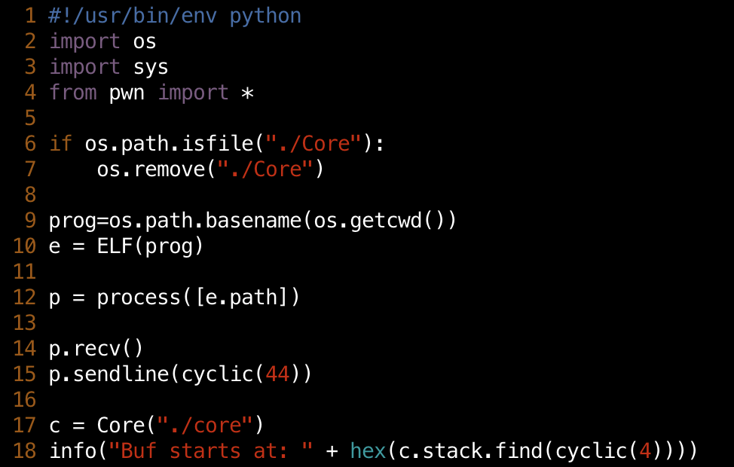
Writing a Robust Exploit
We need A fixed address
  E.g., program buffer address, $EBP/$RBP locations
How?
  The stack starts on the same address ALWAYS
  Unless you change the configuration
  (argv, env, auxv, kernel …)

Slide 89
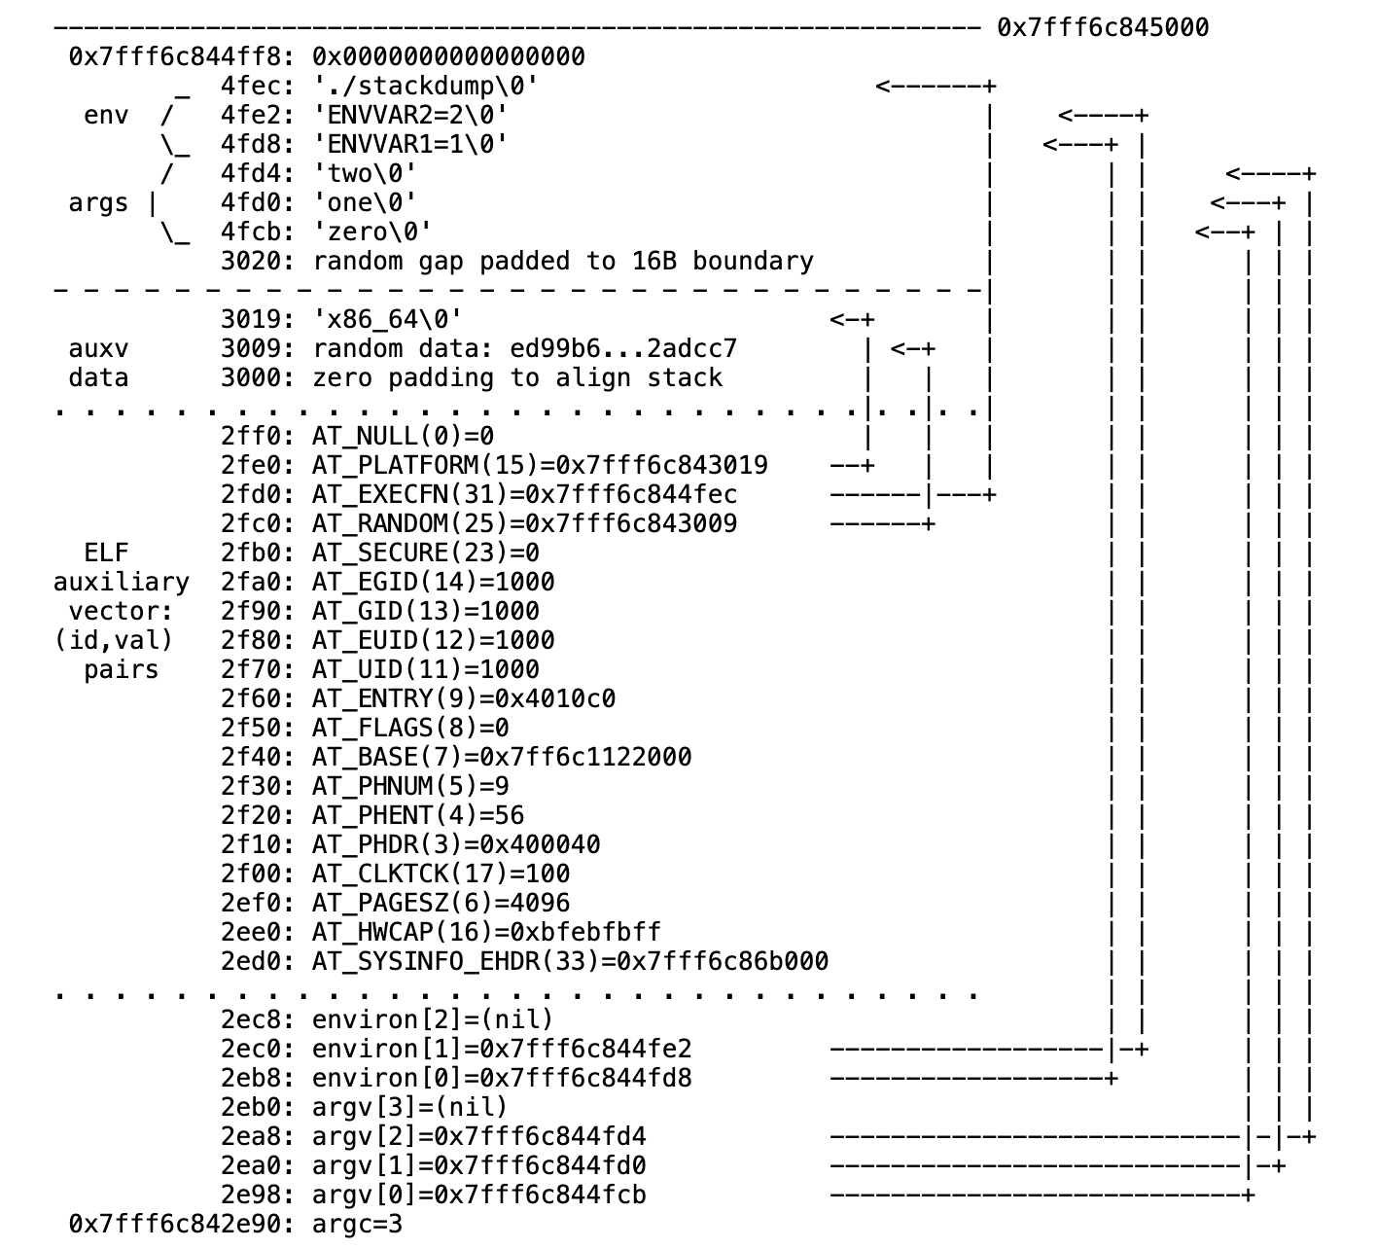
Why Stack Address Vary?
For Unit2 challenges, you find your code and stack at the same address across different executions
  Subsequently, the content of base pointer ($ebp or $rbp)
Stack location can vary depending on many different reasons
  Running from GDB or /bin/bash
  Running from /usr/bin/zsh or /bin/bash
  Remote connection from Windows or Linux
Different configuration may introduce different set of environment variable
Notes:
Unit2 write up

Slide 90
Loading Executable Object Files into Virtual Address
Executable Object File
Kernel virtual memory
Memory
invisible to user code
0
ELF header
User stack
(created at runtime)
Program header table
(required for executables)
%esp
(stack
pointer)
.init section
.text section
Memory-mapped region for
shared libraries
Watch Out!
Direction Reversed!
.rodata section
.data section
.bss section
brk
.symtab
Run-time heap
(created by malloc)
.debug
Read/write data segment
(.data, .bss)
Loaded
from
the
executable
file
.line
.strtab
Read-only code segment
(.init, .text, .rodata)
Section header table
(required for relocatables)
0x400000
Unused
0
Notes:
…
Large heap in the high addresses (mmap)

Slide 91
Program Memory Layout (IA32)
/proc/<pid>/maps
Before Kernel pass control to user space (i.e., loader)
3 factors affect stack address
  Command line arguments
  Environment variable
  Kernel version (auxv)
0xc00000000
Top of stack
argv, environ, auxv
Stack
shared memory, memory mappings, and shared libraries
Increasing virtual address
Heap
Program break
Uninitialized data (bss)
Initialized data
Text (program code)
0x0804800

Slide 92
Backup

Slide 93
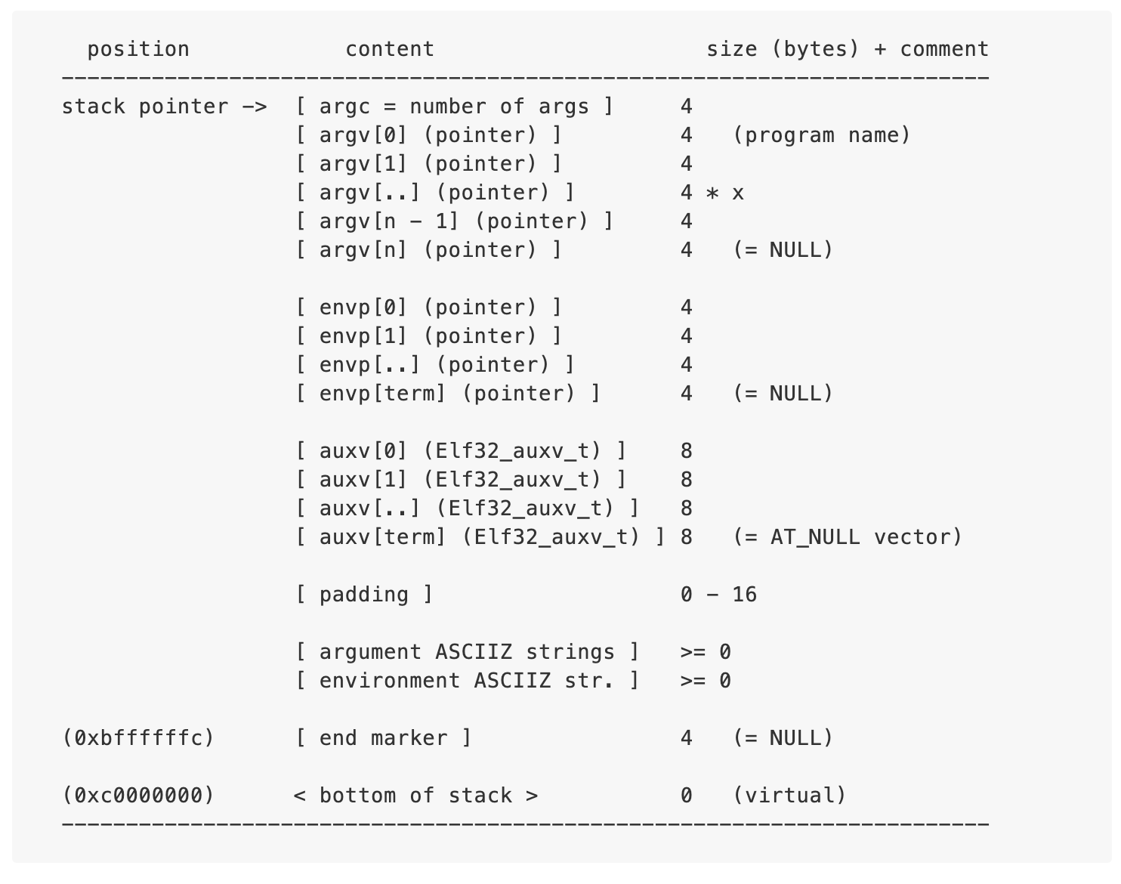
Program Memory Layout (IA32)
/proc/<pid>/maps
3 factors affect stack address
  Command line arguments
  Environment variable
  Kernel version (auxv)
0xc0000000
0x0804800
Text (program code)
Initialized data
Uninitialized data (bss)
Program break
Heap
Increasing virtual address
shared memory, memory mappings, and shared libraries
Top of stack
Stack
argv, environ, auxv
0xc00000000

Slide 94
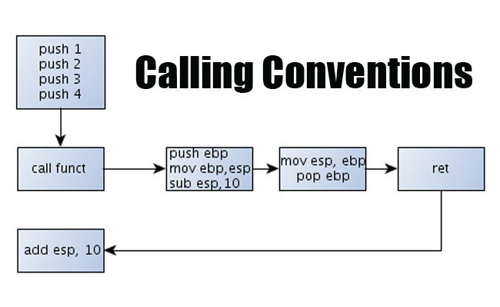
ARGS
RIP
%ebp
EBP
local var0
local var1
buf
Relative to %ebp
  -1234 (%ebp): local var
  1234 (%ebp): function args
Relative to %esp
  parameters to be passed to callee
frame
%esp
ARG1

Slide 95
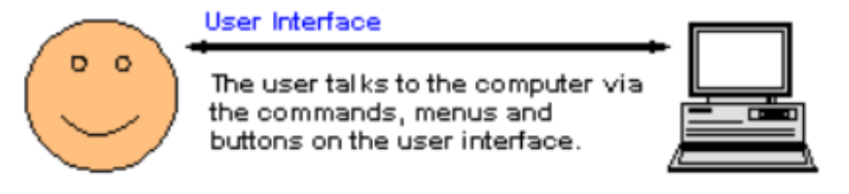
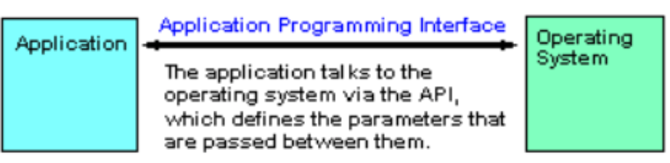
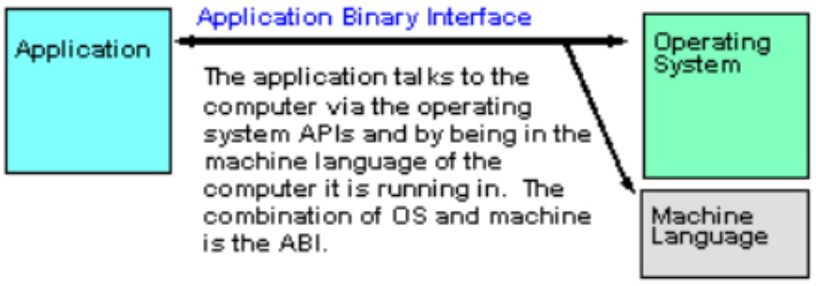
Application Binary Interface (ABI): How a Binary Runs on Computers
A specification defining requirements for portability at binary level (i.e., executables)
  No recompilation or re-linking
  E.g., Copy your binary and run!
  An executable will not run under a different OS on the same machine
Interoperability
C Function
Call
Assembly
Routine
Call

Slide 96
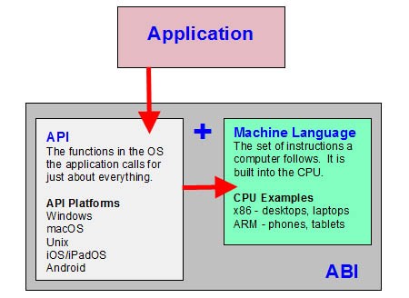
Application Binary Interface (ABI)
ABI is a specification for
  A hardware platform + OS
ABI defines the machine format
ABI is a step beyond API
  Glibc API defines interface for the application interact with the OS
    API compatibility does not ensure runtime compatibility
  E.g., Linux binaries for ARM and x86

Slide 97
Application Binary Interface (ABI)
specifications in ABI include:
  specific processor or processor family
    ARM vs. x86, 32-bit vs. 64-bit
  Any required processor features (e.g., SIMD instructions)
  Data formats
    E.g., Endian needs
  Specific OS or OS family
  Object and executable file formats
  Register usage conventions
    Special purpose registers
  stack frame format
  parameter passing, including function ptr / structure/union parameters
  return value passing, including fp/structure/union return values
Calling Convention

Slide 98
De Brujin Sequence

