Slide 1
CS4459.001
Cyber Attacks & Defense Lab
Shellcoding Part 1
Feb 11, 2025

Slide 2
Unit02 Bonus Points
Best questions
  @Brayan Muniz (bem180000) with "How to avoid hardcoding addresses?"
  @Tommy Nguyen (tpn170000) with "When to core dump?”
Best write-up
  @Ashley Nguyen (atn210009)
OpenCTF participation
  @Kyle Keeton (khk210001)
  @Joseph Bolduc (jjb210006)

Slide 3
From Last Unit
Function call operations
  call,ret, function prologue, epilogue
  calling convention (IA32 vs. AMD64)
Buffer overflow attacks
Frame pointer attacks
Takeaways
  function stack mingles control and data frames
  No mechanisms to safeguard the boundaries

Slide 4
Unit3 Learning Objectives
Writing programs in assembly (GAS/gas)
Shellcode/Shellcoding: Load your own payload
  Your payload ‘get_a_shell()’
  Linux access control
System call
  Vs. library call (glibc)
  32-bit vs. 64-bit

Slide 5
Unit3: Challenges
  Fetch new assignments, write and run your shellcode
    $ fetch unit3-1
  shellcode: a normal shellcode
    32-bit / 64-bit
  nonzero-shellcode: shellcode without using zero

Slide 6
Buffer Overflow
64-bit Stack
argv, environ, auxv
Overflow buffer and overwrite
  local variables
  Previous %ebp (%rbp)
  Function’s return address
main () → run() → recv_input();
Jump to where you wish to run
Saved %rip
%rbp
Saved %rbp
buffer
Stack
buffer
get_a_shell();
%rsp
8 bytes

Slide 7
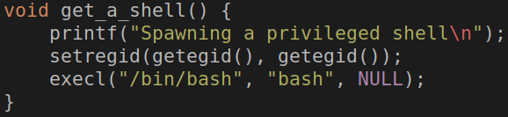
get_a_shell()
Inherit current privilege and then execute a shell
You can read the flag!
setregid(getegid(), getegid())
execl(“/bin/bash”, “bash”, 0);
Notes:
can we better format this?

Slide 8
get_a_shell(): setregid()
getegid();
  Get effective GID
setregid(gid_t rgid, gid_t egid);
  Set real and effective gid
setregid(getegid(), getegid());
  Set real and effective gid as current effective gid
  Privilege escalation!
  Set your gid to unit3-level0-…

Slide 9
Linux Access Control: Resource Ownership
Ownership for user and group
  Who (or which group) owns the file?
Permissions for User, Group, Other
  Write, Read, eXecution
Program with setuid, setguid bits
  Atop the privileges of the user, run with the privileges of the file owner instead

Slide 10
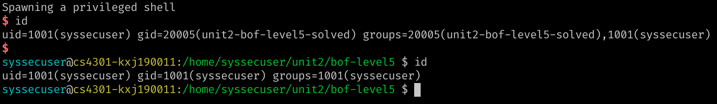
Linux Access Control: Process Identity
UserID (UID) and GroupID (GID)
  Defined from /etc/passwd and /etc/group
Real ID, Effective ID, (Saved ID)
  Real ID: ID of the user that has started the process
  Effective ID: ID the process is running with
Notes:
id –r id –u?

Slide 11

get_a_shell()
execl(“/bin/bash”, “bash”, 0);
  Transform the process and run “/bin/bash” with arg0 as ‘bash’
exec* function family
  execl(filepath, “arg0”, “arg1”, “arg2”, …, “argN”, 0)
    Run program at filepath with args… (arg list ends with ‘\0’)
    exec’l’ → ‘l’ist..
  execv(filepath, argv[]);
    argv[0] = arg0, argv[1] = arg1, …, argv[N] = argN, argv[N+1] = 0 (ends with \0)
    exec’v’ → ‘v’ector
  execve(filepath, argv[], envp[]);
    In addition to execv (for argv),
    envp[0] = env0, envp[1] = env1, envp[2] = env2, …, envp[N] = envN, envp[n+1] = 0
Notes:
Transform → Mystic

Slide 12
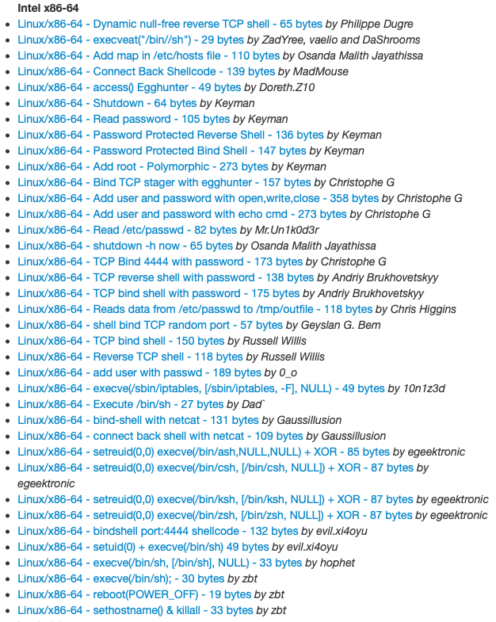
Shellcode
No longer ‘get_a_shell()’ in real attacks
Shellcode
  Assembly code snippet that runs a shell (or more attacks)
We need to have
  setregid(getegid(), getegid());
  execve(“/bin/sh”, 0, 0);
http://shell-storm.org/shellcode/

Slide 13
How to Launch Shellcode?
Land your shellcode in the target program’s address space
  As a part of your input
  As program’s arguments
  As program’s environmental variables
  As the program’s name (argv[0])
Set the return address to your shellcode
Run
  setregid(getegid(), getegid())
  execve(“/bin/sh”, 0, 0);

Slide 14
Writing Shellcode: System Call
System call
  Channel to talk to OS kernel
    A function call to OS kernel
    Context switch (expensive)
Eventual gateway to access system resources
  File I/O, network I/O, memory allocation
  Set/get permissions, run program
  Many more
Varies for different systems and architectures
Check system call number table for 32 bit (x86) and 64 bit (AMD64)
Notes:
Need better source for system call table
Online assemblers and disassemblers
http://shell-storm.org/online/Online-Assembler-and-Disassembler/?opcodes=%5Cx31%5Cxc0%5Cx48%5Cxbb%5Cxd1%5Cx9d%5Cx96%5Cx91%5Cxd0%5Cx8c%5Cx97%5Cxff%5Cx48%5Cxf7%5Cxdb%5Cx53%5Cx54%5Cx5f%5Cx99%5Cx52%5Cx57%5Cx54%5Cx5e%5Cxb0%5Cx3b%5Cx0f%5Cx05&arch=x86-32&endianness=little&dis_with_addr=True&dis_with_raw=True&dis_with_ins=True#disassembly
https://www.exploit-db.com/
https://chromium.googlesource.com/chromiumos/docs/+/HEAD/constants/syscalls.md

Slide 15
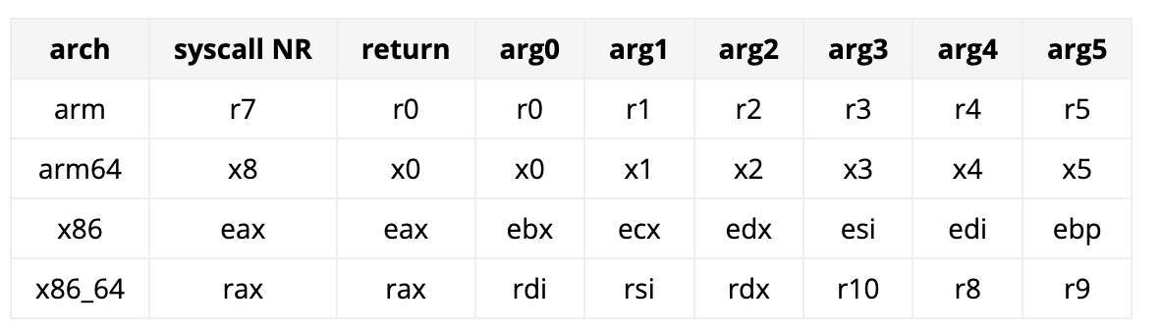
System Call Calling Convention
You can see it as a calling convention between user-land and kernel-land

Slide 16
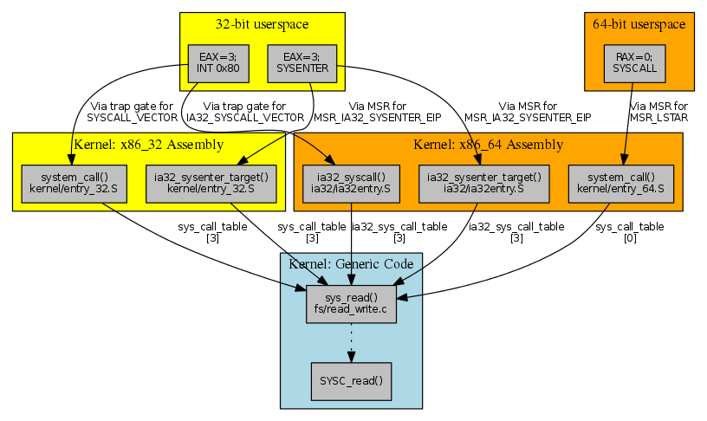
Invoking getuid(): x86
Set %eax as target system call number
  mov $SYS_getegid, %eax // 0x32
Set arguments
  1st arg: %ebx
  2nd arg: %ecx
  3rd arg: %edx
  4th arg: %esi
  5th arg: %edi
Run
  int $0x80
32-bit way
Notes:
hello world assembly
https://tldp.org/HOWTO/Assembly-HOWTO/hello.html

Slide 17
Invoking getuid(): AMD64
Set %rax as target system call number
  mov $SYS_getegid, %rax // 0x6c
Set arguments
  1st arg: %rdi
  2nd arg: %rsi
  3rd arg: %rdx
  4th arg: %r10
  5th arg: %r8
Run
  syscall
64-bit way
Notes:
hello world assembly
https://tldp.org/HOWTO/Assembly-HOWTO/hello.html

Slide 18
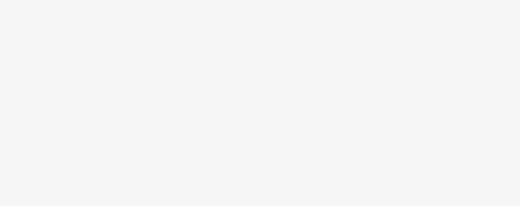
getegid(), setregid() : x86
Return value will be stored in %eax
  mov $SYS_getegid, %eax
  int $0x80
  %eax will hold the return value of getegid()
How to run setregid(getegid(), getegid())?
  mov %eax, %ebx // 1st arg
  mov %eax, %ecx // 2nd arg
  mov $SYS_setregid, %eax // syscall number
  int $0x80
Notes:
http://shell-storm.org/online/Online-Assembler-and-Disassembler/?opcodes=%5Cx31%5Cxc0%5Cx48%5Cxbb%5Cxd1%5Cx9d%5Cx96%5Cx91%5Cxd0%5Cx8c%5Cx97%5Cxff%5Cx48%5Cxf7%5Cxdb%5Cx53%5Cx54%5Cx5f%5Cx99%5Cx52%5Cx57%5Cx54%5Cx5e%5Cxb0%5Cx3b%5Cx0f%5Cx05&arch=x86-32&endianness=little&dis_with_addr=True&dis_with_raw=True&dis_with_ins=True#disassembly

Slide 19
Calling EXECVE()
// execve(char* filepath, char** argv, char** envp)
execve(“/bin/sh”, NULL, NULL);
%eax = $SYS_execve
%ebx = address of “/bin/sh”
%ecx = 0
%edx = 0
int $0x80

Slide 20
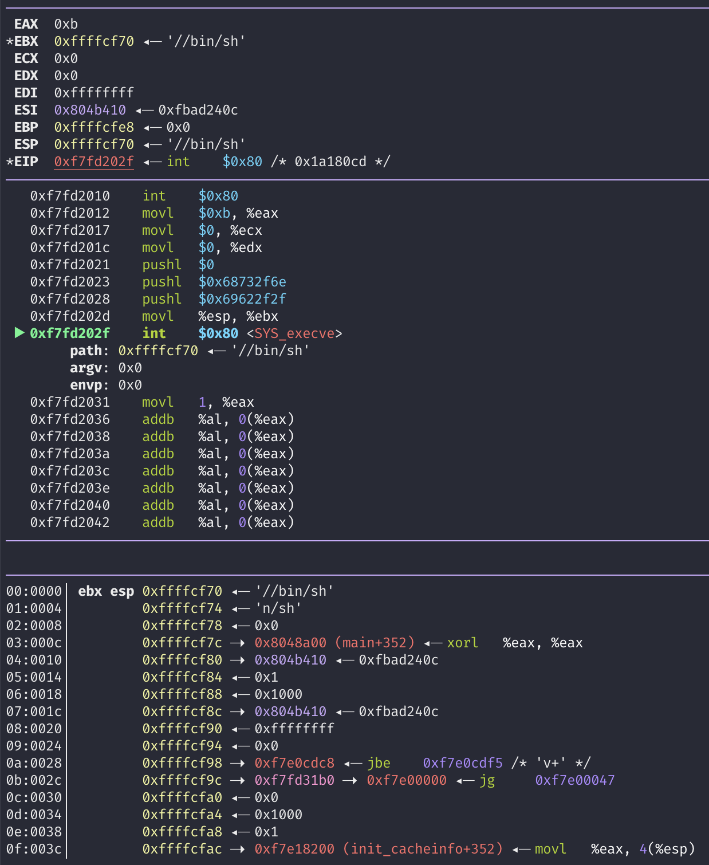
How to Create a String (‘/bin/sh’)?
%ebx = address of “/bin/sh”
Use Stack
  push $0 // why?
  push $0x67832f6e // “n/sh”
  push $0x69622f2f // “//bi”
mov %esp, %ebx
Notes:
stack diagram

Slide 21
Controlling the Attack Surface
Limit/monitor the input channels to the program (or service)
  Command-line
  STDIN, input files
  Environment variables
Limit/monitor the contents of the input
  Are you string?
  Are you too lengthy?
  Do you contain any control characters? – e.g., “;”

Slide 22
Shellcode with Zero-bytes
push $0
Standard functions will cut off your shellcode
  scanf(), strcpy(), fgets() …

Slide 23
Removing Zero from Your Shellcode
You still need Zeros for your code
Do do you create and use Zeros?

Slide 24
Many Tricks
mov $0x41414141, %eax
sub $0x41414141, %eax
xor %eax, %eax
mov %eax, %ebx
Try it from shell-storm
  NOTE: shell-storm assembler/disassembler only understands ‘Intel’ syntax 😔
http://shell-storm.org/online/Online-Assembler-and-Disassembler/
Notes:
mov eax, 0x41414141
sub eax, 0x41414141
http://shell-storm.org/online/Online-Assembler-and-Disassembler/

Slide 25
Loading You Payload
Leverages program inputs
  Many sanitizations for their inputs
  E.g., how program cut string end?
Program will only accept
  ASCII characters
  Alphanumeric characters
  Limits in input length
  No escape characters …

Slide 26
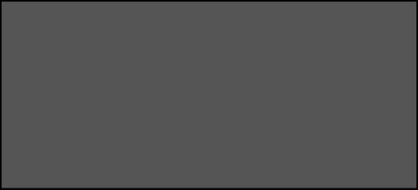
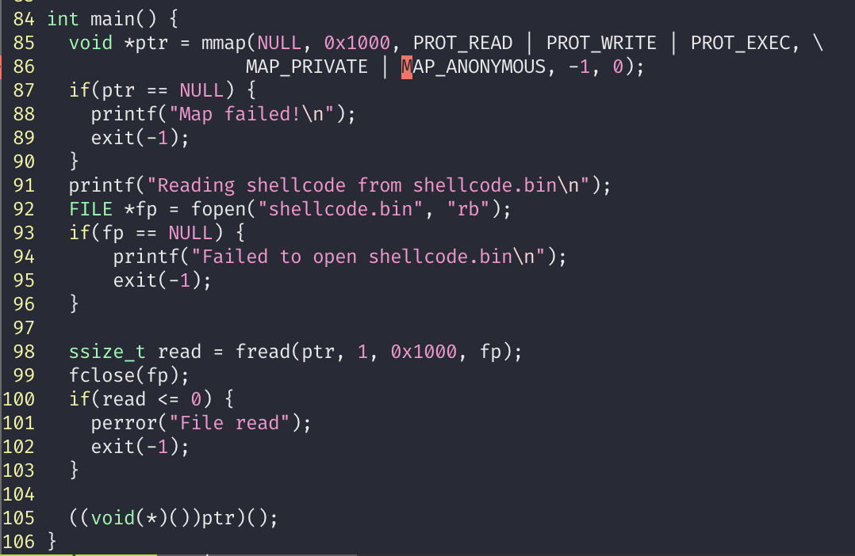
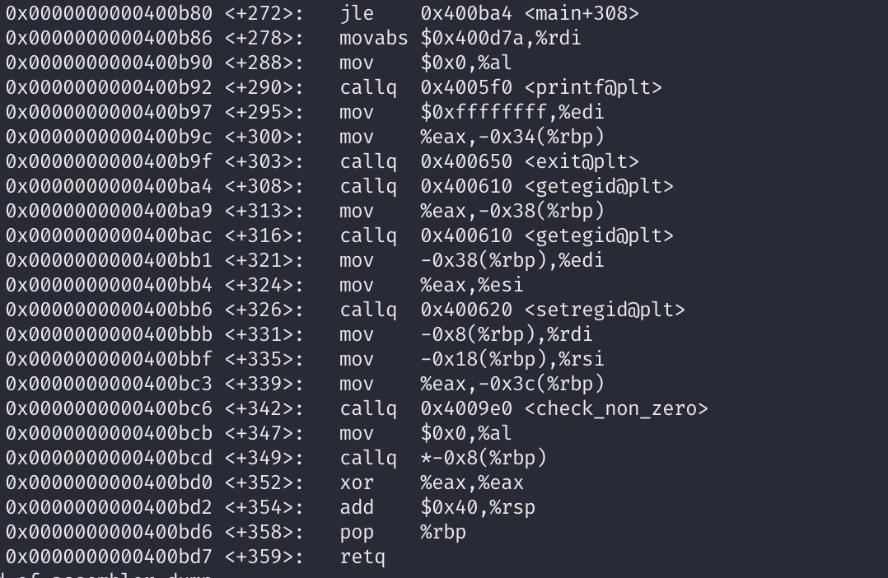
Debugging shellcode
Function Pointer
(( void (*)()) ptr) ();
Notes:
for better visualization https://github.com/frazrepo/vim-rainbow

Slide 27
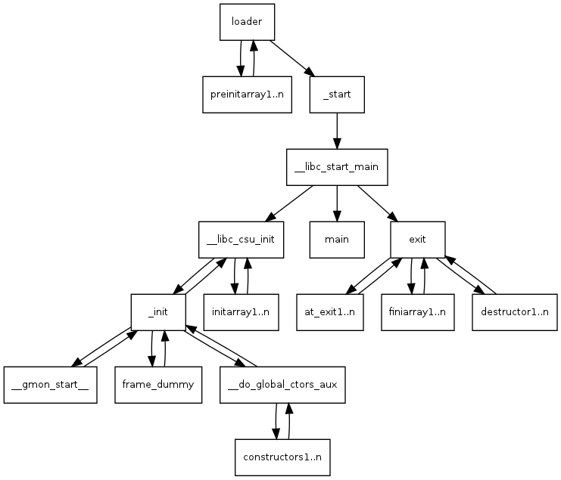
How Linux Runs a Program?

Slide 28
Stack for Communication
Used for
  Storing local variables
    Your input buffer could be here…
  Passing function arguments
  Storing return address
  Storing frame (base) pointer (i.e., saved %ebp)
    Chaining stack frames
What others?
  filename, ARGV, ENVP, AUX

Slide 29

How Linux Runs a Program?
  Reading:
    How programs get run: ELF binaries
    https://lwn.net/Articles/631631/
    ELF (Executable and Linkable Format)
  Basics:
    execve(char *name, char** argv, char **envp)
    execve(“program path”, argument_vectors, environment_pointers)
    execve(“/bin/sh”, {“sh”, NULL}, {”SHELL=sh”, “TERM=xterm”, …, NULL});

Slide 30
How Linux Runs a Program?
  Reading:
    How programs get run: ELF binaries
    https://lwn.net/Articles/631631/
    ELF (Executable and Linkable Format)
  Basics:
    execve(char *name, char** argv, char **envp)
    execve(“program path”, argument_vectors, environment_pointers)
    execve(“/bin/sh”, {“sh”, NULL}, {”SHELL=sh”, “TERM=xterm”, …, NULL});

Slide 31
    execve(char *name, char** argv, char **envp)
1. Program path: program to execute; could be an ELF file
  /bin/sh , /bin/ls, /usr/bin/python
2. Argument vectors: list of arguments, each as string (char **argv)
  When running “python a.py 1 2 3”,
  argv[0] = “python”
  argv[1] = “a.py”
  argv[2] = “1”
  argv[3] = ”2”
  argv[4] = “3”
3. Environment Variables: list of environments variables, each as string (char **envp)
  “TERM=xterm”
  “SHELL=sh”
  “EDITOR=/usr/bin/vim”

Slide 32
1. Load the Executable
From the program path (1st arg to execve), the kernel loads code and data to the memory space
  execve(“/bin/sh”, ….)
Code section
  Usually starts from 0x8048000 (32 bit), or 0x400000 (64 bit)
readelf -a /bin/sh
Will store the path name of the program at the bottom of the stack
Program Path
“/bin/sh”

Slide 33
2. Set Environment Variables
Program Path
“/bin/sh”
ENV1
ENV2
Set environmental variables to the current stack
ENV3 …
ENV Ptrs

Slide 34
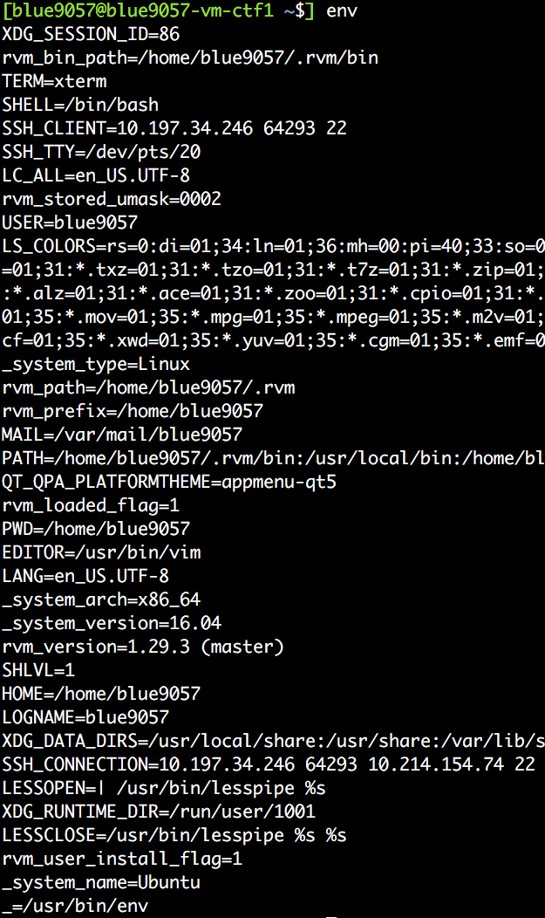
2. Set Environment Variables
Program Path
“/bin/sh”
ENV1
ENV2
Set environmental variables to the current stack.
ENV3
…
ENV Ptrs

Slide 35
3. Set Argument Vectors
Program Path
“/bin/sh”
ENV1
ENV2
Set argument vectors to the current stack.
  When running “python a.py 1 2 3”,
  argv[0] = “python”
  argv[1] = “a.py”
  argv[2] = “1”
  argv[3] = ”2”
  argv[4] = “3”
ENV3
…
ENV Ptrs
ARGV4
ARGV3
…
ARGV Ptrs

Slide 36
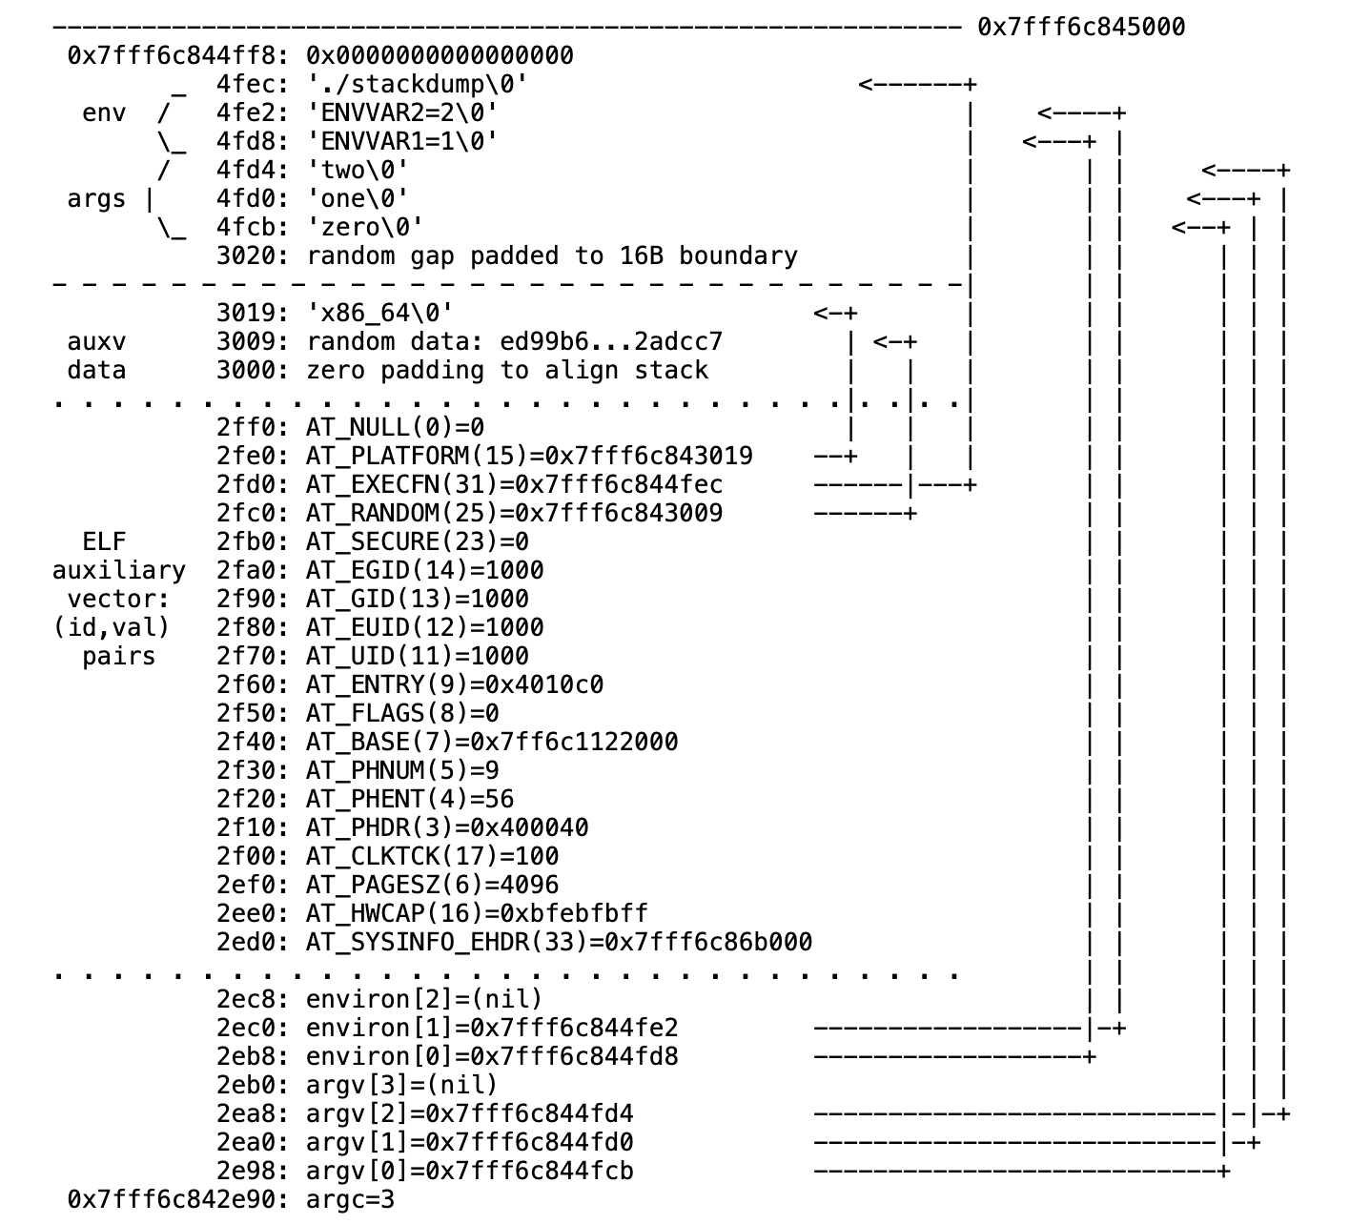
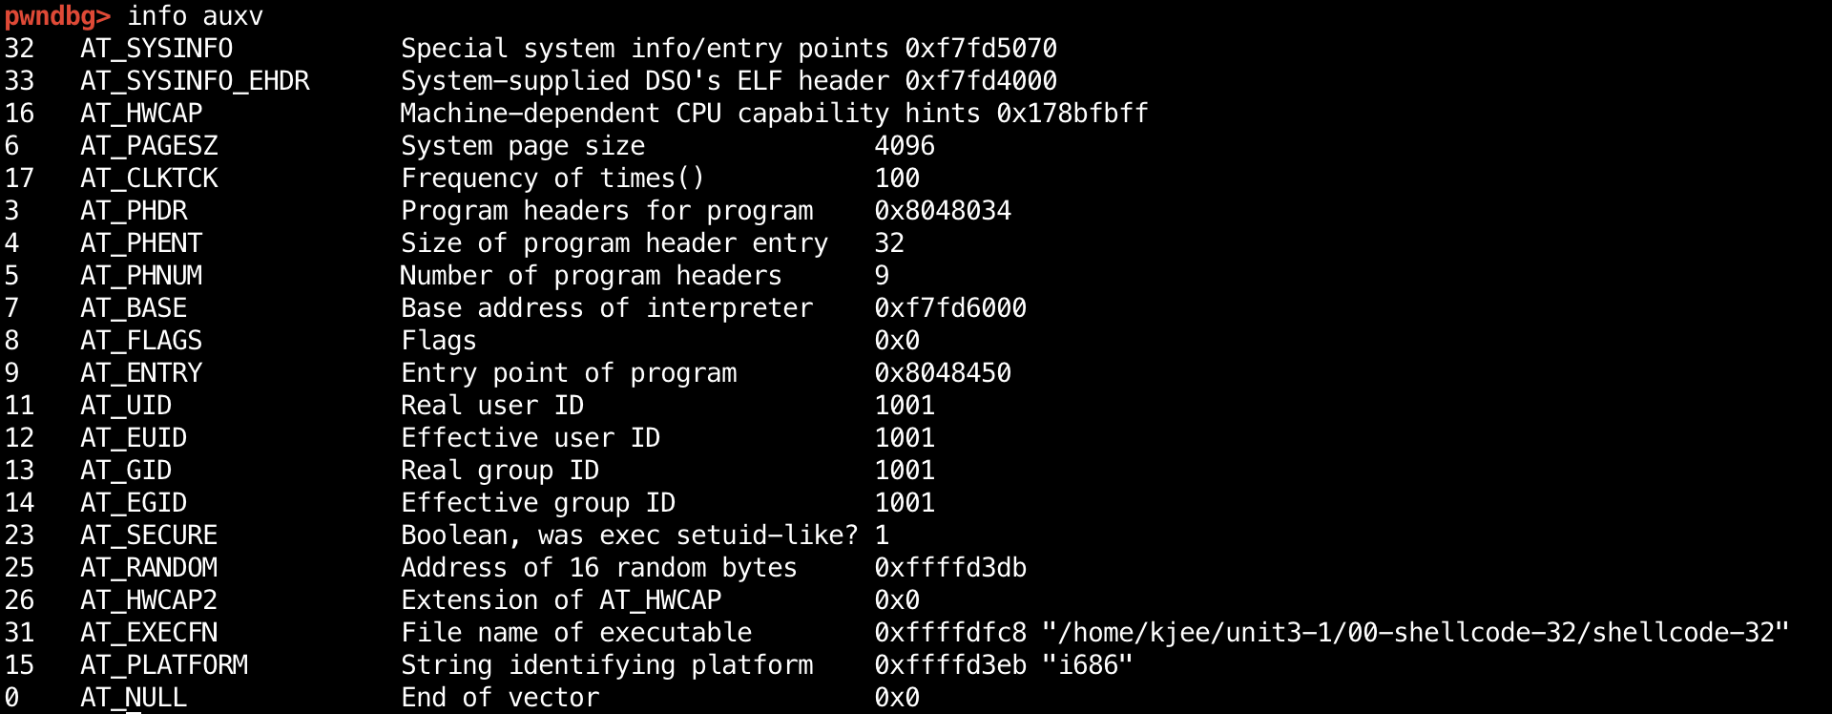
4. Set Auxiliary Vectors (AUXV)
Kernel’s communication channel to user program
  Key-Value pairs

Slide 37
5. Call _start
readelf -a …

Slide 38
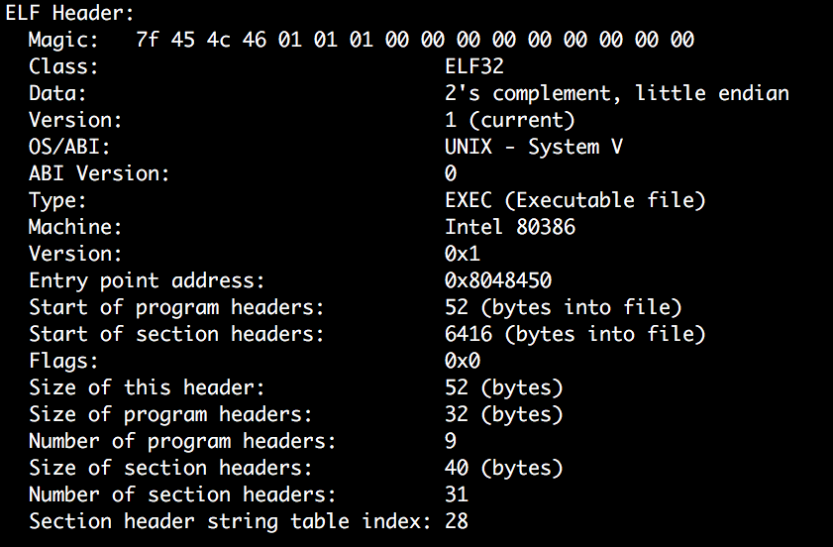
4. Call _start
readelf -a …
Addr of _start()
Notes:
readelf –h exec

Slide 39
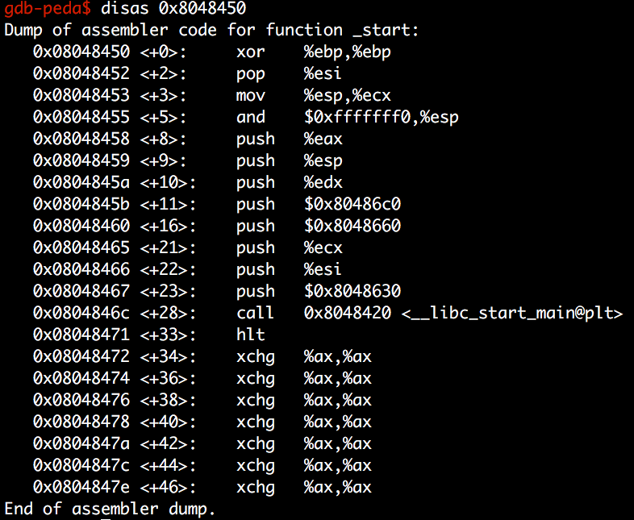
5. Call _start
readelf -a …
Addr of main()

Slide 40
5. Call _start
Program path
ENVS
readelf -a …
Calls __libc_start_main
And then, libc_start_main sets the address of argv, envp, then calls main(argc, argv, envp)
ENVP Ptrs
ARGs
ARGV Ptrs
…
ENVP
ARGV
ARGC
The stack of main() starts at here:

Slide 41
Check with GDB
b *main
r abcd efgh
telescope $esp 100

Slide 42
Backup

