Slide 1
CS4459.001
Cyber Attacks & Defense Lab
Shellcoding – Part2
Feb 20, 2025

Slide 2
Allowed system calls: shellcode.bin
getegid(); setregid(); execve();
Should not contain other system calls
  e.g., read();

Slide 3
Bonus Points
Shortest shellcode for short-shellcode-32
  I have seen 3-bytes one
Shortest shellcode for alphanumeric challenge.

Slide 4
Don’t Miss Out Any Units!

Slide 5
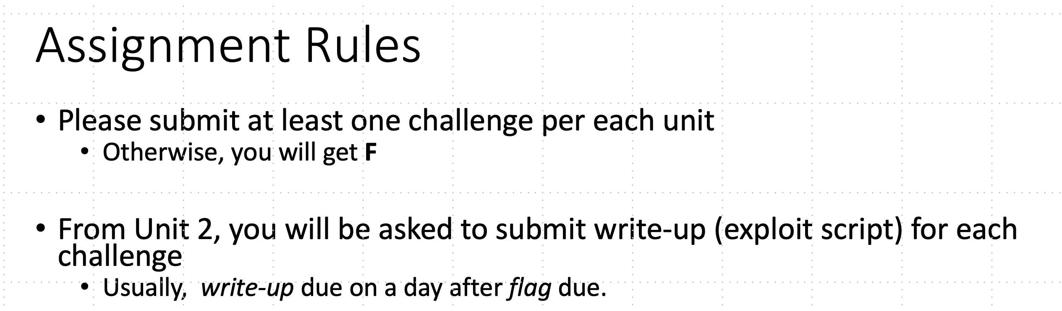
Assignment Rules
Notes:
Please do not publish your challenges + your solutions online

Slide 6
Unit3-Part2
  short-shellcode-{32,64}
  ascii-shellcode-64: shellcode only contains bytes 0x00 ~ 0x7f
  press-f-to-pay-respect: '0xf' every two byte
  Bonus challenges
    ascii-shellcode-32
    alphanumeric-shellcode
    Prime shellcode: shellcode only uses prime numbers
  More (bonus) challenges depending on students' progress

Slide 7
Stack-ovfl-* for Unit 3
All has a buffer overflow vulnerability
All DO NOT have get_a_shell()
You should put your shellcode on the stack and jump there…

Slide 8
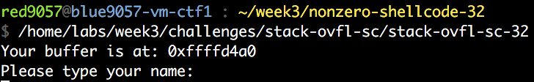
How Can You Put Your Shellcode?
make print
Send it to the binary via pwntool (writing to the buffer)

Slide 9
How Can You Put Your Shellcode?
What if it does not let you know or use buffer?
Put your shellcode as an environment variable
  env = {’SHELLCODE’ : SHELLCODE}
Put your shellcode as a program argument
  process(‘program-name’, env=env)

Slide 10
Getting the Shellcode Address
Use GDB with core!
c = Core(‘core’)
c.stack.find(SHELLCODE)

Slide 11
Running Shellcode
Return to here executes shellcode
Requires an exact address of a shellcode…
SHELLCODE
Fails
Fails

Slide 12
NOP-sled
Return to here executes shellcode
nop (0x90)
  An instruction that does nothing
  Opcode is 0x90
  Multi-bytes nop exists
NOP Sled (full of 0x90s)
SHELLCODE
Fails
Fails

Slide 13
NOP-sled Trick
SHELLCODE = “\x90” * 500 + SHELLCODE
  Return to anywhere at the NOP-sled (sized 500 in this case) will let you run the shellcode!
NOP Sled (full of 0x90s)
SHELLCODE

Slide 14
Unit-3 BoF Challenges
  stack-ovfl-sc-*: put your shellcode on your input buffer
  stack-ovfl-use-envp-*: put your shellcode on envp
  stack-ovfl-no-envp-*: put your shellcode on argv
  stack-ovfl-no-envp-no-argv-*: put your shellcode as the filename..
  stack-ovfl-where-*: restrict ret addr to code address..
  Stack-ovfl-where-*-2: remove all data from &argv to stack bottom

Slide 15
Shellcodes from the Wild
The shorter, the better
  To fit into the smallest possible spaces
Some special characters to avoid (’\0’, ‘;’, ‘&’ …)
  Input sanitizations are common
Many public resources

Slide 16
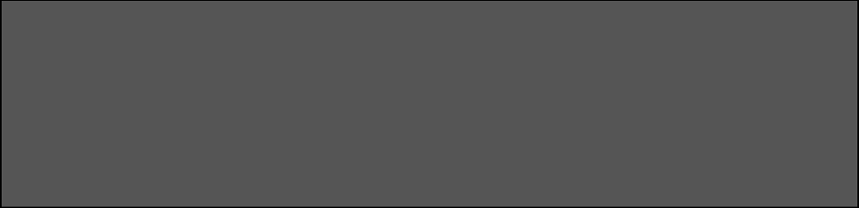
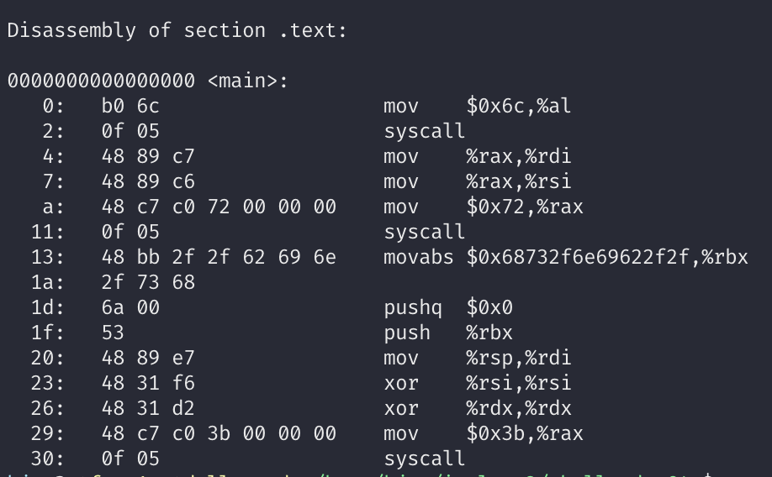
Short Shellcode
Privilege escalation handled
  eax = getegid();
  setregid( eax, eax);
Executing "/bin/sh" ?
  execv("/bin/sh", 0, 0);
Think about "context"!

Slide 17

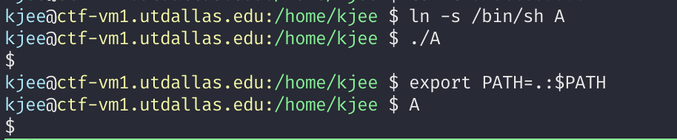
Mind Your Context
Symbolic link
  An alias of a file
  You can set a new name of a file…
‘/bin/sh’ -> ‘A’ # how many bytes can you reduce?

Slide 18
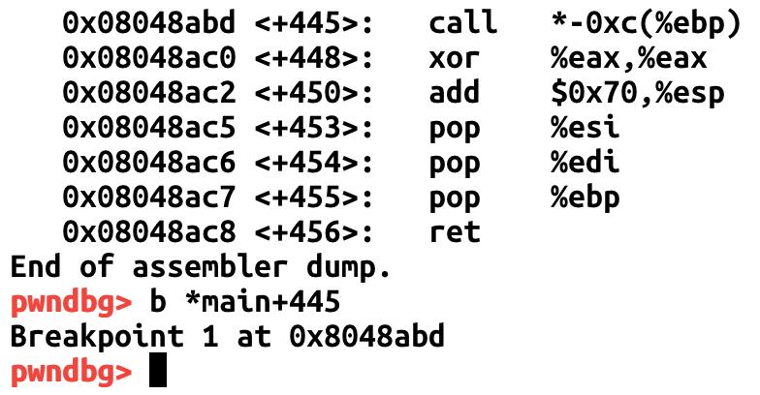
Reuse Existing Context
In short-shellcode-32, main()
Calls shellcode here!

Slide 19
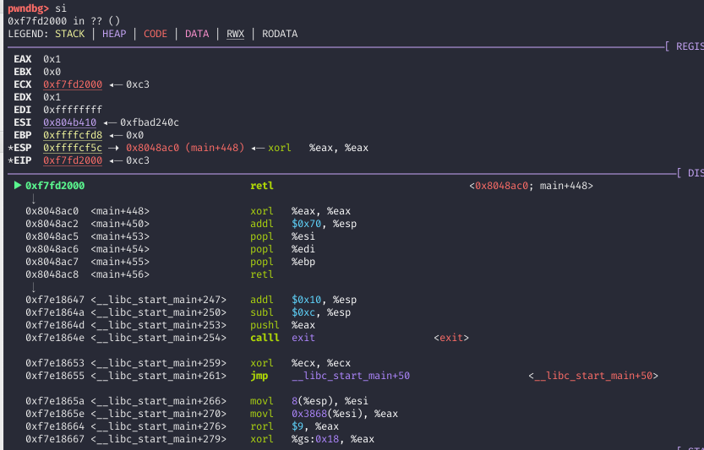
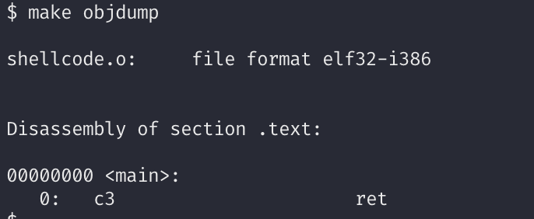
Reuse Existing Context
short-shellcode-32
run and step-in ...
%EBX is zero
%ECX points to somewhere..
%EDX is 0x1….

Slide 20
Backup

Slide 21
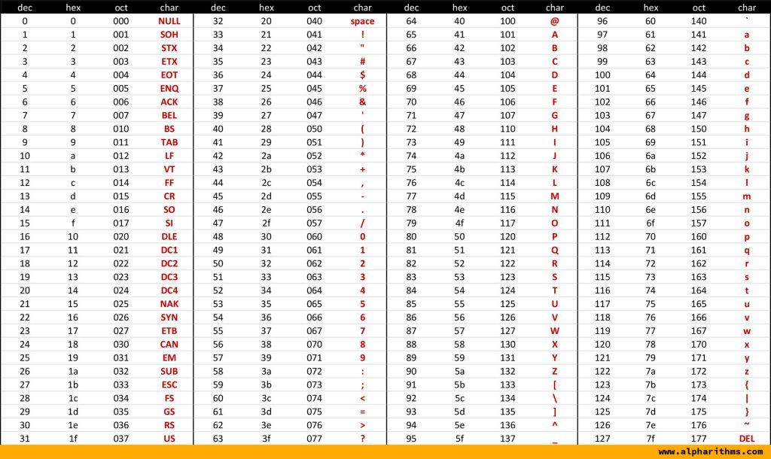
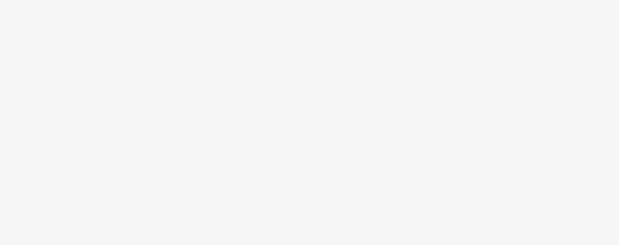
Alphanumeric
int $0x80
  \xcd\x80
Non-ASCII, non-printable, non-alphanumeric
How?

Slide 22
Alphanumeric
Create \xcd\x80 from alphanumeric values
.byte: puts raw bytes, in assembly
  .byte 0x32 (‘0’)
  .byte 0x7a (‘z’)
Can we create \xcd\x80 by applying some operations on such 0x32, 0x7a?

Slide 23
Alphanumeric
Execute CD 80, int $0x80!
XOR 0xff
XOR 0xfa
Alpha-numeric code
0xcd
0x32
0x7a
0x80
We call this as ‘self modifying code’…

Slide 24
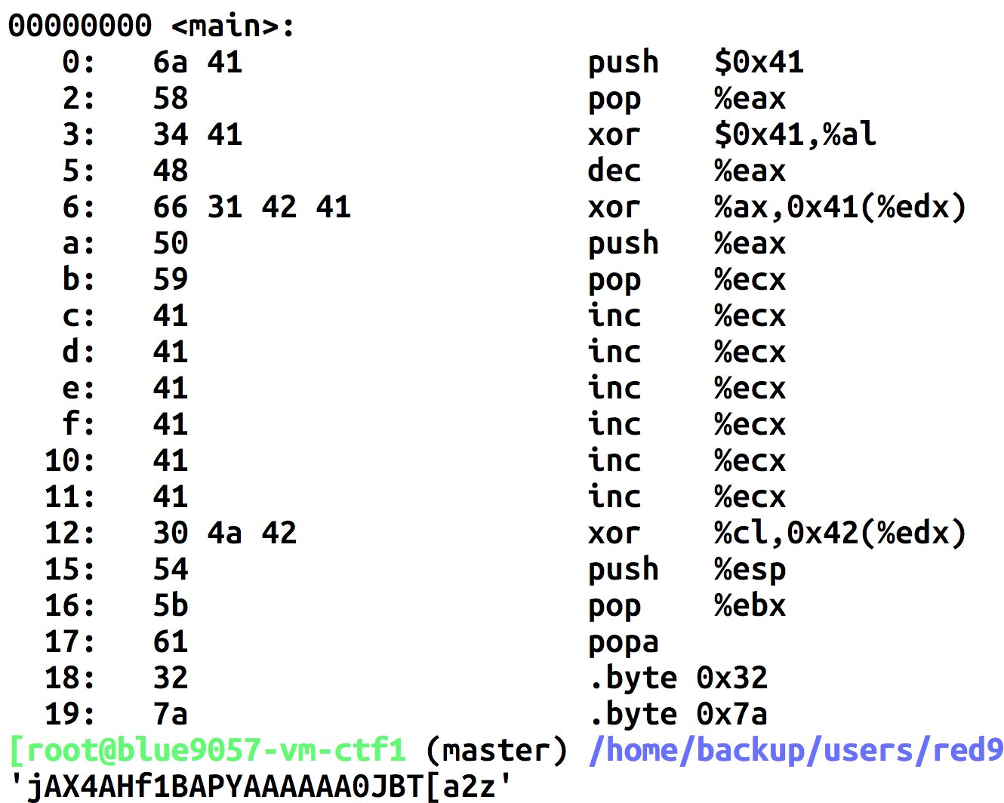
Helpful Instructions
Make eax -1 only with alphanumeric…
jAX4AH
0xff ^ 0x32 = 0xcd, “f1BA”
Mov registers with push & pop = “PY”
Make ecx 0xfa (0xff+6 = 0xfa..)
0xff ^ 0x7a = 0x80, “0JB”
Do not use pop %ebx. Use popa…

Slide 25
Stack
Used for
  Storing local variables
    Your input buffer could be here…
  Passing function arguments
  Storing return address
  Storing frame pointer (i.e., saved %ebp)
What others?
  filename
  ARGV
  ENVP

