Slide 1
CS4459.001
Cyber Attacks & Defense Lab
Stack Cookies & NX/DEP & ASLR
Mar 3, 2026

Slide 2
‘checksec’ command
ASLR check
0: Disable ASLR. This setting is applied if the kernel is booted with the ”norandmaps” boot parameter.
1: Randomize the positions of the stack, virtual dynamic shared object (VDSO) page, and shared memory regions. The base address of the data segment is located immediately after the end of the executable code segment.
2: Randomize the positions of the stack, VDSO page, shared memory regions, and the data segment. This is the default setting.

Slide 3
Unit 4
CTF-VM1
CTF-VM2
0-dep-1 (10pt)
1-dep-2 (20pt)
2-dep-3 (30pt)
3-stack-cookie-1 (10pt)
4-stack-cookie-2 (20pt)
5-stack-cookie-3 (30pt)
6-stack-cookie-4 (30pt)
aslr-1 (10pt)
aslr-2 (10pt)
aslr-3 (20pt)
aslr-4 (20pt)
aslr-5 (30pt)
aslr-6 (30pt)

Slide 4
CTF-VM2
Cloned copy if CTF-VM1
Address Space Layout Randomization (ASLR)
  will learn about it later
Connect via
ssh <netid>@ctf-vm2.utdallas.edu

Slide 5
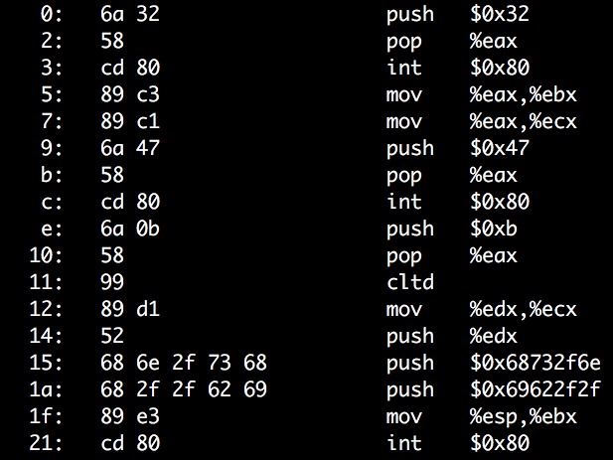
Stack Buffer Overflow + Run Shellcode
ADDR of SHELLCODE
RETURN ADDR
EEEE
SAVED %ebp
DDDD
COOKIE
BUFFER
CCCC
BUFFER
BBBB
BUFFER
AAAA
BUFFER

Slide 6
Defense
Prevent buffer overflow!
  A direct defense
  Could be accurate but could be slow..
Make exploit hard!
  An indirect defense
  Could be inaccurate but could be fast..
Exploit Mitigation
DEP, Stack-cookie, ASLR, etc.

Slide 7
Defense
Base and bound checks
  Prevent buffer overflow!
  A direct defense
Stack Cookie
  An indirect defense
  Prevent overwriting return address
Data execution prevention (DEP, NX, etc.)
  An indirect defense
  Prevent using of shellcode
Notes:
Text font

Slide 8
Spatial Memory Safety: Base and Bound Checks
A FAT pointer
Allocation
  Access must be between [a_base, a_bound)
A
char *a
// char *a_base;
// char *a_bound;
a[-1]
Base
Bound
a[512]
a = (char*) malloc(512);
// a_base = a;
// a_bound = a+512
a[0], a[1], a[2], …, and a[511] are OK
a[512] NOT OK
a[-1] NOT OK

Slide 9
Base and Bound Check
B
C
Propagation
A
char *b = a;
// b_base = a_base;
// b_bound = a_bound;
a[-1]
Base
Bound
a[512]
char *c = &b[2];
// c_base = b_base;
// c_bound = b_bound;

Slide 10
Base and Bound Check
B
C
Propagation
char *c = &b[2];
c_base = b_base
c_bound = b_bound
A
c[1] = ‘a’;
c== b+2 == a+2
c+1 == b+3 == a+3
c_base <= c+1 && c+1 < c_bound
a[-1]
Base
Bound
a[512]
c[510] = ‘a’;
c == b+2 == a+2
c+510 == b+510+2 == a+510+2 == a+512
c_base <= c+510 but c+510 >= c_bound
Disallow write!
Notes:
3

Slide 11
Base and Bound Check
Buffer?
  strcpy(c, “A”*510);
When copying 510th character:
This is how dynamic languages (e.g., Java, Python, Golang) protect
buffer overflows
C++ STL (Standard Template Libraies)
  std::vector in C++
c[510] = ’A’;
c+510 > c_bound (c+510 == a+512 > bound…)
Detect buffer overrun!
Notes:
KJEE: Detailed illustrations for STL?

Slide 12
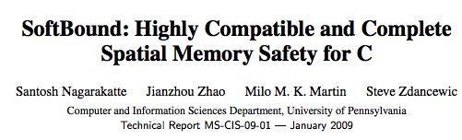
[PLDI’09]
In Proceedings of
Programming Language Design and Implementation
(PLDI) 2009
ptr = malloc(size);
ptr_base = ptr;
ptr_bound = ptr + size;
if (ptr == NULL) ptr_bound = NULL;
int array[100];
ptr = &array;
ptr_base = &array[0];
ptr_bound = &array[100];
newptr = ptr + index; // or &ptr[index]
newptr_base = ptr_base;
newptr_bound = ptr_bound;
Notes:
KJEE: Add some illustration + animation ..

Slide 13
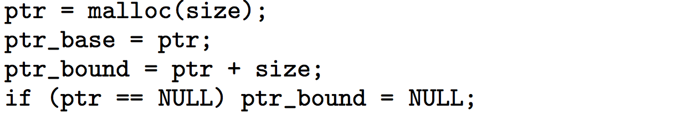
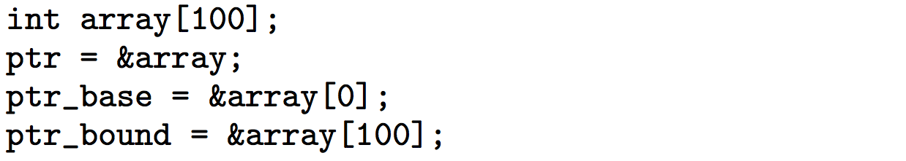
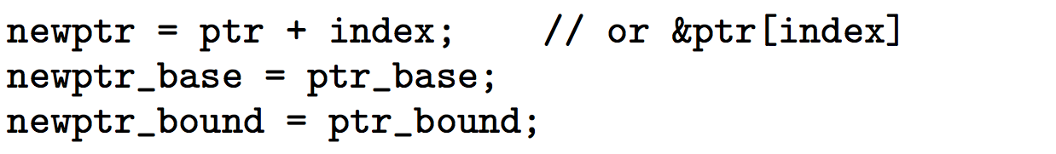
[PLDI’09]
In Proceedings of
Programming Language Design and Implementation
(PLDI) 2009
Notes:
KJEE: Add some illustration + animation ..

Slide 14
Drawbacks
+2x overhead on storing a pointer
  char *a
    char *a_base;
    char *a_bound;
+2x overhead on assignment
  char *b = a;
    b_base = a_base;
    b_bound = a_bound;
+2 comparisons added on access
  c[i]
    if(c+i >= c_base) { … }
    if(c+i < c_bound) { … }
Many other problems…
Use more cache
More TLBs
etc….

Slide 15
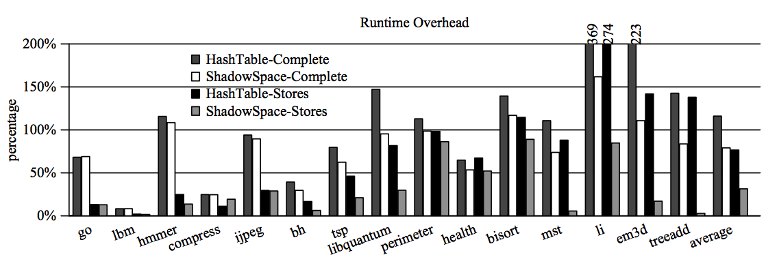
[PLDI’09]

Slide 16
Security vs. Performance Trade-Off
100% Buffer Overflow Free
  You pay +200% Performance Overhead
    Specifically, for memory operations
    Does it matter?
  Think about the economy…
    Or “Usability”
  Most of the cases, it may not matter
Notes:
KJEE: How much “memory operation” takes in the overall computing?

Slide 17
An Economic Defense: Stack Cookie
A defense specific to sequential stack overflow
On a function call
Before the function returns
RETURN ADDR
SAVED %ebp
cookie = some_random_value;
COOKIE
BUFFER
BUFFER
if(cookie != some_random_value)
printf(“Your stack is smashed\n”);
BUFFER

Slide 18
Stack Cookie: Attack Example
strcpy(buffer, “AAAABBBBCCCCDDDDEEEE\x35\x45\x04\x08”)
On a function call
Before a function returns
0x8044535
RETURN ADDR
RET
cookie = some_random_value;
EEEE
SAVED %ebp
DDDD
COOKIE
Cookie
CCCC
BUFFER
BBBB
if (cookie != some_random_value)
printf(“Your stack is smashed\n”);
BUFFER
AAAA
BUFFER

Slide 19
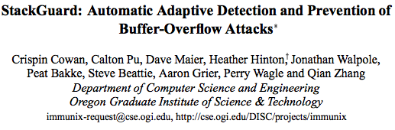
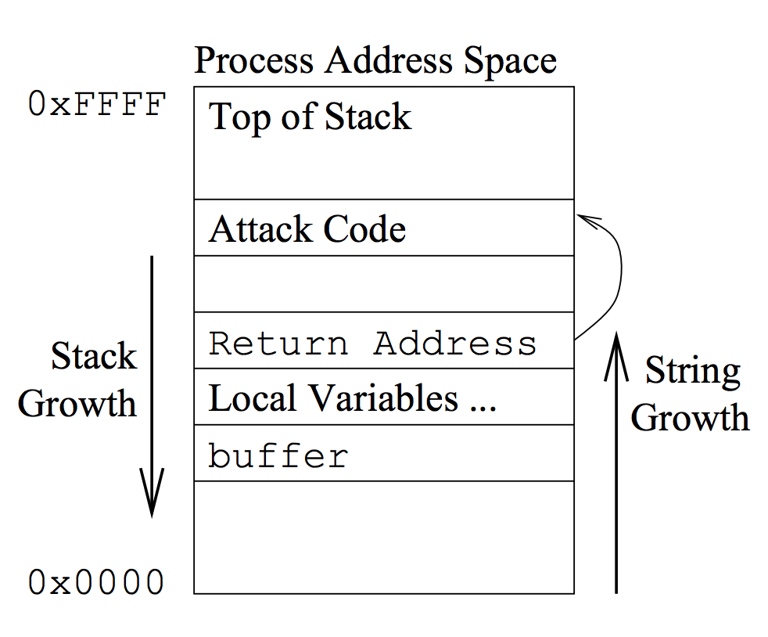
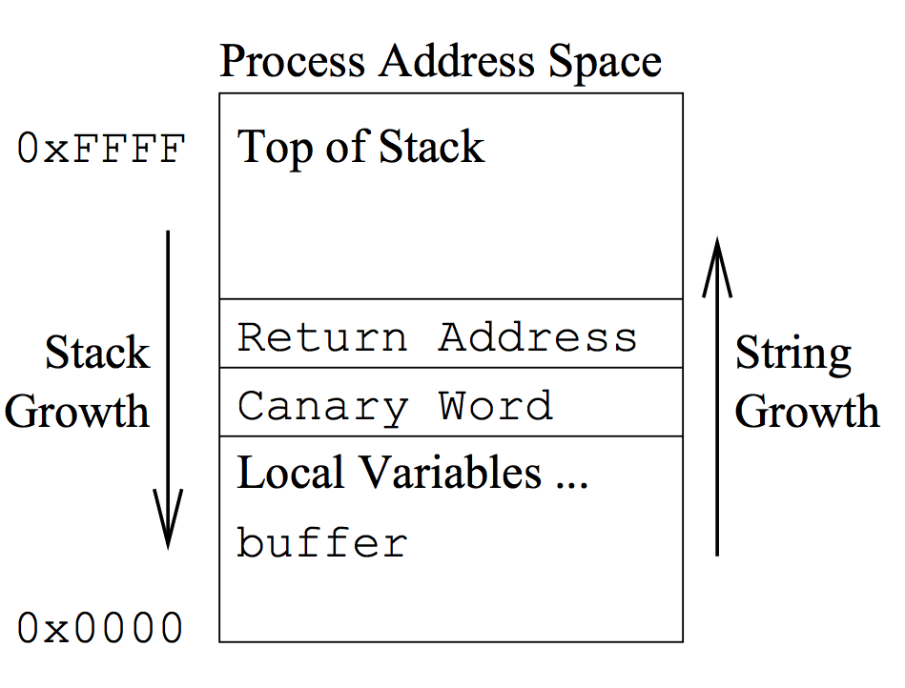
[SEC’98]
In Proceedings of
The 7th USENIX Security Symposium (1998)
RETURN ADDR
SAVED %ebp
COOKIE
BUFFER
BUFFER
BUFFER

Slide 20
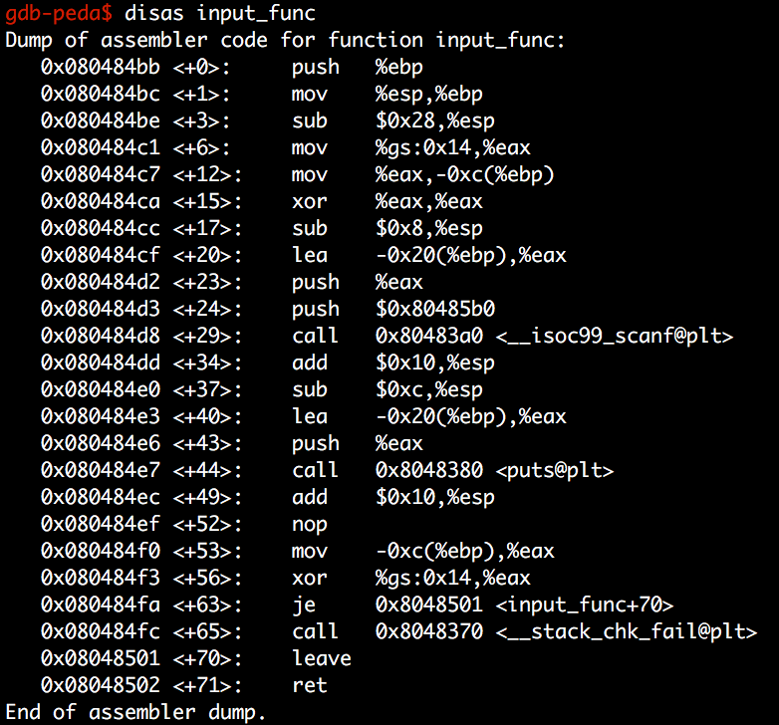
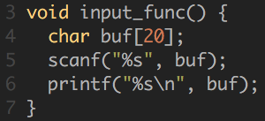
Stack Cookie in gcc
(ProPolice)
Get canary from %gs
Store canary at ebp-c
GCC ProPolice
Clear canary in %eax
Get canary in stack
Cookie stored in -0xc(%ebp)
Xor that with value in %gs

Slide 21
Stack Cookie in gcc
(ProPolice)
Cookie stored in -0xc(%ebp)

Slide 22
Stack Cookie: Overhead
2 memory move
1 compare
Per each function call
1~5% overhead

Slide 23
Stack Cookie: Assignments
Stack-Cookie-1
  Bypassing a fixed value cookie
  EASY
Stack-Cookie-2
  Bypassing a random value cookie (using rand())
  Please defeat rand()
Stack-Cookie-3
  Bypassing gcc ProPolice
Stack-Cookie-4
  Overwriting a local variable to not to touch canary!

Slide 24
Stack Cookie: Weaknesses
Effective for common mistakes
  strcpy(), memcpy()
  read(), scanf()
  Missing bound check in a for loop
But can only block sequential overflow
What if ‘buffer[24] = 0xaa’
aa
RETURN ADDR
SAVED %ebp
COOKIE
BUFFER
BUFFER
BUFFER
Stack-Cookie-4

Slide 25
Stack Cookie: Weaknesses
Fail if attacker can guess the cookie value
  strcpy(buf, “AAAABBBBCCCC\x44\x33\x22\x11EEEE…”)
  (stack-cookie-1)
Use a random value for a cookie!
  Is rand() safe (check stack-cookie-2)?
See https://www.includehelp.com/c-programs/guess-a-random-number.aspx
0x8044535
RETURN ADDR
RET
EEEE
SAVED %ebp
0x11223344
Cookie
CCCC
BUFFER
BBBB
BUFFER
AAAA
BUFFER
Stack-Cookie-1 and -2

Slide 26

Stack Cookie: Weaknesses
Security in 32-bit Random Cookie
  One chance over 2³² (4.2 billion) trial
  Seems super secure!
Fail if attacker can read the cookie value…
  Maybe you can’t read %gs:0x14
  But, what about -0xc(%ebp)?
RETURN ADDR
RET
SAVED %ebp
0x83ec5589
Cookie
BUFFER
BUFFER
BUFFER

Slide 27
Stack Cookie: Weaknesses
Security in 32-bit Random Cookie
  One chance over 2³² (4.2 billion) trial
  Seems super secure!
Attacker can break this in 1024 trial
  If application uses fork();
RETURN ADDR
RET
SAVED %ebp
0x83ec5589
Cookie
BUFFER
BUFFER
BUFFER

Slide 28
Stack Cookie: Weaknesses
Random becomes non-random if fork()-ed..
RETURN ADDR
RET
RETURN ADDR
RET
SAVED %ebp
SAVED %ebp
0x83ec5589
Cookie
fork()!
0x83ec5589
Cookie
BUFFER
BUFFER
BUFFER
BUFFER
BUFFER
BUFFER

Slide 29
Stack Cookie: Weaknesses
RETURN ADDR
SAVED %ebp
0x83ec5589
BUFFER
Servers…
BUFFER
Why?
RETURN ADDR
fork()!
BUFFER
RETURN ADDR
SAVED %ebp
SAVED %ebp
0x83ec5589
RETURN ADDR
0x83ec5589
BUFFER
SAVED %ebp
fork()!
BUFFER
BUFFER
0x83ec5589
BUFFER
BUFFER
fork()!
BUFFER
BUFFER
BUFFER
BUFFER

Slide 30
Bypassing Stack Cookies
Assumption
  A server program contains a sequential buffer overflow vulnerability
  A server program uses fork()
  A server program let the attacker know if it detected stack smashing or not
    E.g., an error message, “stack smashing detected”, etc.

Slide 31
Bypassing Stack Cookies
0x83ec5589
Attack
  Try to guess only the last byte of the cookie
  0x00 ~ 0xff (256 trials)
Result
  Stack smashing detected on
    00, 01, 02, 03, …, 0x88
  When testing 0x89
    No smashing and return correctly
RETURN ADDR
SAVED %ebp
89
01
02
0x83ec5589
00
BUFFER
CCCC
BUFFER
BBBB
BUFFER
AAAA

Slide 32
Bypassing Stack Cookies
0x83ec5589
Attack
  Try to guess the second last byte of the cookie
  0x00 ~ 0xff (256 trials)
Result
  Stack smashing detected on
    00, 01, 02, 03, …, 0x54
  When testing 0x55
    No smashing and return correctly
RETURN ADDR
SAVED %ebp
89
0x83ec5589
00
55
01
02
BUFFER
CCCC
BUFFER
BBBB
BUFFER
AAAA

Slide 33
Bypassing Stack Cookies
An easy side-channel attack
  Max 256 trials to match 1 byte value
  Move forward if found the value
    In 32-bit: 4 X 256 = max 1,024 trials
    In 64-bit: 8 X 256 = max 2,048 trials
Security vs. Performance
  Stack Cookies pay some performance degradation for some grade of security

Slide 34
Data Execution Prevention (DEP)
A.K.A. No-Execute (NX)
Q: Know how to exploit a buffer overflow vuln. What’s next?
  A: Jump to your shellcode!
Another Q: why do we let the attacker run a shellcode? Block it!
  Attacker uploads and runs shellcode in the stack
  Stack only stores data
  Why stack is executable?
    Make it non-executable!

Slide 35
Notes:
KJEE-TODO: We may add some more stories on this

Slide 36
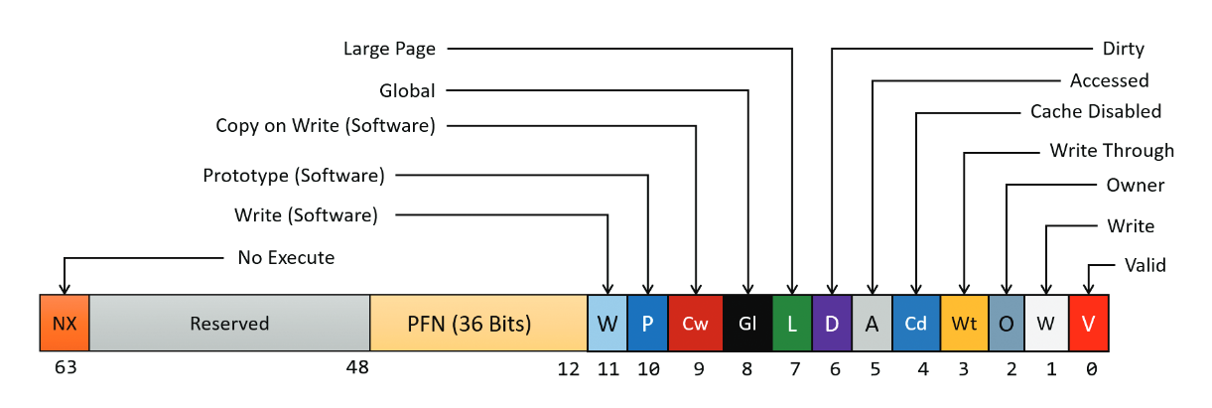
All Readable Memory used to be Executable
Intel/AMD CPUs
  No executable flag in page table entry – only checks RW
  AMD64 – introduced NX bit (No-eXecute, in 2003)
https://de-engineer.github.io/Virtual-Address-Translation-and-structure-of-PTE/

Slide 37
All Readable Memory used to be Executable
Intel/AMD CPUs
  No executable flag in page table entry – only checks RW
  AMD64 – introduced NX bit (No-eXecute, in 2003)
Windows
  Supporting DEP from Windows XP SP2 (in 2004)
Linux
  Supporting NX since 2.6.8 (in 2004)
DEP is a marketing term..
NX (No eXecute) is also a marketing term
W⊕X (Write XOR Execute)
Notes:
KJEE-TODO: If we want to go deeper, we can discuss more on HW vs. SW design choices on this.

Slide 38
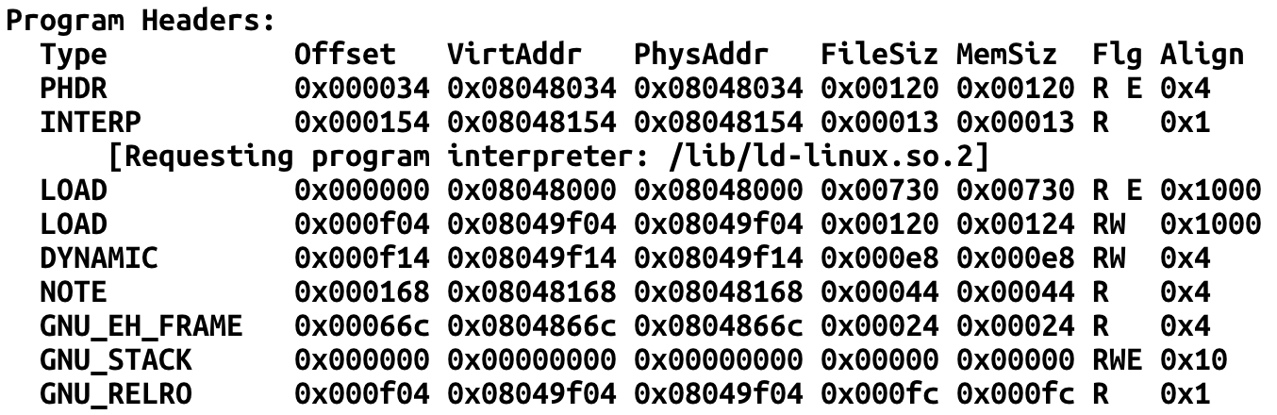
Exec / non-exec stack
readelf -a stack-ovfl-sc-32
Notes:
KJEE-TODO: what are differences?

Slide 39
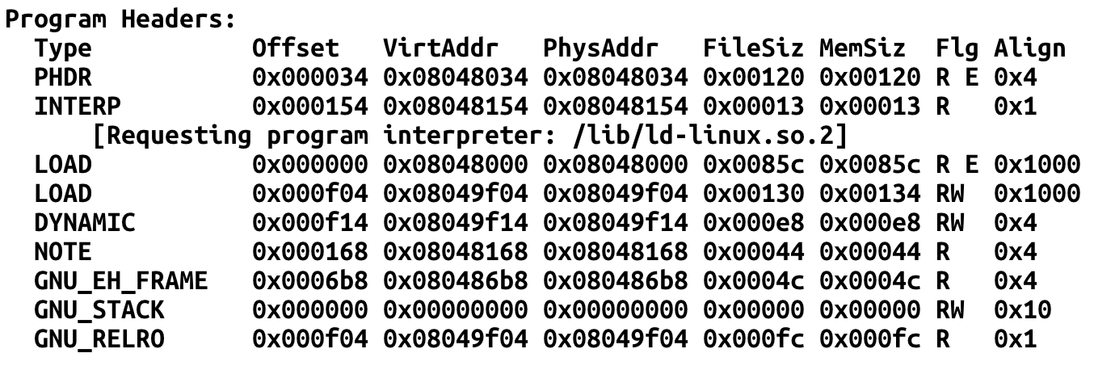
Exec / non-exec stack
readelf -a dep-1
Notes:
KJEE-TODO: what are differences?

Slide 40
Non-executable Stack
Now most of programs built with non-executable stack
Then, how to run a shell?
  call system(“/bin/sh”) likewise how we called execute_me()
  What if the program does not have system() in the code?
Library!
  Return-to-Libc

Slide 41
Dynamically Linked Library
When you build a program, you use functions from library
  printf(), scanf(), read(), write(), system(), etc.
Where does that function reside?
  1) In the program
  2) In #include <stdio.h>, the header file
  3) Somewhere in the process’s memory

Slide 42
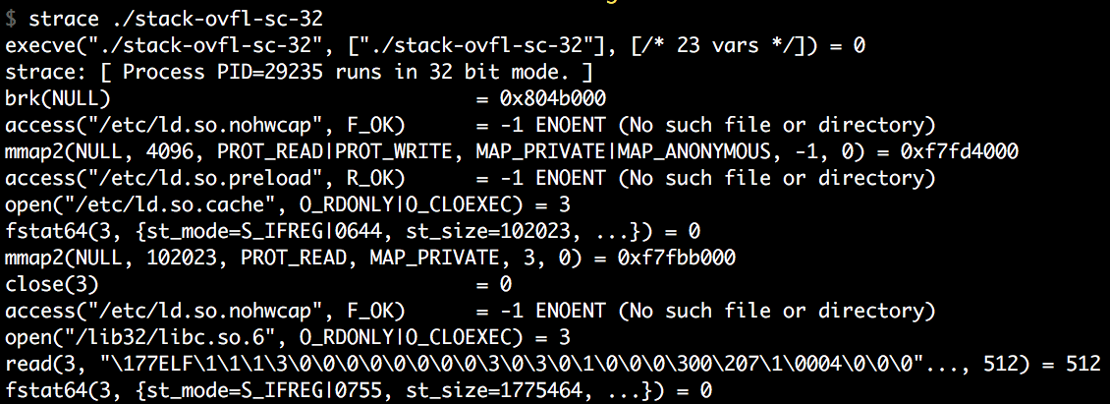
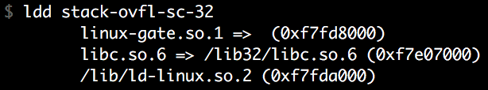
How a Program is Loaded…
execve(target, …, …)
  Load the target ELF file first
  Load required libraries for the target ELF (header contains the list)
  Build stack, heap and other memory
  Run!

Slide 43
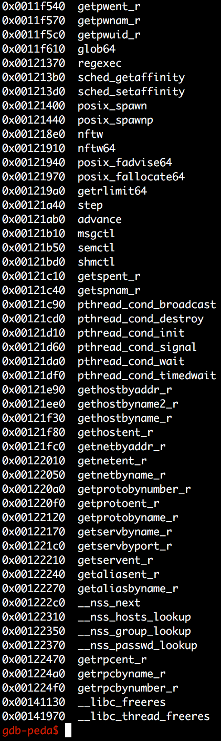
Dynamically Linked Library: libc
The most of programs written in C will be linked with libc
  Contains essential functionalities!
  execve(), system(), open(), read(), write(), etc.
But where our system() is?
  Let’s check with gdb!
Notes:
KJEE-TODO: The most of programs written in C → ??? What are the programs that doesn’t link itself to libc?

Slide 44
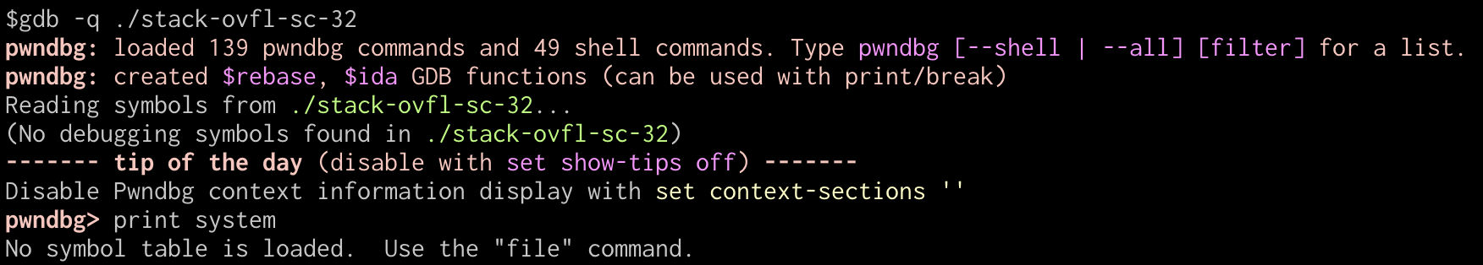
Finding libc Functions
GDB
Why?
  You should RUN the program to see linked libraries

Slide 45
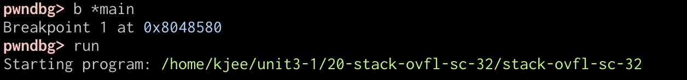
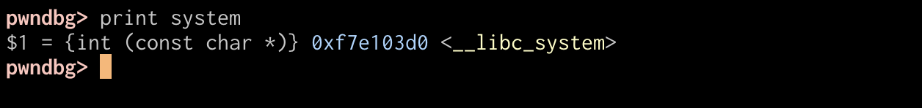
Finding libc Functions
GDB

Slide 46
Stack Overflow Again
Now you know where system()is!
“A” * 0x80 + “BBBB” + “\x40\x19\xe4\xf7”
  This will run system()
  But how to run system(“/bin/sh”) or system(“a”)?

Slide 47
Function Call and Stack
ARG 2
Arguments
  0x8(%ebp) is the 1st argument
  0xc(%ebp) is the 2nd argument
  …
What if we call ‘system()’ by changing ‘Ret’?
ARG 1
RETURN ADDR
RET
SAVED %ebp
%ebp
0x83ec5589
Local 1
Local 2
Local 3
Local 4
%esp

Slide 48
Function Call and Stack
%ebp = 0x41414141
ARG 2
Overflow
Leave
  mov %ebp, %esp
  pop %ebp
Return
  pop %eip
ARG 1
%esp
system()
RETURN ADDR
RET
%esp
AAAA
SAVED %ebp
%ebp
0x83ec5589
Local 1
AAAA
AAAA
Local 2
AAAA
Local 3
Local 4
AAAA
%esp
Notes:
KJEE-TODO: pip %eip is illegal

Slide 49
Function Call and Stack
%ebp = 0x41414141
ARG 2
ARG 2
0x8(%ebp)
Executing system()
  push %ebp
  mov %ebp, %esp
  sub $0x10c, %esp
Argument access
  What is 0x8(%ebp)?
ARG2 of the vulnerable function will be ARG1
  Ret addr + 8!
ARG 1
ARG 1
0x4(%ebp)
%esp
system()
RETURN ADDR
RETURN ADDR
AAAA
0x0(%ebp)
%ebp
%esp
AAAA
SAVED %ebp
SAVED %ebp
%ebp
0x83ec5589
Local 1
AAAA
AAAA
Local 2
AAAA
Local 3
Local 4
AAAA
%esp

Slide 50
Calling System(“/bin/sh”)
ARG 5
ARG 4
ARG 3
ARG 2
Addr of “/bin/sh”
Let’s overwrite
  RET ADDR = addr of system()
  ARG2 = “/bin/sh”
ARG 1
BBBB
RETURN ADDR
System()
RET
SAVED %ebp
AAAA
%ebp
AAAA
0x83ec5589
Local 1
AAAA
Local 2
Local 3
AAAA
Local 4
AAAA
%esp

Slide 51
Calling System(“/bin/sh”)
ARG 5
ARG 4
ARG 3
ARG 2
Addr of “/bin/sh”
0x8(%ebp)
Let’s overwrite
  RET ADDR = addr of system()
  ARG2 = “/bin/sh”
When running system…
ARG 1
BBBB
RETURN ADDR
AAAA
RET
%ebp
SAVED %ebp
AAAA
AAAA
0x83ec5589
Local 1
AAAA
Local 2
Local 3
AAAA
Local 4
AAAA
%esp

Slide 52
Calling Multiple Functions
ARG 5
ARG 4
ARG 3
ARG 2
Addr of “/bin/sh”
0x8(%ebp)
What if system() returns?
  0x0(%ebp) = saved %ebp
  0x4(%ebp) = return address
Return to ‘BBBB’
  Can we change this?
ARG 1
BBBB
RETURN ADDR
AAAA
RET
%ebp
SAVED %ebp
AAAA
AAAA
0x83ec5589
Local 1
AAAA
Local 2
Local 3
AAAA
Local 4
AAAA
%esp

Slide 53
Calling Multiple Functions
ARG 5
ARG 4
Addr of “asdf”
ARG 3
ARG 2
Addr of “/bin/sh”
0x8(%ebp)
system(“/bin/sh”)
printf(“asdf”)
Hmm, we can run multiple functions!
ARG 1
printf()
RETURN ADDR
system()
RET
SAVED %ebp
AAAA
%ebp
AAAA
0x83ec5589
Local 1
AAAA
Local 2
Local 3
AAAA
Local 4
AAAA
%esp

Slide 54
DEP: Assignments
Dep-1
  Run some_function() in the program
    Exploit PATH env to run sh!
Dep-2
  No some_function(). Run system() in the library
Dep-3
  No library (static binary). Run 3 functions
some_function();
read(3, some_stack_address, 0x100);
printf(some_stack_address);

Slide 55
DEP-3
Program is statically linked
  No libc, but have some functions in the program
    printf(), read(), etc.
some_function()
  Takes no argument
  Opens a.txt
    Will return the file descriptor number 3
  Hint: create a symlink to flag-3 as “a.txt”

Slide 56
DEP-3
0x00000100
0xffffd100
0x00000003
ARG 3
ARG 2
printf()
0x8(%ebp)
Call three functions
ARG 1
read()
some_function()
// Opens a.txt as fd 3
read(3, 0xffffd100, 0x100)
// Read 0x100 (256) bytes from fd 3
// (a.txt, which should be a flag)
printf(0xffffd100)
// Print string data stored at 0xffffd100
RETURN ADDR
some_func()
RET
SAVED %ebp
AAAA
%ebp
AAAA
0x83ec5589
Local 1
AAAA
Local 2
Local 3
AAAA
Local 4
AAAA
%esp

Slide 57
Address Space Layout Randomization (ASLR)
Attackers need to know which address to control (jump/overwrite)
  Stack - shellcode
  Library - system();
  Heap – chunks metadata (will learn this later)
Defense: let’s randomize it!
  Attackers do not know where to jump…
  Win!

Slide 58
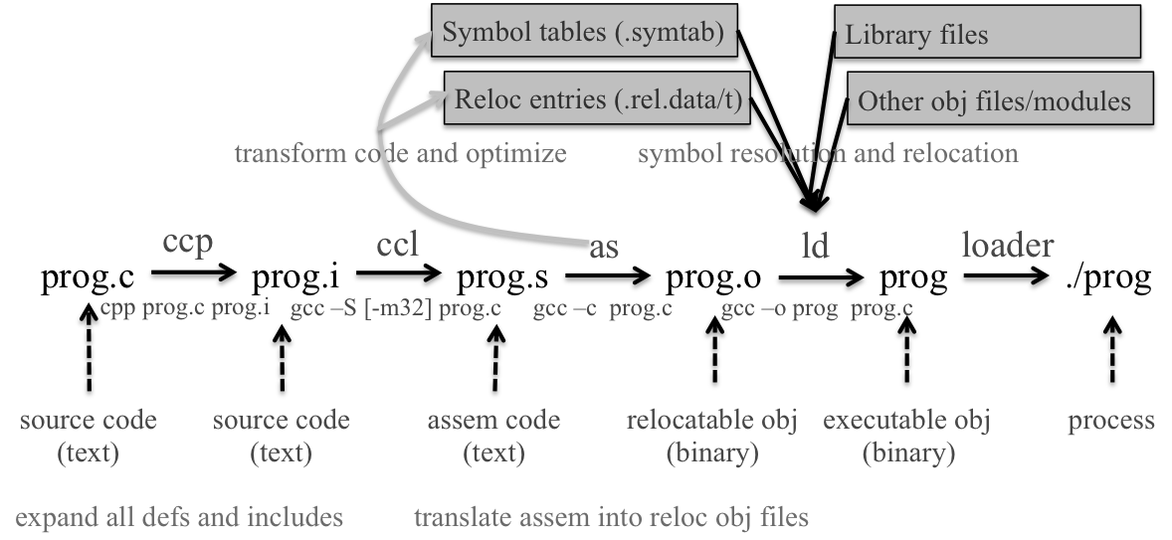
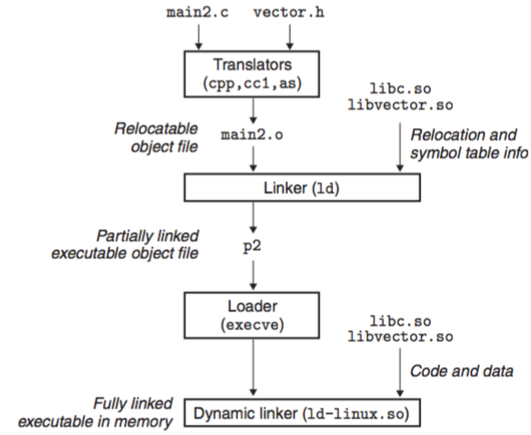
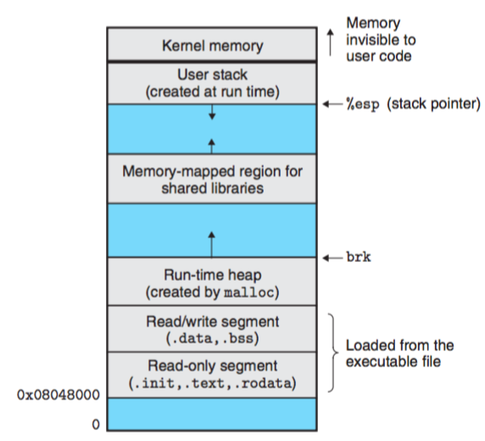
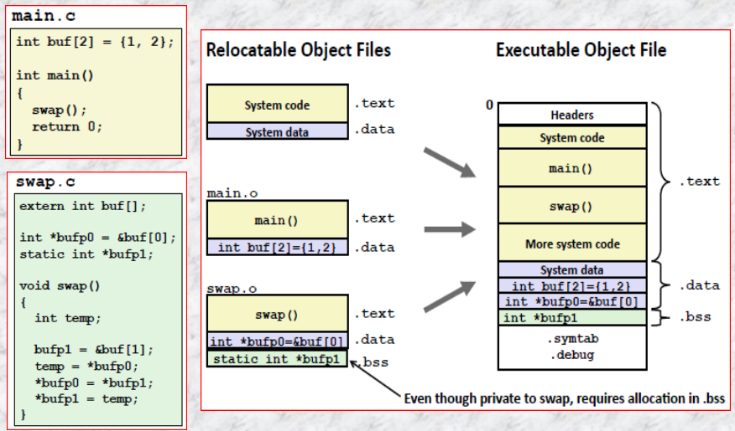
Compiling, Linking and Loading
https://people.cs.pitt.edu/~xianeizhang/notes/Linking.html

Slide 59
Loading Executable Object Files into Virtual Address
Executable Object File
Kernel virtual memory
Memory
invisible to user code
0
ELF header
User stack
(created at runtime)
Program header table
(required for executables)
%esp
(stack
pointer)
.init section
.text section
Memory-mapped region for
shared libraries
.rodata section
.data section
.bss section
brk
.symtab
Run-time heap
(created by malloc)
.debug
Read/write data segment
(.data, .bss)
Loaded
from
the
executable
file
.line
.strtab
Read-only code segment
(.init, .text, .rodata)
Section header table
(required for relocatables)
0x400000
Unused
0
Notes:
…
Large heap in the high addresses (mmap)

Slide 60
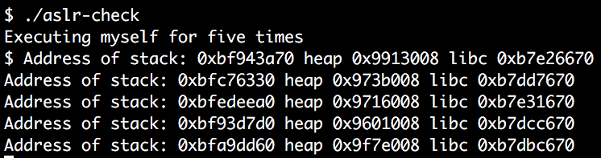
ASLR: Randomize Addresses per Each Execution
Notes:
implement aslr-check script.

Slide 61
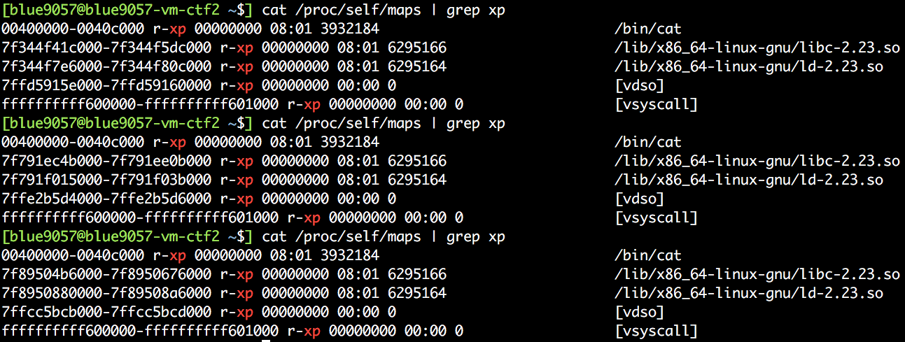
How Random is the Address?
Space | Entropy | Chance
32bit stack | 19 bits | 1 in 524288
32bit heap | 13 bits | 1 in 8192
32bit library | 8 bits | 1 in 512
64bit stack | 30 bits | 1 in 1G…
64bit heap | 28 bits | 1 in 128M
64bit library | 28 bits | 1 in 128M
64bit Windows | 19 bits | 1 in 524288
Notes:
KJEE-TODO: check what is aslr-check

Slide 62
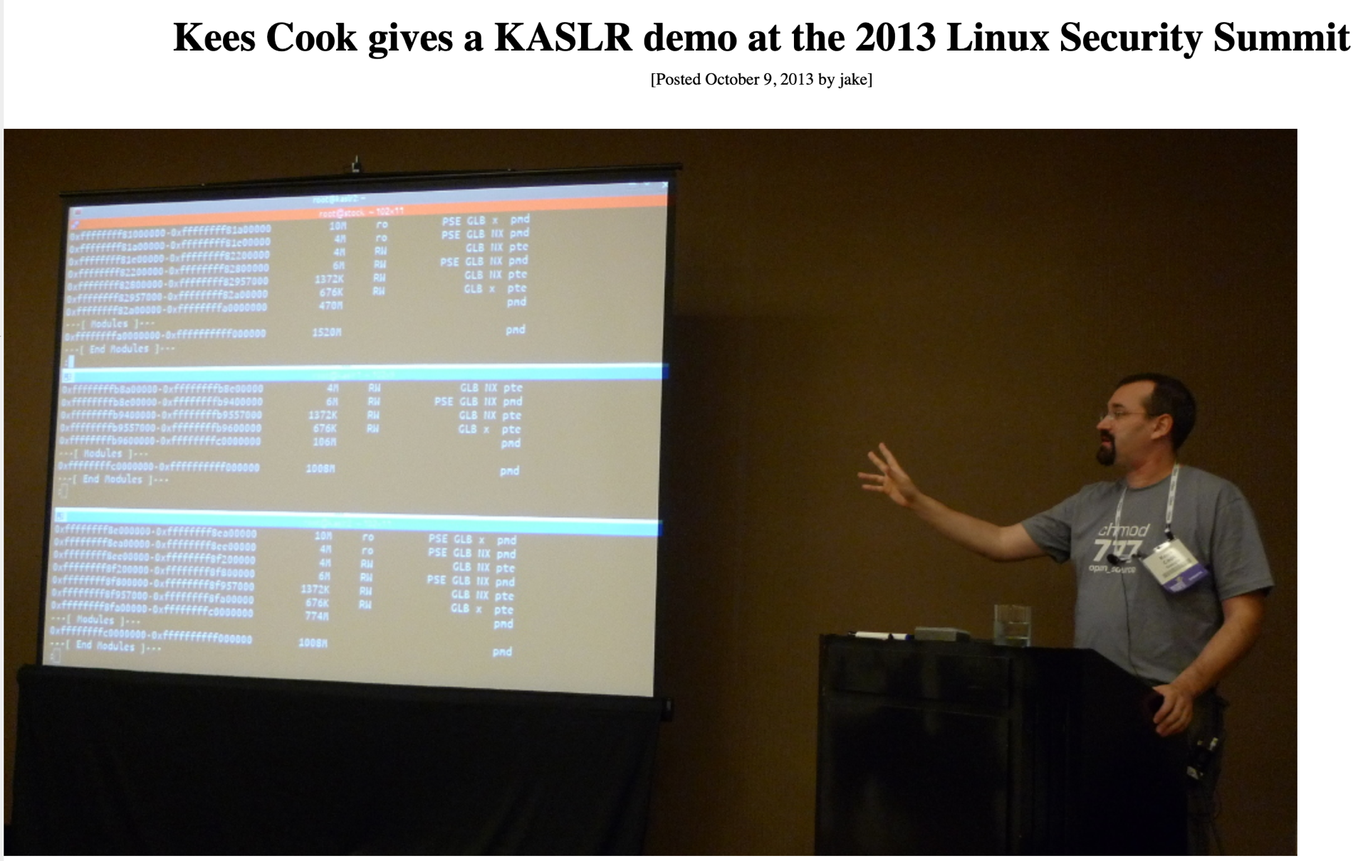
ASLR - History

Slide 63
ASLR - History
Linux PaX adapt this first in 2002
OpenBSD – 2003
Linux – 2005
Windows – Vista in 2007
iOS – iOS 4.3 in 2011
Android – Android 4.0 ICS in 2011
Notes:
KJEE-TODO: we can add more details on it.

Slide 64
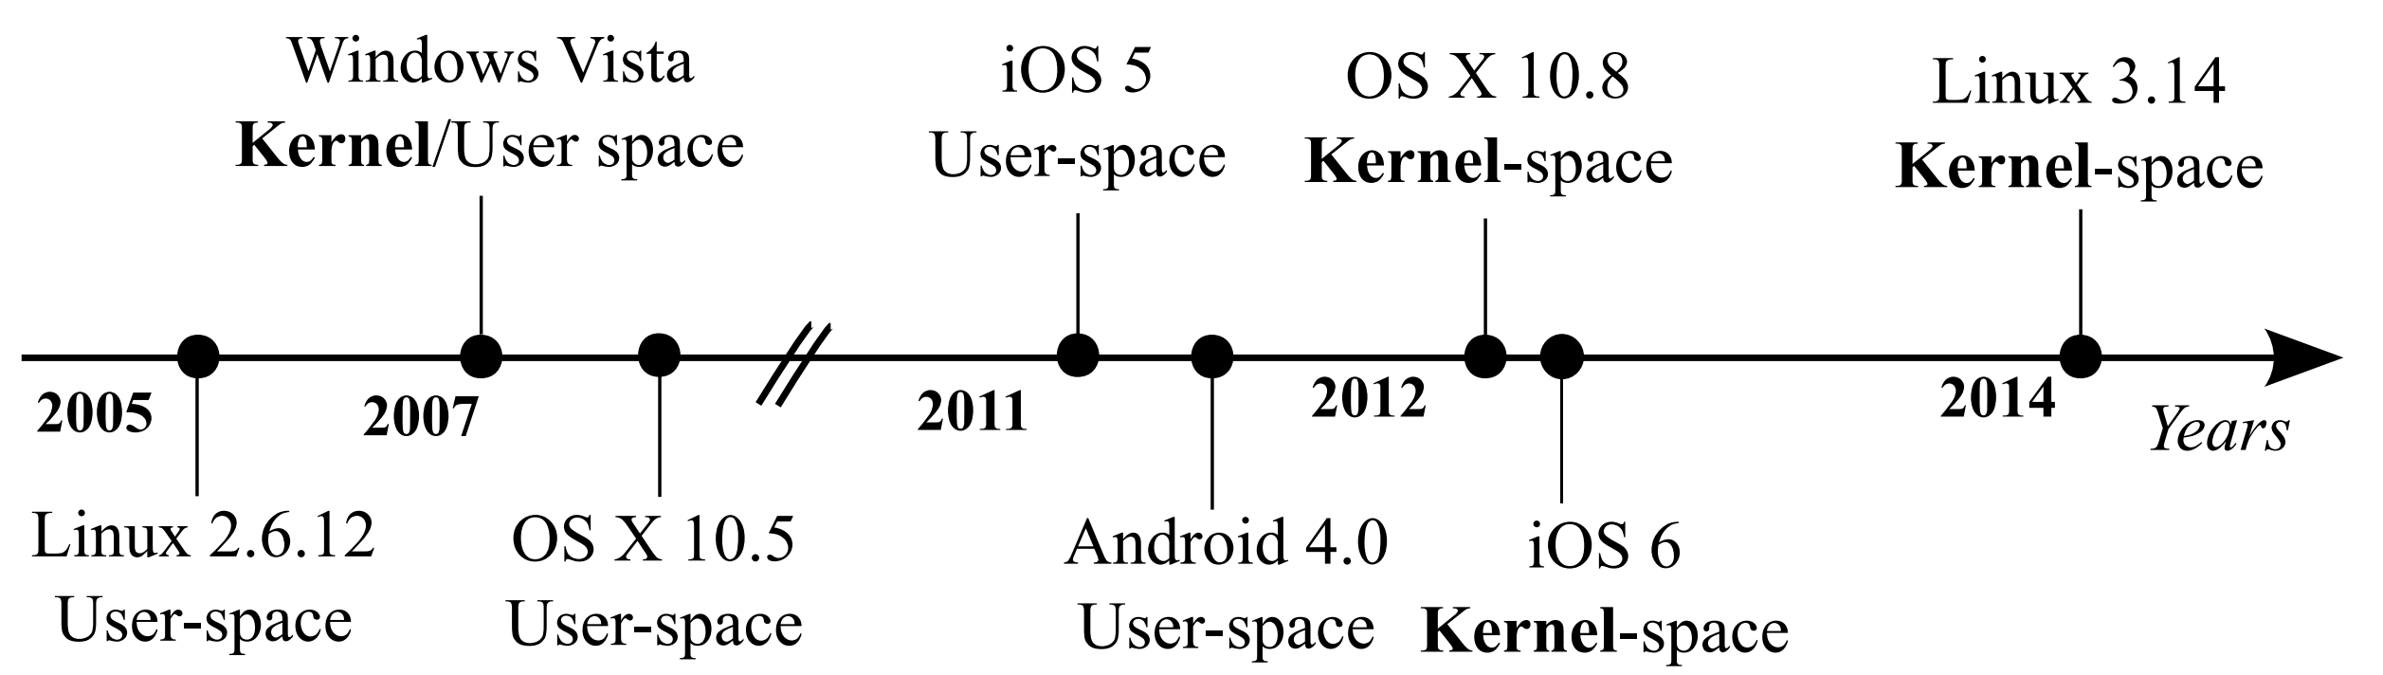
ASLR - History
Linux PaX adapt this first in 2002
OpenBSD – 2003
Linux – 2005
Windows – Vista in 2007
iOS – iOS 4.3 in 2011
Android – Android 4.0 ICS in 2011
Notes:
KJEE-TODO: Clarify kernel- vs userspace- ASLR

Slide 65
Relativism
CODE
PRINTF
0x23423
< 1% in 64-bit
  Access all strings via relative address from current %rip
    lea 0x23423(%rip), %rdi
  printf(”asdf”)
DATA
”asdf”
Notes:
thunk -- thunk usually refers to a small piece of code that is called as a function, does some small thing, and then JUMPs to another location (usually a function) instead of returning to its caller. Assuming the JUMP target is a normal function, when it returns, it will return to the thunk's caller.

Slide 66
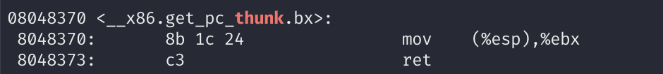
Relativism (32 bit)
CODE
PRINTF
0x23423
~ 3% in 32-bit
  Cannot address using %eip
How?
  call +5; pop %ebx; add $0x23423, %ebx; ← GETTING %EIP to %EBX
DATA
”asdf”
and + $0x23423
Notes:
thunk -- thunk usually refers to a small piece of code that is called as a function, does some small thing, and then JUMPs to another location (usually a function) instead of returning to its caller. Assuming the JUMP target is a normal function, when it returns, it will return to the thunk's caller.

Slide 67
Overhead?
Segment Base
CODE
0x23423
(offset)
PRINTF
64-bit support %rip addressing: ~ 1% overhead
  printf(”asdf”);
  Access all strings via relative address from current %rip
    lea 0x23423(%rip), %rdi
32-bit no support %eip addressing: ~ 3% overhead
How? (thunk)
  call +5
  pop %ebx ← GETTING EIP to EBX
  add $0x23423, %ebx
DATA
”asdf”

Slide 68
CAVEAT
To have a strong defense, systems must randomize all addresses (or segments)
  Code, data, stack, heap, library, mmap(), etc.
However, Code/data still merely randomized
  Why? Some compatibility issue…
Notes:
KJEE-TODO:
More details on segments
What are the compatibility issues?

Slide 69
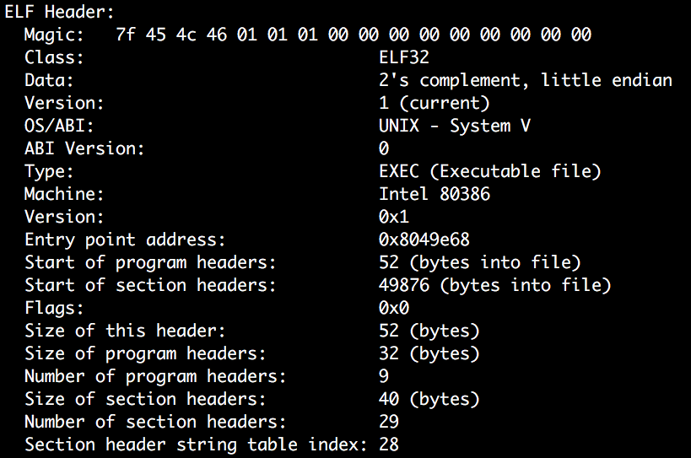
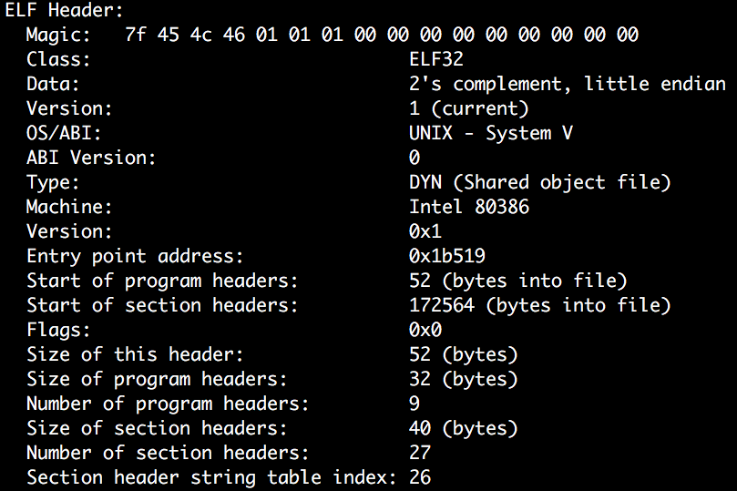
Position Independent Executable (PIE)
/bin/cat from Ubuntu 16.04.3
/bin/sh from Ubuntu 16.04.3

Slide 70
Then, How Can We Bypass ASLR?
Brute-force
  Get a core dump
  Set that address
  Run for N times!
Eventually the address will be matched..
  Look at the table
Requires too many trials in some cases…
Space | Entropy | Chance
32bit stack | 19 bits | 1 in 524288
32bit heap | 13 bits | 1 in 8192
32bit library | 8 bits | 1 in 512
64bit stack | 30 bits | 1 in 1G…
64bit heap | 28 bits | 1 in 128M
64bit library | 28 bits | 1 in 128M
64bit Windows | 19 bits | 1 in 524288

Slide 71
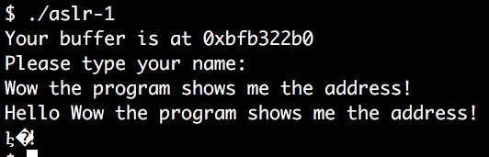
Leak address
Information Leak
  Leak the target address!
  Use shellcode – stack buffer or argv, envp, stack top, etc.
  Libc? Where is the system()?
But leaking the exact target address could be difficult

Slide 72
Understanding ASLR Characteristics
How do they randomize the address?
  Change the BASE address of each area
  Use relative addressing in the area
Relative addressing?
  Kernel let program know where the start is
    0xffffd800 if stack starts at 0xffffe000
    STACK_START – 0x800 is that address
  system()?
    LIBC_BASE + SYSTEM_OFFSET == system()
  Attacker cannot know this

Slide 73
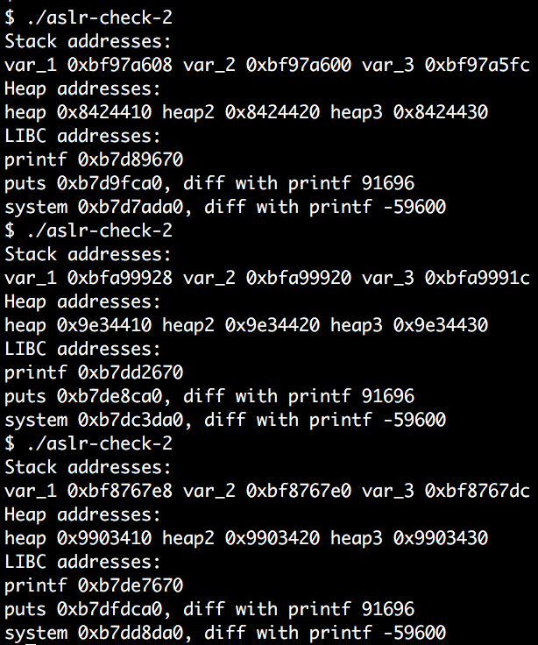
Relative Addressing
Addresses are different,
But offset distances remain the same
Notes:
KJEE-TODO: offset-based addressing

Slide 74
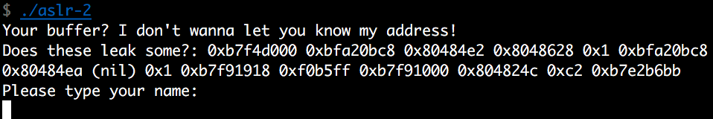
ASLR Bypass Strategy
Stack
  Leak one address
  Calculate the distance between the leaked one and the one with your interest
    BUFFER_ADDRESS – LEAKED_ADDRESS = OFFSET
  Leak one address in your exploit
    LEAKED_ADDRESS + OFFSET = LEAKED_ADDRESS
  Calculate the OFFSET from the core dump!

Slide 75
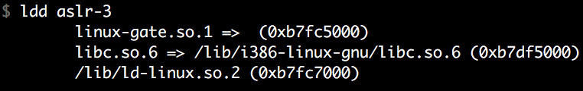
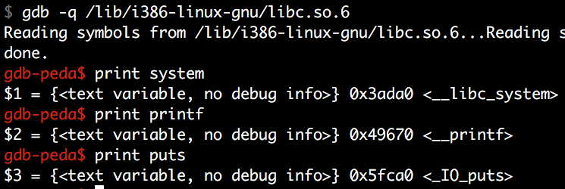
ASLR Bypass Strategy
Library
  ldd first
  Open that library with gdb
  Print functions!
    Prints offset
Attacking Library
  Leak one library address
  Find what is the base address (LEAK is BASE + SOME_OFFSET)
  Calculate SYSTEM (LEAK – SOME_OFFSET + SYSTEM_OFFSET)

Slide 76
Catch
To have a strong defense, systems must randomize all addresses
(or segments)
  Code, data, stack, heap, library, mmap(), etc.
However, code/data segment still merely randomized
  Why? Performance, compatibility issue…
Notes:
KJEE-TODO:
More details on segments
What are the compatibility issues?

Slide 77
Position Independent Executable (PIE)
/bin/cat from Ubuntu 16.04.3
/bin/sh from Ubuntu 16.04.3

Slide 78
Assignment: Unit-4
  aslr-1
    Leaks buffer address
  aslr-2
    Leaks some stack address (use relative addressing to get the buffer address!)
  aslr-3
    Leaks some variables in the stack (use relative addressing, too)
    Think about how you may utilize the leak after submitting your input…
  aslr-4
    Leaks the address of printf (use relative addressing to figure out system()’s address)

Slide 79
Assignment: Unit-4
  aslr-5
    Program contains a function that you can leak some addresses. Call that to leak.
    After that, use that address for your exploit (without invoking a new process() again)
  alsr-6
  aslr-7

Slide 80
Assignment: Unit-4
  ASLR: connect to ctf-vm2.syssec.utdallas.edu
    The same credential should work (id, private key, etc.)
  Challenges are in /home/labs/unit4
    Run `fetch unit4`
  Have fun!

