Slide 1
CS4459.001
Cyber Attacks & Defense Lab
Return Oriented Programming (ROP)
Mar 12, 2026

Slide 2
Assignment: Unit-5
  ASLR: connect to ctf-vm2.utdallas.edu
  Challenges are in /home/labs/unit5
    Run fetch unit5
  Overview
    Rop-2: open(), read(), write()
    Rop-3: Call mprotect() to grant execute permission on data and run shellcode…
    Rop-4: Build a string by returning to strcpy() multiple times..
    Rop-5: Leak GOT and overwrite that via ROP
    Rop-6: No ‘pop %rdx’ …

Slide 3
Unit5 Restrictions
The attacker can still
  Overwrite some memory location
  Hijack the control flow – e.g., overflow to overwrite RET address
  Stably locate (some/limited) code gadgets
The attackers cannot
  Run their code

Slide 4
Defenses
Data Execution Prevention
  Call existing functions in the program
  Call library functions
  → Code-reuse attack
Stack Cookie
  Information leak
  Side-channel attack
  Non-sequential overwrite
ASLR
  Information leak (leak any address of stack or library)

Slide 5
Modern Defense since 2014
Stack-cookie + DEP + ASLR
  All enabled in Windows, Linux, MacOS, Android, iOS, etc..
  But ASLR was not enabled to program text (-fPIC)
    You can jump to the fixed location in the program’s code…
    E.g., 0x8048584… etc.
We have learned how we can bypass each of them
  Zero defense → stack canary → DEP → ASLR
How about all combined?
  Let’s bypass them even if they are somewhat combined
W⊗X
W⊗X
W⊗X
W⊗X
W⊗X
W⊗X
Notes:
https://msrc-blog.microsoft.com/2010/12/08/on-the-effectiveness-of-dep-and-aslr/
TODO: we need to fix figure to fix text and randomize stack and heap

Slide 6
DEP + ASLR
DEP-1, DEP-2, DEP-3
Code re-use: your exploit was returning to library (libc) functions
  execve(), system(), read(), printf(), etc.
How did you get the address?
  From gdb, assuming the addresses are not randomized
What if such addresses are randomized by ASLR?
  DEP + ASLR

Slide 7
Two types of ASLR
Not ALL segments are
randomized
Unit 5
Normal
  We call this non-PIE (Position Independent Executable)
  Your program code (TEXT or .txt) address will be always at the fixed location
    i.e., addresses that you see in GDB is the address on the execution
  Library, heap, and stack are all randomized.
PIE (Position Independent Executable)
  Your program code (TEXT or .txt) will also be randomized in each time of execution
Notes:
readelf –h command can provide entry point address.

Slide 8
Two types of ASLR
Unit 5
Normal
  We call this non-PIE (Position Independent Executable)
  Your program code (TEXT or .txt) address will be always at the fixed location
    i.e., addresses that you see in GDB is the address on the execution
  Library, heap, and stack are all randomized.
PIE (Position Independent Executable)
  Your program code (TEXT or .txt) will also be randomized in each time of execution
Notes:
readelf –h command can provide entry point address.

Slide 9
Breaking DEP + ASLR
We will learn how to break DEP + ASLR step by step
We will first tackle challenges that does not randomize (fixed) the program’s code section
  Yes, you can use those functions!
Then, can you easily get the shell from the program?

Slide 10
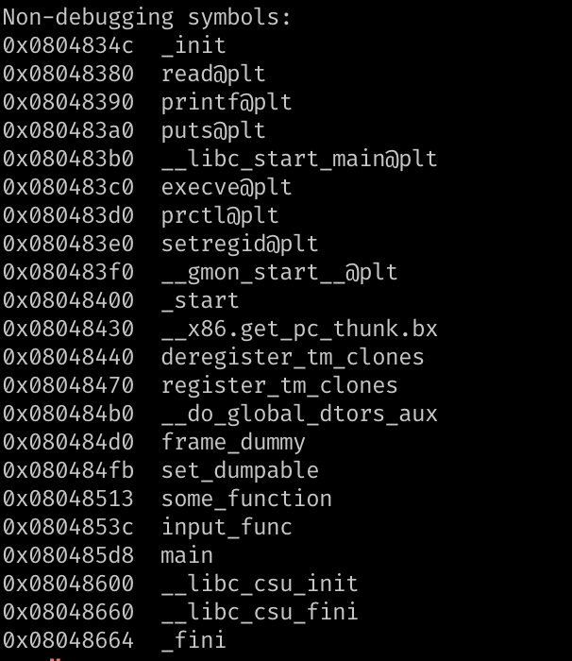
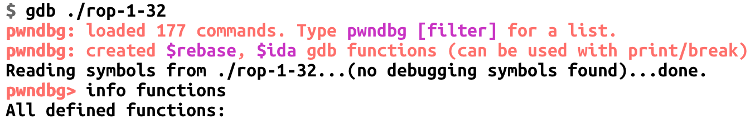
Getting a Privileged Shell
setregid(50000, 50000);
execve(“/bin/sh”, 0, 0);
In case if the program contains those two functions, we can easily call them.
Really?

Slide 11
Chaining Function Calls in DEP-3
Read_ARG3
size = 100
Read_ARG2
Addr of buffer
Read_ARG1
fd = 3
printf(stack)
Print data in stack…
read()
read(3, stack, 100)
some_function()
Open a.txt
%esp

Slide 12
Chaining Function Calls in DEP-3
Read_ARG3
size = 100
Read_ARG2
Addr of buffer
Read_ARG1
fd = 3
Return!
printf(stack)
Print data in stack…
read()
read(3, stack, 100)
some_function()
Open a.txt
%esp

Slide 13
Chaining Function Calls in DEP-3
Read_ARG3
size = 100
Read_ARG2
Addr of buffer
Read_ARG1
fd = 3
Return!
Jump to some_function()
printf(stack)
Print data in stack…
read()
read(3, stack, 100)
%esp
some_function()
Open a.txt

Slide 14
Chaining Function Calls in DEP-3
Read_ARG3
size = 100
Read_ARG2
Addr of buffer
some_function() // prolog
push %ebp
mov %esp, %ebp
sub $0x50, %esp
Read_ARG1
fd = 3
printf(stack)
Print data in stack…
read()
read(3, stack, 100)
%esp
some_function()
Open a.txt

Slide 15
Chaining Function Calls in DEP-3
Read_ARG3
size = 100
Read_ARG2
Addr of buffer
some_function() prolog
push %ebp
mov %esp, %ebp
sub $0x50, %esp
Read_ARG1
fd = 3
printf(stack)
Print data in stack…
read()
read(3, stack, 100)
%esp
some_function()
Open a.txt

Slide 16
Chaining Function Calls in DEP-3
Read_ARG3
size = 100
Read_ARG2
Addr of buffer
some_function() prolog
push %ebp
mov %esp, %ebp
sub $0x50, %esp
Read_ARG1
fd = 3
printf(stack)
Print data in stack…
read()
read(3, stack, 100)
Saved_ebp
%esp

Slide 17
Chaining Function Calls in DEP-3
Read_ARG3
size = 100
Read_ARG2
Addr of buffer
some_function() prolog
push %ebp
mov %esp, %ebp
sub $0x50, %esp
Read_ARG1
fd = 3
printf(stack)
Print data in stack…
read()
read(3, stack, 100)
Saved_ebp
%esp

Slide 18
Chaining Function Calls in DEP-3
Read_ARG3
size = 100
Read_ARG2
Addr of buffer
some_function() prolog
push %ebp
mov %esp, %ebp
sub $0x50, %esp
Read_ARG1
fd = 3
printf(stack)
Print data in stack…
read()
read(3, stack, 100)
Saved_ebp
%ebp
%esp

Slide 19
Chaining Function Calls in DEP-3
Read_ARG3
size = 100
Read_ARG2
Addr of buffer
some_function() prolog
push %ebp
mov %esp, %ebp
sub $0x50, %esp
Read_ARG1
fd = 3
printf(stack)
Print data in stack…
read()
read(3, stack, 100)
Saved_ebp
%ebp
%esp

Slide 20
Chaining Function Calls in DEP-3
Read_ARG3
size = 100
Read_ARG2
Addr of buffer
some_function() prolog
push %ebp
mov %esp, %ebp
sub $0x50, %esp
Read_ARG1
fd = 3
printf(stack)
Print data in stack…
read()
read(3, stack, 100)
Saved_ebp
%ebp
%esp

Slide 21
Chaining Function Calls in DEP-3
Read_ARG3
size = 100
Read_ARG2
Addr of buffer
some_function() epilog
leave
ret
Read_ARG1
fd = 3
printf(stack)
Print data in stack…
read()
read(3, stack, 100)
Saved_ebp
%ebp
%esp

Slide 22
Chaining Function Calls in DEP-3
Read_ARG3
size = 100
Read_ARG2
Addr of buffer
some_function() // epilog
leave
ret
Read_ARG1
fd = 3
// mov $ebp, $esp; pop $ebp
printf(stack)
Print data in stack…
read()
read(3, stack, 100)
Saved_ebp
%ebp
%esp

Slide 23
Chaining Function Calls in DEP-3
%ebp
Read_ARG3
size = 100
Read_ARG2
Addr of buffer
some_function() // epilog
leave
ret
Read_ARG1
fd = 3
// mov $ebp, $esp; pop $ebp
printf(stack)
Print data in stack…
read()
read(3, stack, 100)
%esp
Saved_ebp

Slide 24
Chaining Function Calls in DEP-3
%ebp
Read_ARG3
size = 100
Read_ARG2
Addr of buffer
some_function() // epilog
leave
ret
Read_ARG1
fd = 3
// mov $ebp, $esp; pop $ebp
printf(stack)
Print data in stack…
read()
read(3, stack, 100)
%esp
Saved_ebp

Slide 25
Chaining Function Calls in DEP-3
%ebp
Read_ARG3
size = 100
Read_ARG2
Addr of buffer
some_function() // epilog
leave
ret
Read_ARG1
fd = 3
// mov $ebp, $esp; pop $ebp
printf(stack)
Print data in stack…
%esp
read()
read(3, stack, 100)
Execute read(3, buffer, 100)!
Saved_ebp
Notes:
KJEE-TODO: Needs to fix the animation

Slide 26
Return Chain
Read_ARG3
size = 100
Read_ARG2
Addr of buffer
From the return address, if you return to a function
  Then after finishing the function’s execution
  The processor will return to the next address…
some_function();
read();
printf();
Read_ARG1
fd = 3
printf(stack)
Print data in stack…
read()
read(3, stack, 100)
some_function()
Open a.txt

Slide 27
ROP-1 (Return-oriented Programming)
Read_ARG3
size = 100
We call this execution made by a chain of return as
  Return-oriented Programming (ROP)
We can chain arbitrary number of functions
  But wait, what about arguments?
Read_ARG2
Addr of buffer
Read_ARG1
fd = 3
printf(stack)
Print data in stack…
read()
read(3, stack, 100)
some_function()
Open a.txt

Slide 28
ROP-1: Function Arguments..
YYYY
setregid(50000, 50000);
execve(“/bin/sh”, 0, 0);
XXXX
Setregid_ARG2
50000
Or with any other string with symlink to “/bin/sh”
We can first set the return address as
  setregid();
Then, set +8 and +12 as 50000 for its arguments
And then, we put execve() at +4, to chain the call
setregid_ARG1
50000
execve()
setregid()

Slide 29
ROP-1: Function Arguments..
ZZZZ
YYYY
setregid(50000, 50000);
execve(“/bin/sh”, 0, 0);
XXXX
Setregid_ARG2
50000
And then, we put execve() at +4, to chain the call
Seems we call
  execve(50000, XXXX, YYYY);
  This will always fail because 50000 is not a valid address
So, if you have some function arguments
  You can’t chain multiple functions
setregid_ARG1
50000
execve()
setregid()
No!

Slide 30
What Do You Want to Put for XXXX?
0
0
Let’s take a look at the stack on the right
Addr “/bin/sh”
execve()
Setregid_ARG2
50000
setregid_ARG1
50000
XXXX
setregid()
%esp

Slide 31
What Do You Want to Put for XXXX?
0
0
Let’s look at the stack on the right
At return
Addr “/bin/sh”
execve()
Setregid_ARG2
50000
setregid_ARG1
50000
XXXX
setregid()
%esp

Slide 32
What Do You Want to Put for XXXX?
0
0
Let’s look at the stack on the right
At return
  setregid(50000, 50000)
Addr “/bin/sh”
execve()
Setregid_ARG2
50000
setregid_ARG1
50000
XXXX
%esp
setregid()

Slide 33
What Do You Want to Put for ‘XXXX’?
0
0
Let’s take a look at the stack on the right
At return
  setregid(50000, 50000);
What if we run the following instruction sequence
for XXXX?
  pop %edi
  pop %ebp
  ret
Addr “/bin/sh”
execve()
Setregid_ARG2
50000
setregid_ARG1
50000
pop-pop-ret
%esp
setregid()

Slide 34
What Do You Want to Put for XXXX?
0
0
Let’s take a look at the stack on the right
pop %edi
pop %ebp
ret
Addr “/bin/sh”
execve()
Setregid_ARG2
50000
setregid_ARG1
50000
%esp
pop-pop-ret
setregid()

Slide 35
What Do You Want to Put for XXXX?
0
0
Let’s take a look at the stack on the right
pop %edi
pop %ebp
ret
Addr “/bin/sh”
execve()
Setregid_ARG2
50000
%esp
setregid_ARG1
50000
pop-pop-ret
setregid()

Slide 36
What Do You Want to Put for XXXX?
0
0
Let’s take a look at the stack on the right
pop %edi = 50000
pop %ebp
ret
Addr “/bin/sh”
execve()
Setregid_ARG2
50000
%esp
setregid_ARG1
50000
pop-pop-ret
setregid()

Slide 37
What Do You Want to Put for XXXX?
0
0
Let’s take a look at the stack on the right
pop %edi = 50000
pop %ebp
ret
Addr “/bin/sh”
execve()
Setregid_ARG2
50000
%esp
setregid_ARG1
50000
pop-pop-ret
setregid()

Slide 38
What Do You Want to Put for XXXX?
0
0
Let’s take a look at the stack on the right
pop %edi = 50000
pop %ebp
ret
Addr “/bin/sh”
execve()
%esp
Setregid_ARG2
50000
setregid_ARG1
50000
pop-pop-ret
setregid()

Slide 39
What Do You Want to Put for XXXX?
0
0
Let’s take a look at the stack on the right
pop %edi = 50000
pop %ebp = 50000
ret
Addr “/bin/sh”
execve()
%esp
Setregid_ARG2
50000
setregid_ARG1
50000
pop-pop-ret
setregid()

Slide 40
What Do You Want to Put for XXXX?
0
0
Let’s take a look at the stack on the right
pop %edi = 50000
pop %ebp = 50000
ret
Addr “/bin/sh”
execve()
%esp
Setregid_ARG2
50000
setregid_ARG1
50000
pop-pop-ret
setregid()

Slide 41
What Do You Want to Put for XXXX?
0
0
Let’s take a look at the stack on the right
pop %edi = 50000
pop %ebp = 50000
ret
execve(“/bin/sh”, 0, 0);
Addr “/bin/sh”
%esp
execve()
Setregid_ARG2
50000
setregid_ARG1
50000
pop-pop-ret
setregid()

Slide 42
ROP: We Can Chain Any # of Functions
Function with one argument
  [func] [pop-ret] [arg1][next_function]
Function with two arguments
  [func] [pop-pop-ret] [arg1][arg2] [next_function]
Function with three arguments
  [func] [pop-pop-pop-ret] [arg1][arg2] [arg3][next_function]
Function with four arguments
  [func] [pop-pop-pop-pop-ret] [arg1][arg2] [arg3][arg4][next_function]

Slide 43
i386 (32-bit) Calling Convention
execve();
0
pop %rdx, ret;
Arguments on the stack
  [func] [pop-N-ret] [arg1] [arg2] [arg3] […]
Pop-N-ret is important
  pop ret – can call functions with 1 arg
  pop pop ret – can call functions with 2 args
  pop pop pop ret – can call functions with 3 args
  pop… ret –can call functions with N args..
XXXX
0
pop %rsi; pop %r15; ret
ADDR “/bin/sh”
pop %rdi; ret;
setregid()
XXXX
50001
pop %rsi; pop %r15; ret
50001
pop %rdi; ret;

Slide 44
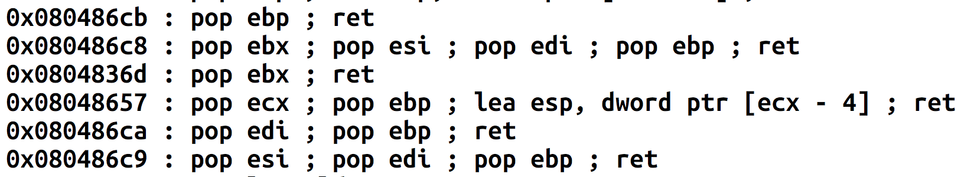
ROP Gadgets
How can we find such a many ’pop’s?
From disassembly,
  Or using a tool: ROPGadgets
1 pop
2 pops
3 pops

Slide 45
ROP-1-32
0
0
setregid(50000, 50000);
execve(“/bin/sh”, 0, 0);
Addr “/bin/sh”
execve()
Setregid_ARG2
50000
setregid_ARG1
50000
POP-POP-RET
setregid()

Slide 46
ROP-1-64: 64bit
0
0
ROP in 32-bit is easier than 64bit
  because of calling conventions
  32-bit function gets arguments from the stack
In amd64, arguments are passed by Registers
  $rdi
  $rsi
  $rdx
  $rcx
  $r8
  $r9
Addr “/bin/sh”
execve()
Setregid_ARG2
50000
Passing arguments via stack will not work!
setregid_ARG1
50000
POP-POP-RET
setregid()
Notes:
How about ARM?

Slide 47
ROP-1-64: Setting Register Values
We can set register values using ‘pop XXX’

Slide 48
What Do You Want to Put for XXXX?
0
0
Let’s look at the stack on the right
pop %edi = 50000
pop %ebp = 50000
ret
Addr “/bin/sh”
execve()
%esp
Setregid_ARG2
50000
setregid_ARG1
50000
pop-pop-ret
setregid()

Slide 49
ROP-1-64: Setting Register Values
We can set register values using pop XXX
Arguments are at $rdi, $rsi, $rdx, $rcx…
Can we find?
  pop %rdi; ret;
  pop %rsi; ret;
  pop %rdx; ret;
  …
Yes

Slide 50
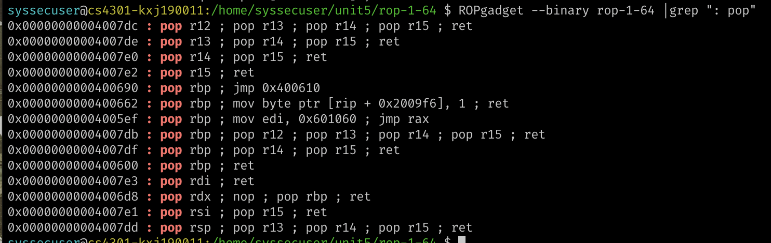
ROP-1-64: Setting Register Values

Slide 51
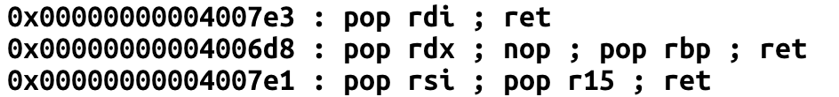
ROP-1-64: Passing Args in amd64
setregid()
pop %rdi
ret
pop %rsi
pop %r15
ret
XXXX
Setregid_ARG2
50001
pop %rsi; pop %r15; ret
setregid_ARG1
50001
%rsp
pop %rdi; ret;

Slide 52
ROP-1-64: Passing Args in amd64
setregid()
pop %rdi
ret
pop %rsi
pop %r15
ret
XXXX
Setregid_ARG2
50001
pop %rsi; pop %r15; ret
setregid_ARG1
50001
%rsp
pop %rdi; ret;

Slide 53
ROP-1-64: Passing Args in amd64
setregid()
pop %rdi = 50001
ret
pop %rsi
pop %r15
ret
XXXX
Setregid_ARG2
50001
pop %rsi; pop %r15; ret
%rsp
setregid_ARG1
50001
pop %rdi; ret;

Slide 54
ROP-1-64: Passing Args in amd64
setregid()
pop %rdi = 50001
ret
pop %rsi
pop %r15
ret
XXXX
Setregid_ARG2
50001
pop %rsi; pop %r15; ret
%rsp
setregid_ARG1
50001
pop %rdi; ret;

Slide 55
ROP-1-64: Passing Args in amd64
setregid()
pop %rdi = 50001
ret
pop %rsi
pop %r15
ret
XXXX
Setregid_ARG2
50001
%rsp
pop %rsi; pop %r15; ret
setregid_ARG1
50001
pop %rdi; ret;

Slide 56
ROP-1-64: Passing Args in amd64
setregid()
pop %rdi = 50001
ret
pop %rsi
pop %r15
ret
XXXX
Setregid_ARG2
50001
%rsp
pop %rsi; pop %r15; ret
setregid_ARG1
50001
pop %rdi; ret;

Slide 57
ROP-1-64: Passing Args in amd64
setregid()
pop %rdi = 50001
ret
pop %rsi = 50001
pop %r15
ret
XXXX
%rsp
Setregid_ARG2
50001
pop %rsi; pop %r15; ret
setregid_ARG1
50001
pop %rdi; ret;

Slide 58
ROP-1-64: Passing Args in amd64
setregid()
pop %rdi = 50001
ret
pop %rsi = 50001
pop %r15
ret
XXXX
%rsp
Setregid_ARG2
50001
pop %rsi; pop %r15; ret
setregid_ARG1
50001
pop %rdi; ret;

Slide 59
ROP-1-64: Passing Args in amd64
setregid()
%rsp
pop %rdi = 50001
ret
pop %rsi = 50001
pop %r15 = XXXX
ret
XXXX
Setregid_ARG2
50001
pop %rsi; pop %r15; ret
setregid_ARG1
50001
pop %rdi; ret;

Slide 60
ROP-1-64: Passing Args in amd64
setregid()
%rsp
pop %rdi = 50001
ret
pop %rsi = 50001
pop %r15 = XXXX
ret
XXXX
Setregid_ARG2
50001
pop %rsi; pop %r15; ret
setregid_ARG1
50001
pop %rdi; ret;

Slide 61
ROP-1-64: Passing Args in amd64
%rsp
setregid()
pop %rdi = 50001
ret
pop %rsi = 50001
pop %r15 = XXXX
ret
setregid(50001, 50001);
XXXX
Setregid_ARG2
50001
pop %rsi; pop %r15; ret
setregid_ARG1
50001
pop %rdi; ret;

Slide 62
ROP-1-64: execve?
execve();
0
pop %rdx, ret;
XXXX
0
pop %rsi; pop %r15; ret
ADDR “/bin/sh”
pop %rdi; ret;
%rsp

Slide 63
ROP-1-64: execve?
execve();
0
pop %rdx, ret;
XXXX
0
pop %rsi; pop %r15; ret
ADDR “/bin/sh”
%rsp
pop %rdi; ret;

Slide 64
ROP-1-64: execve?
execve();
0
rdi = addr of “/bin/sh”
pop %rdx, ret;
XXXX
0
pop %rsi; pop %r15; ret
%rsp
ADDR “/bin/sh”
pop %rdi; ret;

Slide 65
ROP-1-64: execve?
execve();
0
rdi = addr of “/bin/sh”
pop %rdx, ret;
XXXX
0
%rsp
pop %rsi; pop %r15; ret
ADDR “/bin/sh”
pop %rdi; ret;

Slide 66
ROP-1-64: execve?
execve();
0
rdi = addr of “/bin/sh”
rsi = 0
r15 = 0 // Don’t care
pop %rdx, ret;
%rsp
XXXX
0
pop %rsi; pop %r15; ret
ADDR “/bin/sh”
pop %rdi; ret;

Slide 67
ROP-1-64: execve?
execve();
0
rdi = addr of “/bin/sh”
rsi = 0
r15 = 0 // Don’t care
%rsp
pop %rdx, ret;
XXXX
0
pop %rsi; pop %r15; ret
ADDR “/bin/sh”
pop %rdi; ret;

Slide 68
ROP-1-64: execve?
execve();
%rsp
0
rdi = addr of “/bin/sh”
rsi = 0
r15 = 0 // Don’t care
rdx = 0
pop %rdx, ret;
XXXX
0
pop %rsi; pop %r15; ret
ADDR “/bin/sh”
pop %rdi; ret;

Slide 69
ROP-1-64: execve?
%rsp
execve();
0
rdi = addr of “/bin/sh”
rsi = 0
r15 = 0 // Don’t care
rdx = 0
execve(“/bin/sh”, 0, 0)
pop %rdx, ret;
XXXX
0
pop %rsi; pop %r15; ret
ADDR “/bin/sh”
pop %rdi; ret;

Slide 70
ROP-1-64: Exploit
execve();
0
pop %rdx, ret;
XXXX
0
pop %rsi; pop %r15; ret
ADDR “/bin/sh”
pop %rdi; ret;
setregid()
XXXX
50000
pop %rsi; pop %r15; ret
50000
pop %rdi; ret;

Slide 71
ROP-2-32 and ROP-2-64
Task
  Call open(), read(), write() (or printf()) by building ROP chain
  Very similar to DEP-3, but requires argument pops
Use tool
  ROPGadget -- binary [program_name]

Slide 72
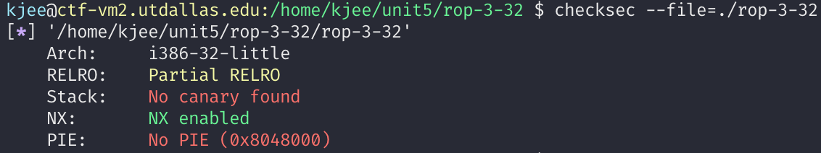
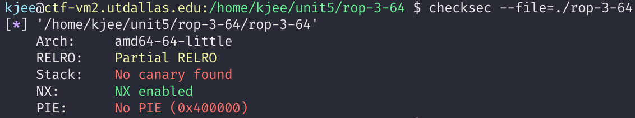
ROP-3-*
DEP/NX Enabled
Can’t execute stack

Slide 73
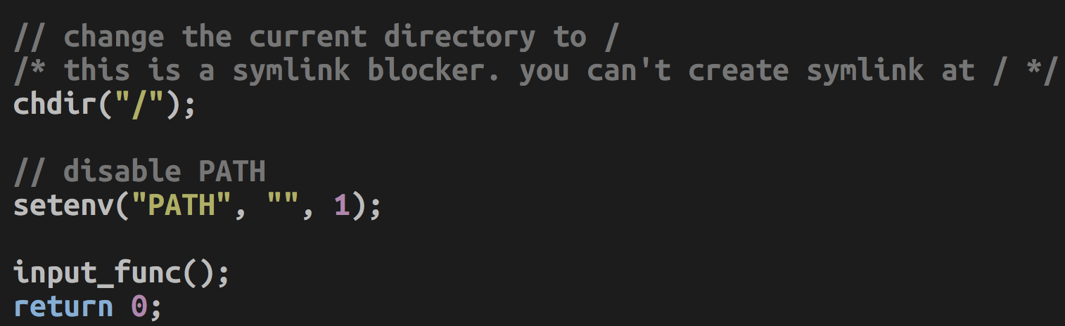
ROP-3-*
chdir(“/”)
  Your working directory is at ‘/’
  You can’t execute “sh” or “\xb8” in current working directory (cwd)
setenv(“PATH”, “”, 1);
  Clear PATH ENV variable; system(“sh”) will never work.

Slide 74
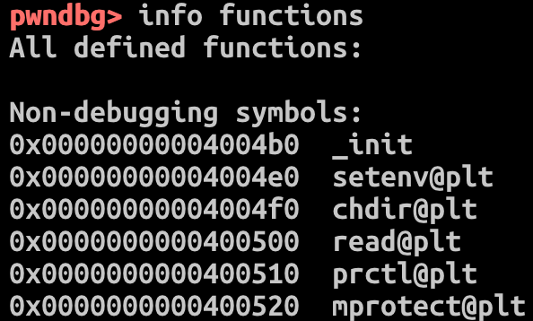
ROP-3-*
Restrictions
  Can’t execute stack → Can’t use shellcode
  Do not know the address of system()
  Do not know the address of setregid()
  Can’t use symlink
Availability
  You have mprotect()!

Slide 75
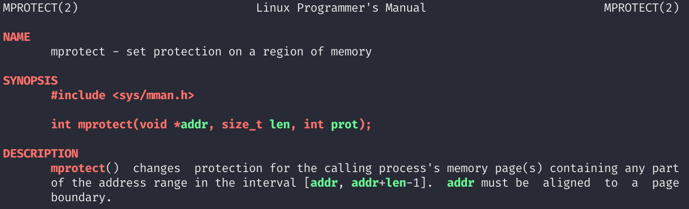
ROP-3-*
Task
  Call mprotect() to create readable/writable page
mprotect(): Changes memory permission (run 'man mprotect')

Slide 76
ROP-3-*
Finding the target
  Any non-executable memory that you can write
  Stack? Global Variables? Heap? Code? Library?
It can be anywhere, but make sure remember the address
Then, you will
  Release the permission of the address
  Put your shellcode on that address
  Jump to the address

Slide 77
ROP-3-*
USAGE: mprotect(addr, size, prot);
  mprotect(0x804a000, 0x1000, 7);
    0x804a000: the address must be page-aligned, which means the last 3 digits must be 0
    0x1000: size, multiplication of the page size, which is 4KB (0x1000 == 4096)
    7: PROT_READ | PROT_WRITE | PROT_EXEC

Slide 78
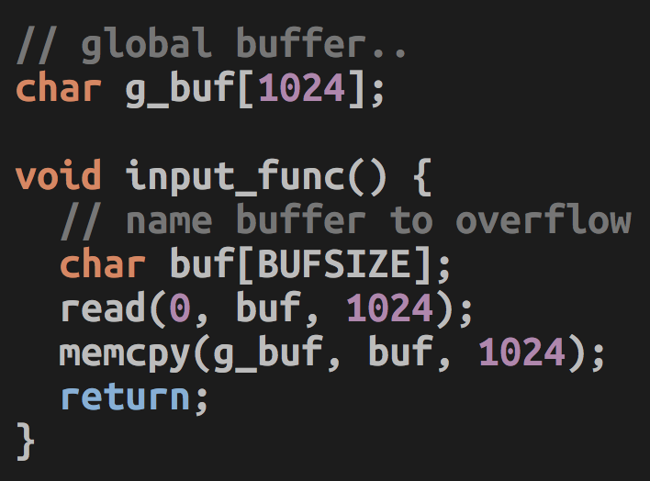
ROP-3-*
Vulnerability
  Your input goes to "buf"
    Local variable on the stack (don’t know the addr)
  Your input will be copied to "g_buf"
    Global variable has the fixed address
    The program is not PIE
  Overflow "buf"
    Put your shellcode at the start of "buf"
    Call mprotect(g_buf (aligned), 0x1000, 7);
    Jump to g_buf;

Slide 79
ROP-3-*
32-bit
  [shellcode][buffer-fill-upto-saved-ebp]
  [mprotect()][g_buf][g_buf-aligned][0x1000][7]
  This will call mprotect(g_buf&0xfffff000, 0x1000, 7)
  and then g_buf();
64-bit
  [shellcode][buffer-fill-upto-saved_rbp]
  [pop rdi][g_buf_aligned][pop rsi r15][0x1000][0][pop rdx][7]
  [mprotect][g_buf]
  Call mprotect(g_buf & 0xfffffffffffff000, 0x1000, 7);
  and then g_buf()

Slide 80
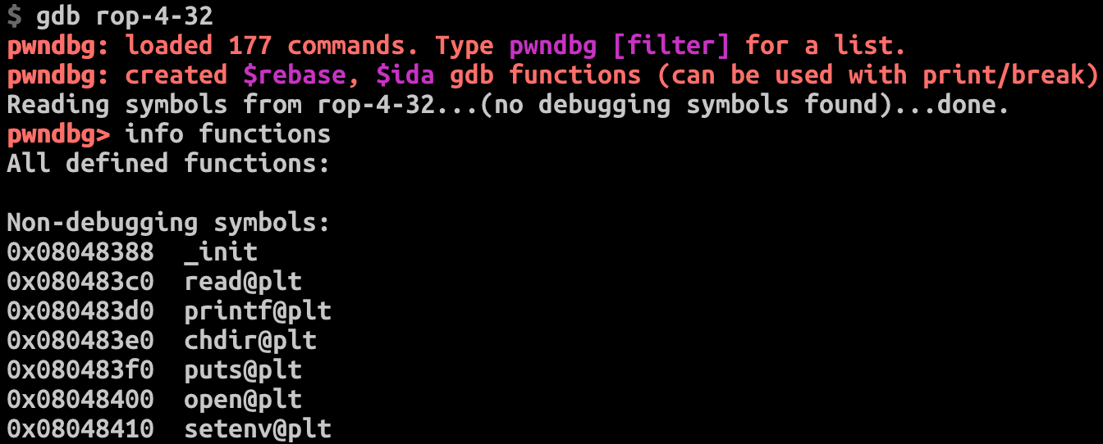

ROP-4-*
Restrictions
  Can’t execute stack → No shellcode
  Do not know the address of
  system()
  Do not know the address of
  setregid()
  Can’t use symlink
Availability
  Can run open()/read()/printf()
  Can run strcpy()

Slide 81
open() / read() / printf()
fd = 3 = open(“/home/labs/unit5/rop-4-32/flag”, 0);
read(3, some_buffer, 100);
printf(some_buffer);

Slide 82
open() / read() / printf()
fd = 3 = open(“/home/labs/unit5/rop-4-32/flag”, 0);
read(3, some_buffer, 100);
printf(some_buffer);

Slide 83
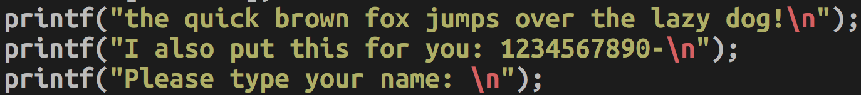
Can You Build a String via ROP?
Yes; using strcpy()
How?

Slide 84
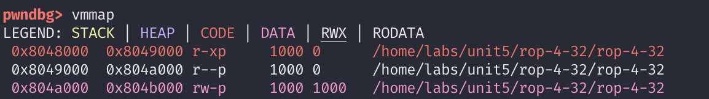
Where Should We Build a String?
vmmap
Where can you write?
GOT.PLT section
Notes:
/home/kjee/unit5/rop-4-32 $ readelf -a rop-4-32 |grep 804a000 will tell you more information.

Slide 85

How to Build a String?
Dst: 0x804a800
Src: “the quick brown fox jumps over the lazy dog!”, 0x8048768
Call: strcpy(0x804a800, 0x8048768);
Result: 0x804a800 → “the quick brown….”

Slide 86

Building “sh”
Dest: .data, 0x804a800
Src: “the quick brown fox jumps over the lazy dog!”, 0x8048768
^24th position
Src: 0x8048768 + 24 = 0x8048780
Call: strcpy(0x804a800, 0x8048780)
Result: 0x804a800 → “s over the lazy dog!”

Slide 87
Building “sh”
Dst: .data, 0x804a801 (+1)
Src: “the quick brown fox jumps over the lazy dog!”, 0x8048768
^1st position
Src: 0x8048768 + 1 = 0x8048769
Call:
strcpy(0x804a801, 0x8048769);
Result: 0x804a800 → “she quick brown fox jumps over the lazy dog!”

Slide 88

Terminating a String
Dst: .data, 0x804a802 (+2)
Src: “the quick brown fox jumps over the lazy dog!\0”, 0x8048768
^44th position
Src: 0x8048768 + 44 = 0x8048794
Call: strcpy(0x804a802, 0x8048794)
Result: 0x804a800 → “sh\0” → “sh”

Slide 89

ROP-4-*
Tasks
  Build a string in the fixed address with "w"rite enabled
  (use vmmap, e.g., 0x804a000 ~ 0x804b000)
    Find them using vmmap on gdb, see the address of fixed, readable, and writable.
    “/home/labs/unit5/rop-4-32/flag”
    “/home/labs/unit5/rop-4-64/flag”
  Call
    open(flag_file, 0);
    read(3, some_address, 100);
    printf(some_address);

Slide 90
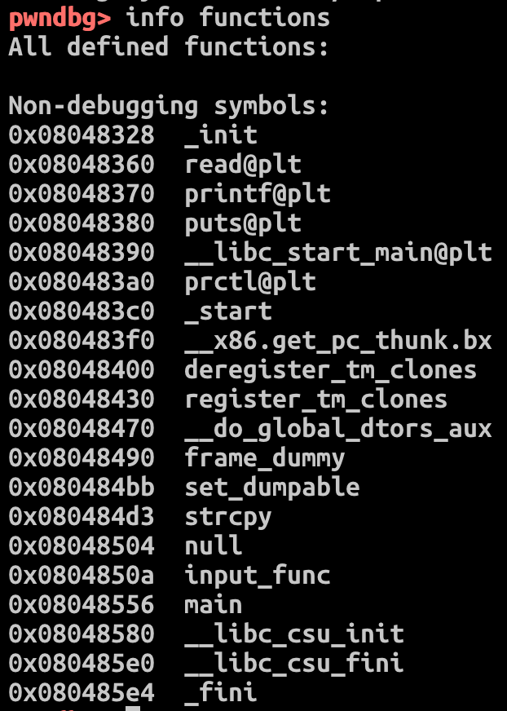
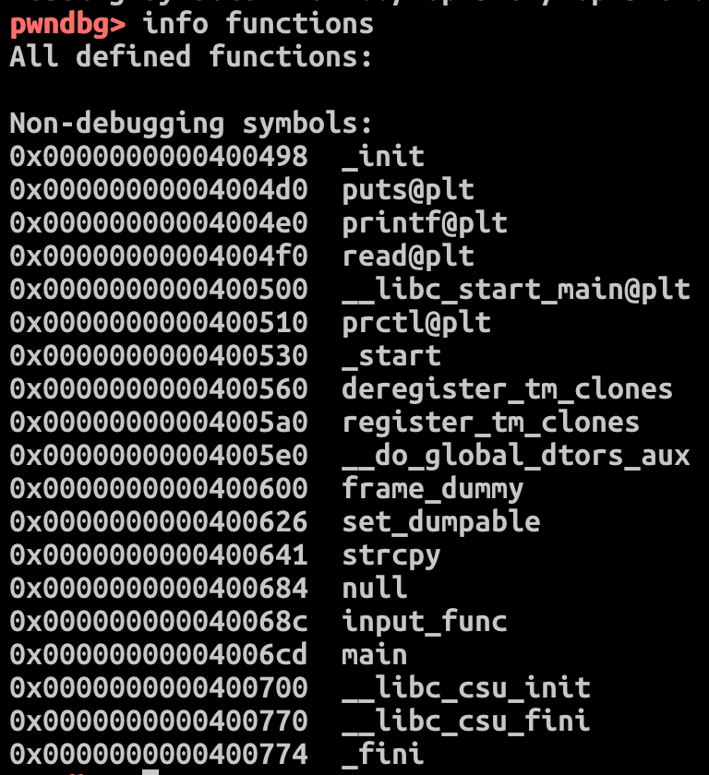
ROP-5-32 and ROP-5-64
Available Functions
  puts
  printf
  read
  prctl
  strcpy
  input_func
  main
  prctl
No open()
No execve()

Slide 91
ROP-5-32/ROP-5-64 Exploit Sketch
Leak GOT of printf();
  Find the GOT of printf();
Use ROP chain to leak the address of printf() in libc
  printf(0x804a010);
  printf(0x601020);
The printf() call will give you an address!

Slide 92
ROP-5-32/ROP-5-64 Exploit Sketch
Recall ASLR-4
  If we know the address of printf() in libc, then we can calculate the address of execve() in libc!
  How?
    Calculate an offset = execve – printf from libc
    execve = offset + printf
Call execve() then!

Slide 93
ROP-5-32/ROP-5-64 Exploit Sketch
Leak address of printf() function
  Call printf() // GOT of printf()
  Convert that into an integer value in pwntools script
  Apply offset to get the address of execve();
Return to input_function()
  You can send your exploit to the program one more time
Call execve();
  $ cat flag

Slide 94
ROP-6-64
No "pop %rdx"
Use gadgets in __libc_csu_init() to control
%rdi, %rsi, and %rdx with
  %r13, %r14, and %r15
Control %r12 and %rbx to call execve()
  Trick!
  callq *(%r12, %rbx, 8);

Slide 95
AMD64 (64-bit) Calling Convention
Set argument first
  [pop %rdi ret] [arg1]
  [pop %rsi %r15 ret] [arg2] [xxx]
  [pop %rdx ret] [arg3]
  [pop %rcx … ret] [arg4] [xxx]…
  [pop %r8 … ret] [arg5] [xxx]…
  [pop %r9 … ret] [arg6] [xxx]…
  …
Then call func
  [func]

Slide 96
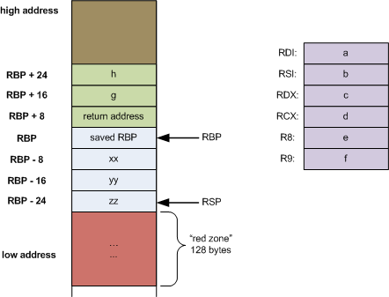
ROP Restrictions in 64-bit
Found pop %rdi
  Can call functions with 1 argument
Found pop %rdi and pop %rsi
  Can call .. with 2 arguments
%rdi, %rsi and %rdx..
  3 arguments
…

Slide 97
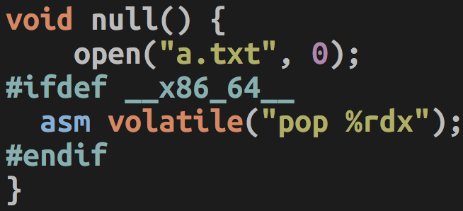
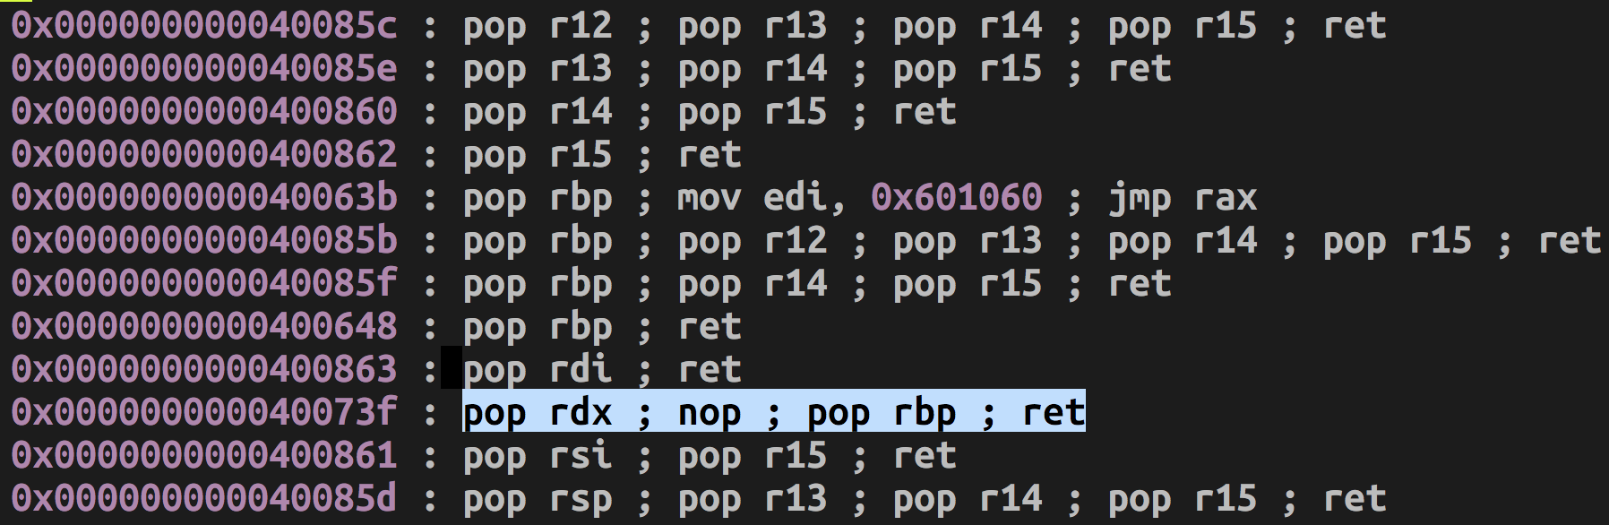
pop %rdx
Level-5 has this gadget for you!

Slide 98
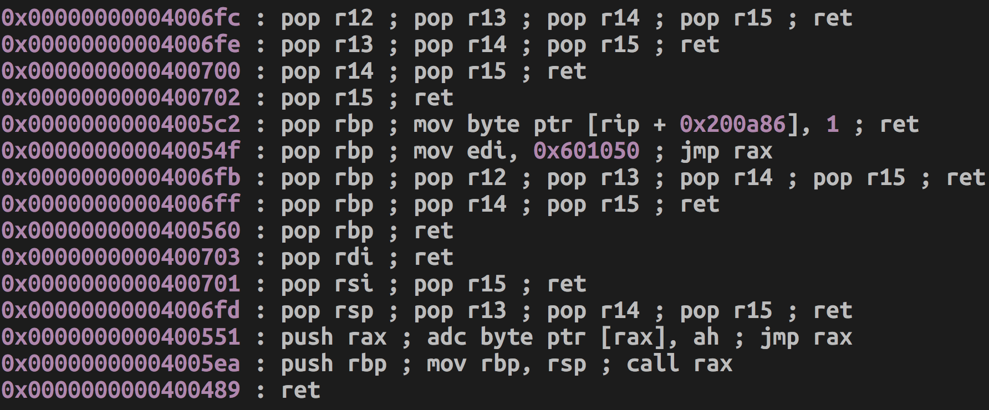
But, not for Level 6 ….
NO POP RDX…

Slide 99
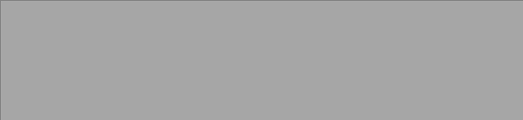
EXECVE()
64bit:
execve(rdi = “xxxx”, rsi, rdx);
Requirements for %rsi and %rdx
  argv and envp
  0
  → There is no argument and environment variable at all
  A pointer to
    Array of string addresses (any valid memory address ends with 0 would be fine)
    Ends with ‘\0’

Slide 100
EXECVE()
64bit:
execve(rdi = “xxxx”, rsi, rdx);
Requirements for %rsi and %rdx
  argv and envp
  0
  → There is no argument and environment variable at all
  A pointer to
    Array of string addresses (any valid memory address ends with 0 would be fine)
    Ends with ‘\0’
  char **argv = {“arg1”, “arg2”, “arg3”, 0}
  char **envp = {“PATH=.”, “SHELL=/bin/bash”, 0}

Slide 101
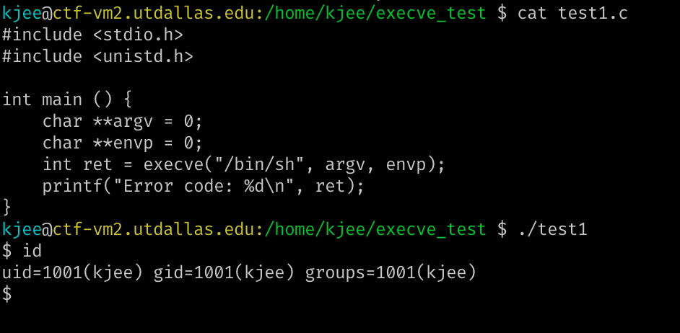
EXECVE(): TEST1

Slide 102
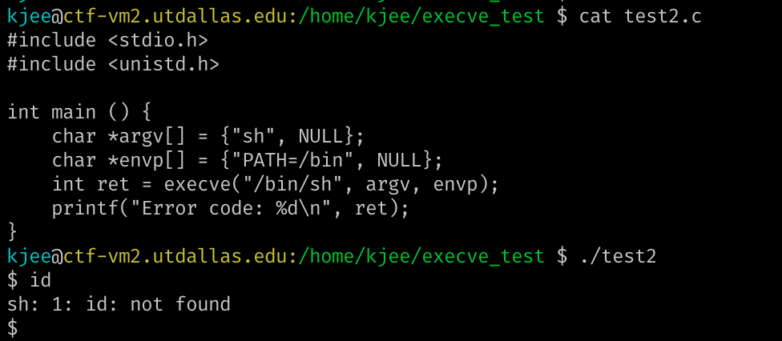
EXECVE(): TEST2

Slide 103
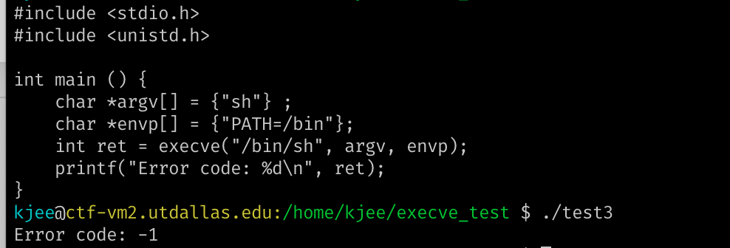
EXECVE(): TEST3
https://codimd.syssec.org/s/tgjS_Vmi-
Try to strace command
Notes:
Missing "NULL" ends

Slide 104
Backup

Slide 105
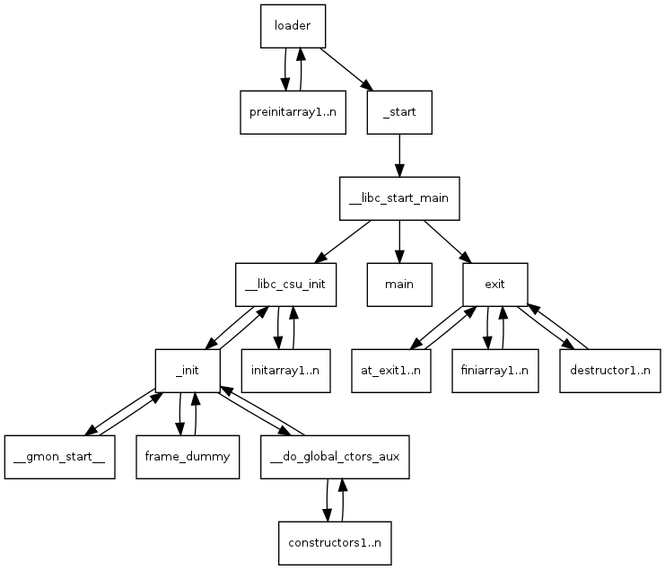
How DO We Get to “main()”?
Kernel (load_elf_binary()) Sets-up stack for you: argc, argv, envp, auxv
  File descriptors: 0, 1, 2 (stdin, stdout, stderr)
  pass control to ‘loader’
‘loader’
  Relocates shared libraries
  Calls ‘pre-initializer(s)’
  Then, calls ‘_start()’
→ _start();
→ __libc_start_main();
→ main();
Notes:
https://lwn.net/Articles/631631/

Slide 106
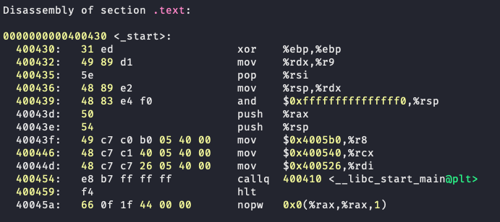
start()
Zero'ing %ebp
Notes:
https://fasterthanli.me/series/making-our-own-executable-packer/part-12

Slide 107
start()
Stack pointer (%rsp) alignment
Notes:
https://fasterthanli.me/series/making-our-own-executable-packer/part-12

Slide 108
start()
Setting up arguments for "__libc_start_main()"
int __libc_start_main(int (*main) (int, char**, char**), int argc, char** ubp_av,
void (*init) (void), void (*fini) (void),
void (*rtld_fini) (void), void (*__unbounded stack_end));
Notes:
https://fasterthanli.me/series/making-our-own-executable-packer/part-12
https://code.woboq.org/userspace/glibc/csu/libc-start.c.html

Slide 109
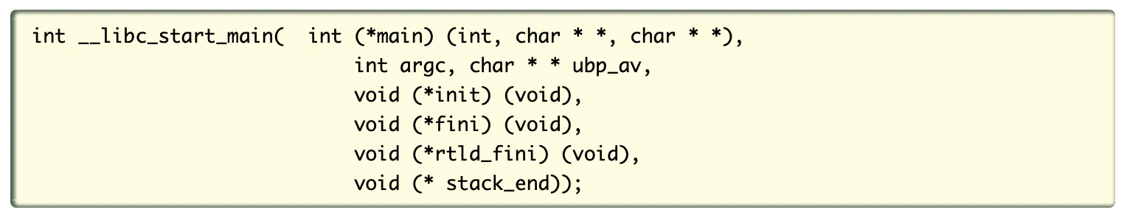
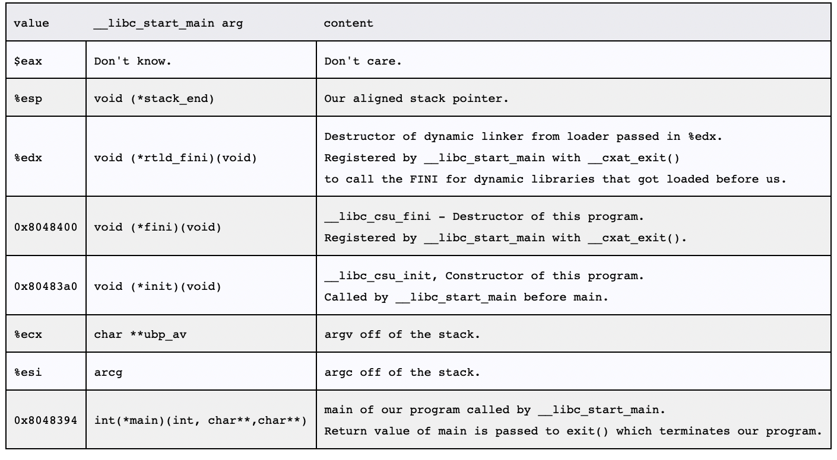
__libc_start_main();
Takes care of setuid, setgid programs
Starts up threading
Registers the fini (our program), and rtld_fini (run-time loader) arguments to get run by at_exit
Calls the init argument
Calls the main with the argc and argv
Calls exit with the return value of main

Slide 110
__libc_start_main()
  → __libc_init_first();
  → __libc_init();
  → __libc_csu_init();
    Call all constructors in the program
    Usually, we rarely have constructors,
    but this function still resides in
    the program’s address space
Finally, → main();
Notes:
KJEE-TODO: we can have a better visualization

Slide 111
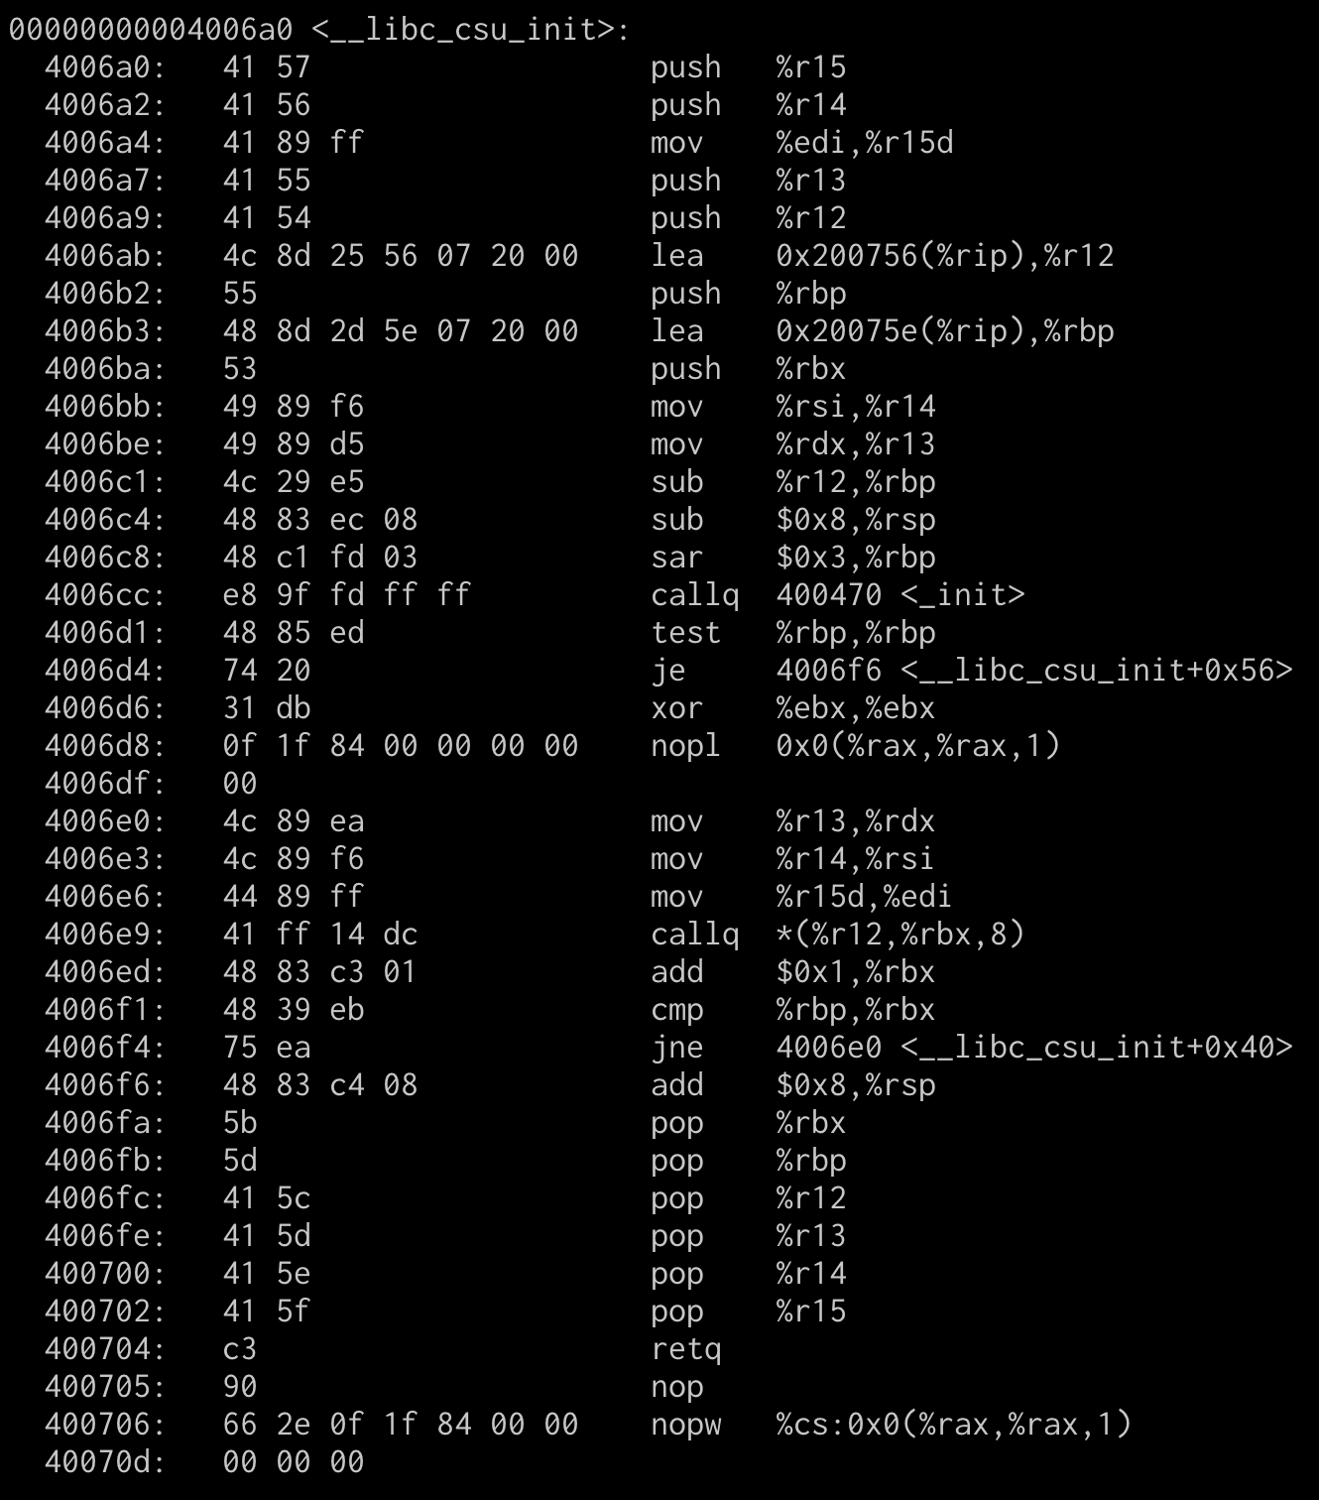
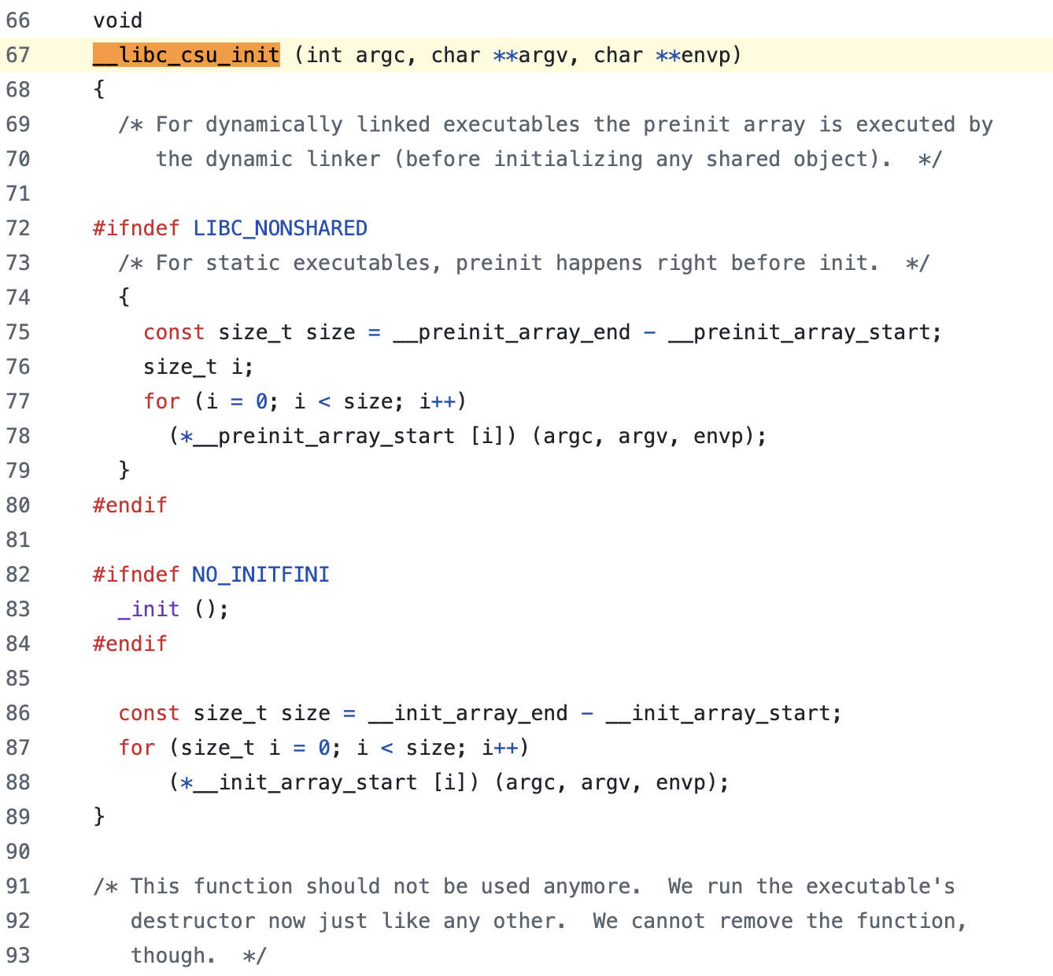
__libc_csu_init();
Function call with 3 arguments

Slide 112
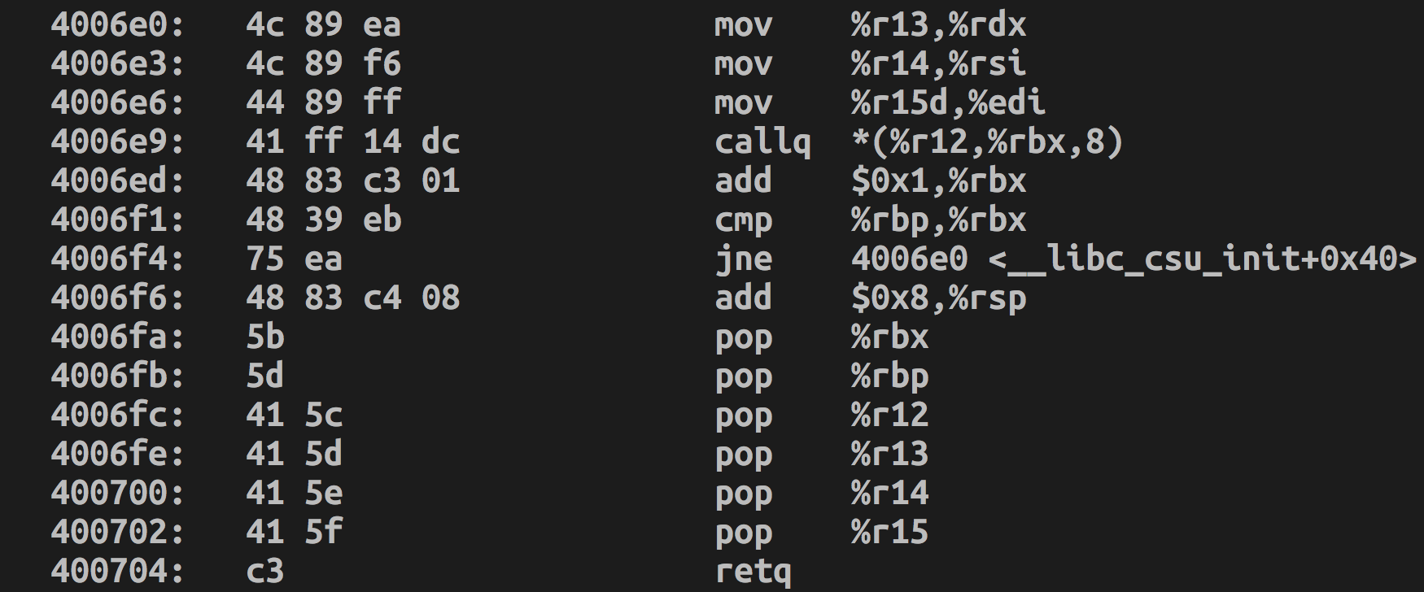
Controlling %rdx via __libc_csu_init();
Set %rdx, %rsi, %rdi and call execve!
Notes:
5e 41 5f c3
http://shell-storm.org/online/Online-Assembler-and-Disassembler/?opcodes=5f+c3%0D%0A&arch=x86-64&endianness=little&dis_with_addr=True&dis_with_raw=True&dis_with_ins=True#disassembly
http://shell-storm.org/online/Online-Assembler-and-Disassembler/?opcodes=5e+41+5f+c3%0D%0A&arch=x86-64&endianness=little&dis_with_addr=True&dis_with_raw=True&dis_with_ins=True#disassembly

Slide 113
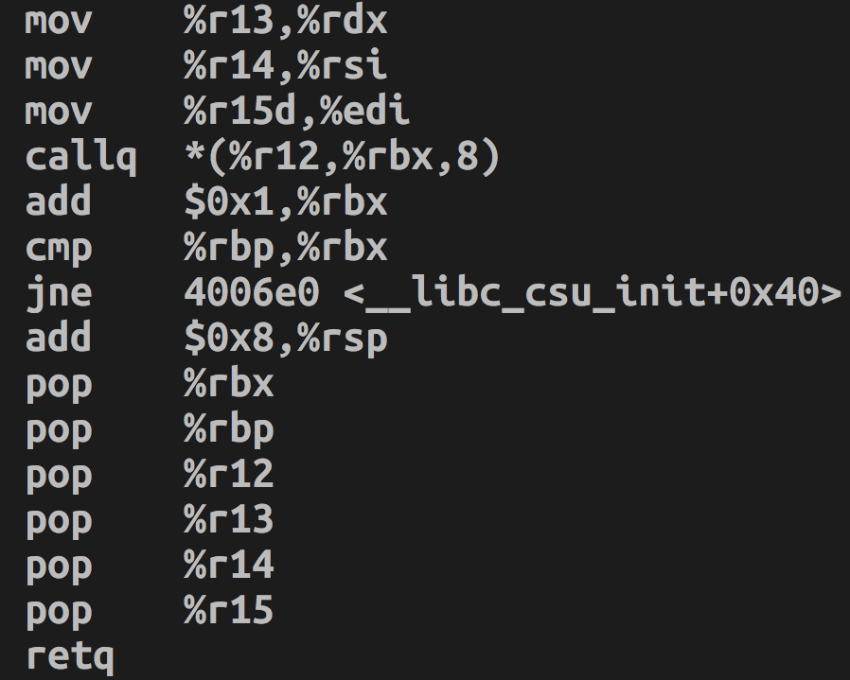
Controlling %rdx
Set %r13 = 0 → %rdx = 0
Set %r14 = 0 → %rsi = 0
Set %r15 = string → $rdi = $r15d (lower 4bytes)
callq *(%r12, %rbx, 8);
%r15d → %edi;
we first can set %rdi as some string address and then set %r15 as the same value.
In this case,
mov %r15d, %edi will make no different

Slide 114
callq *(%r12, %rbx, 8)
callq *(%r12, %rbx, 8)
func_ptr = %r12 + [%rbx * 8]
func_ptr();
Indirect function call to a memory operand
AT&T Memory Referencing SYNTAX
seg:offset (base, idx, scale)
→ base + idx * scale + seg:offset

Slide 115
callq *(%r12, %rbx, 8)
callq *(%r12, %rbx, 8)
func_ptr = %r12 + [%rbx * 8]
func_ptr();
Example:
Set %rbx = 0 → %r12[0]
Meaning:
Getting the value from the address
pointed by %r12

Slide 116
callq *(%r12, %rbx, 8)
callq *(%r12, %rbx, 8)
func_ptr = %r12 + [%rbx * 8]
func_ptr();
Example:
Set %rbx = 0 → %r12[0]
Meaning:
Getting the value from the address
pointed by %r12
Action:
Set %r12 = execve()?

Slide 117
callq *(%r12, %rbx, 8)
callq *(%r12, %rbx, 8)
func_ptr = %r12 + [%rbx * 8]
func_ptr();
Example:
Set %rbx = 0 → %r12[0]
Meaning:
Getting the value from the address
pointed by %r12
Action:
r12[0] = *(0x4004d0)
= 0x0b5a25ff
Jump to 0xb5a25ff -> SIGSEGV

Slide 118
callq *(%r12, %rbx, 8)
callq *(%r12, %rbx, 8)
func_ptr = %r12 + [%rbx * 8]
func_ptr();
Example:
Set %rbx = 0 → %r12[0]
Meaning:
Getting the value from the address
pointed by %r12
Action:
r12[0] = *(0x4004d0)
= 0x0b5a25ff
Jump to 0xb5a25ff -> SIGSEGV

Slide 119
callq *(%r12, %rbx, 8)
We need to set %r12 as
  An address that contains the address of execve();
WHAT? Is there any memory block for this????
  YES

Slide 120
ELF, GOT, PLT

Slide 121
ELF, PLT, GOT
PLT
printf()
strcpy()
The program
Calls a function
In PLT
read()
PLT jumps to GOT
Program
printf()
Libc
printf()
…
strcpy()
…
read()
…
_dl_dynamic_resolve
GOT
7fa174b06800
_resolve
_resolve
GOT stores addr of
_dl_dynamic_resolve
_resolve

Slide 122
Procedure Linkage Table (PLT)
A program calls printf()
Before running the program
  Points to printf@plt, at the code section (read-only!)
After running the program
  Points to printf() at the libc section (0x7fa174b06XXX)

Slide 123
What is PLT (Procedure Linkage Table)?
To call a function, a program needs to know the address
The program does not know the address of library functions at compile time
  E.g., printf() from libc library
The ELF loading find the function address at runtime to map library function
  That’s PLT (Procedure Linkage Table)!
How does it work? Trampoline!

Slide 124
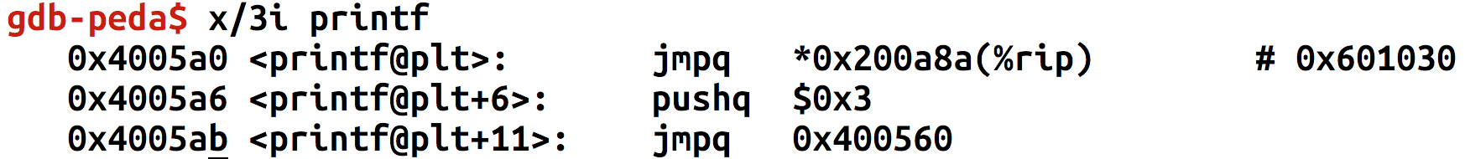
Reverse Engineering PLT
Disassemble
Jump to the address stored at 0x601030
  *0x601030 indicates the value in that address (because of *)
  You wish to patch %r12 to 0x601030 to call printf()…

Slide 125
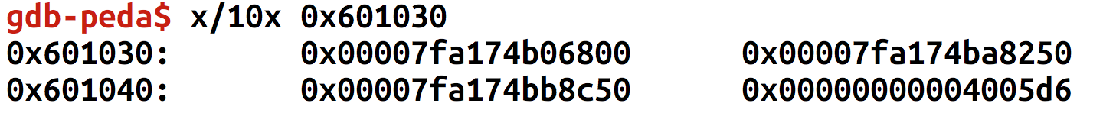
Reverse Engineering PLT
What is in 0x601030?
0x7fa174b06800

Slide 126
PLT and GOT (Global Offset Table)
0x4005a0 (printf@plt) serve as a link to the printf in the libc
  Calling 0x4005a0
  -> jump to *0x601030
  -> jump to printf();
  -> calling printf();
0x601030 indicates an entry for printf() in GOT
Program calls PLT
PLT jumps to the address stored in GOT
GOT update the entry with the real address of printf() in libc
Notes:
KJEE: 1st phase, 2nd phase
KJEE: mention search / look-up function.

Slide 127
ELF, PLT, GOT:
Execution #1
PLT
printf()
strcpy()
The program
Calls a function
In PLT
read()
PLT jumps to GOT
Program
printf()
Libc
printf()
…
strcpy()
…
read()
…
GOT
libc_printf
libc_strcpy
libc_read
GOT stores libc addr
Notes:
KJEE: execution 1

Slide 128
ELF, PLT, GOT:
Execution #2
PLT
printf()
strcpy()
The program
Calls a function
In PLT
read()
PLT jumps to GOT
Libc
printf()
…
strcpy()
…
read()
…
Program
printf()
GOT
libc_printf
libc_strcpy
libc_read
GOT stores libc addr
Notes:
KJEE: execution 1

Slide 129
ELF, PLT, GOT
PLT
printf()
strcpy()
The program
Calls a function
In PLT
read()
PLT jumps to GOT
Program
printf()
Libc
printf()
…
strcpy()
…
read()
…
_dl_dynamic_resolve
GOT
7fa174b06800
_resolve
_resolve
_resolve
GOT stores addr of _dl_dynamic_resolve();

Slide 130
Global Offset Table (GOT)
Reside on the data section (writable)
  i.e., 0x8049XXX (32-bit) or 0x6010XX (64-bit)
  Fixed even if under ASLR if program is not PIE
Each entry first has the address of
_dl_dynamic_resolve();
After the initial call,
the entry will have the function address
Notes:
KJEE: data section address for i386 vs x86_64

Slide 131
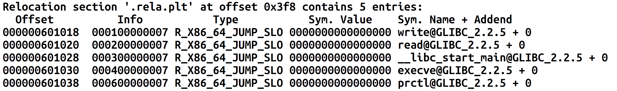
Locating GOT
readelf -a

Slide 132



Slide 133
Control Flow Hijack:
Always control + computation
shellcode (aka payload) | padding | &buf
computation + control
Return-oriented programming (ROP): shellcode without code injection
Notes:
Where can we put payloads?
Think in the line of DEP/NX and ASLR

Slide 134
Motivation: Return-to-libc Attack
ptr to
“/bin/sh”
…
argv
argc
return addr
caller’s ebp
buf (64 bytes)
argv[1]
buf
ret transfers control to system, which finds arguments on stack
&system
Overwrite return address with address of libc function
Set-up fake return address and argument(s)
ret will “call” libc function
No injected code!
%ebp
%esp
Notes:
ret → pop %esp

Slide 135
What if we don’t know the address of system?
Use existing application logic that does!
Notes:
&system() address floats around due to ASLR

Slide 136
ptr to
“/bin/sh”
…
argv
argc
return addr
caller’s ebp
buf (64 bytes)
argv[1]
buf
What if we don’t know the absolute address any pointers to “/bin/sh”
(objdump gives addresses, but we don’t know ASLR base address)
&system
%ebp
Notes:
Stack is randomized (floating around) under aslr

Slide 137
ptr to
“/bin/sh”
…
argv
argc
return addr
caller’s ebp
buf (64 bytes)
argv[1]
buf
Need to find an instruction sequence, aka gadget,
with (relative to) esp
&system
%ebp
%esp
137
Notes:
Not clear this point – gadgets relative to esp

Slide 138
Scorecard for ret2libc
No injected code ➔ DEP ineffective
Requires knowing address of system()
... or does it.

Slide 139
ROP Programming
Disassemble code
Identify useful code sequences as gadgets
Assemble gadgets into desired shellcode
xor %ecx, %ecx
mul %ecx
push %ecx
push $0x68732f2f
push $0x6e69622f
mov %esp, %ebx
mov $0xb, %al
int $0x80
Example shellcode
The trick is to find the desired instruction sequences, or semantically equivalent ones

Slide 140
There are many
semantically equivalent
ways to achieve the same net shellcode effect

Slide 141
Gadgets
A gadget is any instruction
sequence ending with ret
Notes:
[KJEE] we may want to add some examples

Slide 142
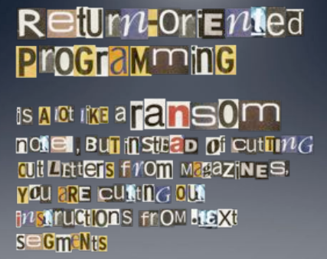
Image by Dino Dai Zovi

Slide 143
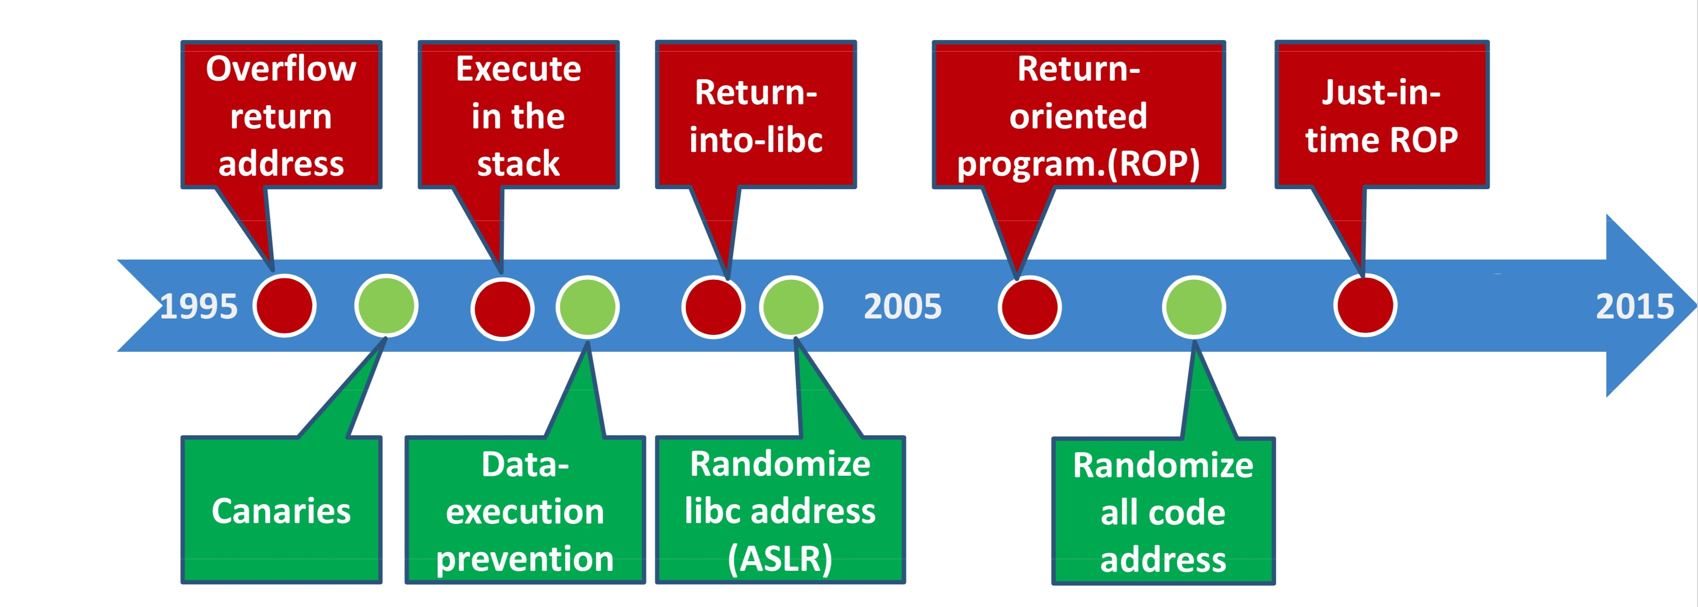
ROP Overview
Idea: We forge shellcode out of existing application logic gadgets
Requirements:
vulnerability (e.g., stack overflow)
+ some fixed segment (unrandomized locations) + gadgets
History:
  No code randomized: Code injection
  DEP enabled by default: ROP attacks using libc gadgets publicized ~2007
  Libc base addr randomized
  ASLR library load points
…
Notes:
[KJEE] check out the latest status or code randomization.

Slide 144
Gadgets
a₅
v₂
a₃
v₁
Mem[v2] = v1
Desired Logic
Suppose a₂ and a₃ on stack
esp
Stack
a₁: pop eax;
a₂: ret
a₃: pop ebx;
a₄: ret
a₅: mov [ebx], eax
eax
ebx
eip
v₁
a₁
Implementation 2

Slide 145
Gadgets
a₅
v₂
a₃
v₁
Mem[v2] = v1
Desired Logic
esp
Stack
a₁: pop eax;
a₂: ret
a₃: pop ebx;
a₄: ret
a₅: mov [ebx], eax
eax
ebx
eip
v₁
a₁
a₃
Implementation 2

Slide 146
Gadgets
a₅
v₂
a₃
v₁
Mem[v2] = v1
esp
Desired Logic
Stack
a₁: pop eax;
a₂: ret
a₃: pop ebx;
a₄: ret
a₅: mov [ebx], eax
eax
ebx
eip
v₁
v₂
a₃
Implementation 2

Slide 147
Gadgets
a₅
v₂
a₃
v₁
esp
Mem[v2] = v1
Desired Logic
Stack
a₁: pop eax;
a₂: ret
a₃: pop ebx;
a₄: ret
a₅: mov [ebx], eax
eax
ebx
eip
v₁
v₂
a₄
a₅
Implementation 2
Notes:
Stack based IR: Java bytecode

Slide 148
Gadgets
esp
a₅
v₂
a₃
v₁
Mem[v2] = v1
Desired Logic
Stack
a₁: pop eax;
a₂: ret
a₃: pop ebx;
a₄: ret
a₅: mov [ebx], eax
eax
ebx
eip
v₁
v₂
a₅
eip
Implementation 2

Slide 149
Equivalence
a₃
v₂
a₂
v₁
Mem[v2] = v1
Desired Logic
semantically equivalent
esp
Stack
“Gadgets”
a₁: mov eax, [esp]
a₂: mov ebx, [esp+8]
a₃: mov [ebx], eax
a₁: pop eax; ret
a₂: pop ebx; ret
a₃: mov [ebx], eax
Implementation 1
Implementation 2

Slide 150
Equivalence
a₃
v₂
a₂
v₁
Mem[v2] = v1
Desired Logic
Address
independent!
Stack
a₁: pop eax; ret
...
a₃: mov [ebx], eax
...
a₂: pop ebx; ret
a₁: pop eax; ret
a₂: pop ebx; ret
a₃: mov [ebx], eax
Implementation 2

Slide 151
Return-Oriented Programming (ROP)
…
argv
argc
return addr
caller’s ebp
buf (64 bytes)
argv[1]
buf
Mem[v2] = v1
Desired Shellcode
%ebp
Find needed instruction gadgets at addresses a₁, a₂, and a₃ in existing code
Overwrite stack to execute a₁, a₂, and then a₃
%esp

Slide 152
Return-Oriented Programming (ROP)
a₃
v₂
a₂
v₁
a₁
…
argv
argc
return addr
caller’s ebp
buf (64 bytes)
argv[1]
buf
Mem[v2] = v1
Desired Shellcode
%ebp
a₁: pop eax; ret
a₂: pop ebx; ret
a₃: mov [ebx], eax
Desired store executed!
%esp

