Slide 1
CS4459.001 Cyber Attacks & Defense Lab
Arbitrary Read / Write and Format String Vulnerability
Apr 2, 2026

Slide 2
Unit-6
Challenges in the /home/labs/unit6 directory
Hosted in ctf-vm2
Serial Read, Arbitrary Read (AR), Arbitrary Write (AW)
Level 0 ~ 3
Format String Vulnerability (FSV) - 32 / 64 bits
Level 4/5, 6/7, 8/9, a/b, c/d
PIE-enabled binary
Level e (30 point)
Level f (bonus 30 point)

Slide 3
Unit-6
Serial Read (sr), Arbitary Read (ar), Arbitrary Write (aw)
0-sr-1, 1-ar-2: 15 pts
2-aw-1, 20 pt, 3-aw-2: 20 pts
Format string 32|64
4-fs-read-1-32, 5-fs-read-1-64, 20 pts
6-fs-read-2-32, 7-fs-read-2-64, 20 pts
8-fs-arbt-read-32, 9-fs-arbt-read-64, 25 pts
a-fs-arbt-write-32, b-fs-arbt-write-64, 30 pts
c-fs-code-exec-32, d-fs-code-exec-64, 30 pts
PIE challenges (bonuses)
e-fs-code-exec-pie-64, 30 pt
f-fs-no-binary-pie-64, 40 pt

Slide 4
Buffer Overflow (BoF) and Control Flow Hijacking (CFH)
BoF has been our primary attack vector
To hijack control flow and deviate
BoF: fill the buffer more than its size
Overwriting return address (saved %eip)
Overwriting frame pointer (saved %ebp)
Control Flow Hijacking
Return to shellcode: Run your own code
Return to some other functions: Code re-use attack
Return to ROP gadgets: Code re-use attack with ROP gadgets
shellcode
RETURN ADDR
DDDD
SAVED %ebp
COOKIE
CCCC
BUFFER
BBBB
BUFFER
AAAA
BUFFER

Slide 5
Control Flow Hijacking (CFH)
Entry points to CFH
RET / JMP / CALL to shellcode
RET / JMP / CALL to some other functions
RET / JMP / CALL to ROP gadgets
Targets to overwrite
Return address
Global offset table (GOT)
Function pointers
Jump table entry
Eventually we seek to gain control over %EIP / %RIP

Slide 6
ELF, PLT, GOT
PLT
printf()
strcpy()
The program
Calls a function
In PLT
read()
PLT jumps to GOT
Program
printf()
Libc
printf()
…
strcpy()
…
read()
…
_dl_dynamic_resolve
GOT
7fa174b06800
_resolve
_resolve
_resolve
GOT stores addr of _dl_dynamic_resolve

Slide 7
What is the Requirement for CFH?
Is buffer overflow the only way to achieve Control Flow Hijacking?
Overwriting return address (saved %eip)
Overwriting frame pointer (saved %ebp)
What we need is the capability to overwrite certain address
Arbitrary write!
Today we will learn arbitrary read/write
RETURN ADDR
RETURN ADDR
SAVED %ebp
SAVED %ebp
COOKIE
BUFFER
BUFFER
BUFFER

Slide 8

Attack Primitives
Arbitrary Read
Read from any address A, any number N of bytes
The attacker must know the address A
Example:
Read 100 bytes from 0xffffd100 (somewhere in the stack)
Read 100 bytes from 0x8048500 (somewhere in the code section)
Can this break:
Stack-Cookie?
ASLR?
DEP?
Notes:
KJEE: checkmark

Slide 9
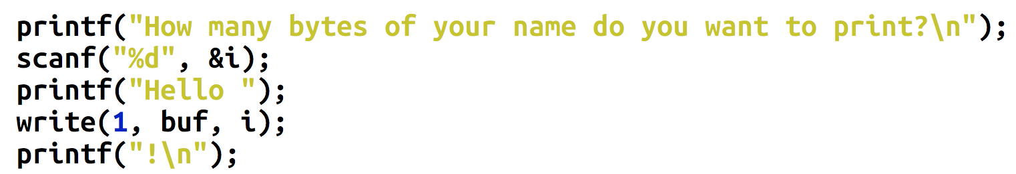
Breaking Stack-Cookie
The cookie value is on the stack
Sequential read can break stack-cookie easily
RETURN ADDR
SAVED %ebp
COOKIE
BUFFER
BUFFER
BUFFER

Slide 10
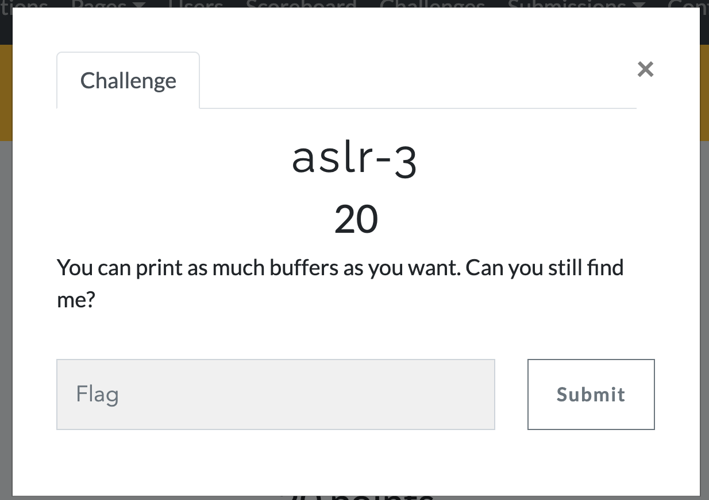
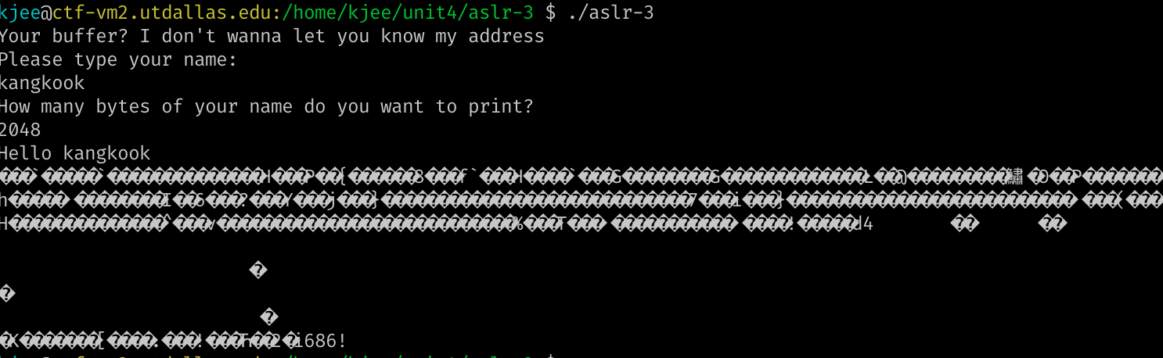
Sequential Read Example
ASLR-3
Leak addresses via sequential leaks from one point of the stack
We do not know ‘A’, but can specify ‘N’
Sometimes this is more powerful than arbitrary read
Notes:
KJEE: we may want to visualize stack

Slide 11
Breaking Stack-Cookie
The cookie value is on the stack
Arbitrary Read
Read where? → The address that the cookie is stored!
Then launch buffer overflow attack
You should know the address of the stack..
RETURN ADDR
SAVED %ebp
COOKIE
BUFFER
BUFFER
BUFFER

Slide 12
Breaking ASLR
Arbitrary Read
Read anywhere if you know the address…
Read where?
Non-PIE: Code section is fixed 0x8048000 ~ 0x804a000
0x401000 ~ and 0x601000 in 64 bit
Stack – random
Library – random
Heap – random
Code/data sections are the only fixed locations

Slide 13
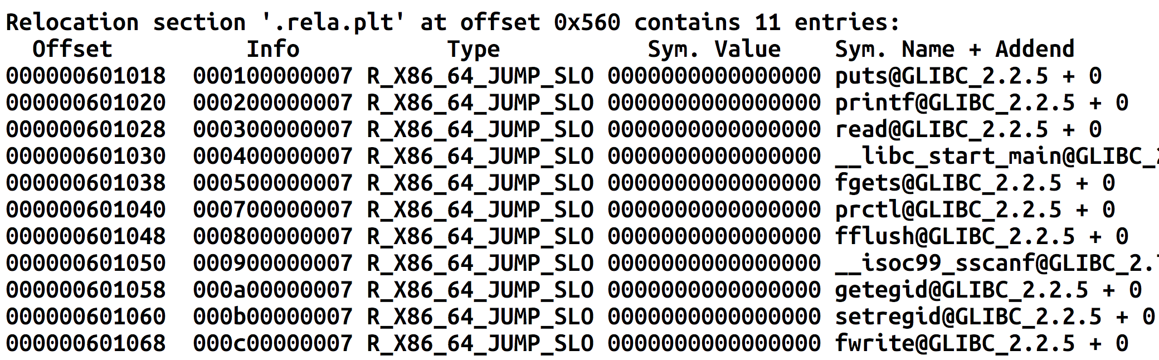
Breaking ASLR + DEP
GOT stores address of libc functions
printf(), puts(), read(), etc.

Slide 14
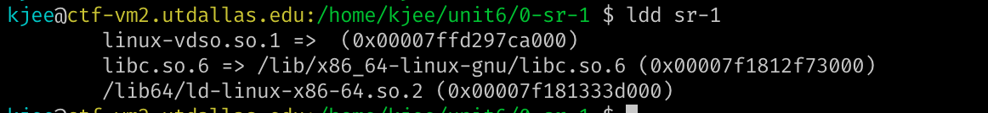
Breaking ASLR + DEP
Read a value from GOT
Can get the address of puts()
Can you calculate the addresses of execve() or system() from puts()?
Yes
Load libc and find offsets, diff, and calculate

Slide 15
Attacking Global Offset Table (GOT)
Read the address in GOT
Leak the address of puts()
Calculate the address of execve() or system() from the offset

Slide 16
Challenges: Unit6
sr-1
The program will perform a sequential read from the stack for you
Read addresses from the leak and exploit the vulnerability!
ar-2
You may perform arbitrary read
Can specify where to read and how many bytes to read
Read GOT of some functions to get the address of that function in libc
Call system(), execve(), whatever you want!

Slide 17
Attack Primitives
Arbitrary Write (AR)
Write on any address, any number of bytes
The attacker must know the address
Example:
Write 100 bytes of data to 0xffffd100 (somewhere in the stack)
Write 100 bytes of data to 0x8048500 (somewhere in the code section)
Can achieve Control Flow Hijacking
Overwrite return address
Overwrite frame pointer
Overwriting GOT

Slide 18
Attacking Global Offset Table (GOT)
Attack Outline
Read the address in GOT
Leak the address of printf()
Calculate the address of system() from the offset
Write that address system() to printf()’s GOT
What will happen a program calls printf() ?

Slide 19
ELF, PLT, GOT
PLT
printf()
strcpy()
The program
Calls a function
In PLT
read()
PLT jumps to GOT
Program
printf()
Libc
printf()
…
strcpy()
…
read()
…
GOT
libc_printf
libc_strcpy
libc_read
GOT stores libc addr

Slide 20
ELF, PLT, GOT
PLT
printf()
strcpy()
The program
Calls a function
In PLT
read()
PLT jumps to GOT
Program
printf()
Libc
printf()
…
strcpy()
…
read()
…
GOT
libc_SYSTEM
libc_printf
libc_strcpy
libc_read
GOT stores libc addr

Slide 21
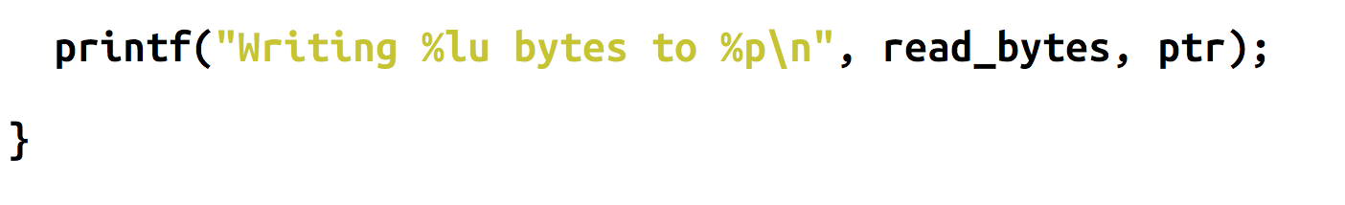
Attacks with Arbitrary Write
GOT address is known for non-PIE
Choose one function that is called in the program
Overwrite the GOT of printf() to system()
What will happen?
system(“Writing %lu bytes to %p\n”); // ??
Notes:
KJEE: let’s see GOT addressing

Slide 22
Arbitrary-Write-1 (AR-1)
Change the GOT of printf() to to ‘please_execute_me()’ via arbitrary write capability!
printf() after the BoF vulnerability will run that function for you.

Slide 23
Arbitrary-Write-2 (AR-2)
Program contains both arbitrary-read (ar) and arbitrary-write (aw) vulnerabilities.
Exploit arbitrary-read (ar) to get the address of libc function
Then calculate the address of system()
Exploit arbitrary write to overwrite the GOT of printf() to system()
printf("Writing %lu bytes to %p\n”);
system(“Writing %lu bytes to %p\n”);

Slide 24
Format String Vulnerability

Slide 25
Format String Vulnerability
Format String
printf(“%d %x %s %p %n\n”, 1, 2, “asdf”, 3, &i);
The vulnerability
char buf[512];
printf(“%s”, buf);
printf(buf);
If you can control a format string, you may inject arbitrary directives
%d %x %p %s %n etc.
Notes:
Highlight!!

Slide 26
Format String Vulnerability
Format String
printf(“%d %x %s %p %n\n”, 1, 2, “asdf”, 3, &i);
Can be exploited as:
Arbitrary READ (ar)
Arbitrary WRITE (aw)

Slide 27
The Format String
Usage
printf(“%d %x %s”, 0, 65, “asdf”);
→ variable number of arguments
This will print 0 (decimal), 41 (hexadecimal), and “asdf”
% parameters
% is a special identifier in the Format String
% seeks for an argument (corresponding to its order…)

Slide 28
Format String Parameters
%d
Expects an integer value as its argument and print a decimal number
%x
Expects an integer value as its argument and print a hexadecimal number
8048000
%p
Expects an integer value as its argument and print a hexadecimal number
0x8048000 # It’s pretty!
%s
Expects an address to a string (char *) and print it as a string

Slide 29
Format String Syntax
%1$08d
%[argument_position] $ [length] [parameter]
Means
Print an integer as a decimal value
Justify its length to length (08)
Get the value from n-th (1st) argument
Print 8-length decimal integer, with the value at the 1st argument (padded with 0) E.g., 00000001

Slide 30
Format String Parameters
%d : Integer decimal %x : Integer hexadecimal %s : String
printf(“%2$08d”, 15, 13, 14, “asdf”);
00000013
printf(“0x%3$08x”, 15, 13, 14, “asdf”);
0x0000000d
printf(“%3$20s”, 15, 13, 14, “asdf”);
printf(“%4$20s”, 15, 13, 14, “asdf”);
asdf

Slide 31
Format String Vulnerability
Format String
printf(“%d %x %s %p %n\n”, 1, 2, “asdf”, 3, &i);
The vulnerability
char buf[512];
printf(“%s”, buf);
printf(buf);
// This will print some values from stack
printf(“%p %p %p %p %p %p”);

Slide 32
Format String Vulnerability
Format String
printf(“%d %x %s %p %n\n”, 1, 2, “asdf”, 3, &i);
Can be exploited as:
Arbitrary Read (AR)
Arbitrary Write (AW)

Slide 33
Format String Vulnerability
Useful identifiers
%x – value, print an argument as a hexadecimal value
%d – value, print an argument as a decimal value
%p – value, print an argument as a hexadecimal value with prefix 0x-
%s – pointer, print an argument as a string; print the data in the address
%n – pointer, write the number of printed bytes to the address

Slide 34
Format String Parameters
%n – store # of printed characters
int i;
printf(“asdf%n”, &i);
// i := 4
printf(“%12345x%n”, 1, &i);
// Print 1 as 12345 characters (“ ” * 12344 + “1”)
// Store 12345 to i

Slide 35
fs-read-1
Use many %p to dump the random value!
Practice %6$p, %7$p, etc..

Slide 36
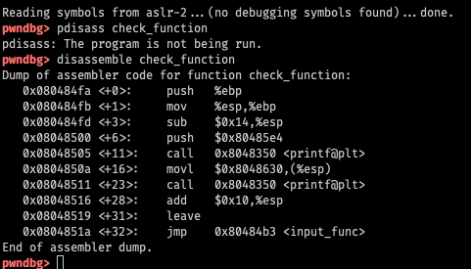
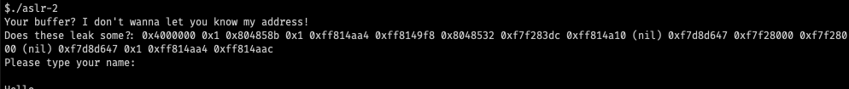
Stack
RETURN ADDR
8th
SAVED %ebp
7th
RESV
6th
RESV
5th
RESV
4th
RESV
3rd
RESV
2nd
0x80485e4 (1st)
1st

Slide 37
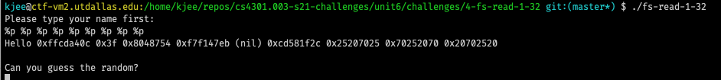
Stack Information Leak via FSV
printf(buf);
Type %p %p %p %p %p %p %p %p %p
This will eventually leak values in the stack

Slide 38
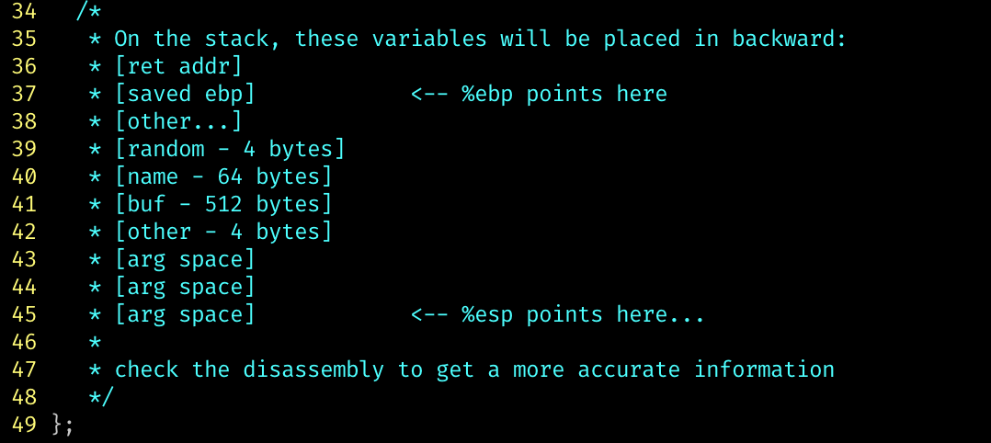
fs-read-2
Buffer is 64 bytes → You can put at most 32 ‘%p’
You cannot reach to the random value on the stack (too far)
Use gdb, to figure out
Values from which address %1$p prints? → [addr_a]
Which address stores the random value → [addr_b]
([addr_b] - [addr_a]) / 4 ; distance as # args
E.g., if that value is 77 → %77$p should reveal random

Slide 39
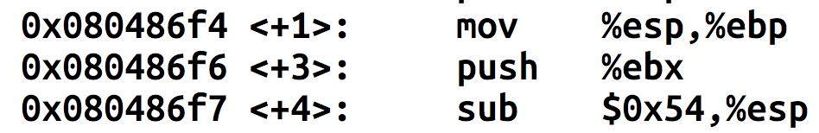
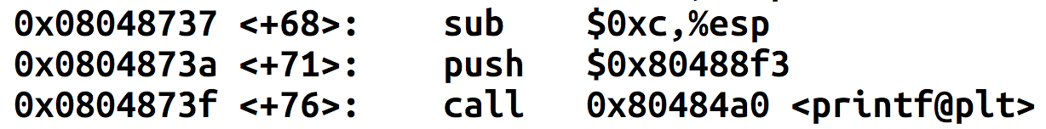
Where is the random in fs-read-1?
RETURN ADDR
SAVED %ebp
BUFFER
BUFFER
0x54
BUFFER
BUFFER
Random is at -0x50(%ebp)
random
6th
variable
5th
RESV
4th
RESV
3rd
RESV
2nd
Arg 1 of printf

Slide 40
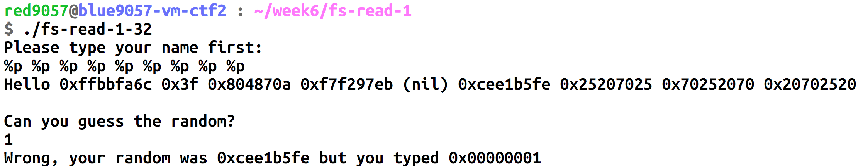
Arbitrary Read via FSV
In fs-read-1
%p %p ….
Why?

Slide 41
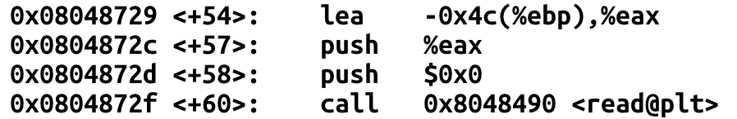
Arbitrary Read via FSV
RETURN ADDR
SAVED %ebp
%p %
%p
The buffer is on the stack
Your input can also be treated as an argument
Can you exploit this to perform arbitrary read via FSV?
0x4c
p %p
%p %
random
6th
variable
5th
RESV
4th
RESV
3rd
RESV
2nd
Arg 1 of printf

Slide 42
Arbitrary Read via FSV (%s)
RETURN ADDR
SAVED %ebp
XXXX
XXXX
Put address to read on the stack
Suppose the address is 0x804a010 (GOT of printf)
Prepare the string input
“\x10\xa0\x04\x08%7$x” (print 0x804a010, test it first)
“\x10\xa0\x04\x08%7$s” (read the data!)
0x4c
%7$s
0x804a010
random
6th
variable
5th
RESV
4th
RESV
3rd
RESV
2nd
Arg 1 of printf

Slide 43
Arbitrary Read via FSV (%s)
Capability
Can read “string” data in the address
Read terminates when it sees “\x00”
Tricks to read more…
“\x10\xa0\x04\x08\x11\xa0\x04\x08\x12\xa0\x04\x08\x13\xa0\x04\x08”
“%7$s|%8$s|%9$s|%10$s”
You will get values separated by | (observing || means that it is a NULL string)
E.g., output “1|2||3” will indicate “12\x003”

Slide 44
Arbitrary Write via FSV (%n)
RETURN ADDR
SAVED %ebp
XXXX
XXXX
Put address to read on the stack
Suppose the address is 0x804a010 (GOT of printf)
Prepare the string input
“\x10\xa0\x04\x08%7$x” (print 0x804a010, test it first)
“\x10\xa0\x04\x08%7$n” (write the data!)
Will write 4, because it has printed “\x10\xa0\x04\x08”
before the %7$n parameter
0x4c
%7$s
0x804a010
random
6th
variable
5th
RESV
4th
RESV
3rd
RESV
2nd
Arg 1 of printf

Slide 45

Arbitrary Write via FSV (%n)
Can you write arbitrary values? Not just 4?
%10x – prints 10 characters regardless the value of argument
%10000x – prints 10000 characters…
%1073741824x – prints 2^30 characters …
How to write 0xfaceb00c?
%4207489484x
NO….

Slide 46

Arbitrary Write via FSV (%n)
Challenges…
Printing 4 billion characters is super SLOW…
Remote attack – you need to download 4GB…
What about 64bit machines – 48bit addresses?
A trick
Split write into multiple times (2 times, 4 times, etc.)

Slide 47
Arbitrary Write via FSV (%n)
Writing 0xfaceb00c to 0x804a010
0xfacebooc → 4 bytes
Prepare two addresses as arguments
“\x10\xa0\x04\x08\x12\xa0\x04\x08”
Printed 8 bytes
Write 0xb00c at 0x0804a010 [ %(0xb00c- 8)x%n] ➔ %45060x%n
This will write 4 bytes, 0x0000b00c at 0x804a010 ~ 0x804a014
Write 0xface at 0x804a012 [ %(0xface – 0xb00c)x%n] ➔ %19138x%n
This will write 4 bytes, 0x0000face at 0x804a012 ~ 0x804a016
What about 0x0000 at 0x804a014 ~ 0x804a016?
We do not care…
0x804a014
0x0000 | 0xb00c
0x804a010
0x804a014
 | 0x0000
0xface | 0xb00c
0x804a010
“\x10\xa0\x04\x08\x12\xa0\x04\x08%45060x%7$n%19138x%8$n

Slide 48
Arbitrary Write via FSV (%n)
Can we overwrite 0x12345678?
Write 0x5678 to the address
% (0x5678 – 8) n
Write 0x1234 to the (address + 2)
% (0x1234 – 0x5678) n
% (0x011234 – 0x5678) n
“\x10\xa0\x04\x08\x12\xa0\x04\x08%22128x%7$n%48060x%8$n
0x804a014
0x0000 | 0x5678
0x804a010
0x804a014
 | 0x0001
0x1234 | 0x5678
0x804a010

Slide 49
Arbitrary Write via FSV (%n) – amd64
Writing 0xfaceb00c to 0x60108c
Prepare two addresses as arguments
“\x8c\x10\x60\x00\x00\x00\x00\x00\x8e\x10\x60\x00\x00\x00\x00\x00”
Printed 16 bytes
Write 0xb00c at 0x60108c [ %(0xb00c-16)x%7n], %45052x%n
This will write 4 bytes, 0x0000b00c at 0x804a010 ~ 0x804a014
Write 0xface at 0x60108e [ %(0xface – 0xb00c)x%6n], %19138x%n
This will write 4 bytes, 0x0000face at 0x804a012 ~ 0x804a016
Will this work?

Slide 50
Arbitrary Write via FSV (%n) – amd64
Writing 0xfaceb00c to 0x60108c
Prepare two addresses as arguments
“\x8c\x10\x60\x00\x00\x00\x00\x00\x8e\x10\x60\x00\x00\x00\x00\x00”
printf will stop printing values if it sees any \x00 in the string
\x00 == NULL, NULL means the end of the string!
How to avoid this?

Slide 51
Arbitrary Write via FSV (%n)
Can we overwrite 0x12345678 to address 0x60108c?
Write 0x5678 to the address
% (0x5678) n ➔ %22136n
Write 0x1234 to the (address + 2)
% (0x1234 – 0x5678) n
% (0x011234 – 0x5678) n ➔ %48060n
“%22136x%10$n%48060x%11$nAA”
Why AA? To make the entire input 8-byte aligned (24 bytes)

Slide 52
Arbitrary Write via FSV (%n)
“%22136x%10$n%48060x%11$nAA”
Why AA? To make the entire input 8-byte aligned (24 bytes)
And then, we will attach 0x60108c
Why does this work?
printf() will process all colored parts and “\x8c\x10\x60”
it will stop printing once it sees \x00
But %10$n and %11$n works…
“%22136x%10$n%48060x%11$n\x8c\x10\x60\x00\x00\x00\x00\x00\x8e\x10\x60\x00\x00\x00\x00\x00”

Slide 53
Arbitrary Code Execution via FSV
Suppose we can control FSV twice
Use %s to read the GOT of puts
Calculate the address of system()
Use %n to write the GOT of printf()
To system()
printf() will become system()
system(“Welcome …”);

Slide 54
fs-arbt-read
Get the address of random value in global variable area
Use %s to leak the value
64bit: put the address at the end!
E.g., “%7$sBBBB\xaa\xdd\xdd\xdd\x00\x00\x00\x00”

Slide 55
fs-arbt-write
Get the address of the target global variable
Get target value: say, 0xfaceb00c
Calculate first and second print values
First: 0xb00c – 8
Second: 0xface - 0xb00c
Use %x to print that many characters, and use %n to overwrite value
64bit: put the addresses at the end!

Slide 56
fs-code-exec
2 printf() calls
Use 1st call as Arbitrary Read
Leak GOT of printf()
Use 2nd call as Arbitrary Write
Overwrite the GOT of printf() → system()

Slide 57
fs-code-exec-pie-64 (bonus 40pt)
PIE, NX, Stack-cookie; 3 printf() calls
Use 1st call as Sequential Read (%p %p %p %p %p %p…)
Leak code address of the program
Get the address of GOT by offsetting it!
Use 2nd call as Arbitrary Read
Leak GOT of printf()
Use 3rd call as Arbitrary Write
Overwrite the GOT of printf() → system()

Slide 58
Extra-credit: fs-no-binary-pie-64 (+40)
PIE, NX, Stack-cookie enabled
Remote challenge nc 10.176.150.33 60051
Two printf() calls
Use SR, AR and AW wisely
Leak binary program!
Understand what program does!
Get a shell!
Read the flag!
Hint: the program does not require setregid(getegid(), getegid()) for you.

Slide 59
ONE GADGET
Notes:
https://github.com/lattera/glibc/blob/master/sysdeps/posix/system.c#L115

Slide 60
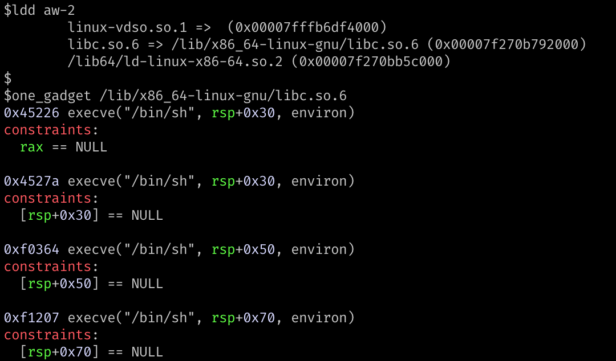
ONE GADGET
Or you may take a simpler approach

Slide 61
Why one_gadget exists?
system(“command”)
fork() // parent waits
execve(“/bin/sh”, [“sh”, “-c”, command, NULL], environ) // child
When we jump to the start of system()
Expects 1st arg is the command (either %rdi or 1st arg on the stack)
Run execve(“/bin/sh”, [“sh”, “-c”, command, NULL], environ);
When we jump in the middle of system()
Skip the part that set up arguments
Call execve(“/bin/sh”, rsp + 0x30, environ);
What if %rsp + 0x30 == 0?
Notes:
https://github.com/lattera/glibc/blob/master/sysdeps/posix/system.c#L115
https://github.com/lattera/glibc/blob/master/sysdeps/posix/system.c#L137

Slide 62
Why one_gadget exists?
When we jump in the middle of system()
Skip the part that set up arguments
Call execve(“/bin/sh”, rsp+0x30, environ);
What if %rsp+0x30 == 0?
What if %rax == 0?
What if %rsp+0x50 == 0?
What if %rsp+0x70 == 0?
Use it with care…

Slide 63
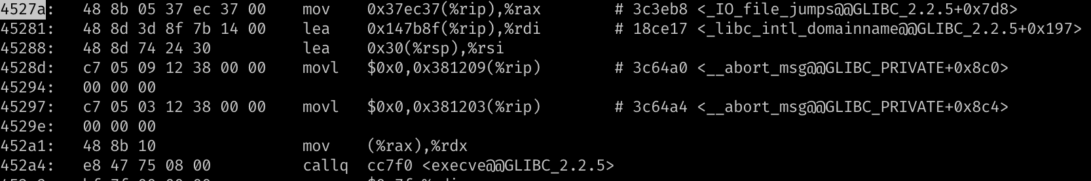
one_gadget
(0x45281 + 7) + 0x147B8F = 0x18ce17

Slide 64
Backup

