Slide 1
CS4459.001
Cyber Attacks & Defense Lab
HEAP Intro
Apr 22, 2025

Slide 2
What is HEAP?
Region of memory created at runtime intended to allocate variables whose size cannot be determined at compile time.
  Oppose to stack variables
  Dynamic by (to) its nature
Memory allocators
  ptmalloc (pthread malloc): glibc
  jemalloc: FreeBSD and Firefox
  tcmalloc: google chrome
  magazine malloc: IOS/OSX

Slide 3
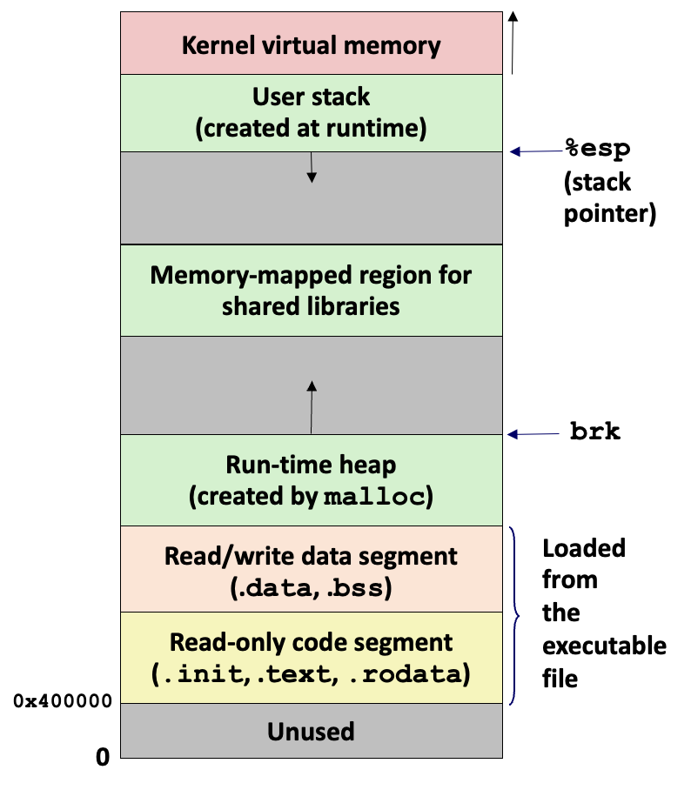
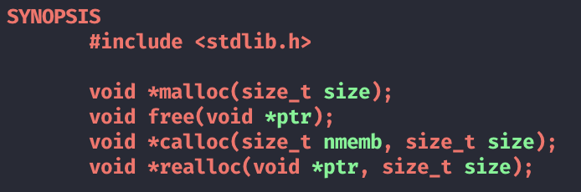
Memory Allocator: Under-the-Hood
Allocator / de-allocator
  malloc() / free()
Try not to bother Kernel
  mmap() / unmap()
Care about space efficiency
Notes:
TODO: find/draw a better figure

Slide 4
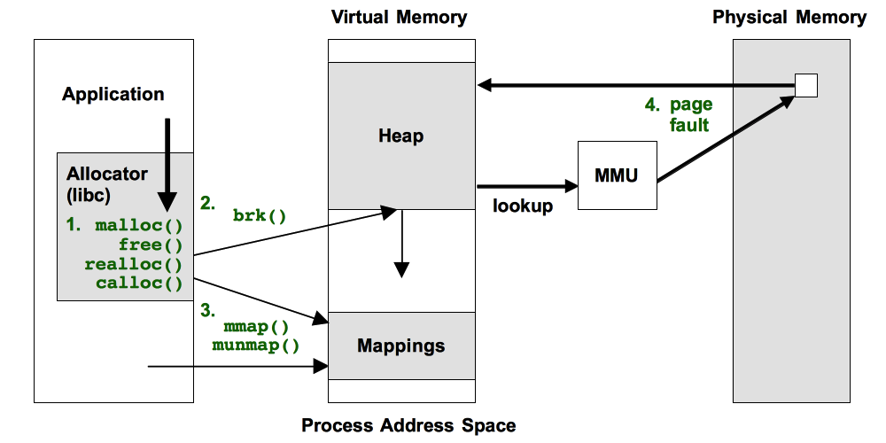
Memory Allocator: Under-the-Hood
Allocator / de-allocator
  malloc() / free()
Try not to bother Kernel
  mmap() / unmap()
Care about space efficiency
Image source - https://www.brendangregg.com/FlameGraphs/memoryflamegraphs.html
Notes:
TODO: want to re-draw the figure (heap should grow opposite way)

Slide 5
Memory allocator: Design Criteria
Performance ? system interaction
Utilization(Space efficiency)
  Internal and external fragmentations
Security
  Object isolation
  Use-after-Free (UAF or dangling pointer), Overflow (OF)
Memory allocator scoreboard
Performance | malloc(): ?? | free(): ??
Fragmentation | External: ?? | Internal: ??
Security | UAF: ?? | Overflow:??

Slide 6
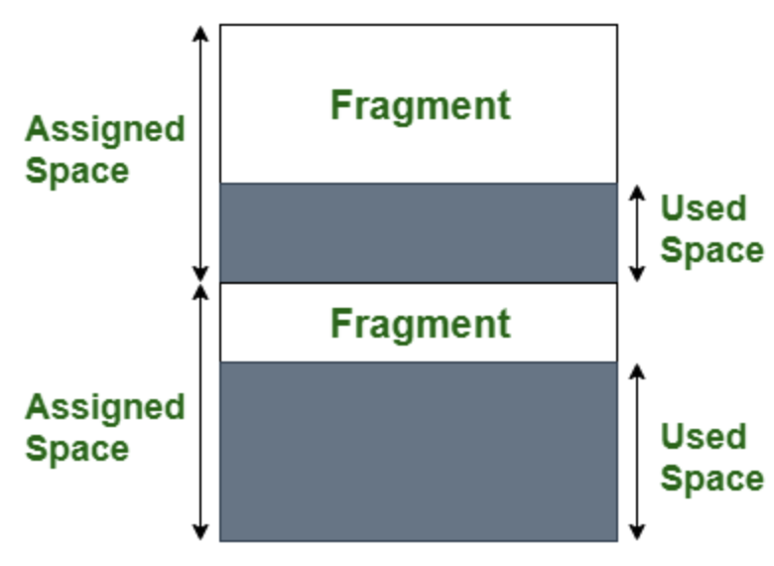
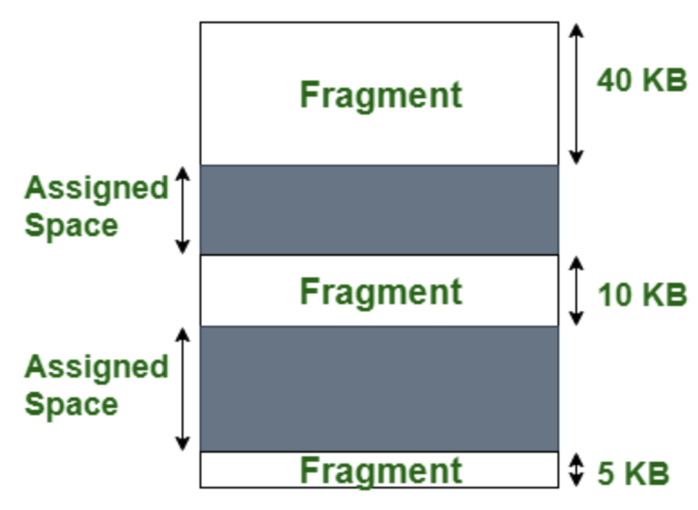
Internal / External Fragmentations
Internal fragmentation: Used / Assigned
External fragmentation: Between assigned chunks
Internal fragmentation
External fragmentation

Slide 7
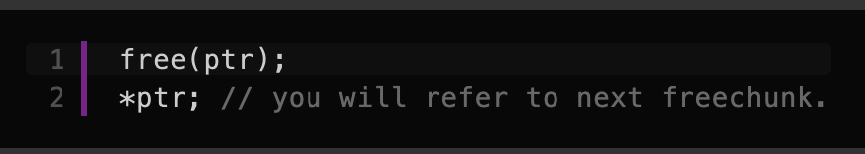
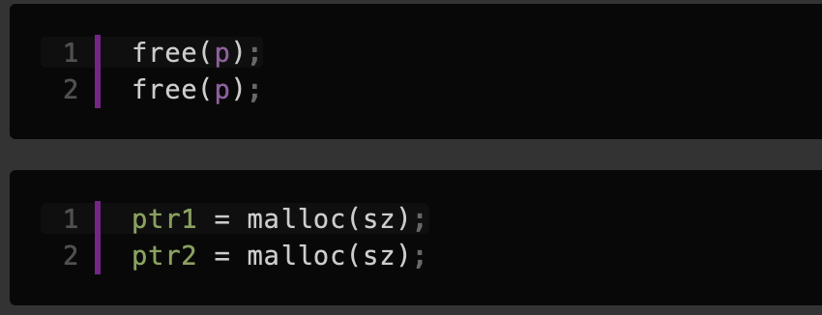
Allocator Security Problems
Use-after-free (UAF)
  ptr → next free-chunk
Double free
ptr1 and ptr2 will point to the
same location
Heap Overflow
  Overflowing the next chunk and P flag with 0 (from 1),
    Current chunk will be regarded as free chunk and then merged
  Allocated for another chunk
  Access to the overlapping chunk with the existing pointer

Slide 8
Simple allocator
ptr1 = malloc(sz1);
ptr2 = malloc(sz2);
free(ptr2);
ptr3 = malloc(sz3);
ptr1
mmap(), unmap()
Notes:
☞

Slide 9
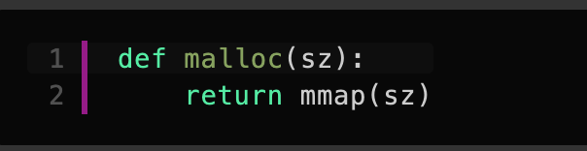
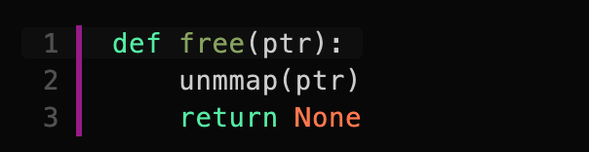
Simple allocator
☞
ptr1
ptr1 = malloc(sz1);
ptr2 = malloc(sz2);
free(ptr2);
ptr3 = malloc(sz3);
sz1
Direct usage of mmap() / unmap()
malloc(sz) → mmap(sz)
free(ptr) → unmmap(ptr)
Notes:
☞

Slide 10
Simple allocator
ptr1 = malloc(sz1);
ptr2 = malloc(sz2);
free(ptr2);
ptr3 = malloc(sz3);
ptr1
☞
sz1
ptr2
Direct usage of mmap() / unmap()
malloc(sz) → mmap(sz)
free(ptr) → unmmap(ptr)
sz2
sz3
Notes:
☞

Slide 11
Simple allocator
ptr1 = malloc(sz1);
ptr2 = malloc(sz2);
free(ptr2);
ptr3 = malloc(sz3);
ptr1
sz1
☞
ptr2
Direct usage of mmap() / unmap()
malloc(sz) → mmap(sz)
free(ptr) → unmmap(ptr)
sz2
Notes:
☞

Slide 12
Simple allocator
ptr1 = malloc(sz1);
ptr2 = malloc(sz2);
free(ptr2);
ptr3 = malloc(sz3);
ptr1
sz1
☞
ptr2
Direct usage of mmap() / unmap()
malloc(sz) → mmap(sz)
free(ptr) → unmmap(ptr)
sz2
ptr3
sz3
Notes:
☞

Slide 13
1. Simple allocator:
Security Scoreboard
Performance | malloc(): mmap() --- | free(): nummap() ---
Fragmentation | External: ++ | Internal: --
Security | UAF: ++ | Overflow: ++
mmap() / unmmap() are expensive
Returns 4KB pages
Page level access control by kernel
Let's improve performance!

Slide 14
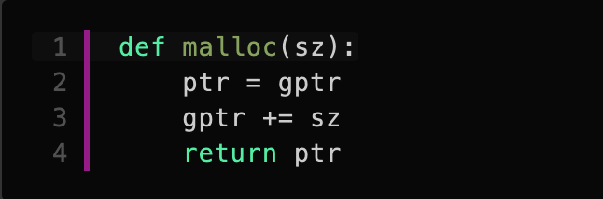
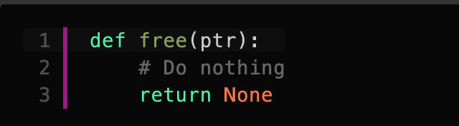
2. Simple and fast allocator
gptr
ptr1
☞
ptr1 = malloc(sz1);
ptr2 = malloc(sz2);
free(ptr2);
ptr3 = malloc(sz3);
sz1
gptr’
Allocate the large chunk and increase as needed
Deallocation do nothing

Slide 15
2. Simple and fast allocator
gptr
ptr1
ptr1 = malloc(sz1);
ptr2 = malloc(sz2);
free(ptr2);
ptr3 = malloc(sz3);
☞
sz1
gptr’
ptr2
Allocate the large chunk and increase as needed
Deallocation do nothing
sz2
gptr”

Slide 16
2. Simple and fast allocator
gptr
ptr1
ptr1 = malloc(sz1);
ptr2 = malloc(sz2);
free(ptr2);
ptr3 = malloc(sz3);
☞
sz1
gptr’
ptr2
Allocate the large chunk and increase as needed
Deallocation do nothing
sz2
gptr”
ptr3

Slide 17
2. Simple and fast allocator
gptr
ptr1
ptr1 = malloc(sz1);
ptr2 = malloc(sz2);
free(ptr2);
ptr3 = malloc(sz3);
sz1
☞
gptr’
ptr2
Allocate the large chunk and increase as needed
Deallocation do nothing
sz2
gptr”
ptr3
sz3
gptr

Slide 18
2. Simple and Fast Allocator:
Security Scoreboard
Performance | malloc(): ++ | free(): +++
Fragmentation | External: -- | Internal: ++
Security | UAF: ++ | Overflow: -
Allocate the exact size
  Internal fragmentation ++
Free just discard the chunk
  External fragmentation –
No UAF, but can overflow to other chunk (object)
Improve memory space utilization!

Slide 19
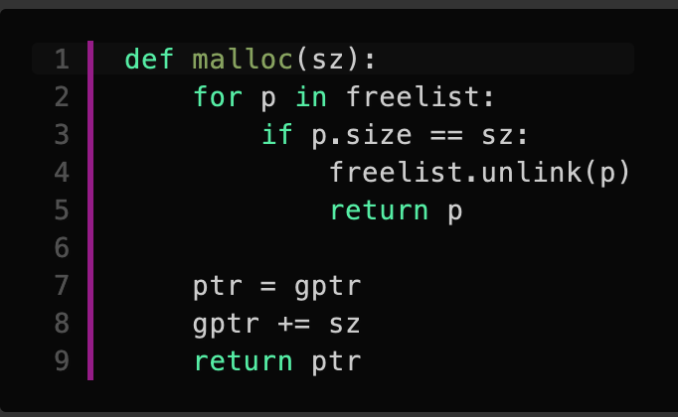
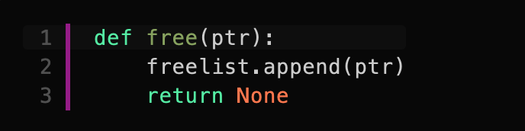
3. Re-usable allocator
gptr
ptr1
ptr1 = malloc(sz1);
ptr2 = malloc(sz2);
free(ptr2);
ptr3 = malloc(sz3);
sz1
ptr2
sz2
ptr3
sz3

Slide 20
3. Re-usable allocator
gptr
ptr1
Free-list
sz1
ptr2
?
sz2
freed chunk
ptr3
Two implementation issues
Issue 1: How do we know the size of chunks?
  For all chunks
Issue 2: How to iterate free-list?
  Free chunks
sz3
Use In-lined metadata

Slide 21
3. Re-usable allocator
gptr
sz1
ptr1
Free-list
sz2
ptr2
freed
sz3
ptr3
freed
Prepend “size” of each chunk
  For both allocated and free chunks

Slide 22
3. Re-usable allocator
gptr
sz1
ptr1
Free-list
sz2
ptr2
append() inlines link field
freed
sz3
ptr3
freed
Free-list can be arbitrarily length → malloc() overhead
  The length is unbounded
Improve malloc() performance!

Slide 23
3. Re-usable allocator
gptr
sz1
ptr1
Free-list
sz2
ptr2
freed
sz3
ptr3
freed
Free-list can be arbitrarily length
→ malloc() overhead
  The length is unbounded
Improve malloc() performance!

Slide 24
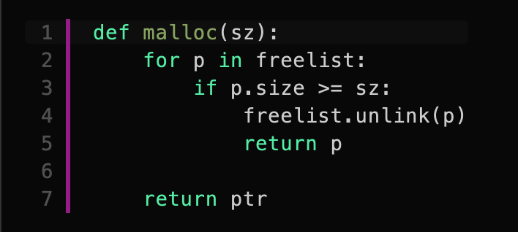
3. Re-usable allocator
gptr
sz1
ptr1
Free-list
sz’
ptr2
Relax the size match
condition
Internal
Fragmentation
sz3
ptr3
freed

Slide 25
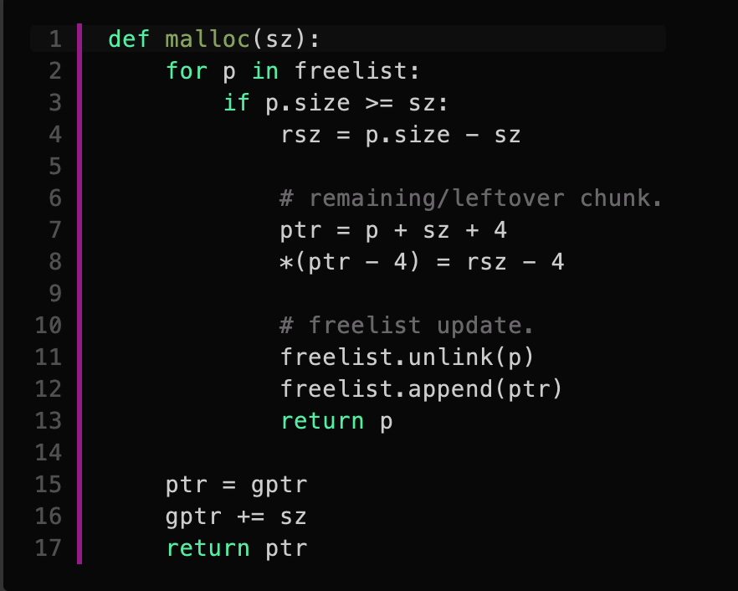
Internal Fragmentation
gptr
sz1
ptr1
Free-list
sz2’
ptr2
Split-and-reuse
  Create a new chunk with remaining space
  Put back to the free-list
rsz := sz2 – 4 - (sz2’ + 4)
free chunk
sz3
ptr3
free chunk

Slide 26
External Fragmentation
gptr
ptr1
Free-list
ptr2
free(ptr4)?
sz3
ptr3
freed
sz4
ptr4
sz5
ptr5
freed

Slide 27
External Fragmentation
gptr
ptr1
Free-list
ptr2
free(ptr4)?
  Three small size chunks
  + size fields
Merge neighboring free chunks
  if next(ptr) is free
  merge(ptr, next(ptr))
  if prev(ptr) if free then
  merge(prev(ptr), ptr)
sz3
ptr3
freed
sz4
ptr4
sz5
ptr5
freed

Slide 28
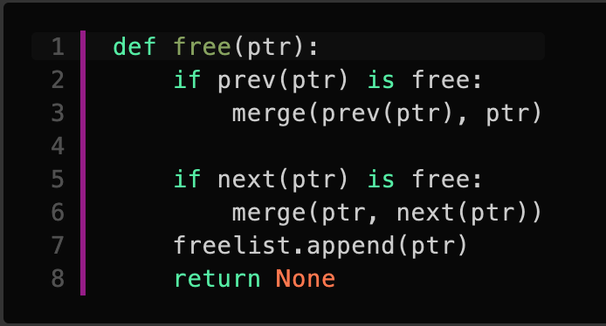
External Fragmentation
gptr
ptr1
Free-list
ptr2
Previous / next merge
Two implementation issues
  How can we iterate?
    immediate predecessor (previous) and successor (next) chunks
  How can we check the chunk status?
    Is it being used or free'd?
sz3
ptr3
freed
sz4
ptr4
sz5
ptr5
freed

Slide 29
next(ptr)
gptr
ptr1
ptr2
Trivial
next(ptr4)
  (ptr4 + sz4 + 4) ➔ ptr5 (next ptr)
    and check P flag, if not in use merge
    sz4’ = sz4 + sz5 + 4
Previous-in-use (P) flag
  Mark at next chunk (you will see why later)
  ‘0’ not in use, ‘1’ being used
sz3
ptr3
freed
sz4
ptr4
freed
sz5
ptr5
NULL
freed
sz6
0

Slide 30
prev(ptr)
gptr
ptr1
sz2
Not an easy way to locate previous chunk
  Free-list iteration is too expensive
  Need previous chunk size
Another Inline metadata
  Size at the end of free chunk
  P flag in my size field
prev(ptr4)
  return ptr4 - * (ptr4 – 8) - 4
  ➔ ptr4 - sz3 - 4
ptr2
sz3
ptr3
free chunk
sz3
sz4’
0
ptr4
NULL
freed
sz6
0

Slide 31
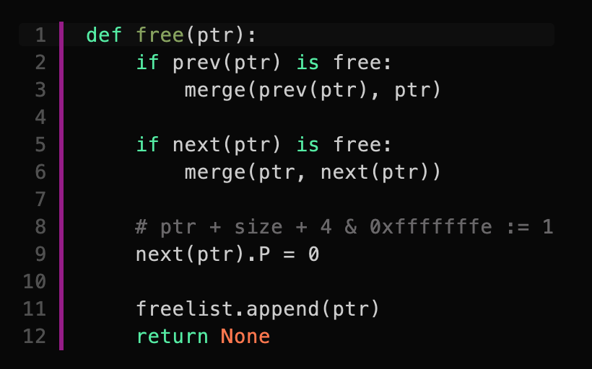
prev(ptr)
gptr
ptr1
Free-list
sz2
ptr2
sz3’ := sz3 + sz4’ + 4
ptr3
free chunk
Set prev-in-use (P) flag of next chunk
sz3’
sz6
0
ptr6

Slide 32
Memory Layout Invariants
After free(), for any given free chunk
  Invariant 1: Previous chunk is always allocated
  Invariant 2: Next chunk is always allocated
Notes:
confirm

Slide 33
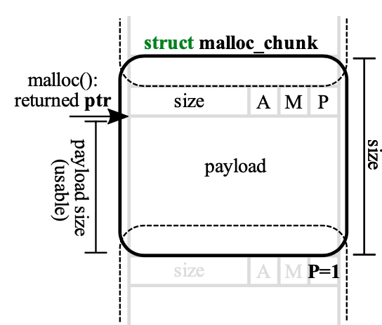
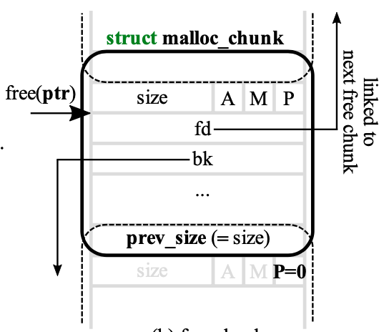
Heap Metadata
All chunk (allocated and free)
  Thee chunk flags
    Arena (non-main-arena)
    Mapped
    Previous-in-Use
  Memory chunks are 8-bytes aligned
    ➔ Last 3 bit of sizes are always ‘0’
Free chunk
  Free-list link pointer
  ‘size’ at the end
    ‘prev_size’ before my ‘size’
Allocated chunk
Free chunk

Slide 34
A, M, P
A (NON_MAIN_ARENA): 0 for chunks in the main arena
  The main arena is the arena that is always there prior to any new threads having been spawned in
  Each thread spawned in a program receives its own arena, and for any chunks malloc’d in each of those threads, this bit is set to 1.
M (IS_MMAPPED): The chunk has been obtained through mmap.
  The other two bits are correspondingly ignored if this bit is set to 1, because mmapped chunks are neither in an arena, nor adjacent to any other free chunks.
P (PREV_INUSE): Set to 0 when the previous chunk is free
  Not the chunk before it in its free-list, but the one before it in memory
  The size of that previous free chunk is stored before the size of this current chunk only if the previous chunk is free, otherwise the previous chunk can use that prev_size space as if it was its own.
  The very first allocated chunk will always have this bit set. If this bit is set to 1, we cannot determine the previous chunk’s size.

Slide 35
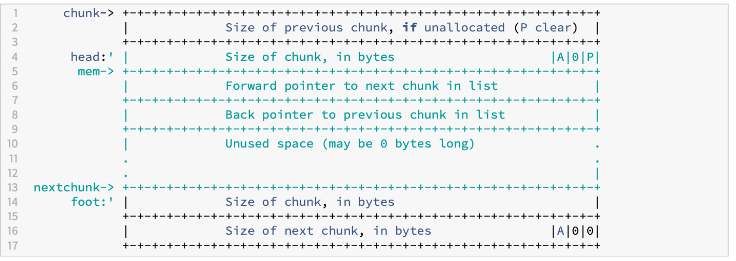
Summary free() operation
Add free-list link pointer
Copy size to the chunk end
Update forward and backward link pointers
  Small and large bins
Set ‘P’ flag of
next chunk to ‘0’
Notes:
https://heap-exploitation.dhavalkapil.com/diving_into_glibc_heap/malloc_chunk

Slide 36
Security Scoreboard
Extensive re-use of allocated memory object
Complex in-line metadata
→ More opportunities for exploits
Performance | malloc(): - | free(): --
Fragmentation | External: ++ | Internal: ++
Security | UAF: -- | Overflow: --

Slide 37
Security Issues
Use-after-free (UAF)
  ptr → next freechunk
Double free
ptr1 and ptr2 will point to the
same location
Heap Overflow
  Overflowing the next chunk and P flag with 0 (from 1),
    Current chunk will be regarded as free chunk and then merged
  Allocated for another chunk
  Access to the overlapping chunk with the existing pointer

Slide 38
In-Class Exercise (20 pt)
Connect to ctf-vm1 (ssh syssec.run –p 2201)
Run
  $ fetch inclass5
Resource
  https://codimd.syssec.org/s/4Aa3Fs_Wt

Slide 39
GLIBC Versions
Heap management routines mainly implemented from
  malloc/malloc.c
Many changes over time to address performance and security issues
  E.g., tcache introduced in 2.26, double-free patched in 2.27
  Current latest 2.35
  CTF-VMs installed 2.23 (largely outdated)
    Other versions under /lib/glibc_versions (32 bit), lib64/glibc_versions (64-bit)
You can link / run specific loader and libc version

Slide 40
GLIBC Versions
Running with loader
  /lib/glibc_versions/2.26/i686_tcache/lib/ld-2.26.so ./heap1
Linking with loader
CFLAGS64=-Wl,-dynamic-linker,/lib64/glibc_versions/2.27-dfree/x64_tcache/lib/ld-2.27.so
CFLAGS=-Wl,-dynamic-linker,/lib/glibc_versions/2.27-dfree/i686_tcache/lib/ld-2.27.so

Slide 41
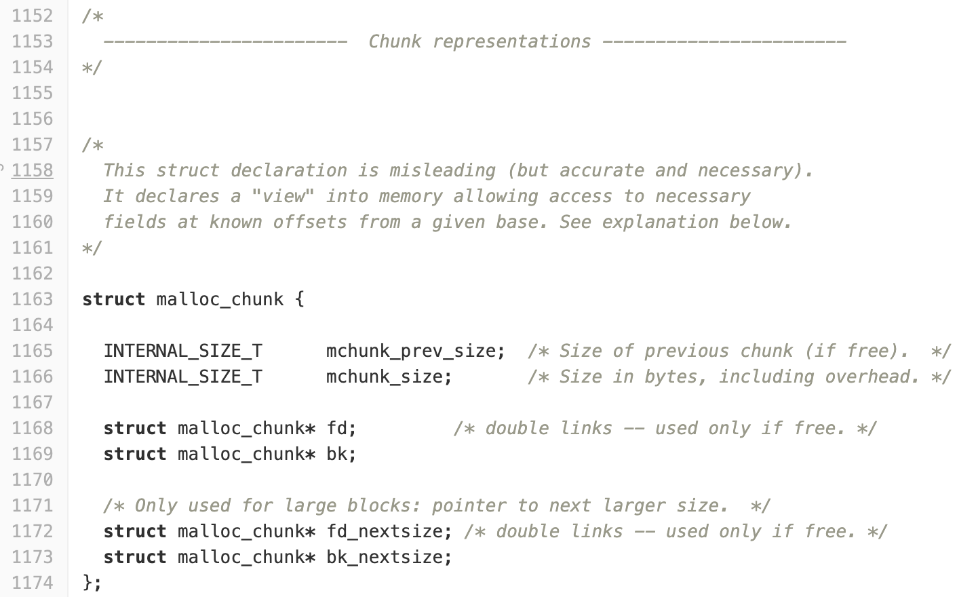
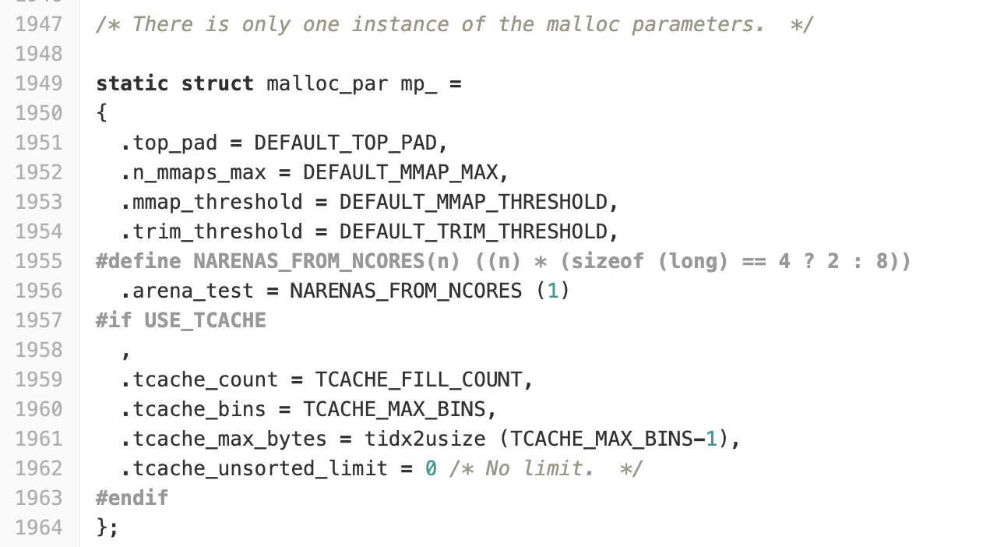
malloc/malloc.c
malloc_chunk
malloc_parameters (mp)

Slide 42
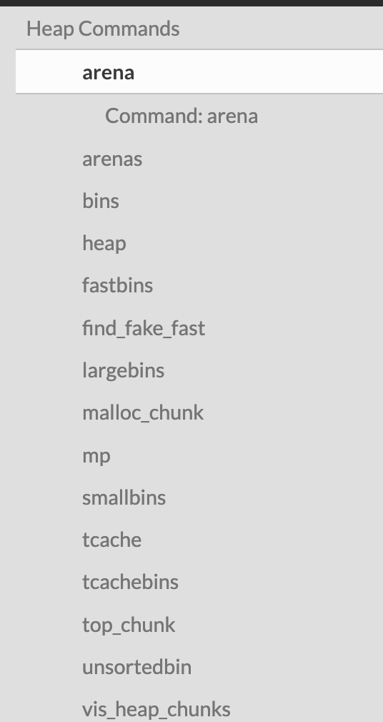
Pwndbg Supports for Heap Operations
Top chunk (top_chunk)
  A large chunk of unallocated heap memory
  Usually indicates the end of heap boundary

Slide 43
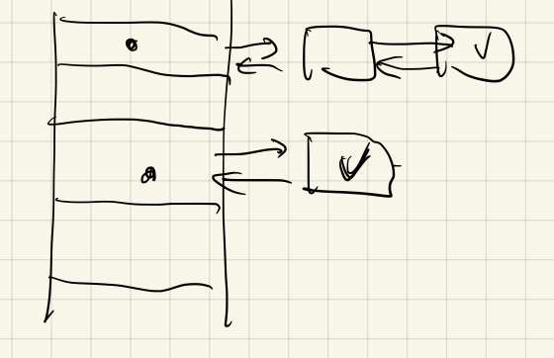
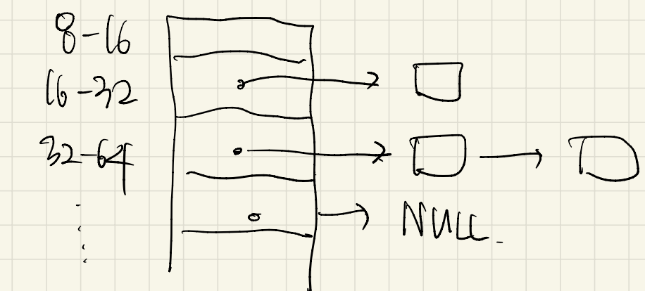
Free-List Optimization (BIN'ing)
Free-list split into multiple BINs based on chunk size
32 fastbin for quick accesses
  push-and-pop
  No merges (no care for fragmentations)
small, and large bins
  Prev, next merges
  need reallocations to different bins
  Additional metadata for forward and backward links

Slide 44
BIN'ing: unsortedbins, fastbins, smallbins largebins, tcache
fastbin
unsortedbin
smallbin
largebin
tcache (2.26 or higher)

Slide 45
HEAP Summary
Binning: size-base groups/operations
  E.g., caching the same size objects together
In-line metadata: metadata before/after or even inside
  E.g., putting metadata inside the free chunk
Cardinal metadata: no encoding, direct pointers and sizes
  E.g., using raw pointers for linked lists

Slide 46
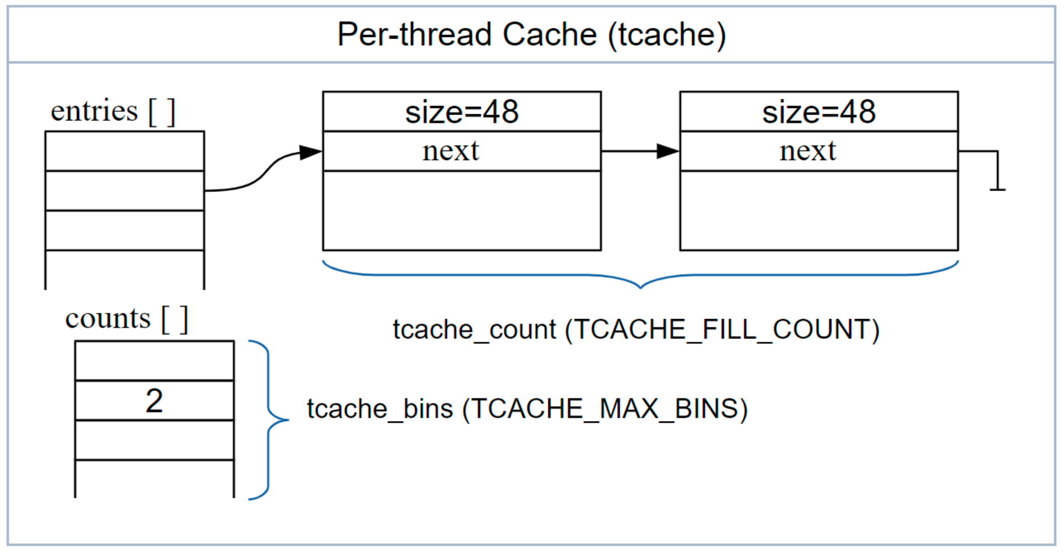
tcache (glibc 2.26 ≧)
Thread cache (tcache)
For chunks allocated or freed,
  First look into tcache bins instead of traversing through fast, small, large bins (or unsorted bins)
  Works on LIFO manner
Notes:
https://www.phoronix.com/scan.php?page=news_item&px=glibc-malloc-thread-cache

Slide 47
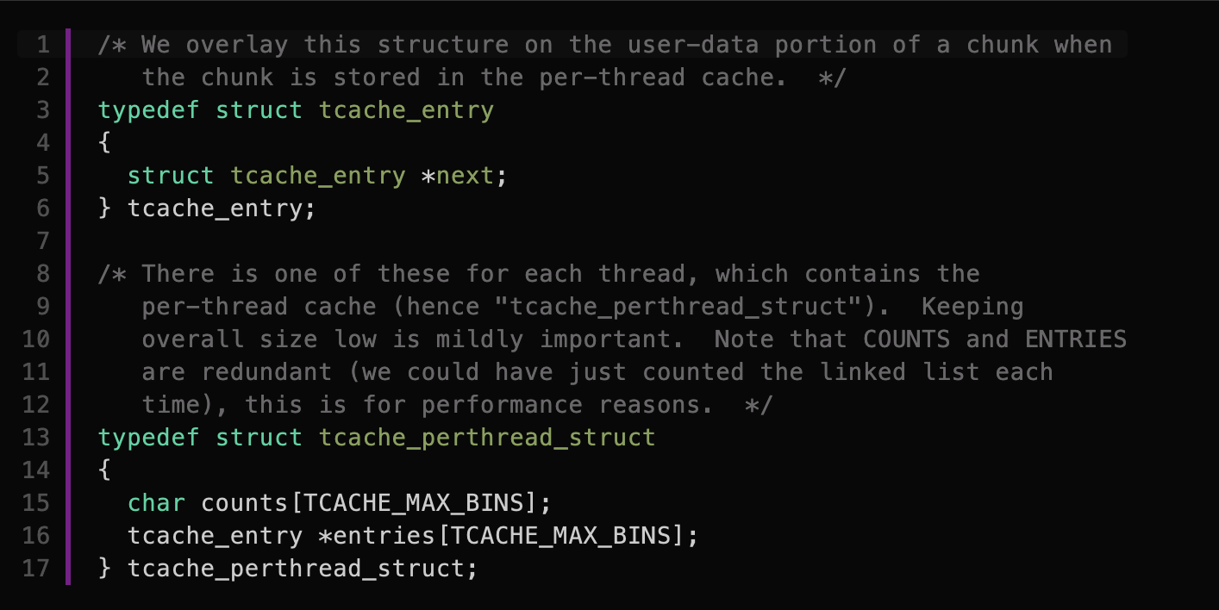
tcache (glibc 2.26 ≧)
Data structure

Slide 48
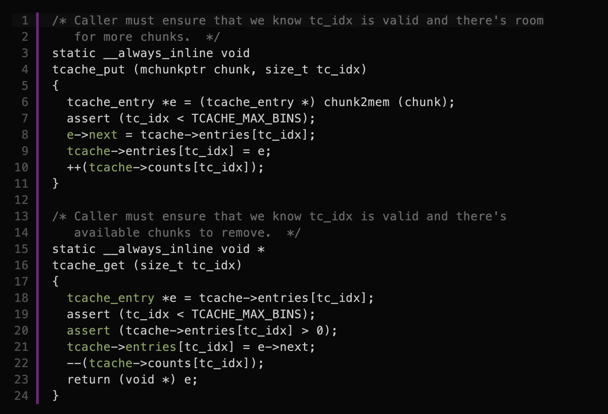
tcache (glibc 2.26 ≧)
tcache_put();, tcache_get();

Slide 49
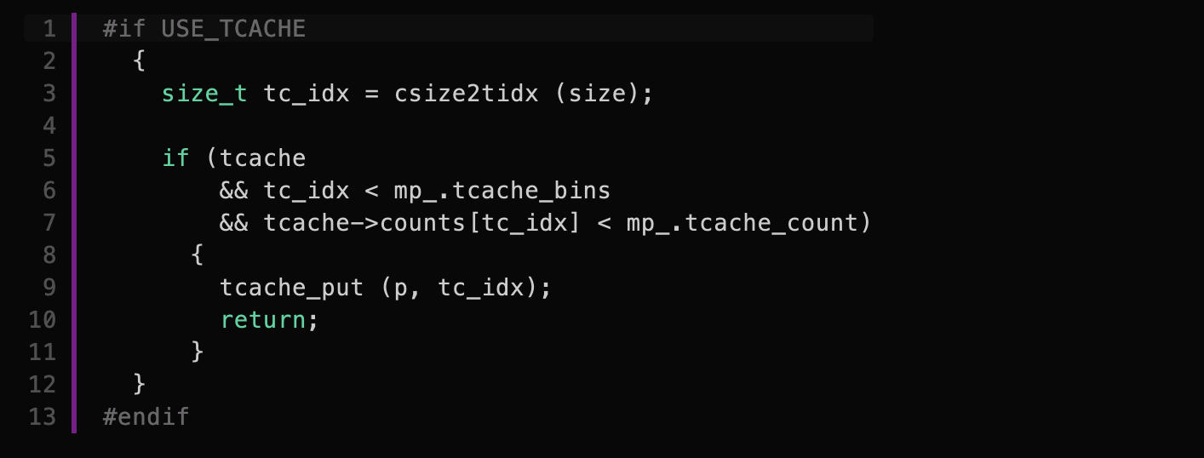
tcache (glibc 2.26 ≧)
free();

Slide 50
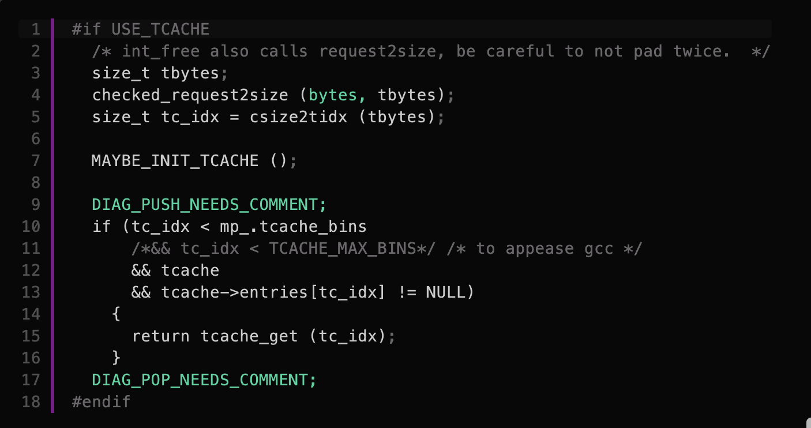
tcache (glibc 2.26 ≧)
malloc();

Slide 51
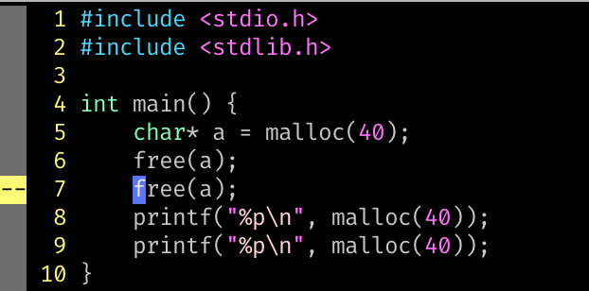
Double Free

Slide 52
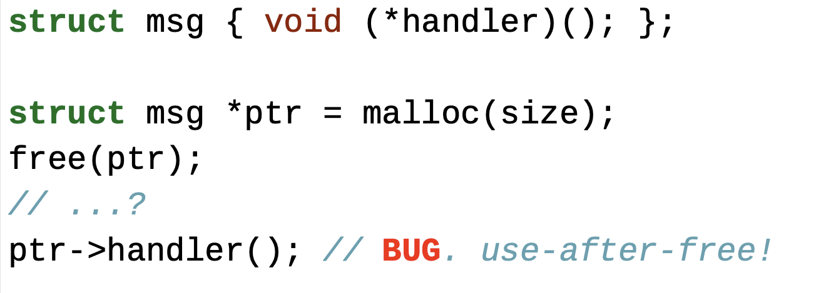
Double Free
What would be the *a? if nothing happened?
  Heap pointer leakage (e.g., fd/bk)
What if another part of code invoked malloc(size)?
  Hijacking function pointers (e.g., handler)

Slide 53
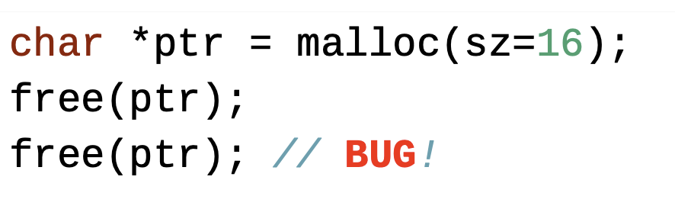
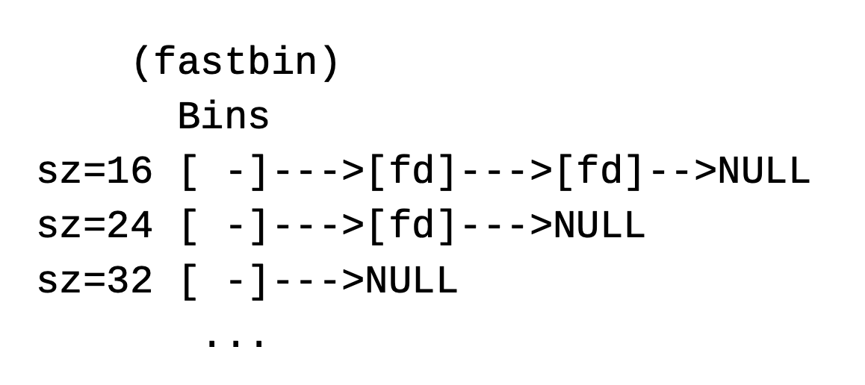
Double Free

Slide 54
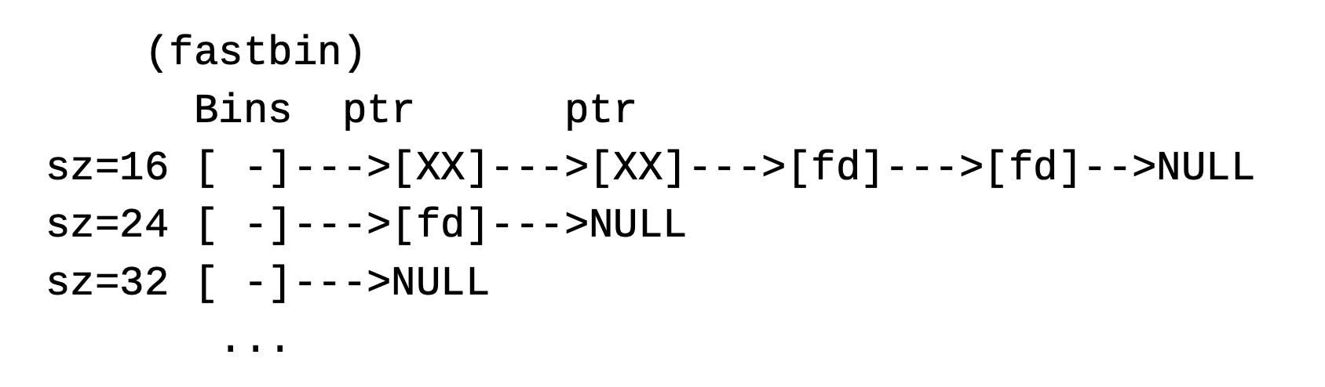
Double Free

Slide 55
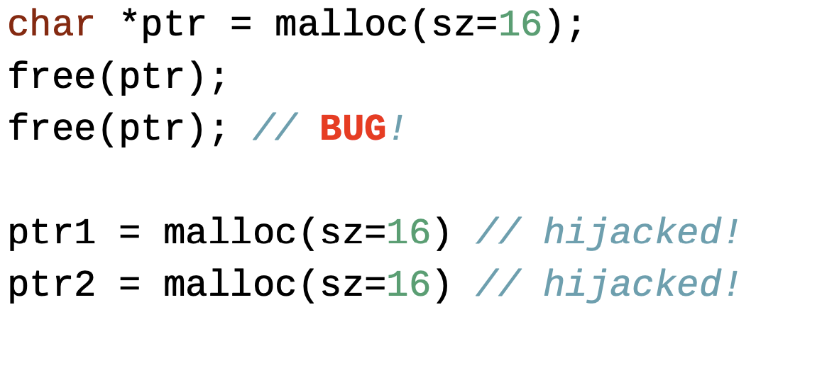
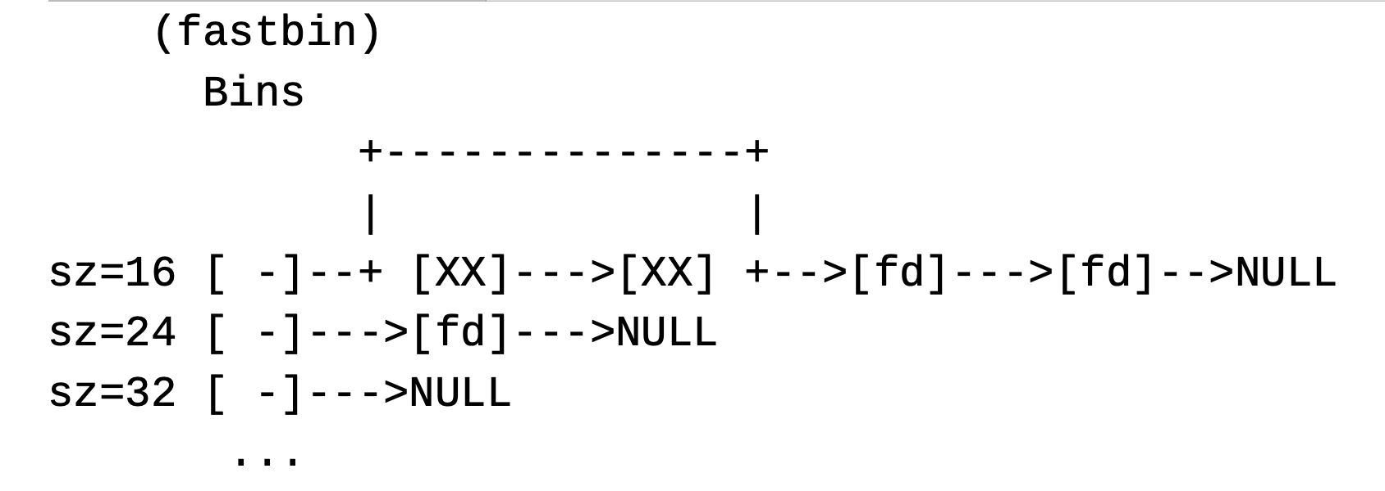
Double Free

Slide 56
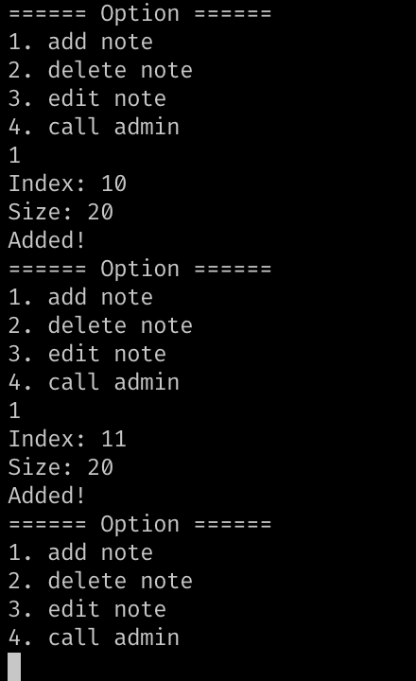
notes_app

Slide 57
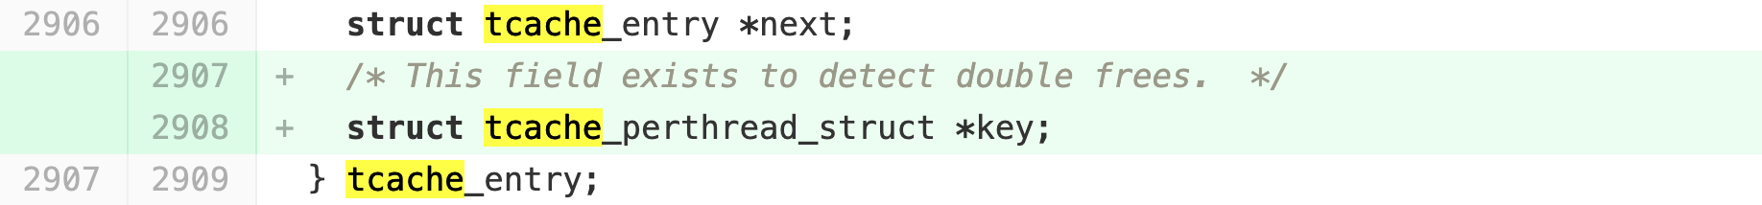
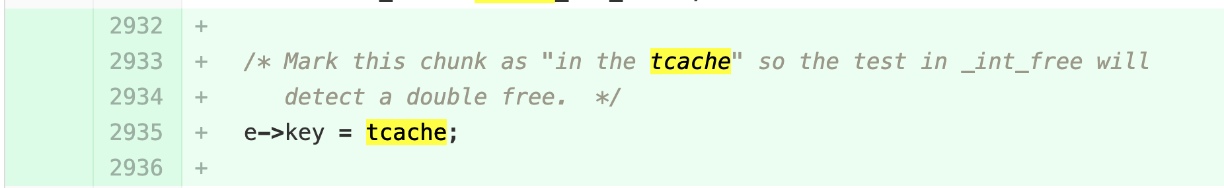
Double Free: Mitigation (glibc 2.27)
Need to check if the bin contains the pointer that we’d like to free()
Notes:
from glic git repo
git checkout 4b246928bd7ffabad7303dffa84ee542450e56d9~1
http://syssec0.utdallas.edu/utd-classes/glibc/-/commit/4b246928bd7ffabad7303dffa84ee542450e56d9

Slide 58
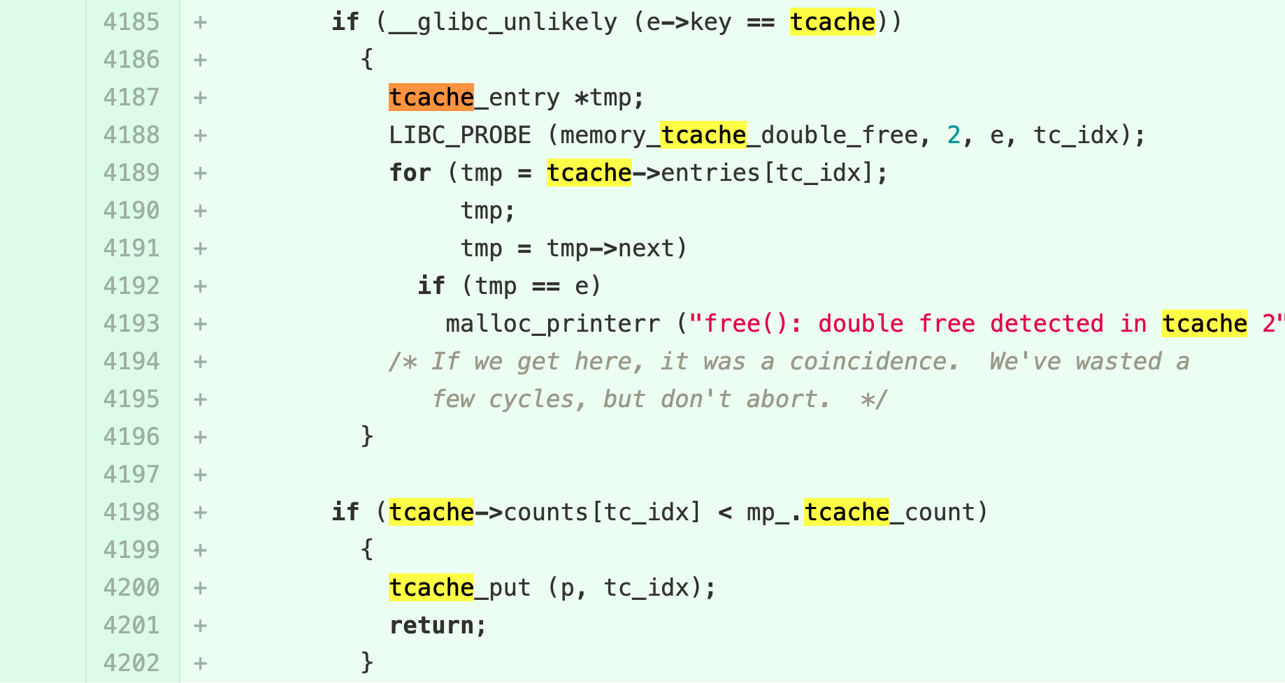
Double Free: Mitigation (glibc 2.27)
Need to check if the bin contains the pointer that we’d like to free()
How can we workaround?
Notes:
from glic git repo
git checkout 4b246928bd7ffabad7303dffa84ee542450e56d9~1
http://syssec0.utdallas.edu/utd-classes/glibc/-/commit/4b246928bd7ffabad7303dffa84ee542450e56d9

