Slide 1
CS4459.001 Cyber Attacks & Defense Lab
HEAP III
Apr 29, 2025

Slide 2
Unit8
0-crackme2, 10
1-babyheap *, 10
2-heapovfl *, 15
3-heapovfl2, 20
4-unlink, 20
5-unlink2, 20
6-off_by_one, 20
7-fastbin, 20
8-notes_app, 20
9-notes_app2, 20
a-candl-note, 30
b-loginbaby, 20

Slide 3
HEAP Summary
In-line metadata: metadata before/after or even inside
E.g., putting metadata inside the free chunk
Cardinal metadata: no encoding, direct pointers and sizes
E.g., using raw pointers for linked lists
Binning: size-base groups/operations
E.g., caching the same size objects together

Slide 4
Heap Attacks
Double Free
Unsafe Unlink
Off-by-one
Leak libc with UAF

Slide 5
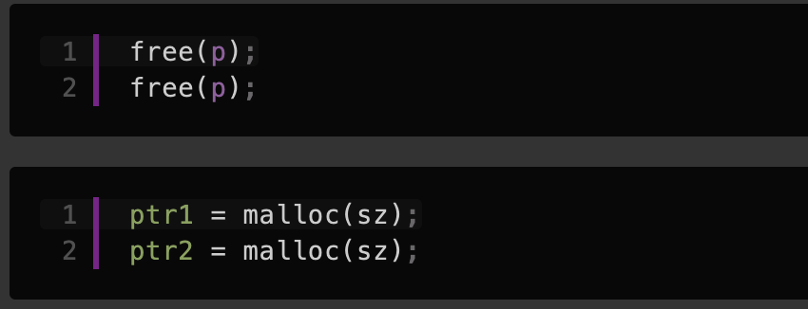
Security Issues
Use-after-free (UAF)
ptr → next freechunk
Double free
ptr1 and ptr2 will point to the same location
Heap Overflow
Overflowing the next chunk and P flag with 0 (from 1),
Current chunk will be regarded as free chunk and then merged
Allocated for another chunk
Access to the overlapping chunk with the existing pointer

Slide 6
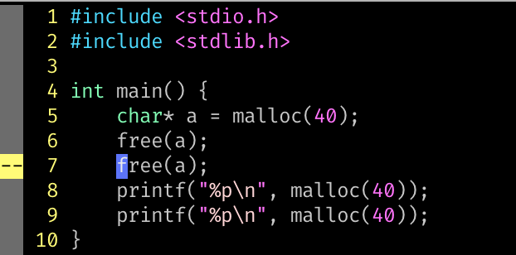
Double Free

Slide 7
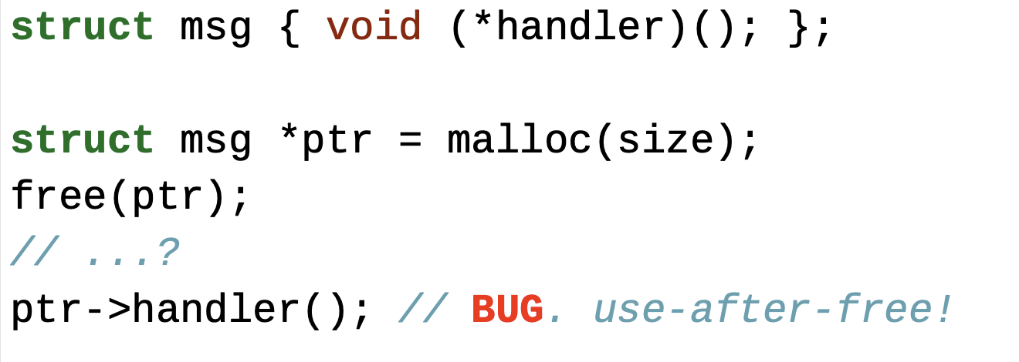
Double Free
What would be the *a? if nothing happened?
Heap pointer leakage (e.g., fd/bk)
What if another part of code invoked malloc(size)?
Hijacking function pointers (e.g., handler)

Slide 8
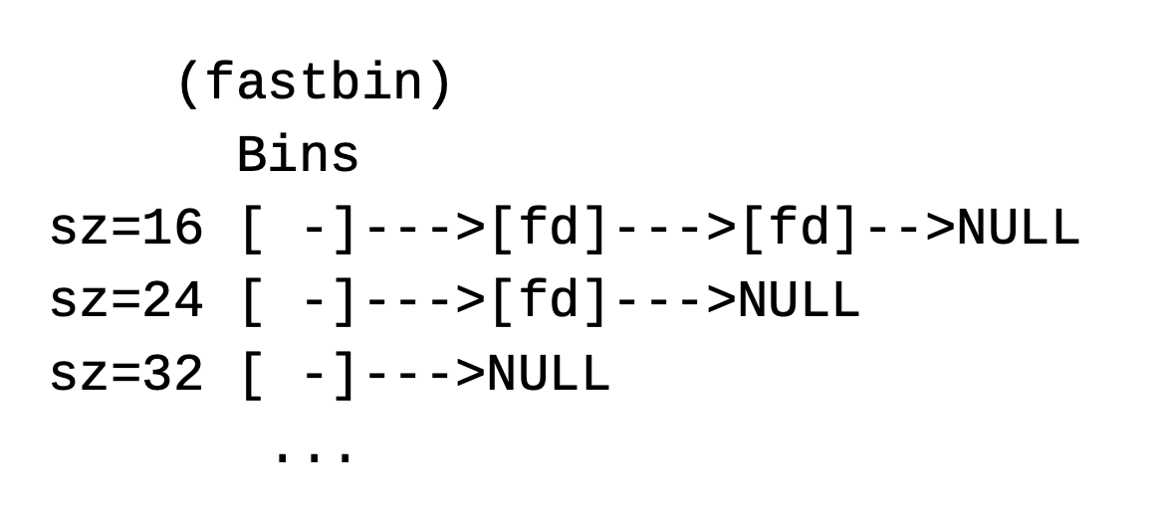
Double Free

Slide 9
Double Free

Slide 10
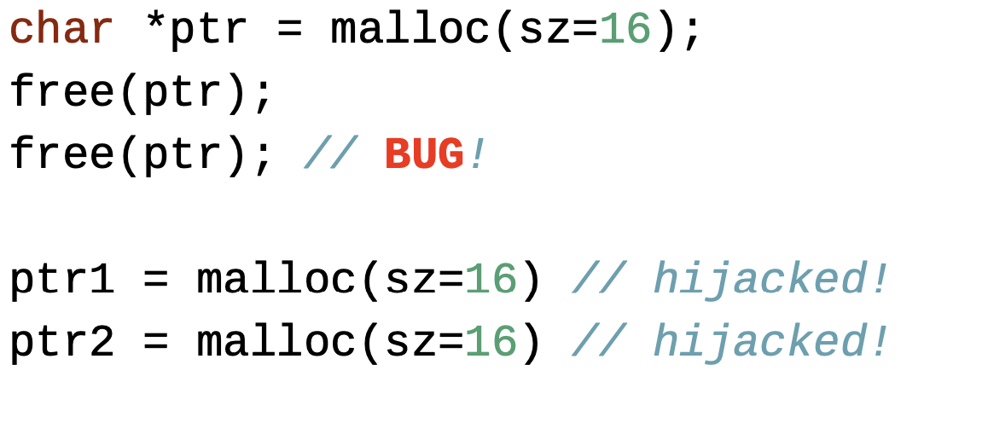
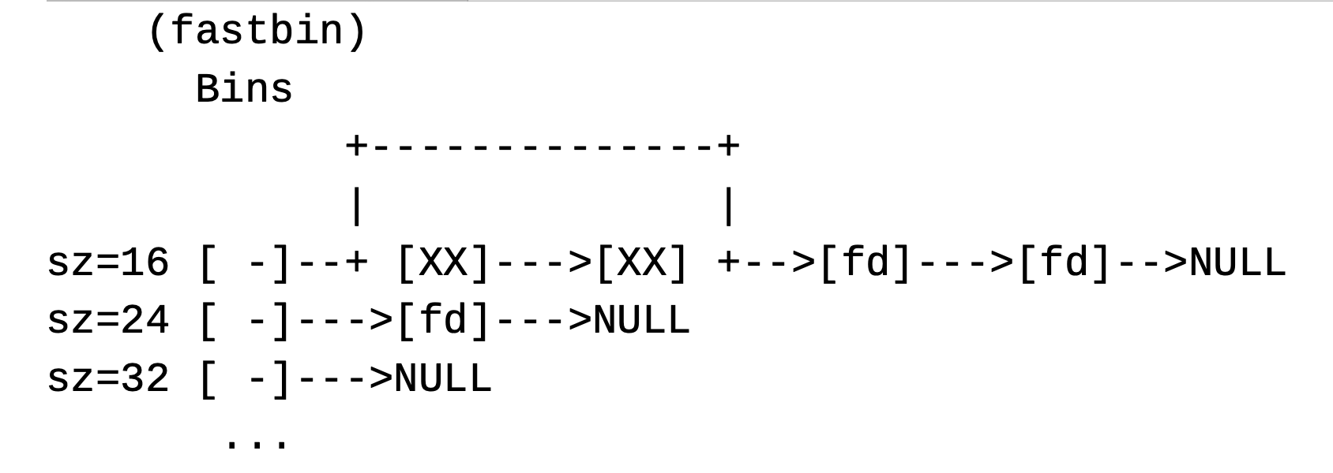
Double Free

Slide 11
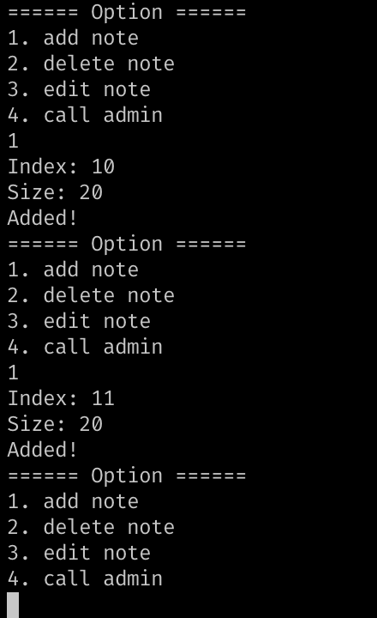
notes_app

Slide 12
Double Free: Mitigation (glibc 2.27)
Need to check if the bin contains the pointer that we’d like to free()
Each ‘tache_entry’ struct now has pointer back to ‘tcach_perthread_struct’.
Notes:
from glic git repo
git checkout 4b246928bd7ffabad7303dffa84ee542450e56d9~1
https://gitlab.syssec.org/utd-classes/glibc/-/commit/4b246928bd7ffabad7303dffa84ee542450e56d9

Slide 13
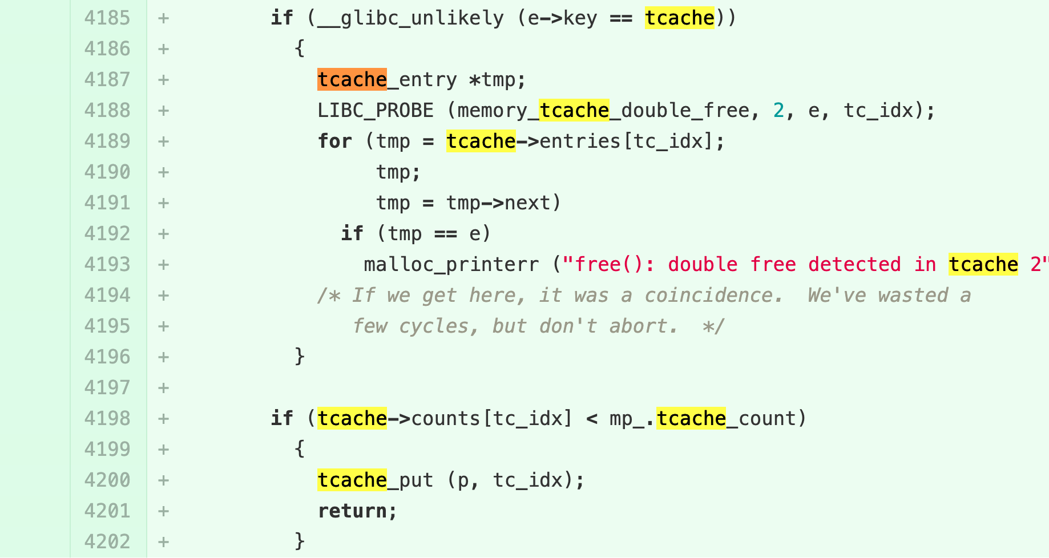
Double Free: Mitigation (glibc 2.27)
Need to check if the bin contains the pointer that we’d like to free()
Looping (cost!) to check for the double free.
How can we workaround?
Notes:
from glic git repo
git checkout 4b246928bd7ffabad7303dffa84ee542450e56d9~1
https://gitlab.syssec.org/utd-classes/glibc/-/commit/4b246928bd7ffabad7303dffa84ee542450e56d9

Slide 14
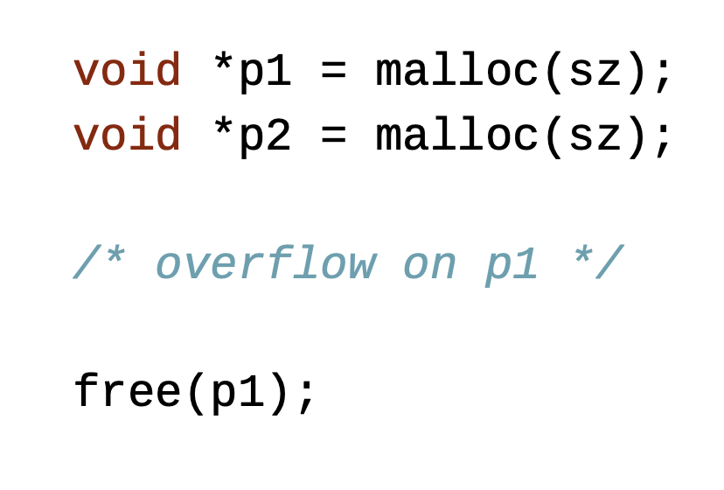
Security Implication of Heap
All metadata can be easily modified/crafted!
Or even new malloc/free objects are created for benefits (and fun!)

Slide 15
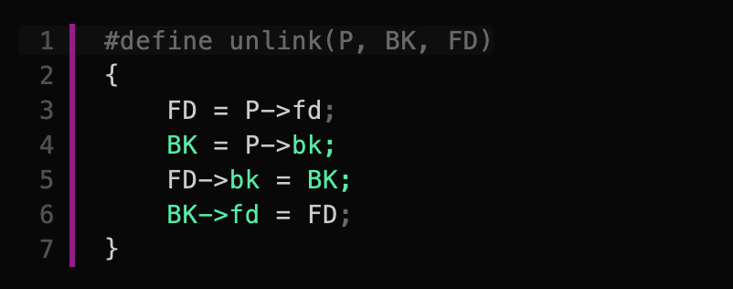
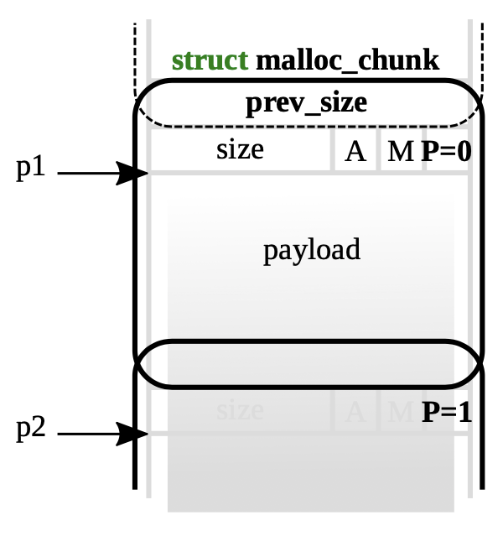
Unsafe Unlink (≦ glibc 2.23)
Overflow to ‘p2’ overwrite ‘dst’ with ‘val’
Merging next free chunk → Arbitrary Write
Precondition
‘p2’ needs to be free chunk
p2’s fd = dst – offsetof(struct malloc_chunk, bk);
p2’s bk = val;
➔ *dst := val; // arbitrary write
Overwrite
size
fd
bk

Slide 16
Unsafe Unlink (≦ glibc 2.23)
Overflow to ‘p2’ overwrite ‘dst’ with ‘val’
Merging next free chunk → Arbitrary Write
Precondition
‘p2’ needs to be free chunk
p2’s fd = dst – offsetof(struct malloc_chunk, bk);
p2’s bk = val;
➔ *dst := val; // arbitrary write
Overwrite
Overwrite
size
fd
bk

Slide 17
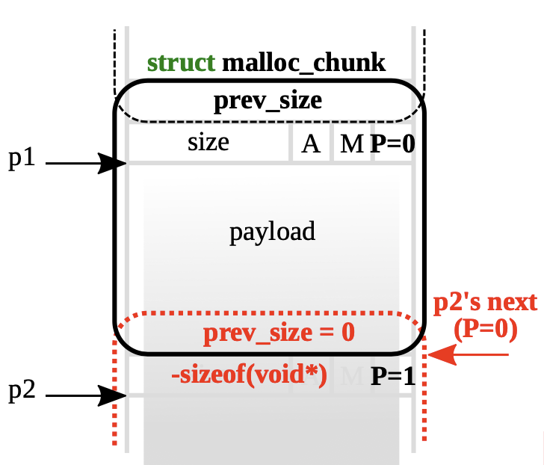
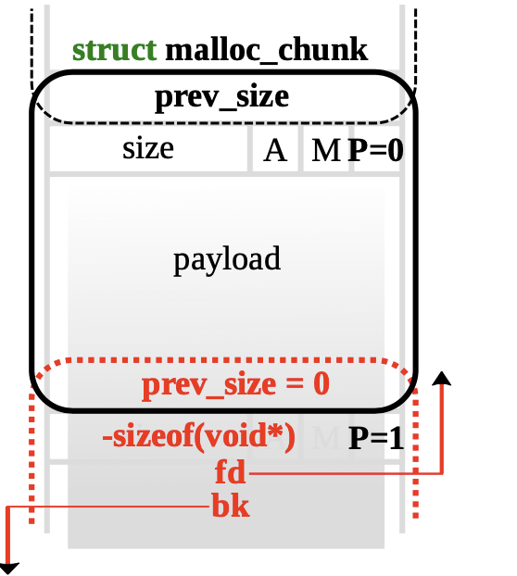
Unsafe Unlink (< glibc 2.3.3)
From ‘p1’, overwrite to ‘p2’ size to -sizeof(void*), treating now as if p2 is free
When free(‘p1’), attempt to consolidate it with p2 as p2 is free

Slide 18
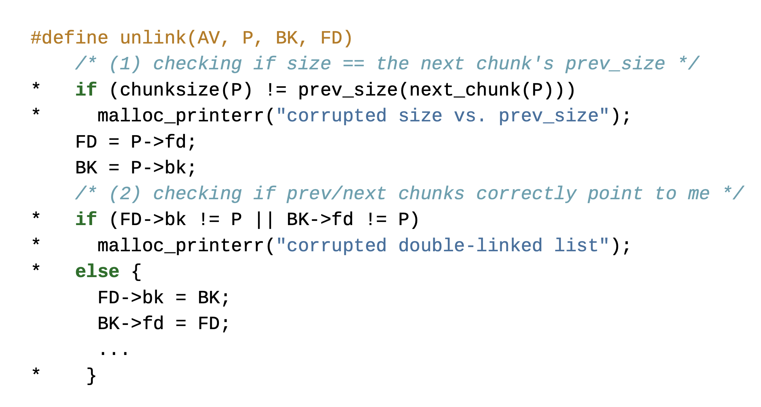
Mitigation on Unlink (glibc 2.27 ≧)

Slide 19
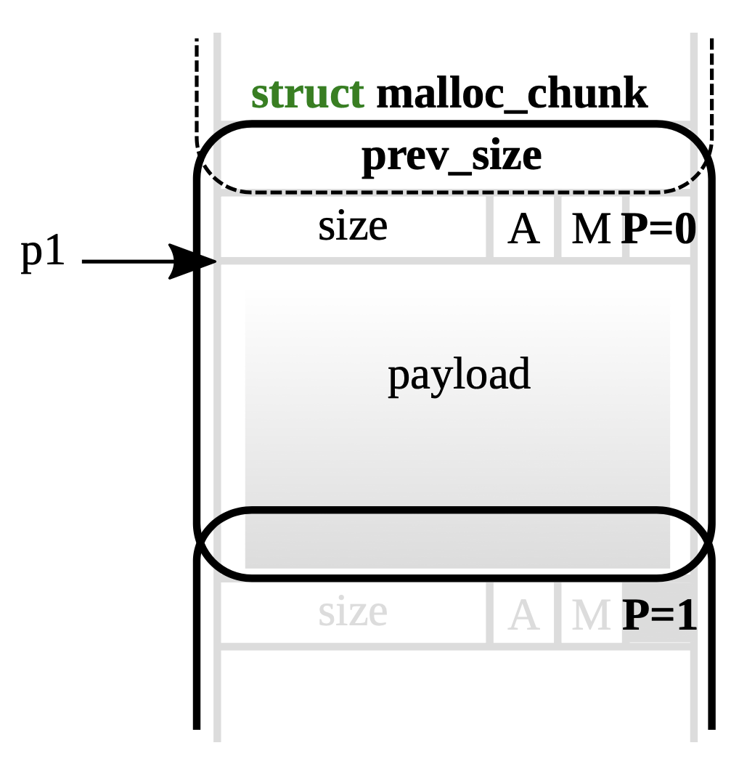
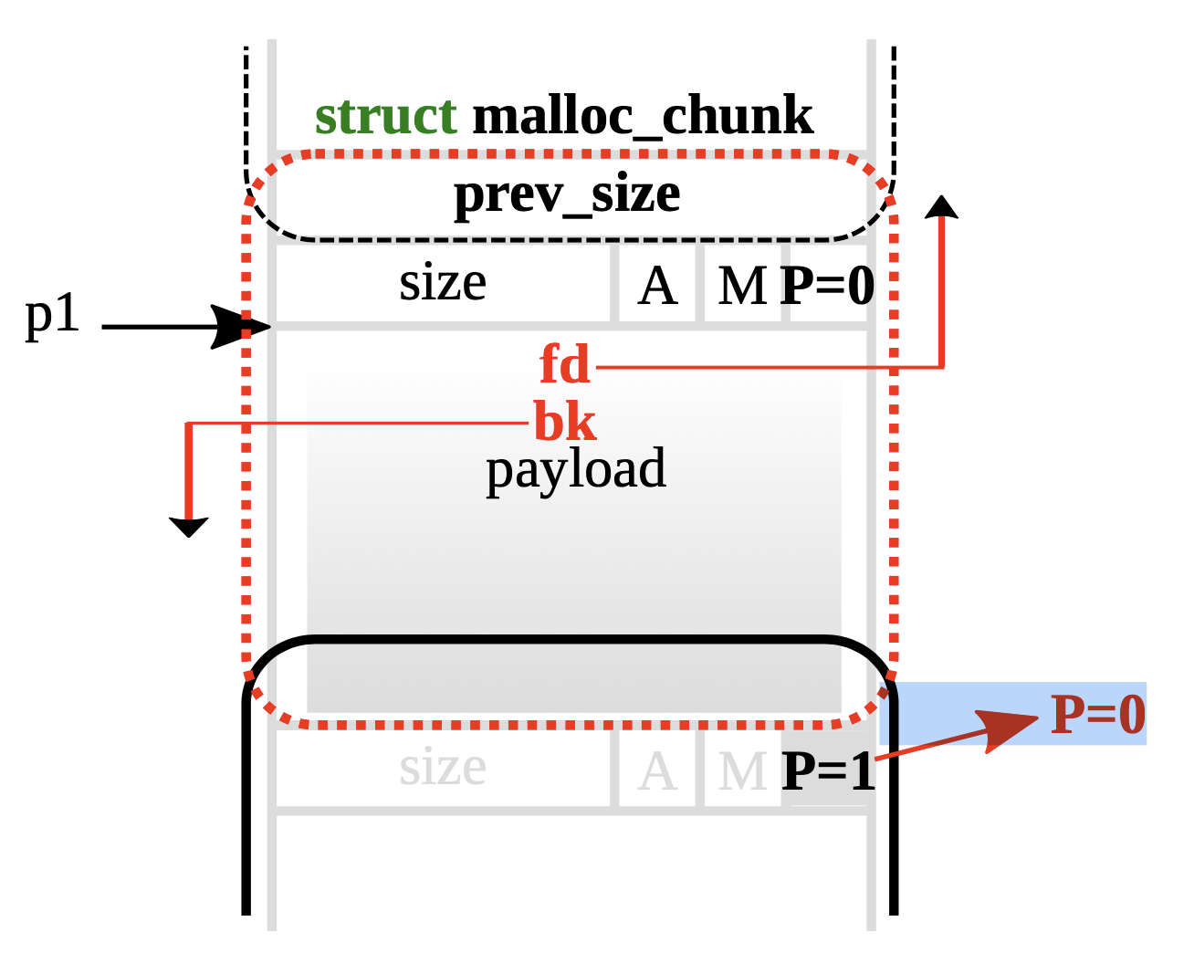
Off-by-One
Common length check mistake
‘>=‘ instead of ‘>’
Trigger arbitrary write as next chunk (say p2) freed

Slide 20
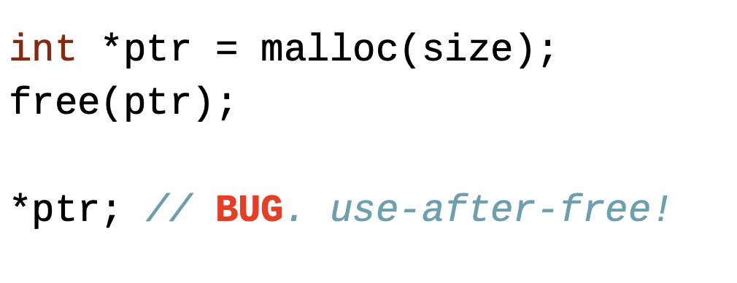
Use-After-Free (UAF)
Simple in concept, but difficult to spot in practice!
Why is it so critical in terms of security?

Slide 21
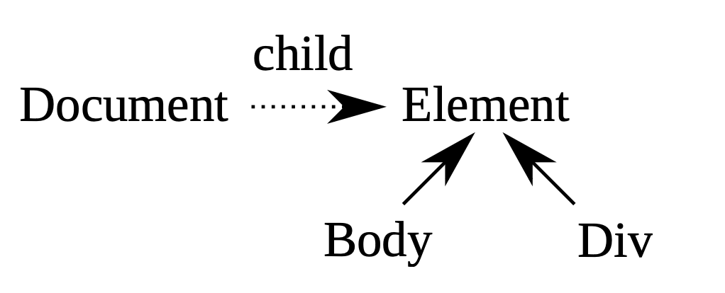
Use-After-Free (UAF)

Slide 22
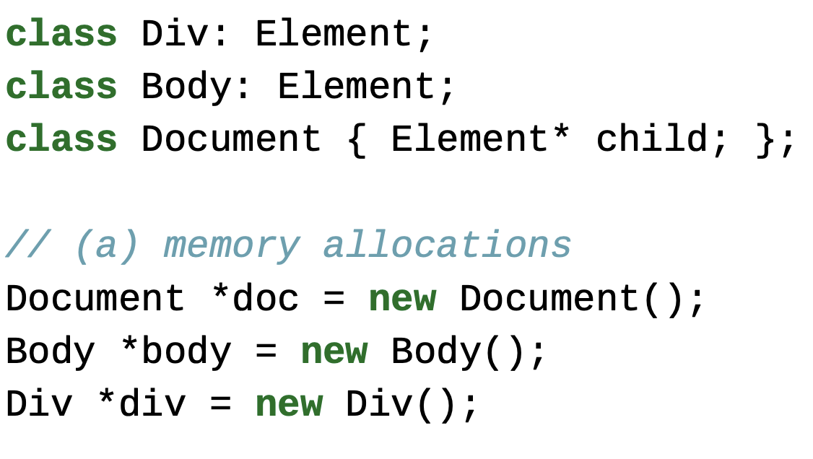
Use-After-Free (UAF)

Slide 23
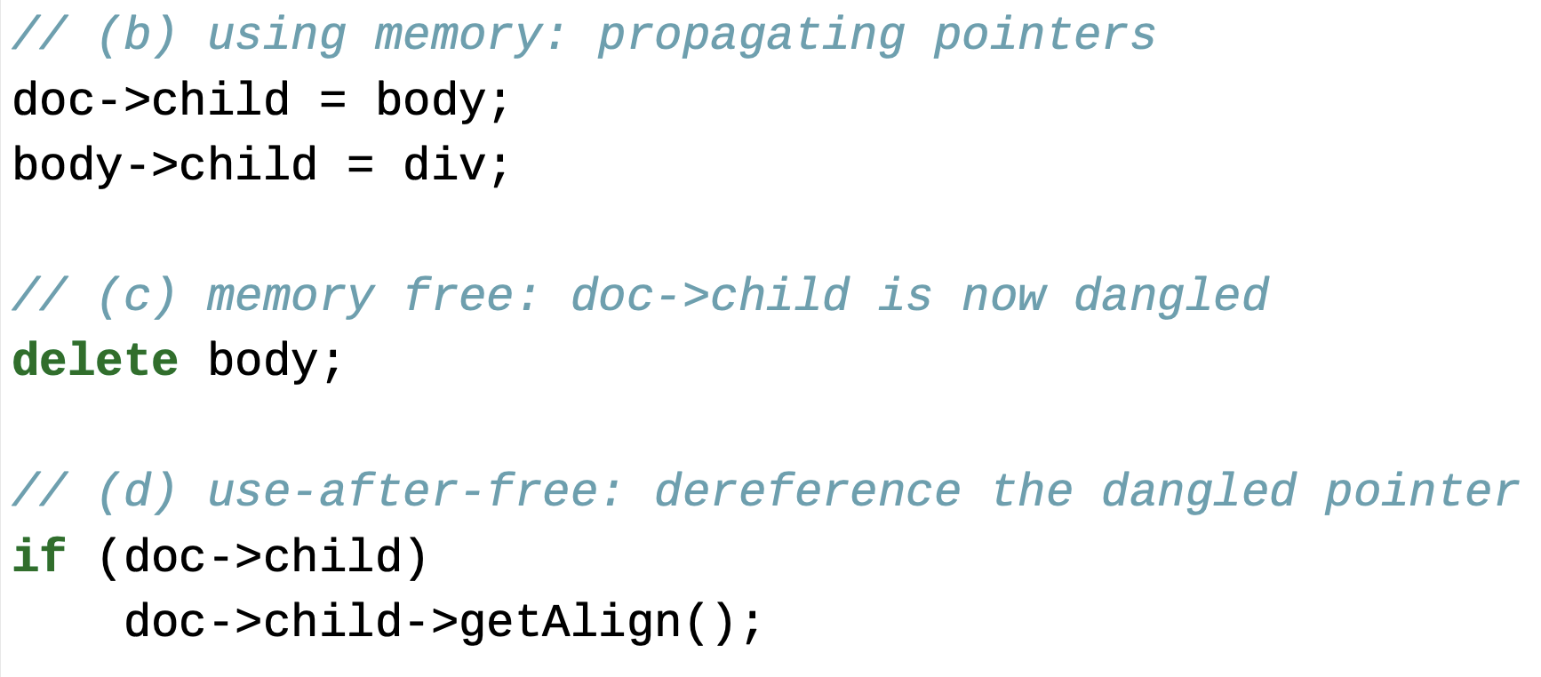
Use-After-Free (UAF)

Slide 24
Libc Leaks with UAF

Slide 25
Heap Defenses
MALLOC_CHECK_
mcheck()
https://man7.org/linux/man-pages/man3/mcheck.3.html
Notes:
Solution
The MALLOC_CHECK_ environment variable is a special environment variable used by glibc that allows it to use a special implementation designed to be tolerant against simple errors.
If the variable is set, the glibc uses an implementation which is less efficient (by performance), however, more tolerant to heap consistency errors. The variable can be set to the following values:
0: any detected heap corruption is silently ignored
1: a diagnostic is printed on stderr
2: abort is called immediately. This can be useful because otherwise a crash may happen much later, and the true cause for the problem is then very hard to track down.
3: This has a combination behavior of 2 and 1, where a diagnostic is printed on stderr, and the program is aborted as soon as memory corruption is hit.

