Slide 1
Special Topic: Python Bytecode Decompilation
Apr 8, 2025

Slide 2
PYC Decompilation Challenges
40 Malware samples (in PYC)
  Uploaded to pylingual.io
Your mission
  Complete incomplete decompilation
    PyLingual implements NLP-assisted decompilation
Unit takeaway
  “Will perfect decompilation help malware analysis?”
  FYI, the decompilers for native binaries produce incomplete decompilation most of the time

Slide 3
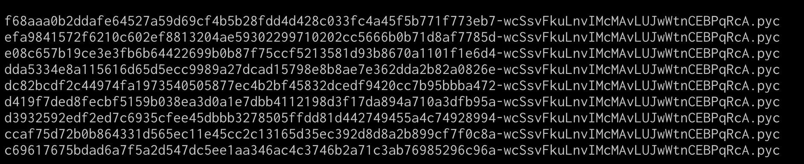
How are Challenges Generated?
Original PYC + salt (NetID) => Challenge PYC
  salt() is to generate individualized/student-specific challenges
Challenge-specific
Student-specific

Slide 4
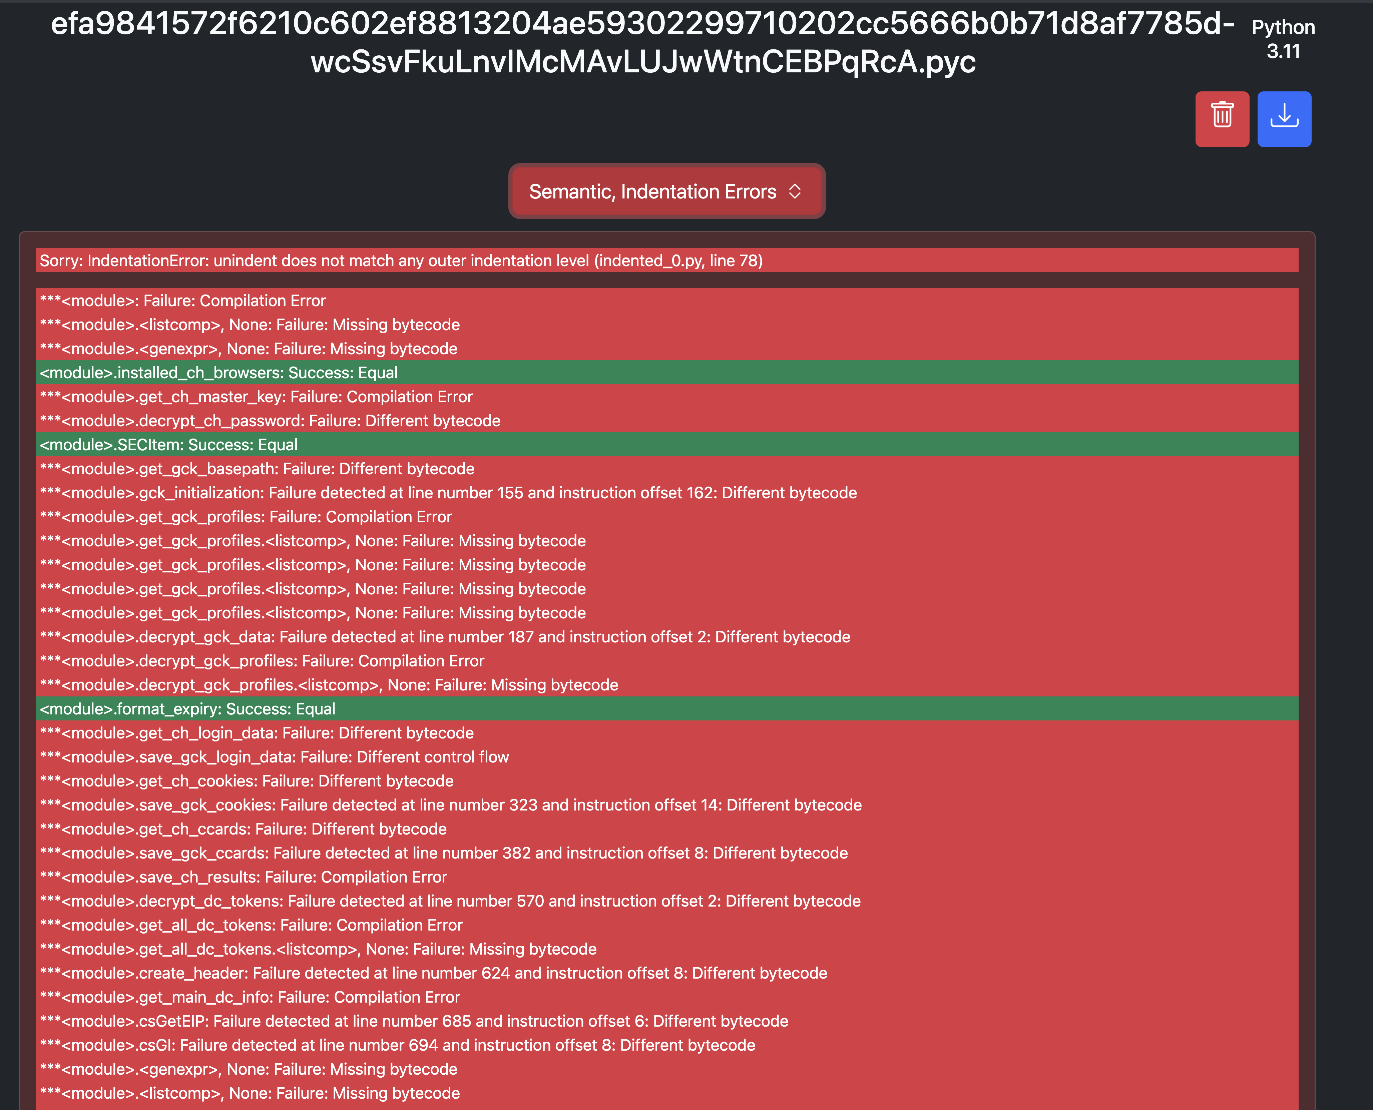
How to Decompile: Basic Workflow
Upload a PYC to pylingual.io
Visit pylingual.io to see the initial decompilation result

Slide 5
How to Decompile: Basic Workflow
Choose code object to fix
  From the source first and then look for the corresponding bytecode
Fix errors and recompile
Move to the next code object

Slide 6
How to Approach: General Strategy
Two families of errors
  Syntax error vs. Semantic errors
  Fix the syntax error first
Semantic errors
  Statement translation errors (easy)
  Control flow errors (hard)
Tip!: Start from small sized PYCs with smaller number of error code objects
$ pyc-unit $ls -lSr

Slide 7
Grading Policy
Base 200 points + Bonus 200 points
Number of challenges solved | Per challenge points | Total points
0 ~ 10 | 20 | 200
11~ 20 | 10 | 100 (bonus)
21 ~ 40 | 5 | 100 (bonus)

Slide 8
High-Level Language Runtimes
Light-weighted VM
  Implement Turing machine atop another Turing machine
  Ex) PyScript project
Code vs. Machine
  Python translates/compiles source (.py) into bytecode (.pyc)
    Java/JVM, dotnet, Lua …
    How about other languages? Haskell, Rust, Golang
Core design issues
  Language syntax and features
  Computation model
  Object structure
  Memory management
  and many more
Notes:
* In PyScript; Cpython is compiled into WebAssembly.

Slide 9
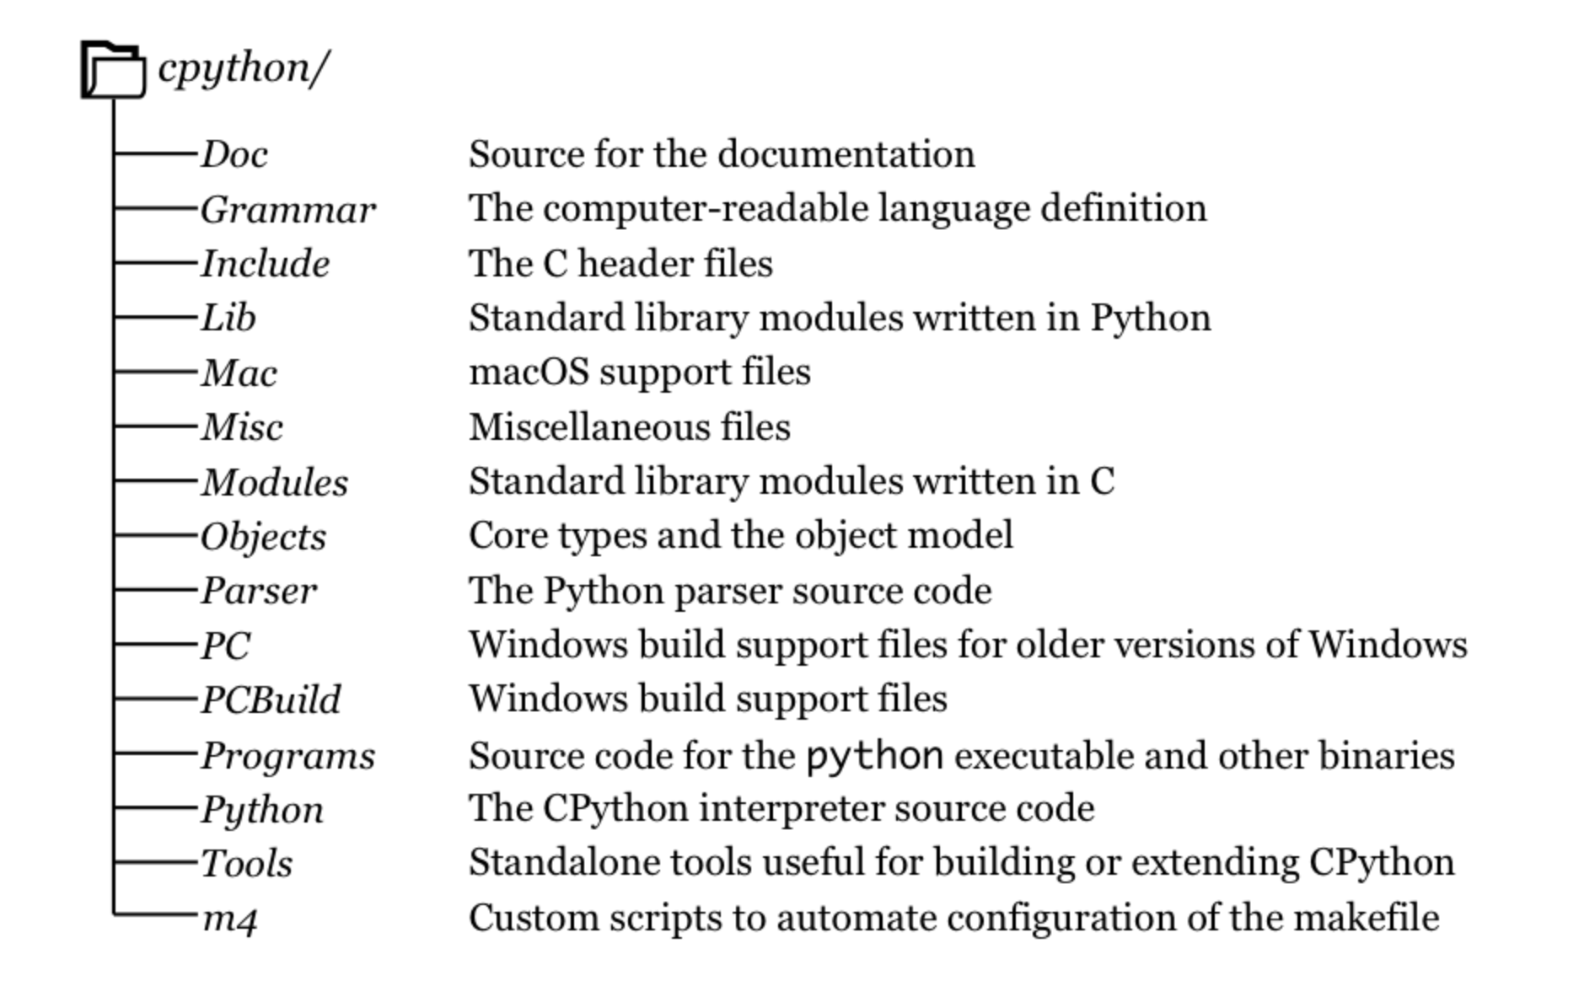
CPython Source Code
Written in C
  Clean and well-maintained
  Designed to be OS- / Architecture- agnostic
Contains
  Python language specification (Grammar/, Docs/)
  Code generation (Parser/)
  Python Objects (Objects/)
  Language runtime (Python/)
  Default modules (Lib/, Modules/)
  and many more

Slide 10
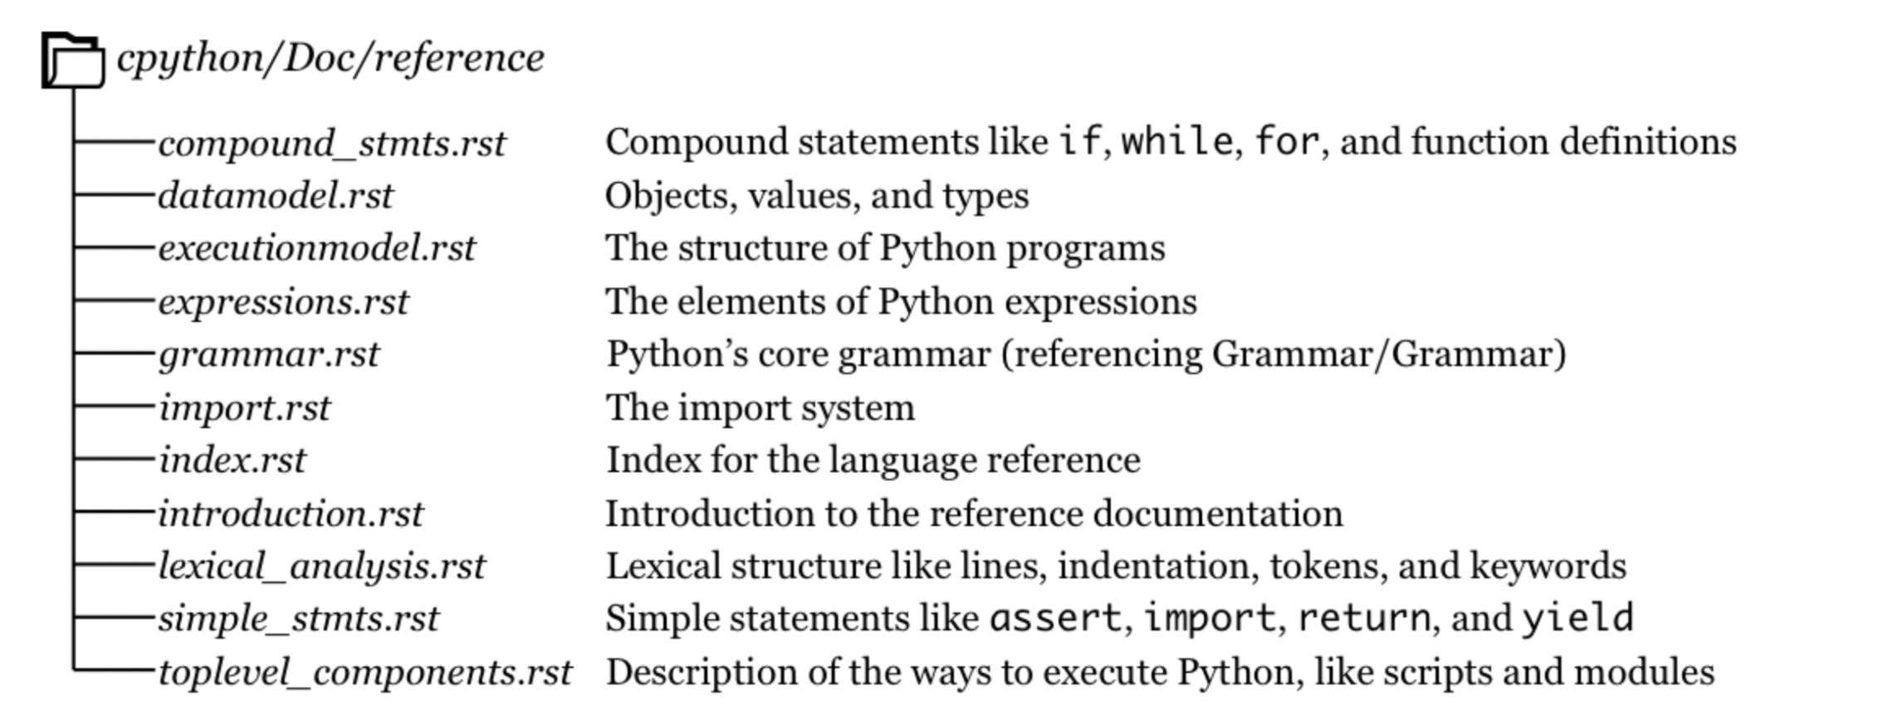
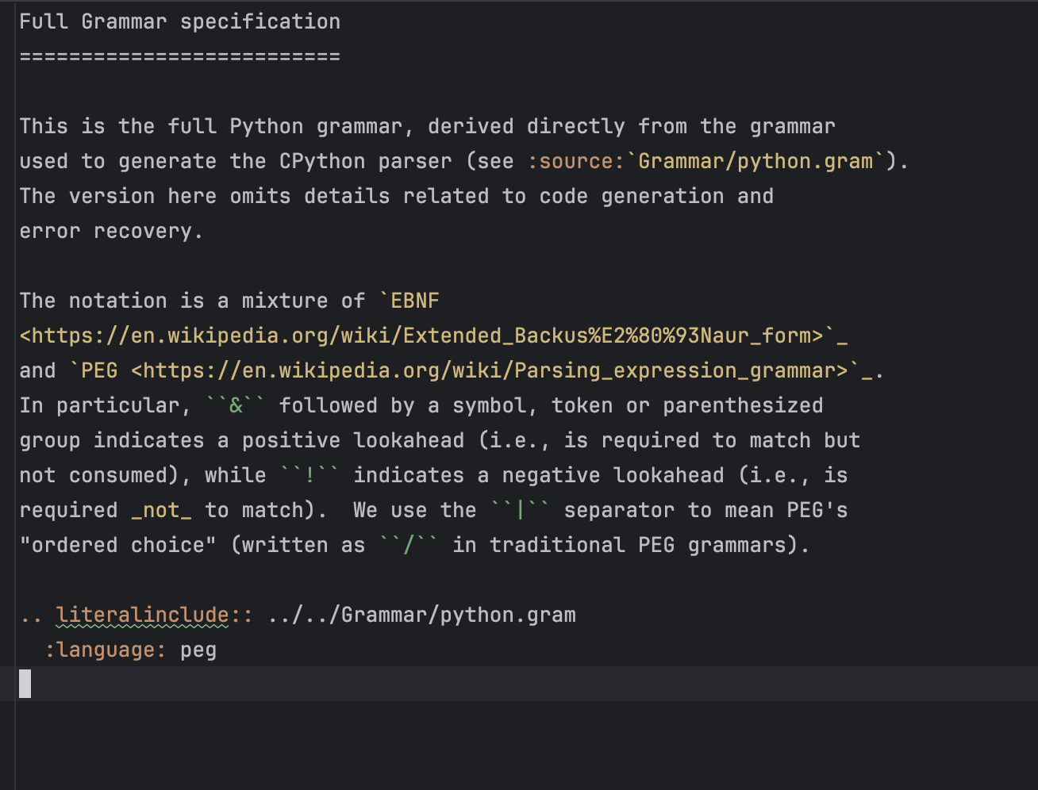
Python Language Specification

Slide 11
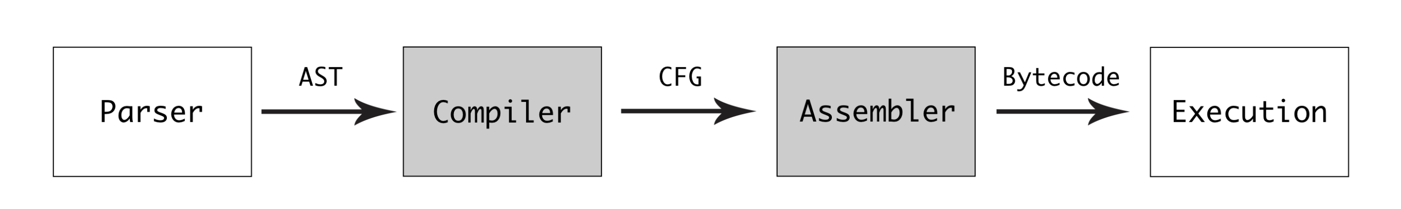
Python (CPython) Execution Model
Do we have another Python?
  Yes, and many: Cython, Jython, PyPi ….
Python code generation
  Source (.py) → Bytecode (.pyc)
  Parser , Compiler, and Assembler
Python language runtime
  Interpreter loop : $SOURCE/Python/ceval.c

Slide 12
Python Code

Slide 13
Python Code Deployment
Packaging with PyInstaller
Depackaging with pyinstxtractor

Slide 14
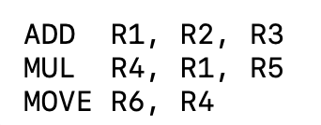
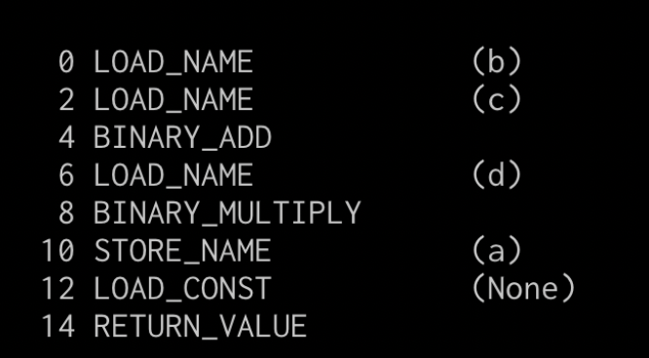
Python Bytecode Computation Model
a = (b + c) * d
Stack-based Machines (JVM, Python bytecode, .NET CLI)
  Simpler Instruction Set
  Easier to Write and Port
  Simpler Compiler Design
  Good for Interpretation
  More Natural for Some Language Semantics
Register-based Machine (Lua’s LuaJIT, Dalvik/ART for Android)

Slide 15
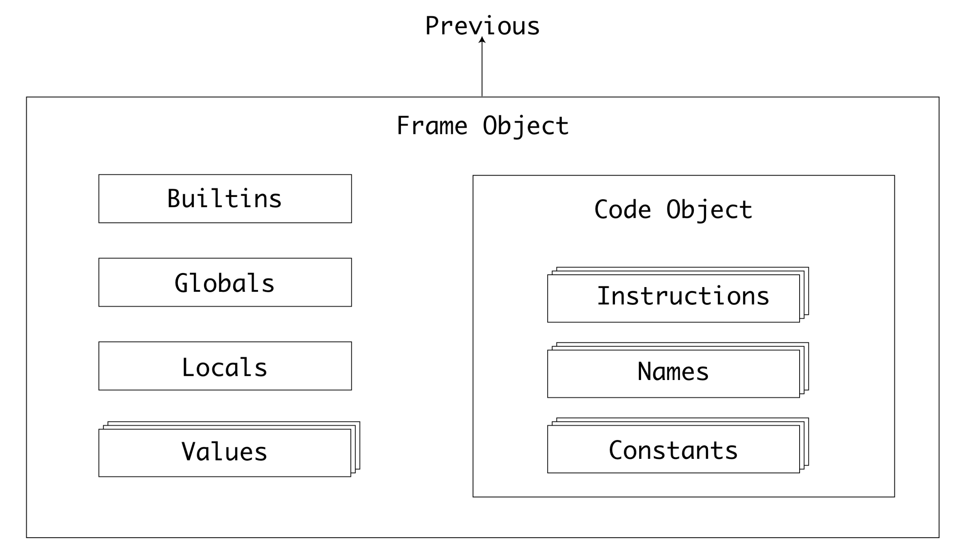
Python Bytecode (PYC)

Slide 16
Backup

