Slide 1
CS4459
Cyber Attacks & Defense Lab (CANDL)
Lec #1 - Introduction
Jan 18, 2023

Slide 2
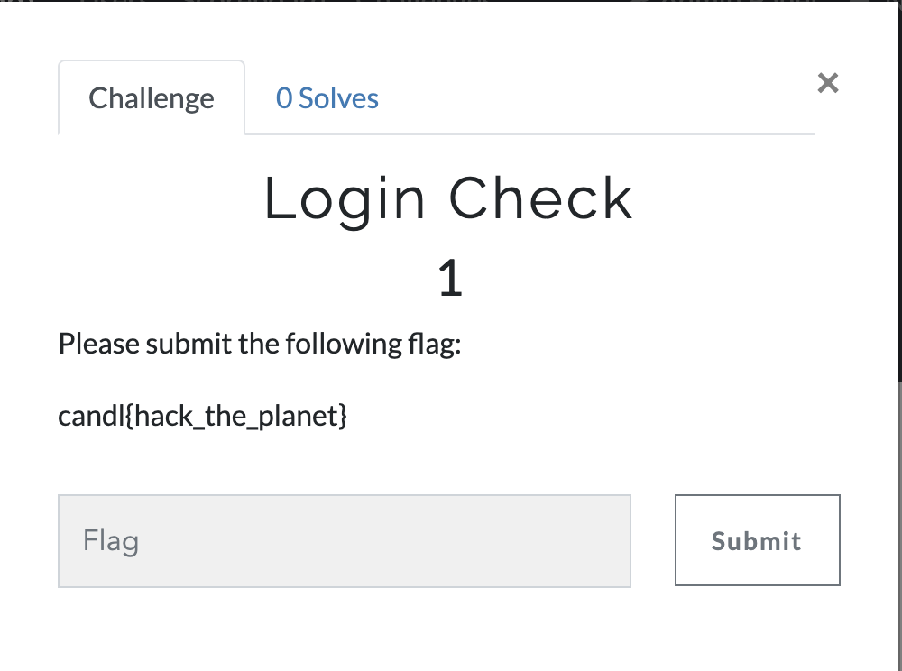
Welcome to CS4459 CANDL
Join class Discord
  https://discord.gg/f9YpjjkBZz
Sign up for CTF scoring server
  https://ctf.syssec.org
  Use your email and UTD NETID
Solve your first challenge

Slide 3
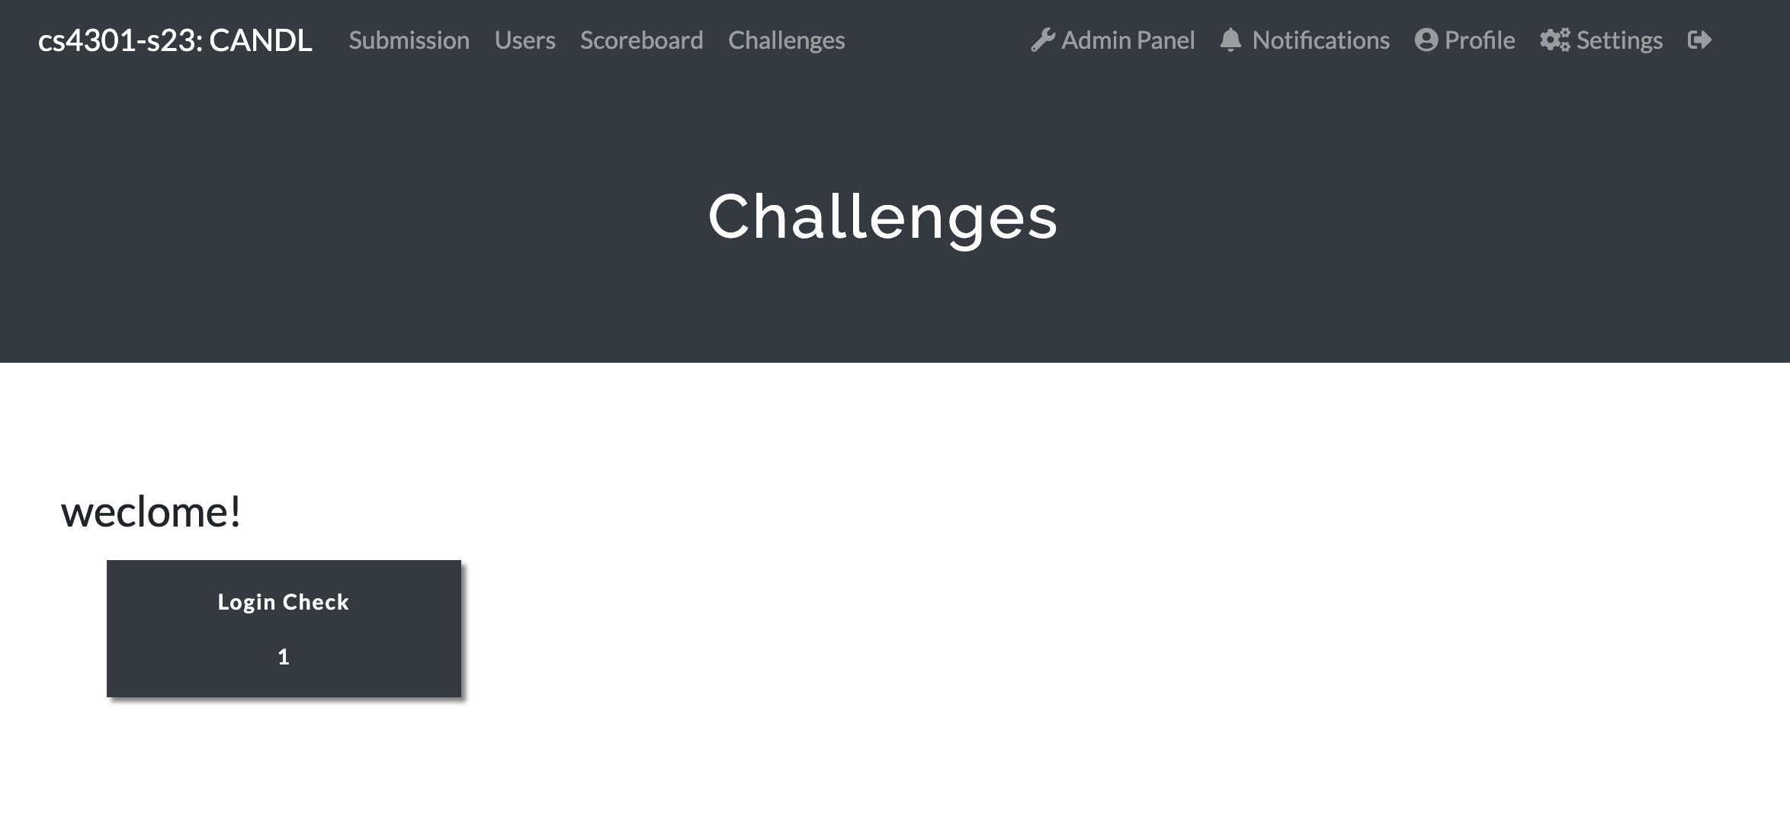
TODO-1: Register Yourself on Scoring Server
Go to: https://ctf.syssec.org
Please submit the flag for the ‘Login Check’

Slide 4
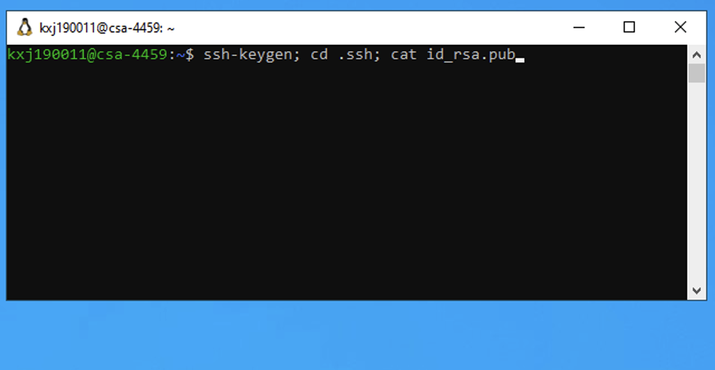
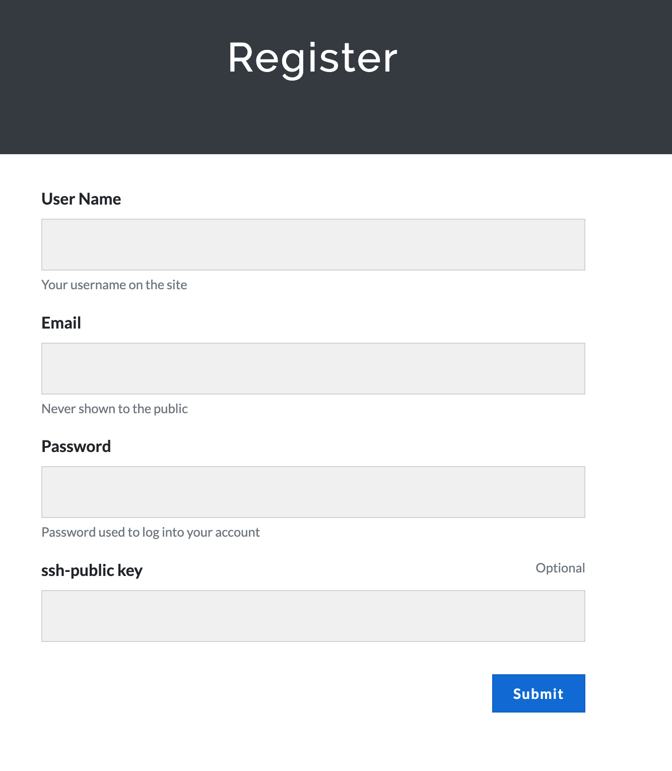
TODO-2: Connect Windows VM
Create public/private key pair from Windows VM
  Use Remote Desktop Application to connect to your Windows VM
From your Windows VM “ssh” into CTF server
Windows terminal applications
  Putty
  Windows Subsystem for Linux (WSL)
  ssh <user-netid>@ctf-vm1.utdallas.edu

Slide 5




Class Lab Settings
Remote Desktop
ssh
CTF-VM
Remote Desktop
ssh
ssh
Remote Desktop

Slide 6
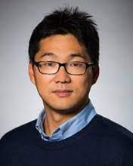

Credits
Dr. Jang Yeongjin (Oregon State University)
Dr. Taesoo Kim (GATech)
Notes:
photos

Slide 7
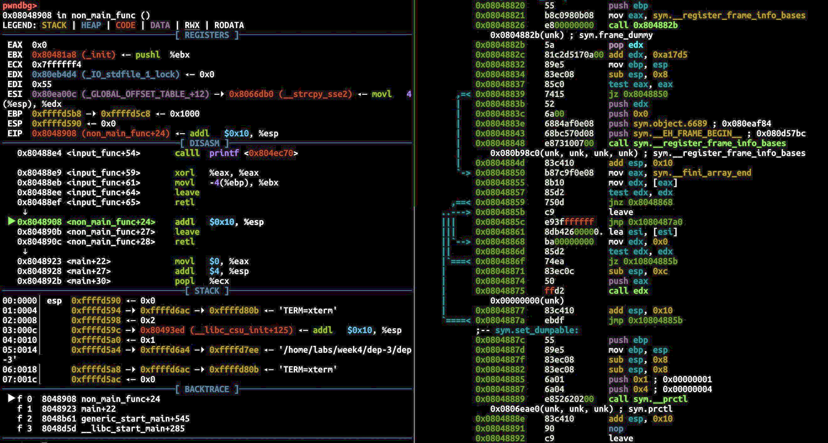
Course Description
Goal: Learn how cyber attacks work at the assembly level
  Understand how attacks work to counter them
Lecture & Exercise
  Learn high-level concepts of attacks in the lecture
  Practice attacks with exercise
Topics
  Reverse engineering
  Binary analysis
  Exploit writing
  Patching vulnerabilities
  etc.

Slide 8
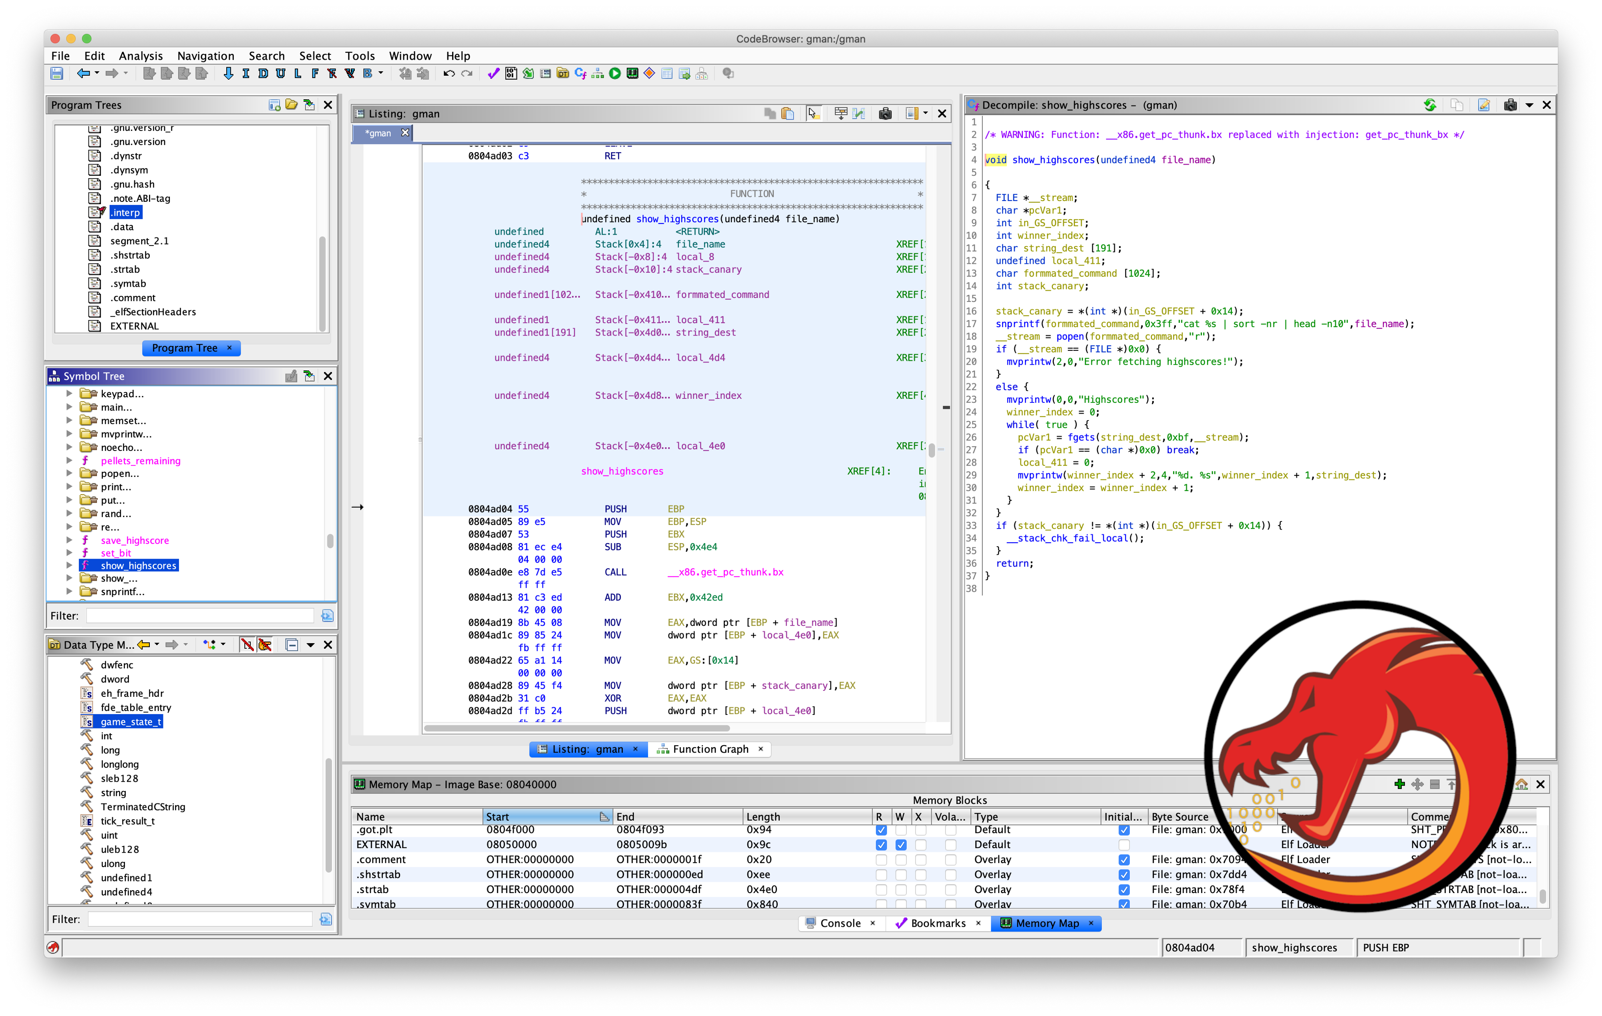
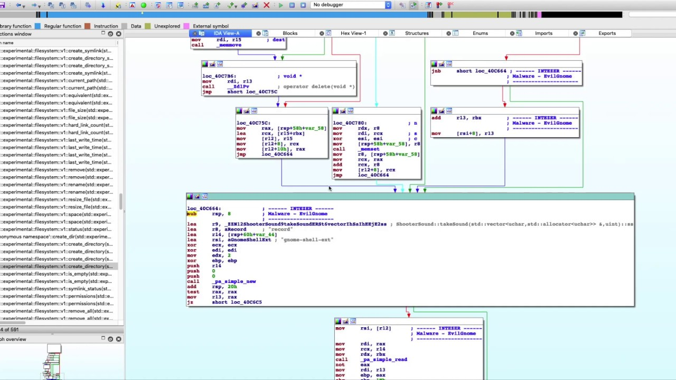
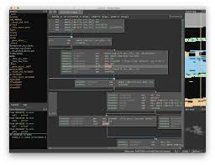
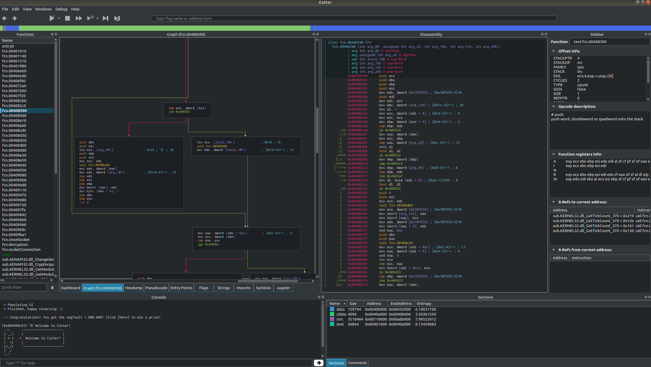

Slide 9
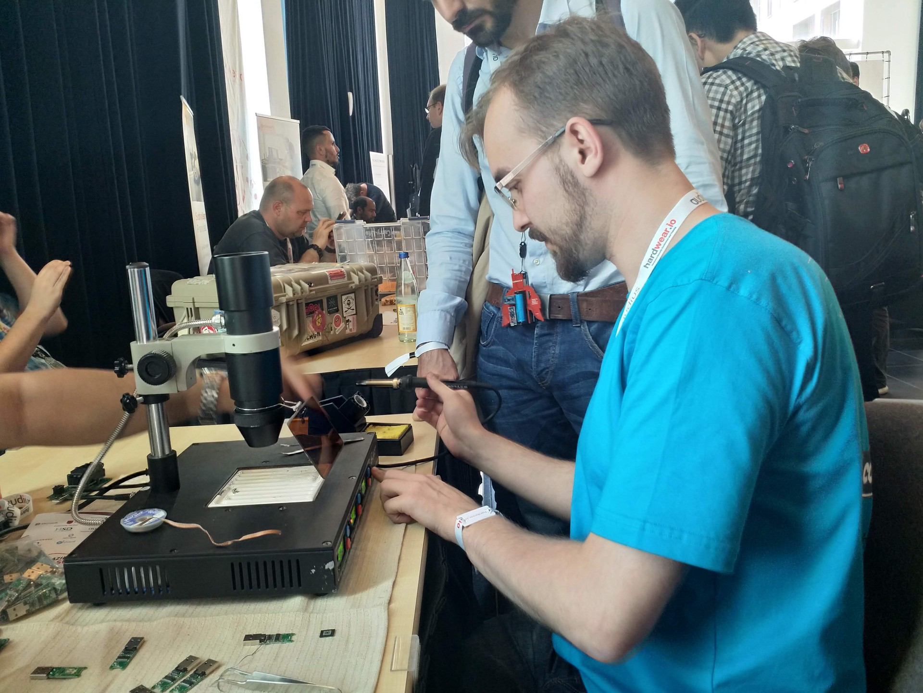
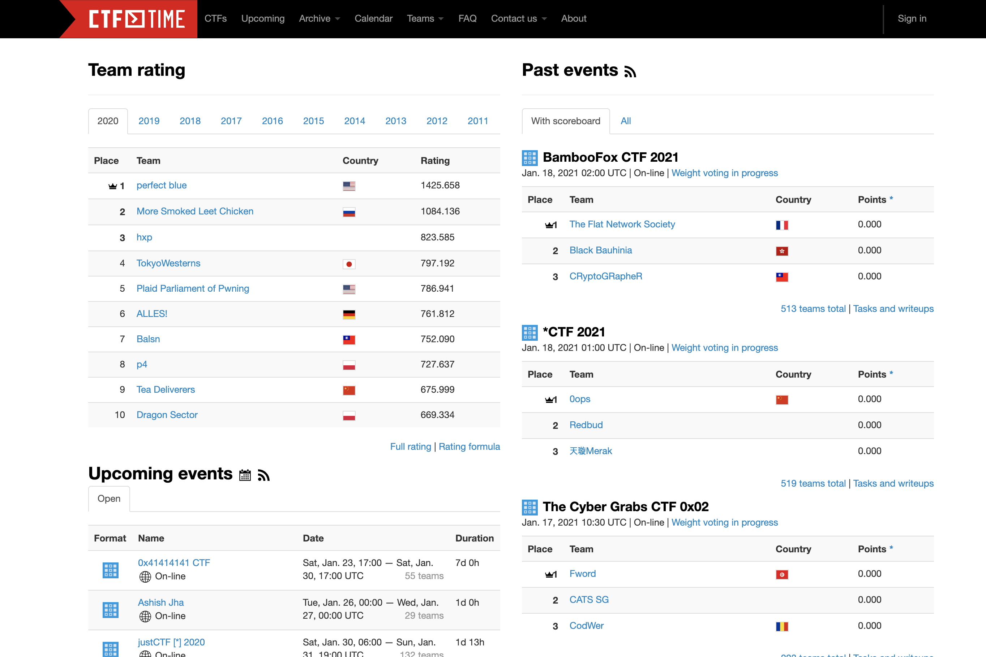
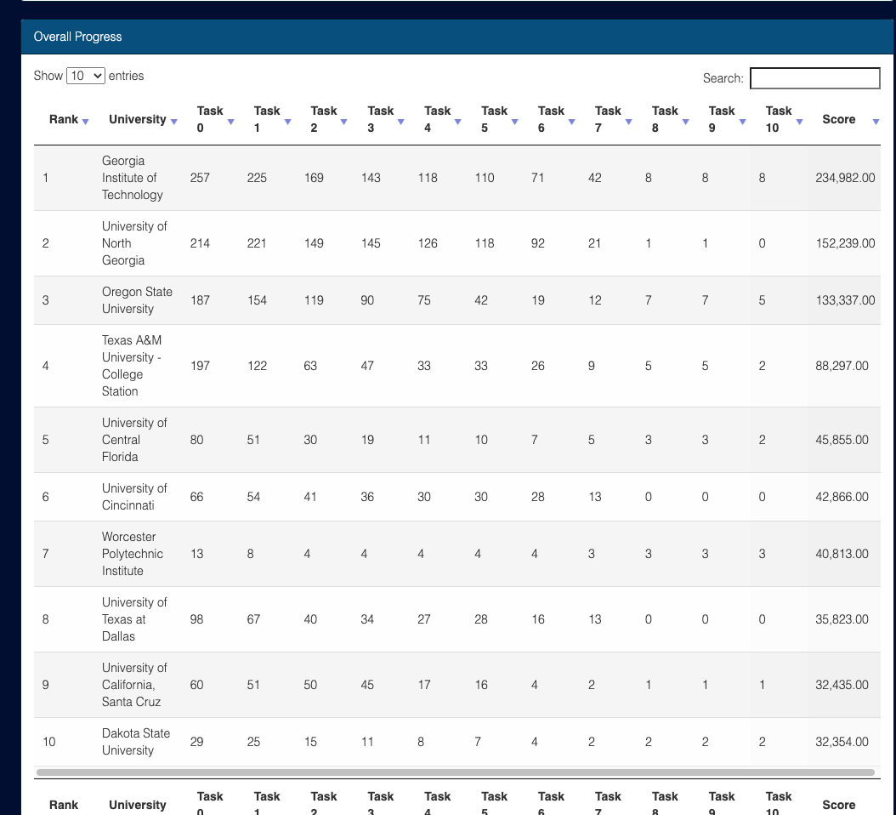

Goal #2
Participate in Cybersecurity Competitions
Notes:
replace

Slide 10
Course Logistics
Class website: https://cs4459.syssec.org
Scoring server: https://ctf.syssec.org
Class Discord channel: https://discord.gg/f9YpjjkBZz
CTF Linux server: TBD
  Join Class Discord and Send / DM your public key to @Josh, @Max
Notes:
https://www.digitalocean.com/community/tutorials/ssh-essentials-working-with-ssh-servers-clients-and-keys

Slide 11


TAs
Josh Wiedemeier
Max Zheng
Notes:
Please send me your profile pics @Take @Josh

Slide 12
Course Meeting Time
Lecture / exercise
  Tue / Thr 4:00 pm – 6:15 pm
  In-person, LAB based course: 1 hour lecture + hands-on
Instructor office hour
  TBD
  In-person: ECSS 3.226 (or 3.221)
Communication
  Email to instructor or head TA
  Contact an TAs via Discord for technical questions / discussions

Slide 13
Course Attendance
Students need to attend all classes
  Penalize absence or tardiness with no proper reasons
  Need to inform the instructor via email, a day in advance
Asynchronous students (not allowed by default)
  Will not record classes
  Need to inform the instructor by via email
  The same due will be applied

Slide 14
Class Operation
The course will be heavily hands-on
~50 students enrolled to the course
  Instructor can't simply cover all
  Take advantage of TAs as much as you can
TA times are also limited
  TAs will provide hands-on guidance
  TAs cannot (or not allowed to) do assignment for you
  Please respect their time and effort
You can discuss technical questions/issues with you peers and TAs
  Logistical issues with me or head TA

Slide 15
Course Schedule
Units | topic | Points
unit1 | Rev. Intro | 170
unit2 | Buffer overflow | ???
unit3 | Shellcoding | ???
unit4 | Stack cookies, DEP, ASLR | ???
unit5 | ROP | ???
unit6 | AR / AW & Format string | ???
unit7 | Heap overflow | ???
unit8 | Advanced topics Windows Malware; Python bytecodes | ???
 | In-class CTF | ???
14 weeks schedule
  Intro – rev engineering and shellcode writing (week 1-3)
  Exploit writing (Week 4 - 13)
  Advanced topics and in-class CTF (Week 13 - 14)
  https://cs4459.syssec.org/cal.html
Each class will
  50~60 min lecture & tutorial + in-class exercise
  Proportion may vary depends on course schedule
The schedule and contents are mostly fixed, but is subject to changes

Slide 16
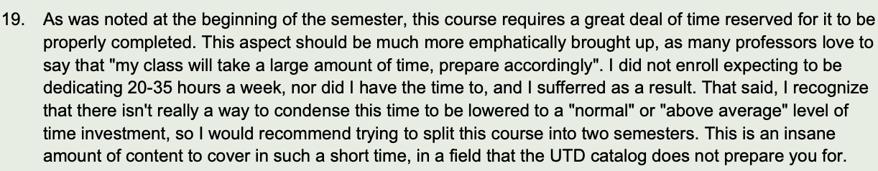
Beware What You Are Getting Into
System-heavy, many low-level struggles
  Intel assembly, 8 units + inclass CTF
  System attacks and defenses
  …
The course will be challenging, heavily hands-on
One student from the past
Notes:
the course was in a beta status, 1.5 x more materials last year.

Slide 17
Labs & Assignments
8 lab sessions, each with 10+ challenges
  1.5 ~ 2 weeks will be given
Each student solves the problem and submit to
  https://ctf.syssec.org
In class assignments + take home assignments
  We will go over tutorials for 1 ~ 2 assignments from the class

Slide 18
Assignments
~10 challenges per each unit
In-class lab will cover 2~3 challenges via tutorials
Scoring
  Register yourself at https://ctf.syssec.org/
  Set the “Login Name” as your NetID
  After the registration, please click and solve “Login Check”
    For sanity check
All the flags are
  candl{your_answer_here}

Slide 19
Assignment Rules
DO NOT SHARE YOUR CODE WITH OTHER STUDENTS
  You are encouraged to discuss with others about the assignments, but do not ask/give the code to the others
  Do not copy other students’ code
  Do not publish your code online
From Unit 2, you will be asked to submit exploit script for each challenge
  Unit 2: Buffer-Overflow
  Describe how you solve the challenge
  Do not copy other students’ write-up
  Mention your collaborators in the write-up
  Do not post challenges + your write-up online
Notes:
Please do not publish your challenges + your solutions online

Slide 20
Assignment Rules
All assignment due in one week from release date unless stated
  Late submissions will get 50% of pts, allowed up to 7 days of delay
Please refer the Student Code of Conduct
We will detect and report Plagiarism
  Getting F or zero point for an entire unit’s assignment
  Can be reported to deal’s office
I do research on code/text comparison to measure similarity
Please submit at least one challenge per each unit
  Otherwise, you will get F

Slide 21
Tips for Solving Challenges
Do discussions!
  Use Discord, ask for help!
  In principle, NO DM to discuss challenges
Come to the class and follow tutorials
Solve challenges In-order
Ask questions
Be aware of your time budget

Slide 22
Grading
75% lab assignment
15% In-class CTF
10% External challenges
  In-class Capture-The-Flag competition as a final
  In-class quizzes
  (Bonus) External Capture-The-Flag competitions (https://ctftime.org/)
Example grading scheme (graduate students will have a higher bar, +5%)
  A- ~ A+ : 85% <= Score <= 100%
  B- ~ B+: 75% <= Score < 85%
  C- ~ C+: 65% <= Score < 75%
  D- ~ D+ : 50% <= Score < 65%
  F: Score <= 50% or misses an entire week’s assignment
Notes:
20% NSA Codebreaker challenge
Task 1 – 5, 4% each, Task 6a and 6b are reserved for extra credits, 2% each.
https://codebreaker.ltsnet.net/home

Slide 23
Where to Begin
Basic skills
  C, x86 ASM
  HEX encoding / decoding, boolean algebra, ASCII
  shell (sh, bash, zsh), RegEx, etc.
  Scripting (Python)
Basic tools
  gdb, pwntools, assembly, text editors, etc.
Join the community & Participate Capture-the-Flag events

Slide 24
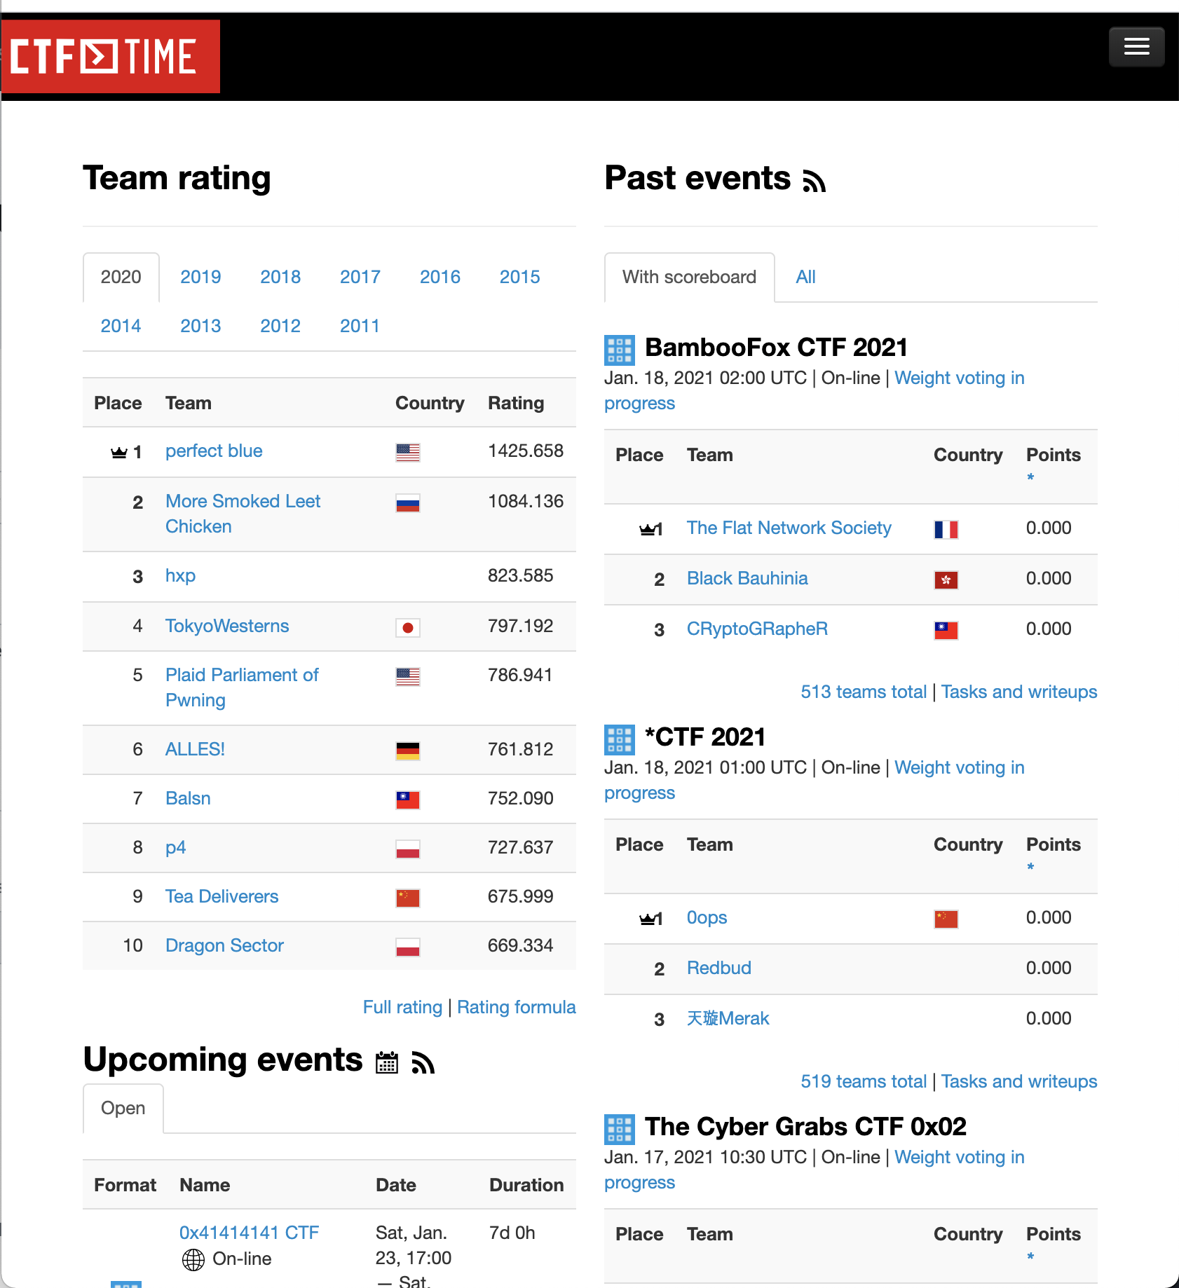
Capture-the-Flag (CTF)
Many CTF events in various topics
  https://ctftime.org
  IoT, Industrial Control Systems ….
Covers diverse topics
  Binary reversing, Pwning, Crypto, steganography …
  You need a team to play CTF
Good for your resume/job application
Fun to play and hang out with funny, smart people

Slide 25
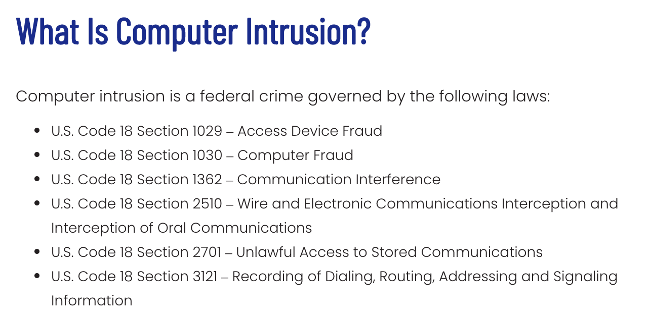
Ethical Hacking
DO NOT ATTACK OTHER’s SYSTEM
  If you found vulnerabilities in CTF VMs or https://ctf.syssec.org
    Please let me know; I reserved some extra credits for this
Attack your own and isolated environment
  Your home directory
  Challenge server
  DO NOT DoS the server…
Follow the law and regulations
  Computer Intrusion under federal law
  Bug bounty policies
// Don't do this
while(1)
fork();
// We are watching you…

Slide 26
Learning Objectives
Basic tools and environment
X86 assembly basics
  32bit and 64bit
  Function calls
  Do not use decompilers: e.g, Ghidra, IDA Pro
Low-level data encoding

Slide 27
Connect to Unit 1
Connect to Windows VM
  http://syssec.run/winvms
Connect ssh (UNIX-like)
  ssh <user_netid>@ctf-vm1.utdallas.edu
Fetch the challenge
  fetch unit1

Slide 28
GDB: Debugger
Start a new process or attached to running process
Can read assembly of a program (disassembly)
  disass main
Can read the status of a program such as registers and memory
  x/w $eax (print the value of eax as 32-bit integer)
  x/s 0x804858f (read the string value at the address 0x804858f)
  x/w 0x804858f (read the integer value at the address 0x804858f)
Can set a breakpoint
  b main (break if main function is called)
  b *main+53 (break before running the instruction at main+53)

Slide 29
GDB: Debugger
Execute a program
  r
Controlling the execution after a break
  c (continue to a next breakpoint)
  ni (run an instruction, do not get into the function)
  si (run an instruction, get into the function)

Slide 30
GDB Plugins
PEDA: Old/outdated
GEF: light-weighted, works better for cross-platform (Intel vs. ARM)
Pwndbg: comprehensive, works well for class challenges
$HOME/.gdbinit

Slide 31
Unit1-level0
Demo

Slide 32
Unit 1 – Basic Reverse Engineering
Prepare students access to CTF environment
Understanding assembly code in a binary program
  Translating x86 assembly into a readable C-like pseudocode (mentally)
Intel assembly (32-bit → 64-bit)
Low-level data encoding
Tools
  Vim: editor
  GDB + pwndbg : debugger
  tmux, ptrace …

Slide 33
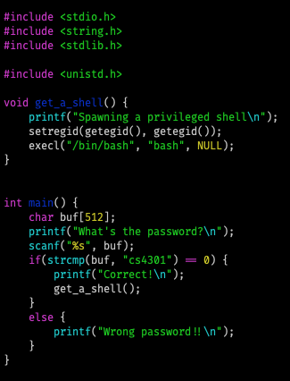

Assignment Structures
Your goal is to read `flag`
  Special permission required

Slide 34
Unit1 Tips
Class will AT&T format (vs. Intel format)
  $HOME/.gdbinit
Do not use decompilers (e.g., Ghidra or IDA Pro)
  It may help you now, but will make hurt you eventually
  Spend more time to read assembly

Slide 35
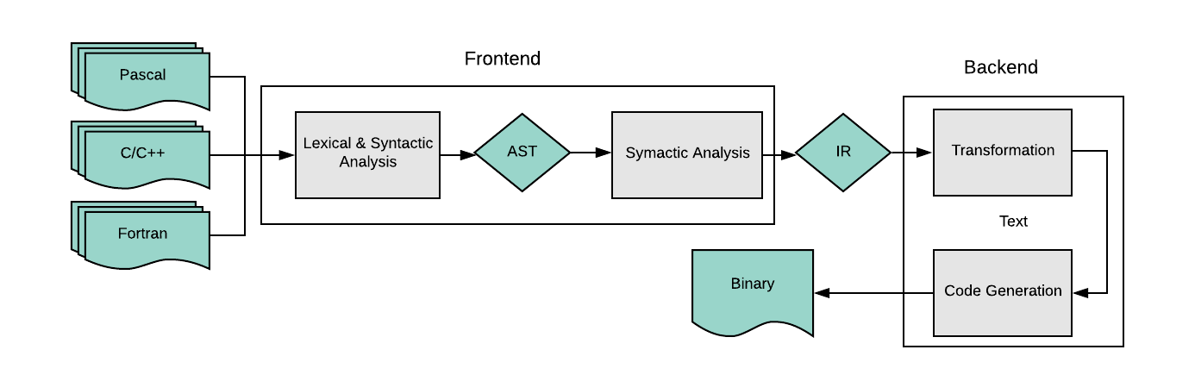
Code Generation Process

Slide 36
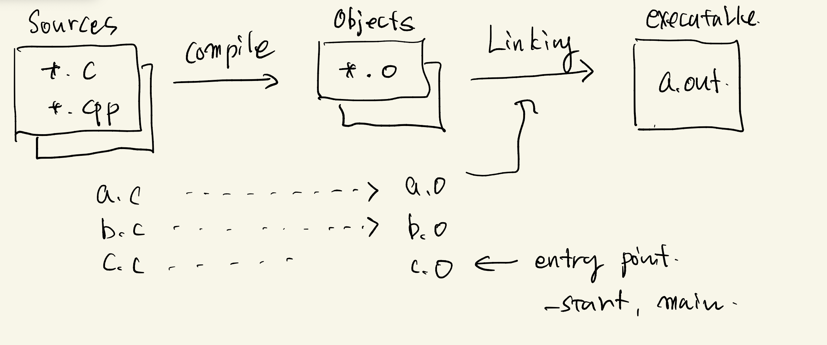
Code, Machine Language, and Assembly Language
Basic Concepts
  Source code
  Object file, object linking, binary
  Assembly, assembler
  Disassembly
  Decompilation
  From later classes
  ELF format
  Loading
  Dynamic linking

Slide 37
Code, Machine language, and Assembly language
You write a code in a programming language (say in C)
Compiler (gcc or clang) translate program to the object files
  Object file is a collection of machine codes translation + header information
  Basically, 0s and 1s
Assembly (language): decorated version of machine language
  With instruction name, variable names
  Human readable translation of machine language
  Assembler translates Assembly into object files (or machine codes)

Slide 38
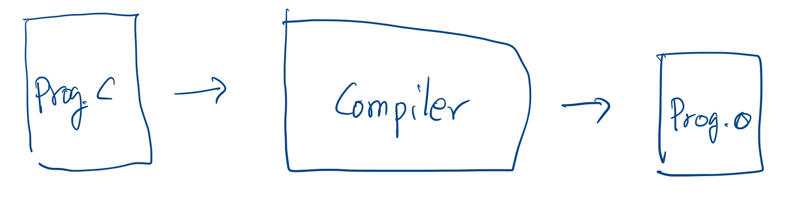
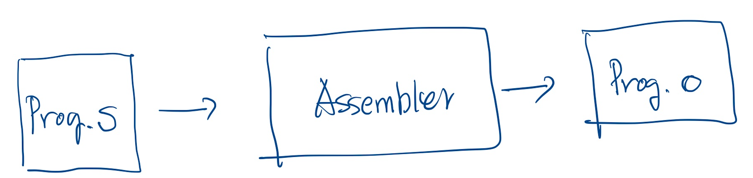
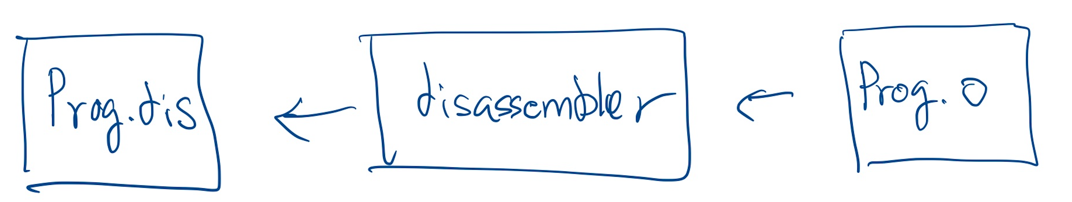
Code, Machine language, and Assembly language
Compilation
Assembly
Disassembly

Slide 39
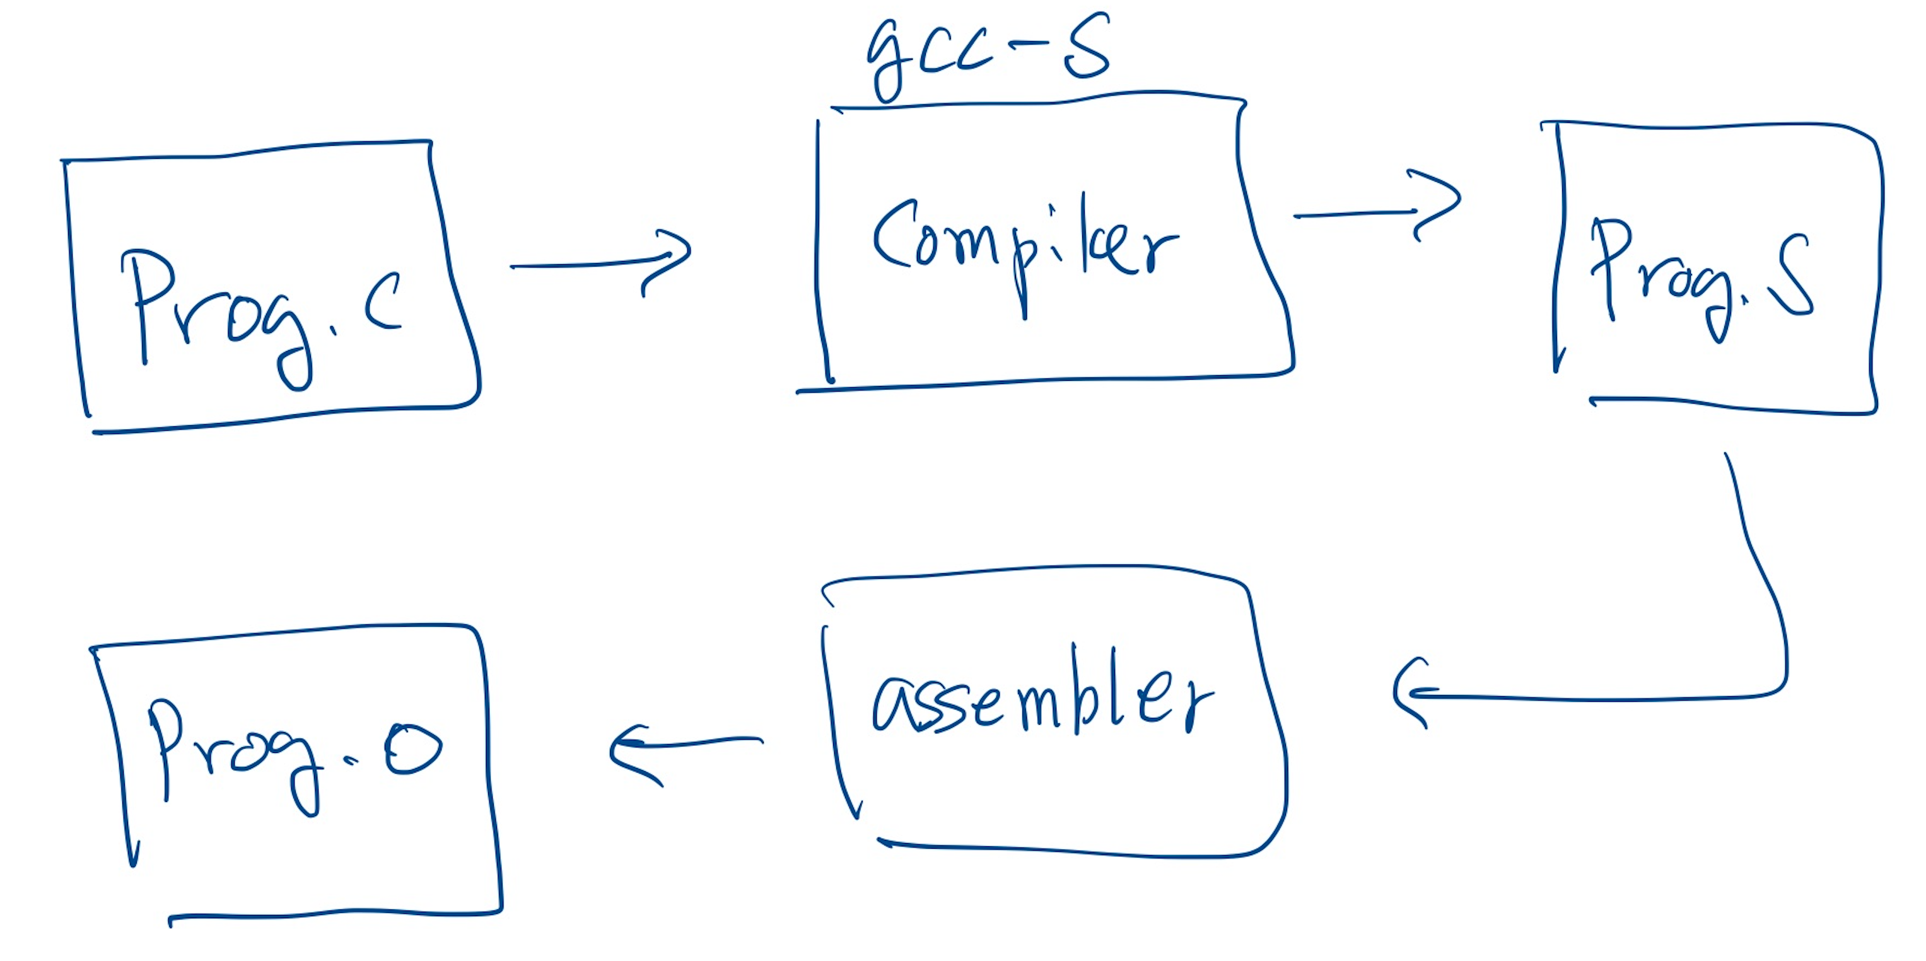
Code, Machine language, and Assembly language
Prog.S
gcc –c -S
  Compilation to assembly
gcc
  Assembly to machine language
Prog.S’
Some uses the term ‘Machine language’ and
‘Assembly language’ interchangeably
Disassemblers
  objdump, Ida pro, Radare2, Ghidra, GDB ….
You can dis-assemble object file and compare with the original assembly
Notes:
KJEE: brief history

Slide 40
Crash Course on X86 assembly

Slide 41
Instruction: Opcode + Operands
You can consider as Command + Arguments
Opcode to
  Move data, do arithmetic, control devices, change CPU context ..
Operands
  Immediate value
  Integer (or float number) constants
  Register
    8 general purpose registers for 32-bit architecture
    +8 for 64-bit architecture (r9 – r15)
  Memory
    Index, base, offset format
Opcode
Operands
[ebx + 2 edi] + 0x1234 # Intel syntax
0x1234 (%ebx, %edi, 2) # AT&T syntax
Notes:
How to efficiently address larger memory space (than addressable bits) was a big challenge → that is why we still see somewhat strange way of construct memory address along with now obsolete segment registers.
Memory addressing used to be a big source of performance degradation
https://www.quora.com/Did-Bill-Gates-really-say-that-640KB-memory-is-enough-for-everyone

Slide 42
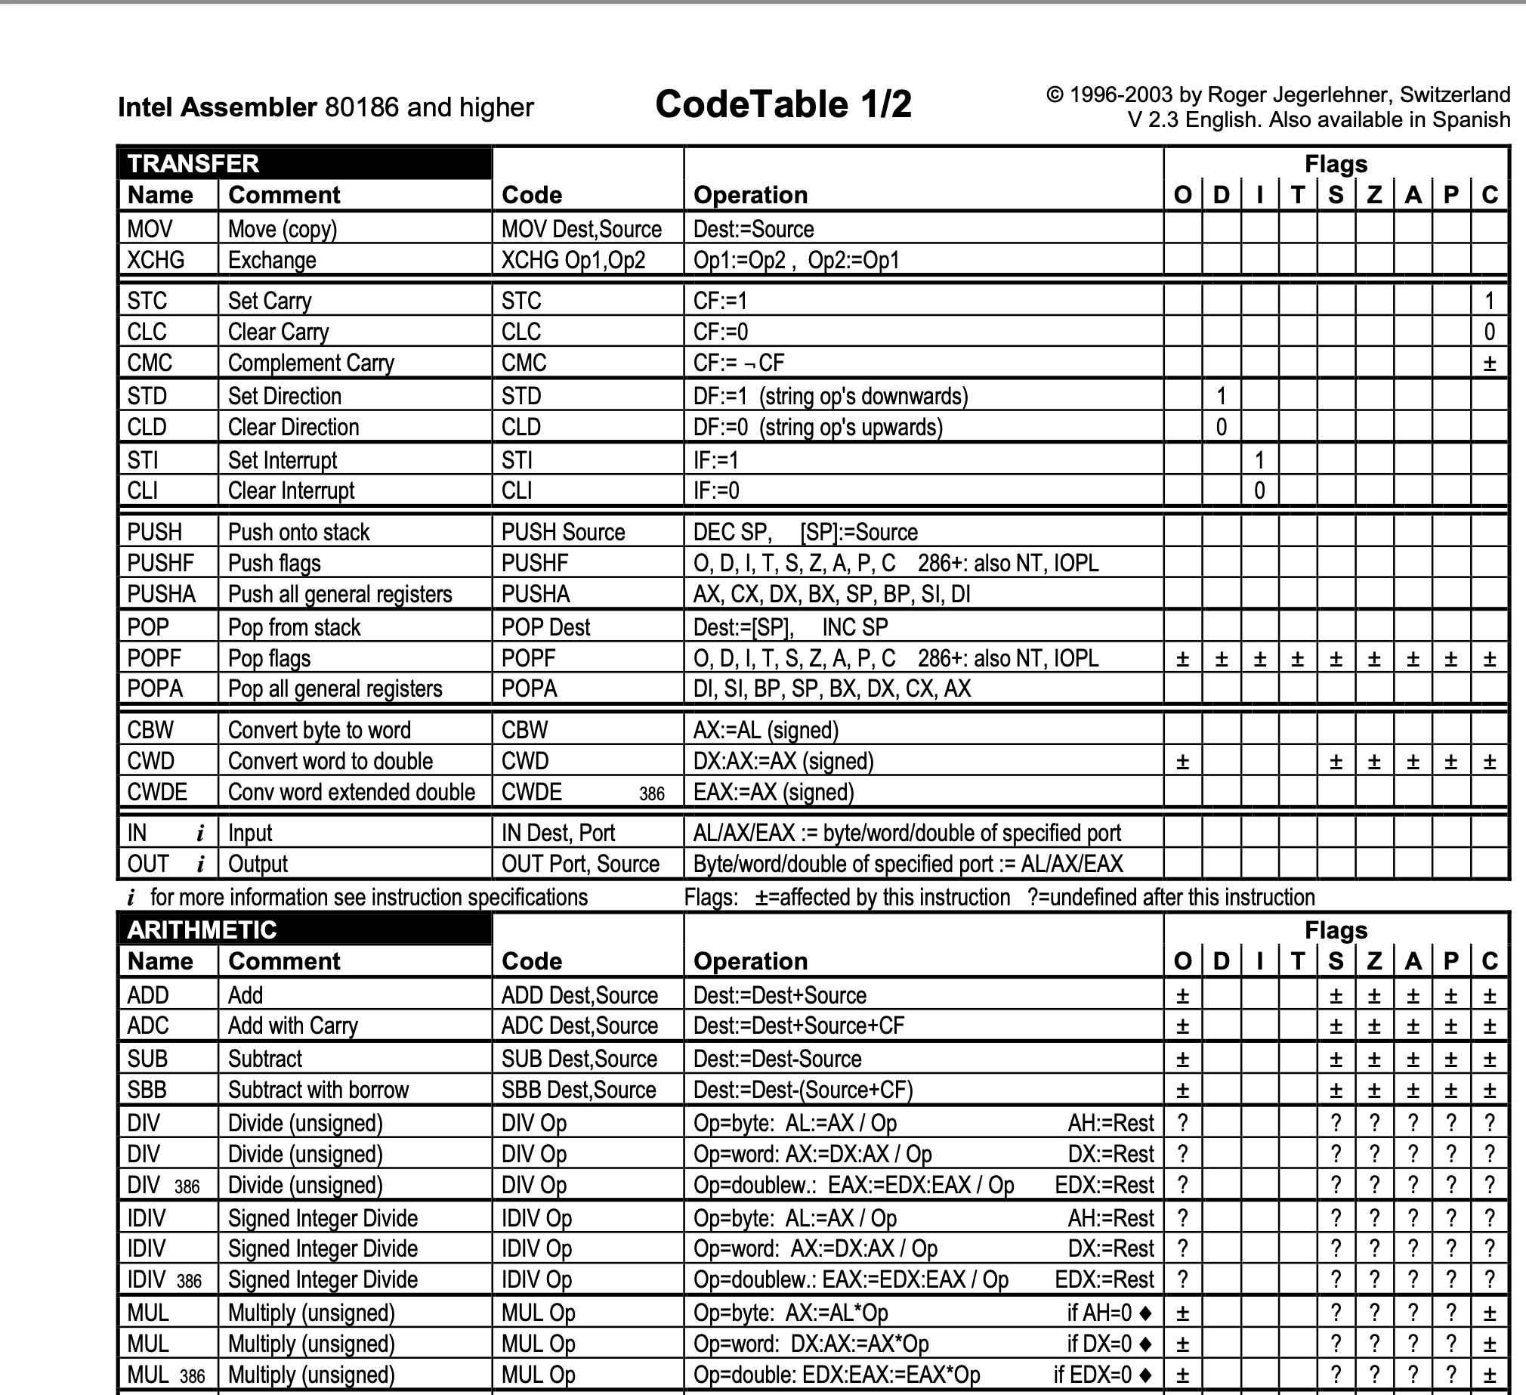
Intel Code Table
Linked in class schedule
http://www.jegerlehner.ch/intel/

Slide 43
AT&T vs. Intel Syntax Comparison
AT&T/GNU Syntax
Intel Syntax
[instruction] [source] [destination]
mov %eax, %ebx
Registers (32 bit)
  %eax, %ebx, %ecx, %edx, %esi, %edi, %esp, %ebp ← prefixed with ‘%’
Immediate Values
  $0x41424344 ← prefixed with ‘$’
Memory addressing
  0x1234 (%ebx, %edi, 2)
[instruction] [destination] [source]
  mov eax, ebx
Registers (32 bit)
  eax, ebx, ecx, edx, esi, edi, esp, ebp
Immediate Values
  0x41424344
Memory addressing
  [ebx + 2 edi] + 0x1234

Slide 44
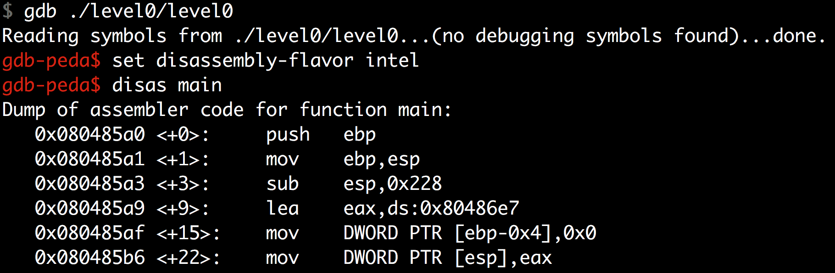
Intel Syntax
If you wish to use Intel syntax, see this.
  https://imada.sdu.dk/Employees/kslarsen-bak/Courses/dm18-2007-spring/Litteratur/IntelnATT.htm
In gdb: set disassembly-flavor intel

Slide 45
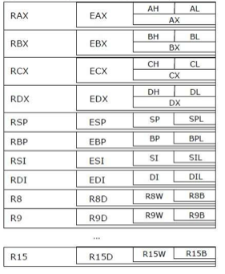
Intel IA32 Registers (i386, 32-bit)
64
32
16
8
0
?L ⬅ lower 8 bits: %al, %bl, %cl, %dl, %sil…
?H ⬅ higher 8 bits: %ah, %bh, %ch, %dh
?X ⬅ lower 16 bits: %ax, %bx, …, 80286
E?X ⬅ extended to 32 bits: %eax, %ebx, …, IA32
R?X, R9 ~ R15
⬅ .. to 64 bits: %rax, %rbx, …, AMD64
General Purpose Registers (GPRs)
Notes:
KJEE: Replace figure and take XMM out

Slide 46

Intel AMD64 Registers (x86_64, 64-bit)
64
32
16
8
0
?L ⬅ lower 8 bits: %al, %bl, %cl, %dl, %sil…
?H ⬅ higher 8 bits: %ah, %bh, %ch, %dh
?X ⬅ lower 16 bits: %ax, %bx, …, 80286
E?X ⬅ extended to 32 bits: %eax, %ebx, …, IA32
R?X, R9 ~ R15
⬅ .. to 64 bits: %rax, %rbx, …, AMD64
General Purpose Registers
Notes:
KJEE: Replace figure and take XMM out

Slide 47
Intel Architecture Evolution
Intel 8086 (1978), 16-bit processor
  Register width is 16-bit:
  %ax, %bx, %cx, %dx, %si, %di, %bp, %sp, %ip
  8-bit addressable:
  %ah, %al, %bh, %bl, … , %sil, %dil
Intel 80386 (1985), 32-bit processor
  %eax, %ebx, %ecx, %edx, %esi, %edi, %ebp, %esp, %eip
Intel Pentium 4 64-bit (Prescott, 2004)
  %rax, %rbx, %rcx, %rdx, %rsi, %rdi, %rbp, %rsp, %rip
  %r8 -- %r15
Notes:
eip, ip are software invisible (hidden)
rip is exposed …(readdressible)

Slide 48
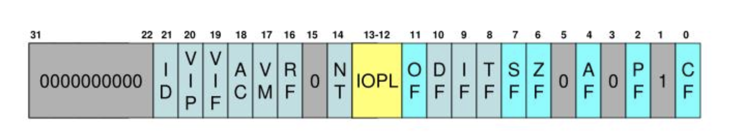
Condition Register (EFLAGS Register)
32-bit (4 bytes) storage to store the execution result of the previous instruction
ZF (Zero Flag) | The result of an arithmetic operation is “Zero”
SF (Sign Flag) | Or Negative Flag, the result of an arithmetic operation is “Negative” (The most significant bit is set)
OF (Overflow Flag) | The result would not fit in the number of bits
CF (Carry Flag) | The result has arithmetic carry
PF (Parity Flag) | The numbers of set bits is odd or even

Slide 49
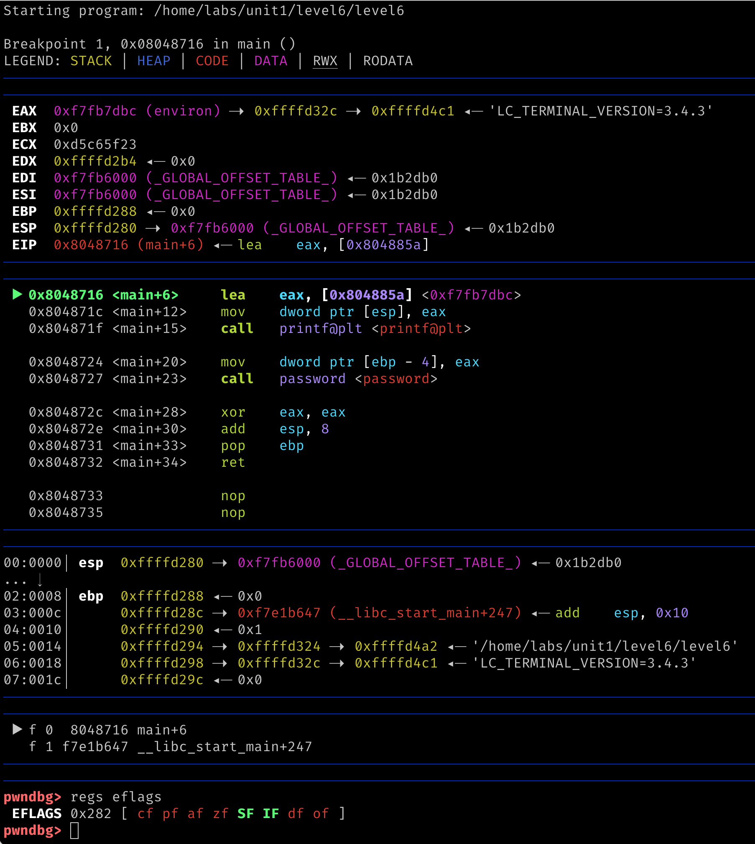
GDB (pwndbg)
Recommended for the class,
but will up to you

Slide 50
Intel Memory Referencing
Segment registers are mostly obsolete
No longer used for address calculation
Special use cases (will learn)
Memory address :=
Base + Index * Scale + Disp
Segment
Registers
Base
    [ebx + 2 edi] + 0x1234 # Intel syntax
    0x1234 (%ebx, %edi, 2) # AT&T syntax
Index
Scale
Displacement
IA32 Memory addressing
Notes:
http://www.cs.iit.edu/~cs561/cs350/addressing/addsclm.html#:~:text=Similar%20to%20index%20mode%2C%20except,base%20register%20plus%20the%20constant.
Some animation?

Slide 51
LEA Instruction
LEA instruction (Load Effective Address)
What would the instruction store in %rax?
lea 0x5656(%rax,%rbx,4),%rax # AT&T
Or
lea rax,[rax+rbx*4 + 0x5656] # Intel
rax := rax+ rbx * 4 + 0x5656

Slide 52
Pointer Registers
Return EIP
%EBP
Saved EBP
foo()
Base Pointer (or Frame Pointer)
  %EBP, %RBP
Stack Pointer
  %ESP, %RSP
Instruction Pointer (or Program Counter)
  %EIP, %RIP
%ESP
Notes:
KJEE: We may animate this ..

Slide 53
Pointer Registers
Return EIP
Saved EBP
foo()
Base Pointer (or Frame Pointer)
  %EBP, %RBP
Stack Pointer
  %ESP, %RSP
Instruction Pointer (or Program Counter)
  %EIP, %RIP
Grows downward
Return EIP
%EBP
Saved EBP
bar()
%ESP
Notes:
KJEE: We may animate this ..

Slide 54
Pointer Registers
Return EIP
Saved EBP
foo()
Base Pointer (or Frame Pointer)
  %EBP, %RBP
Stack Pointer
  %ESP, %RSP
Instruction Pointer (or Program Counter)
  %EIP, %RIP
Grows downward
Return EIP
Saved EBP
bar()
Return EIP
%EBP
Saved EBP
foobar()
%ESP
We will talk more about functions and stack operation later …
Notes:
KJEE: We may animate this ..

Slide 55
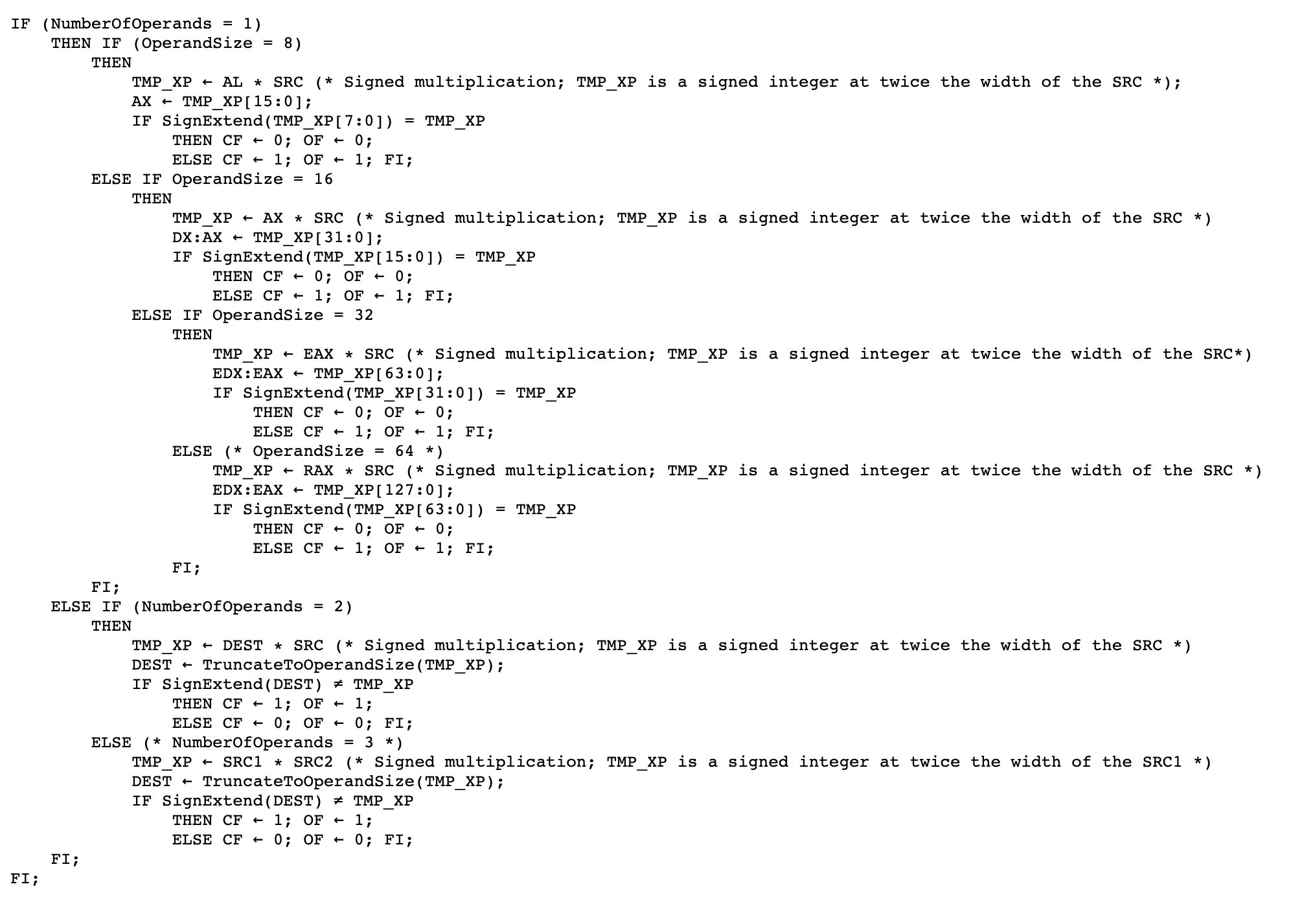
Intel Instruction Format
Opcode + [opr1] [opr2] [opr3]
  An instruction can have 0 ~ 3 operands
    E.g., IMUL instruction
Supported data movements
  Immediate -> Register/Memory
  Register <-> Register
  Register <-> Memory
  Memory <-> Memory
https://www.felixcloutier.com/x86/imul
Watch out!
Notes:
https://docs.oracle.com/cd/E19120-01/open.solaris/817-5477/ennby/index.html#:~:text=An%20x86%20instruction%20can%20have,%2C%20source-%3Edestination).

Slide 56
Data Movement and Arithmetic Instructions

Slide 57
Data Movements
Move values (constant assignment)
  movl $0x41414141, %eax ← %eax := 0x41414141;
  movb $32, %al ← %al := 32;
Accessing memory
  movl -0x4(%ebp), %eax ← %eax :=%ebp - 4
  movq (%rdx,%rcx,4), %rbx ← %rbx := %rdx + %rcx * 4
More data movements
movs, movsb, movsw, movsd, movsq
  Move from string to string (next class)
Notes:
b → byte
l → long (32-bits, 4 bytes)
q -> quadword (64-bits)
W -> word (16-bits, 2 bytes)

Slide 58
Arithmetic and Logical Instructions
logical instructions
  or, and, xor, nor …
  andi, ori, xori …
Arithmetic instructions
  add, sub, mul, div, divu …
  addi, subi, muli …
Notes:
l → long

Slide 59
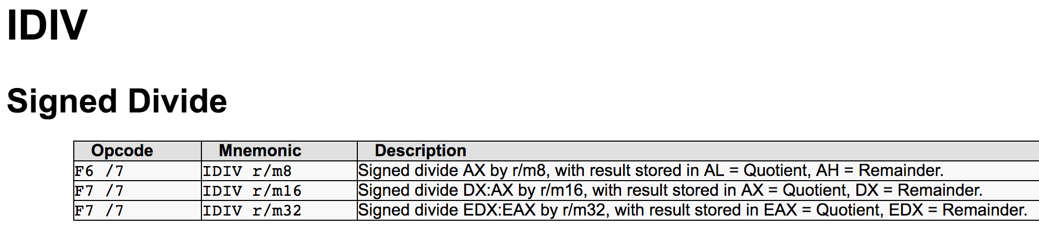
Integer Division Operation
idiv [value]
  Use 64bit integer (EDX:EAX)
  Calls cdq/cltd instruction first (asserting using EDX:EAX as one 64bit integer)
  Divide EDX:EAX with [value]
  Store Quotient at EAX, Remainder in EDX

Slide 60
Integer Division Operation
idiv [value]
  Use 64bit integer (EDX:EAX)
  Calls cdq/cltd instruction first (asserting using EDX:EAX as one 64bit integer)
  Divide EDX:EAX with [value]
  Store Quotient at EAX, Remainder in EDX
Example – in level9, check(int value)
Comparing the remainder of array[i] / value to zero…
  if(array[i] % value == 0)
  0x08048670 <+32>: mov 0x8(%ebp),%eax ← eax is arg1
  0x08048673 <+35>: mov -0x8(%ebp),%ecx ← ecx is loop index
  0x08048676 <+38>: cltd ← use edx:eax, int64
  0x08048677 <+39>: idivl 0x804a02c(,%ecx,4) ← divide array[ecx]/eax
  0x0804867e <+46>: cmp $0x0,%edx ← Remainder…

Slide 61
Idioms
xor %eax, %eax
  Or sub %eax, %eax
  eax = eax ⊗ eax => eax: = 0;
lea 0x10(ecx,ecx,4) %eax
=> eax := 5 * ecx + 10
add $1, %eax
xadd $1, %eax # atomic operation
Notes:
animation

Slide 62
Control Instruction
Comparison
  cmp $0x1234, %eax ← Result stored in $EFLAGS
Jump
  je 0x8048442 <main+94> ← Equal or zero
  jne 0x8048442 <main+94> ← Not equal or non-zero
  jle 0x8048442 <main+94> ← Less or equal, signed
  jbe 0x8048442 <main+94> ← Below or equal, unsigned
  jge 0x8048442 <main+94> ← Greater or equal, signed
  jae 0x8048442 <main+94> ← Above or equal, unsigned

Slide 63
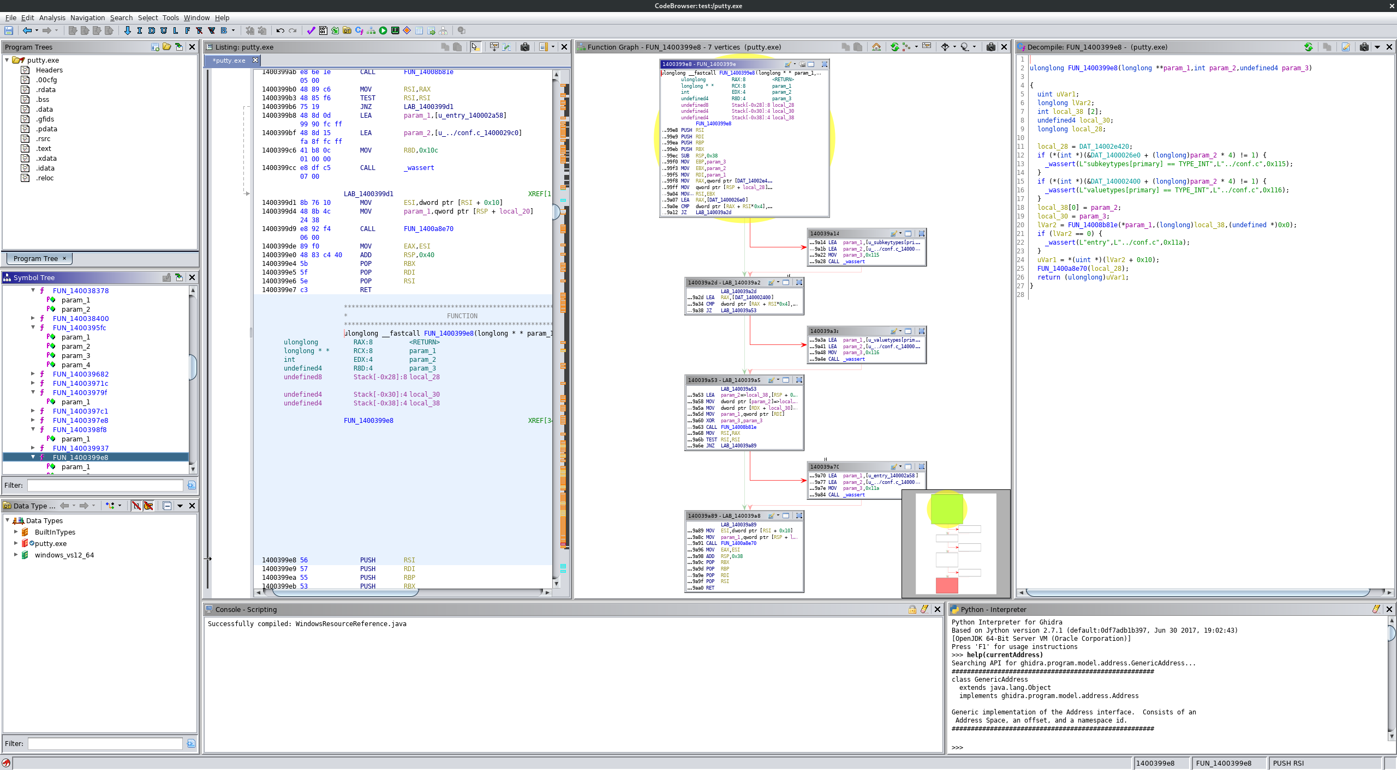
Control Instruction
Notes:
TODO: IDA pro,GDB images

Slide 64
Stack Operation for Function Call Support

Slide 65
Function Support
Function is the only language primitive with CPU-level support
  Turing machine does not require the function
Lambda calculus works on functions
  Church – Turing theorem
    ➔ Turing machine == Lambda calculus (equally capable)
    ➔ Java program == Scala program (equally capable)
  Function promoted to first-class citizen
Function helps programmers
  Modularize code and define logical building blocks
  Namespace
Notes:
This slide maybe a redundant, or distraction…

Slide 66
Function Support
Pointer registers
  %ebp (or %rbp): stack base pointer
  %esp (or %rsp): stack pointer
Instructions
  push, pop ← stack operation support
  call, ret ← function call support
  enter,leave ← stack frame management
Notes:
enter: prolog

Slide 67
Function Support
Pointer registers
  %ebp (or %rbp): stack base pointer
  %esp (or %rsp): stack pointer
Instructions
  push, pop ← stack operation support
  call, ret ← function call support
  enter,leave ← stack frame management
push %ebp
mov %esp, %ebp
mov %ebp, %esp
pop %ebp
Notes:
enter: prolog

Slide 68
Stack Instructions
4 bytes (32-bit)
%ebp : 0xdeadbeef
push %ebp
  Store the value of %ebp at the top of the stack (%esp gets -4)
  mov %ebp, (%esp)
  sub $4, %esp
pop %ebp
  Move the value at the stack top to %ebp (%esp gets +4)
  mov (%esp), %ebp
  add $4, %esp
%esp
Return EIP
Grows downward
Notes:
This is an important slide …
popa, pusha

Slide 69
Stack Instructions
%ebp : 0xdeadbeef
push %ebp
  Store the value of %ebp at the top of the stack (%esp gets -4)
  sub $4, %esp
  mov %ebp, (%esp)
pop %ebp
  Move the value at the stack top to %ebp (%esp gets +4)
  mov (%esp), %ebp
  add $4, %esp
Return EIP
Grows downward
%esp
0xdeadbeef
Notes:
This is an important slide …
popa, pusha

Slide 70
Stack Instructions
push %ebp
  Store the value of %ebp at the top of the stack (%esp gets -4)
  mov %ebp, (%esp)
  sub $4, %esp
pop %ebp
  Move the value at the stack top to %ebp
  then, %esp += 4
  mov (%esp), %ebp
  add $4, %esp
Return EIP
Grows downward
%esp
Saved EBP
Notes:
This is an important slide …
popa, pusha

Slide 71
Stack Instructions
%ebp
push %ebp
  Store the value of %ebp at the top of the stack (%esp gets -4)
  mov %ebp, (%esp)
  sub $4, %esp
pop %ebp
  Move the value at the stack top to %ebp
  then, %esp += 4
  mov (%esp), %ebp
  add $4, %esp
%esp
Return EIP
Grows downward
Notes:
This is an important slide …
popa, pusha

Slide 72
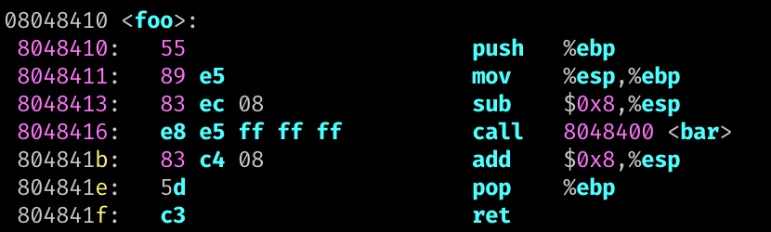
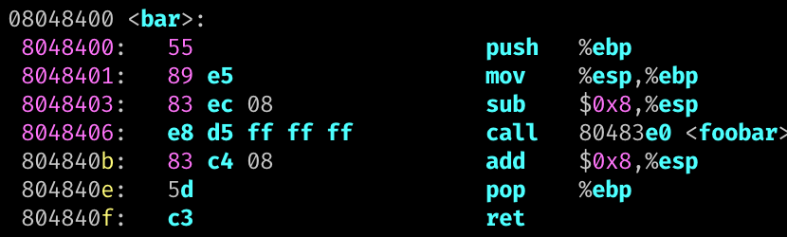
call and ret
call foo
  Pushes %eip to the stack and jump to foo
  push %eip # next instruction
  jmp foo
ret
  Pops to %eip from stack
  pop %eip # Invalid operation
Grows downward
0x804841b
Notes:
Only special instruction can update %eip

Slide 73
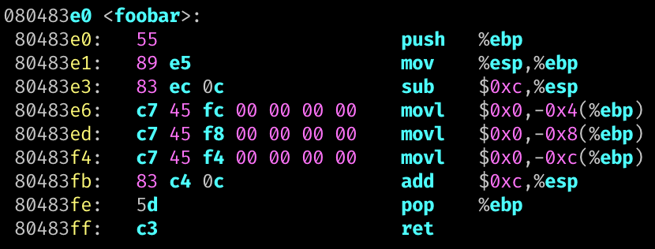
Multiple Function Calls
foo();
0x804841b
Saved EBP
bar();
0x804840b
%ebp
Saved EBP
Local A
foobar();
Local B
%esp
Local C
Notes:
Each stack frame conveys corresponding function call contexts

Slide 74
Calling Convention
Defines caller / callee responsibilities at machine language level
Different calling conventions exists
  cdecl for IA32
  x86-64 for AMD64
Who call printf()? and who has printf();
  Loader/linker will first find the address of printf()
  Q1: How can pass function arguments?
  Q2: How to order function argument?
  Q3: How to get the return value?

Slide 75
IA32 Stack Operations
ARG2
%ebp+c
Grow
Callee
ARG1
%ebp+8
Return IP
Relative to
  Stack pointer: %esp (%rsp)
  Base (frame) pointer: %ebp (%ebp)
Local variables (negative indexing over %ebp)
  mov -0x8(%ebp), %eax -- value at ebp-0x8
  lea -0x24(%ebp), %eax -- address at ebp-0x24
Function arguments from caller (positive indexing over %ebp)
  mov 0x8(%ebp), %eax -- 1st arg
  mov 0xc(%ebp), %eax -- 2nd arg
Prepare function arguments to callee (positive indexing over the stack)
  mov %eax, (%esp) -- 1st arg
  mov $0x4, 0x4(%esp) -- 2nd arg
%ebp
Saved EBP
Local A
%ebp-4
Local B
%ebp-8
%esp
%ebp-c
Local C

Slide 76
IA32 Stack Operations
ARG2
%ebp+c
Grow
Callee
ARG1
%ebp+8
Return IP
Relative to
  Stack pointer: %esp (%rsp)
  Base (frame) pointer: %ebp (%ebp)
Local variables (negative indexing over %ebp)
  mov -0x8(%ebp), %eax -- value at ebp-0x8
  lea -0x24(%ebp), %eax -- address at ebp-0x24
Function arguments from caller (positive indexing over %ebp)
  mov 0x8(%ebp), %eax -- 1st arg
  mov 0xc(%ebp), %eax -- 2nd arg
Prepare function arguments to callee (positive indexing over the stack)
  mov %eax, (%esp) -- 1st arg
  mov $0x4, 0x4(%esp) -- 2nd arg
%ebp
Saved EBP
Local A
%ebp-4
Local B
%ebp-8
Local C
%ebp-c
….
Caller
ARG 2
%esp+4
%esp
ARG 1
%esp

Slide 77

IA32: Call, ret, Function Prologue, Epilogue
Return IP
Saved EBP
call <target>
  push %EIP; JUMP <target>
ret
  jmp (%esp); sub 4 (%esp)
  pop %eip
Local A
Prologue
….
ARG 2
ARG 1
Return IP
Epilogue
%ebp
Saved EBP
mov %ebp, %esp
pop %ebp
Local A
Local B
Local B
%esp

Slide 78
Calling Convention: IA32 vs. AMD64
IA32 (32 bit) – pushes argument on the stack (for callee)
  0x4*n (%esp) : n-th argument
  (%esp) : 1st arg accessed by callee via 0x8(%ebp)
  0x4 (%esp) : 2nd arg accessed by callee via 0xc(%ebp)
  0x8 (%esp) : 3rd arg accessed by callee via 0x10(%ebp)
  Focus on +8 for the index for %ebp at the callee…
AMD64 (64 bit) – use registers to pass argument to callee
  Register order (1st, 2nd, 3rd, 4th, 5th, 6th, etc.)
    %rdi, %rsi, %rdx, %rcx, %r8, %r9, …
    (use stack for more arguments)
  Callee also uses these registers to get arguments

Slide 79
printf()
printf() in x86
  lea 0x8048727,%eax
  mov -0x8(%ebp),%ecx
  mov -0xc(%ebp),%edx
  mov %eax,(%esp)
  mov %ecx,0x4(%esp)
  mov %edx,0x8(%esp)
  call 0x8048370 <printf@plt>
printf() in amd64
  movabs $0x400905,%rdi
  mov -0x8(%rbp),%rsi
  mov -0x10(%rbp),%rdx
  callq 0x400500 <printf@plt>
1st
1st
2nd
2nd
3rd
3rd
1st
2nd
3rd
printf(0x8048727, ebp_8, ebp_c)
printf(0x400905, rbp_8, rbp_10)

Slide 80
AMD64 Stack Operation
Stores local variables (negative access over %rbp)
  mov -0x8(%rbp), %rax
  lea -0x24(%rbp), %rax
Function arguments from registers (not stack)
  mov %rdi, %rax
  mov %rsi, %rax
Function arguments to callee
  mov %rax, %rdi
  mov $0x4, %rsi
  mov $0x40006, %rdx

Slide 81
Commands and Tools

Slide 82
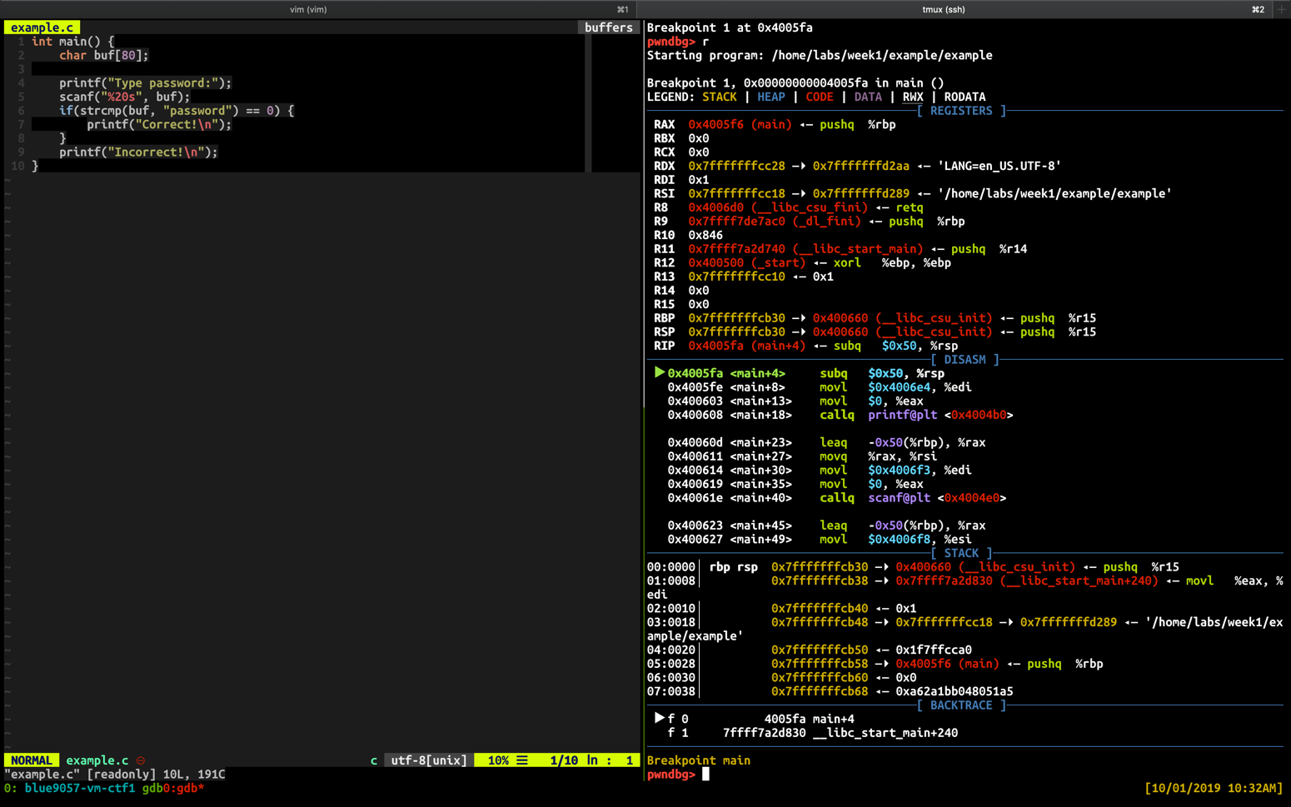
Console Debugging Example
Use tmux to split the window
  Left: vim
  Right: gdb

Slide 83
TMUX tips
CTRL +c : create a new window
CTRL +[0-9] (a number) : select the window with that number
CTRL + → ←↓↑ (arrows) : move to the pane
CTRL + % : split the pane vertically
CTRL + “ : split the pane horizontally

Slide 84
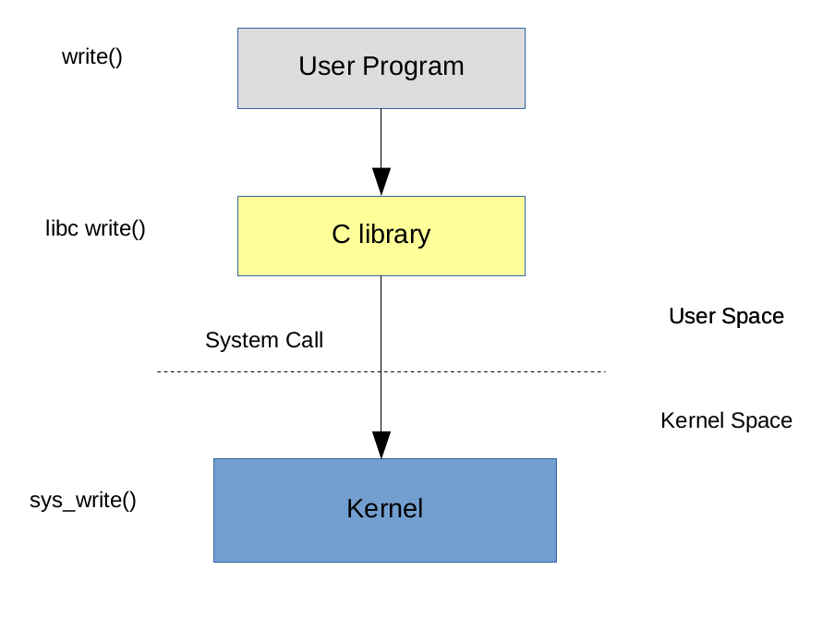
ltrace, strace
Function calls are from
  Program itself, libraries,
  system kernel
ltrace
  Tracking library calls
strace
  Tracking system calls

Slide 85
’xxd’: HEX Dump from a File
HEX output
  xxd <file>
Skip first n entries
  xxd –s <n> <file>
Limit output to n entries
  xxd –l <n> <file>
Reverse HEX dump into binary
  xxd –r

Slide 86
Other Useful Commands
objdump
readelf
strings
many more …

Slide 87
/proc, lsof
/proc
  virtual filesystem that maps the runtime processes and kernel
  pwnlib.util.proc
lsof
  List *Open* Files
  Many resources are represented as a file object (file descriptor)
    Netlink, Socket, Unix Domain Socket, TTY …
  You can as questions like
    Q: Who is accessing the file?
    Q: Who is listening to the network port?
    … and many more

Slide 88
pwntools

Slide 89
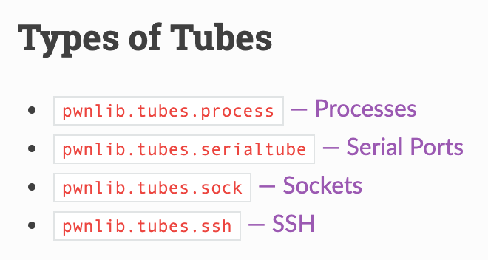
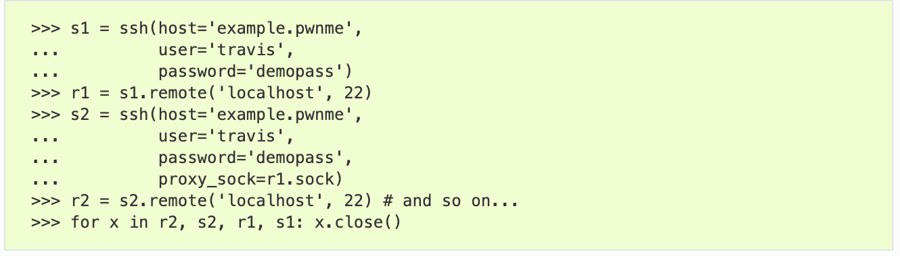
pwntools: pwnlib.tubes
Communication interface for process, network, socket, serial, tty …
  send(), sendline(), ….
  recv(), recvline(), recvuntil() ….
  interactive()

Slide 90
pwntools: process tube
process invoke + interactions
Batch
GDB attach
Interactive
context(arch='i386')
p = process('./7-stack-cookie', )
p.recvuntil(b"How many bytes do you want to read?")
p.sendline("1")
p.recvuntil(b"bytes: \n")
p.sendline(b"A")
p.interactive()

Slide 91
pwntools: remote
nc (netcat)
  ’cat’ for network, establish a pipe between server and client
pwntools remote class
# It works with ipv4 by default
l = listen(1234)
l.spawn_process('/bin/sh’)
r = remote('127.0.0.1', l.lport)
r.sendline(b'echo Goodbye’)
r.recvline() b'Goodbye\n'

Slide 92
pwnlib.util.packing
Simplifies access to the standard struct.pack and struct.unpack
>>> a = p32(-5, sign='signed', endian='big')
>>> a
b'\xff\xff\xff\xfb'
>>> u = make_unpacker(32, signed='unsigned')
>>> u(a)
4227858431

Slide 93
pwntools: Tips
logging support for tubes
>>> p = process('./7-stack-cookie', level='debug')
Set the right context
  arch: i386, amd64, arm, aarch64
  terminal: x-terminal-emulator, tmux
>>> context(arch='i386', terminal='tmux')

Slide 94
bytes, int, int[], str …
python3 is picky on its data types.
bytes ←→ str
bytes ←→ int
Error
>>> open("flag.txt", "rb").read() + "hello, world!"
>>> b = open("flag.txt", "rb").read()
>>> s = b.decode('ascii')
>>> bytes(s, 'ascii')
>>> bytes(s, 'utf-8')
>>> int.from_bytes(b'\x01\x02\x03\x04', "little")
>>> list(b'\x01\x02\x03\x04')
>>> bytes([1,2,3,4,5])
>>> bytes(bytearray(b'\x01\x02\x03\x04'))

Slide 95
pwntools: Resources
Official document
  https://github.com/Gallopsled/pwntools#readme
Tutorial
  https://github.com/Gallopsled/pwntools-tutorial/blob/master/utility.md
And many more …

Slide 96
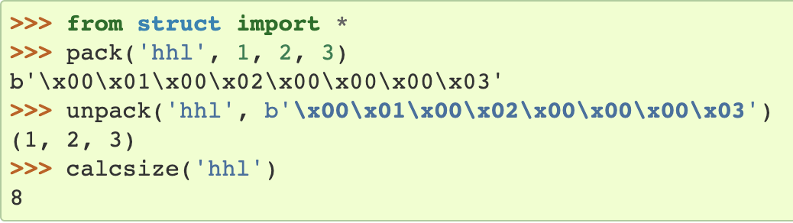
Python struct Module
Python Data Encoding / Decoding (Packing / Unpacking)
Python byte array encoding
‘12ABab’
‘\x30\x31\x41\x42\x61\x62’
Python struct module --- Interpret bytes as packed binary data
  Support conversion between Python values and C structs
  Need to care about Endianness (byte order), size, and alignment
l
h
h
https://docs.python.org/3/library/struct.html
Notes:
python3 is more explicit on differtiating string, unicode, byte array

Slide 97
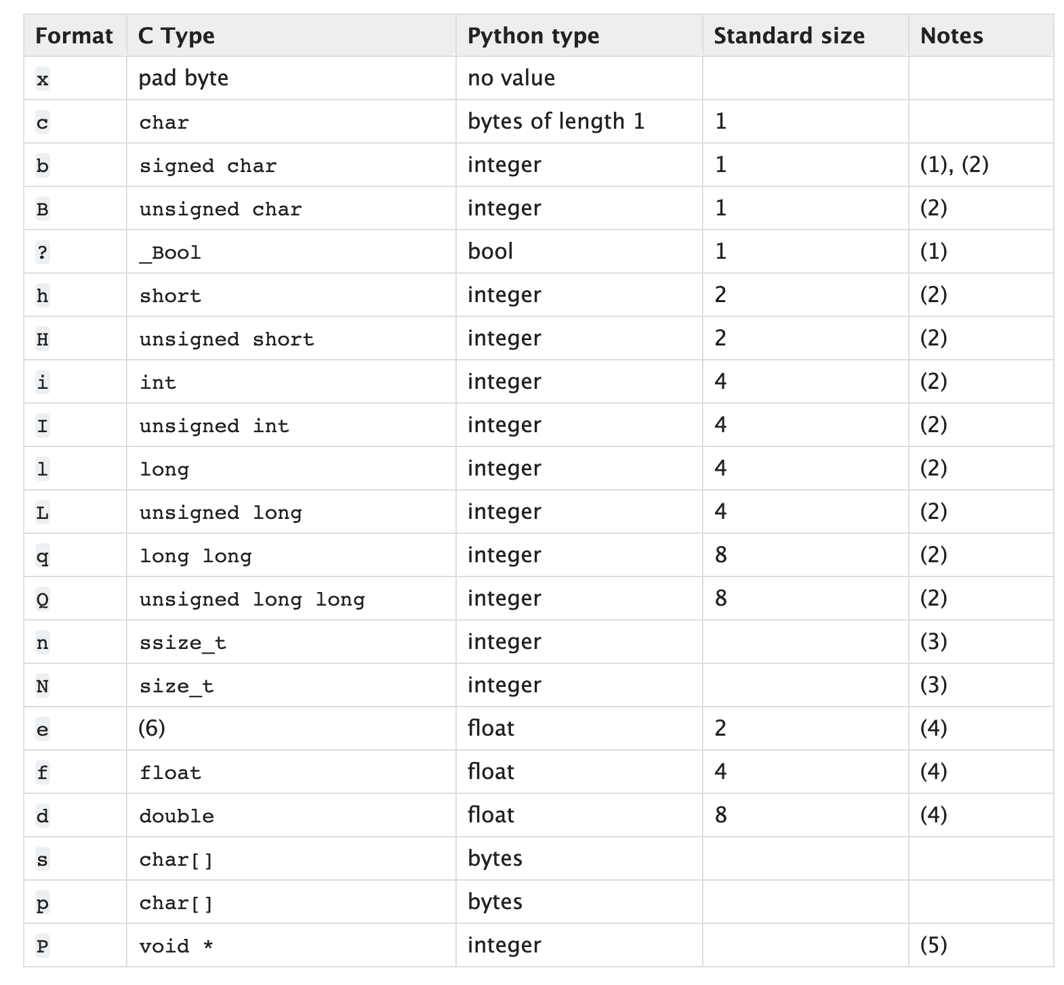
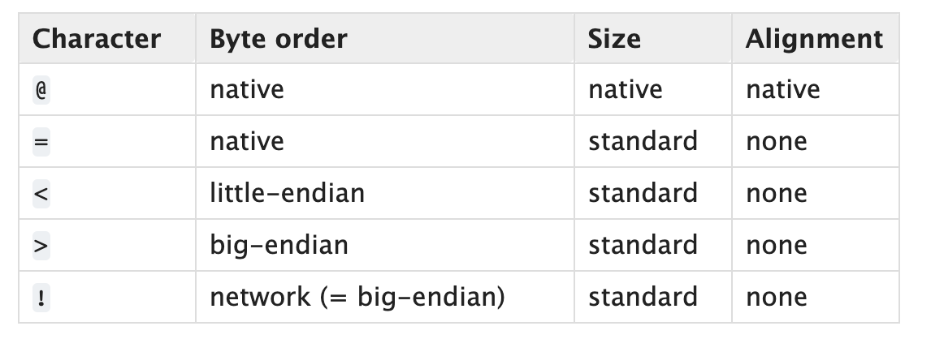
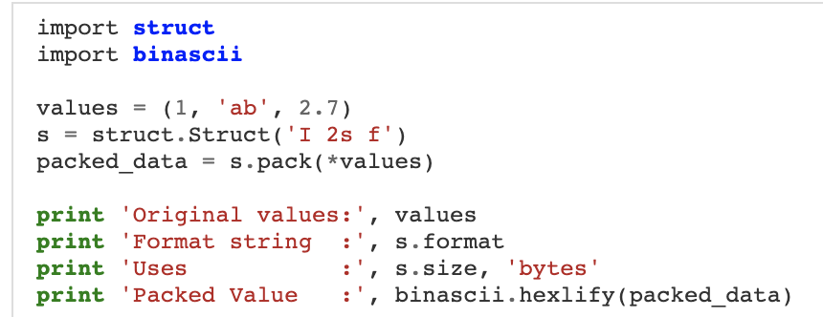
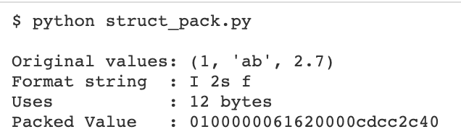
Python struct Module
Default
https://docs.python.org/3/library/struct.html
https://docs.python.org/3/library/struct.html
Notes:
https://pymotw.com/2/struct/
https://docs.python.org/3/library/struct.html
If the first character is not one of these, '@' is assumed.

Slide 98
Low-Level Data Encoding
Two’s complement encoding
Endianness
Primitive Types
ASCII
String

Slide 99
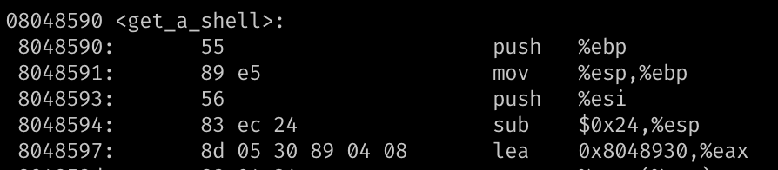
Integer Representations
Unsigned representation (%u)
  8-bit → A byte -> char
Signed
  2’s complement → 1 bit for signedness (%d)
Hexadecimal representation
  0x0 ~ 0xF → 4-bits
  0xB5 → 8-bits (int8_t) → a char
= 214
= 0xD6
Notes:
https://www.electronics-tutorials.ws/binary/signed-binary-numbers.html

Slide 100
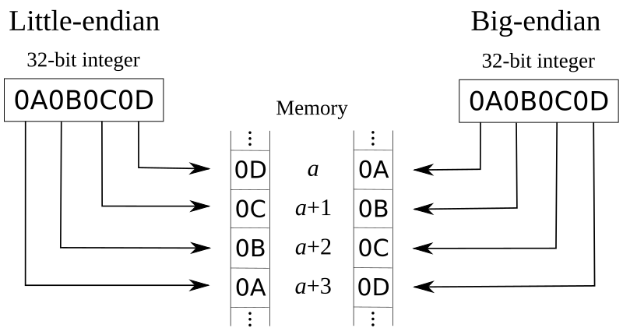
Endianness: Little vs. Big
How the hardware architecture layouts array of bytes
Intel → Little endian
Network
→ Big endian

Slide 101
Bitwise Operations – Truth Table
& (AND)
1 if both are 1
| (OR)
1 if either of one is 1
^ (XOR)
1 if two values are different
AND | 0 | 1
0 | 0 | 0
1 | 0 | 1
OR | 0 | 1
0 | 0 | 1
1 | 1 | 1
XOR | 0 | 1
0 | 0 | 1
1 | 1 | 0
Do not confuse with Logical operators: || , &&

Slide 102
Bitwise Operations - Examples
AND
  1 & 2 = ?
    00000001
    00000010
    = 00000000 = 0
  0x32 & 0x47 = ?
    00110010
    01000111
    = 00000010 = 2
OR
  1 | 2 = ?
    00000001
    00000010
    = 00000011 = 3
  0x32 & 0x47 = ?
    00110010
    01000111
    = 01110111 = 0x77
XOR
  1 ^ 2 = ?
    00000001
    00000010
    = 00000011 = 3
  0x32 ^ 0x47 = ?
    00110010
    01000111
    = 01110101 = 0x75

Slide 103
Bitwise Operations – Reversible XOR
XOR is a reversible operator
  A ^ B = C
  C ^ B = ?
    C = (A^B)
    C ^ B = (A ^ B) ^ B = A ^ (B ^ B)
  # XOR-ing the same value, zero
  B^B = 0
  # A’s 0s will be zero
  # A’s 1s will be one
  A ^ 0 = A
XOR and SWAP
Suppose you have
int a,b;
Swap – temp variable
  int t = a;
  a = b;
  b = t;
Swap – XOR
  a = a^b
  b = a^b ⬄ (a^b)^b => a
  a = a^b ⬄ (a^b)^a => b

Slide 104
Bitwise Operations - AND
Use it to get the least significant bits (byte)
movsbl: move int8_t (char) → int (integer)
  0x0804868c <+44>: movsbl (%eax,%ecx,1),%eax
  0x08048690 <+48>: add $0x20,%eax
  0x08048693 <+51>: and $0xff,%eax
  %eax = [%eax + %ecx * 1]; // read 1 byte (movsbl)
  %eax += 0x20;
  %eax &= 0xff
  int a;
  a += 0x20;
  a &= 0xff; // retain only a byte
Notes:
todo: update example

Slide 105
Bitwise Operations - AND
  int a; a += 0x20; a &= 0xff;
  An unsigned character value could be in the range from 0 to 255
  The code adds 32(0x20) to the character value.
  What if the original value is 255?
    255 + 32 = 287 = 0x11f ← not a character
  287 & 0xff?
    0x11f & 0xff
    0x1f!
0x011f = 00000001 00011111
0x00ff = 00000000 11111111
------------------
> 00000000 00011111
& (AND)

Slide 106
<stdint.h>
Be explicit on
  Data types
    Value or pointer
  Data width: a byte (8-bit), four bytes (32-bit), eight bytes (64-bit)
    2^4 = 16, 2^5 = 32 ….
    2^10 = 1024 ≈ 1K, 2 ^ 20 = 1024 X 1024 ≈ 1M …
      Q: 2^32 ?
  Signedness
Beware of side effects
  overflow, underflow …
Use <stdint.h>
#include <stdint.h>
int32_t a; // 4 bytes
uint8_t b; // 1 byte
…
int8ptr_t c; // 4 bytes
int32ptr_t d; // 4 bytes
…

Slide 107
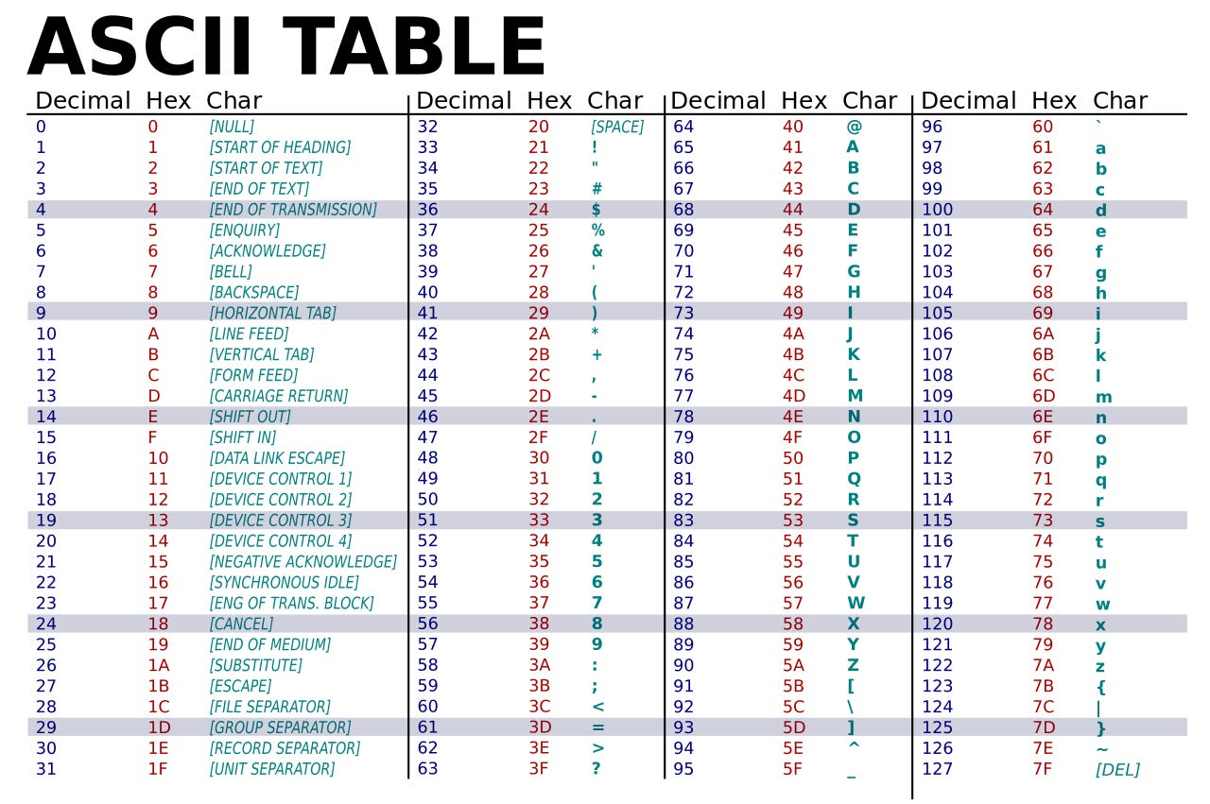
ASCII
A byte to represent a character
0 ~ 255 (0x0 ~ 0xFF) (unsigned) characters
  Limited → Unicode
String terminated by 0x0 (NUL)
Alpha + Digit region starts from 0x30 (48)

Slide 108
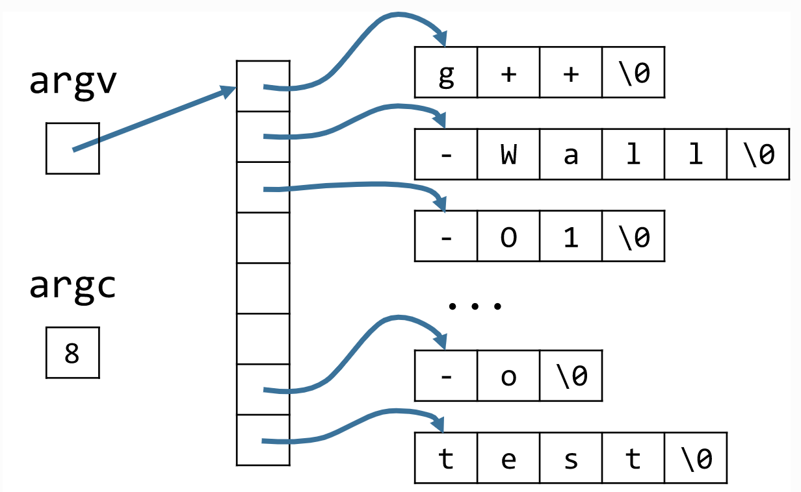
C-Style Strings
String is ‘NULL’ (\0) terminated
char str[6] = { 'h', 'e', 'l', 'l', 'o', '\0' };
Command line arguments
g++ -wall –O1 …. –o test

Slide 109
(Naïve) string functions
int strlen(char* str);
int strcpy(char* dst, char* src);
int strlen (char* str) {
  int l= 0;
  while (str(l) != ‘\0’) {
  l++;
  }
  return l;
}
int strcpy (char* dst, char* src) {
  int l= 0;
  do {
  dst[l] = src[l];
  l++;
  } while (src(l) != ‘\0’)
  return l;
}
How about ‘strcmp’?
Notes:
strcmp return value man strcmp

Slide 110
Backup

Slide 111
2’s Complement (signed binary)

Slide 112
Byte stream and Unicode

Slide 113
Linux Capabilities / SELinux

