Slide 1
CS4459.003 Cyber Attacks & Defense Lab
Shellcoding Part 1
Feb 13, 2024

Slide 2
From Last Class
Buffer overflow attacks
Calling convention + stack layout
No bound check to guard the boundaries

Slide 3
Learning Objectives
Writing programs in assembly (GAS/gas)
Shellcode/Shellcoding: Load your own payload
Your payload ‘get_a_shell()’
Linux access control
System call
Vs. library call (glibc)
32-bit vs. 64-bit

Slide 4
In-class3: Challenges
Fetch new assignments, write and run your shellcode
$ fetch inclass3
shellcode: a normal shellcode
32-bit / 64-bit
nonzero-shellcode: shellcode without using zero

Slide 5
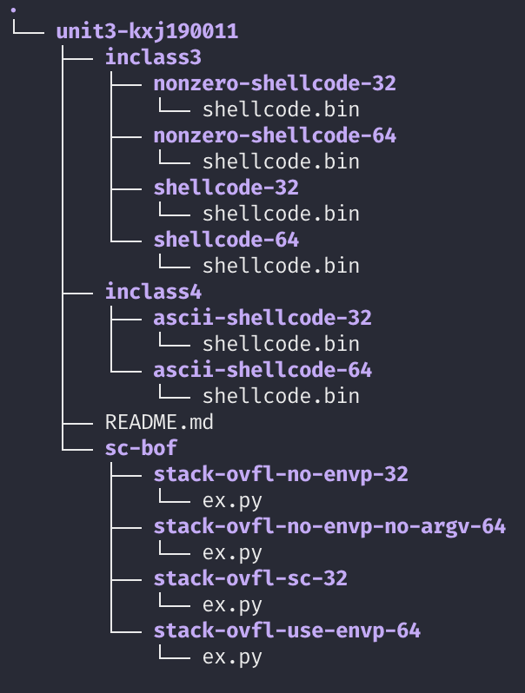
How to Submit?
inclass{3,4}
Include 'shellcode.bin'
'ex.py' only when it is needed
sc-bof
Include 'ex.py'
https://xfersh.syssec.org/JG1JA3/unit3-kxj190011.tar.gz

Slide 6
Buffer Overflow
64-bit Stack
argv, environ, auxv
Overflow buffer and overwrite
local variables
Previous %EBP
Function’s return address
main () → run() → recv_input();
Jump to where you wish to run
Saved %rip
%rbp
Saved %rbp
buffer
Stack
buffer
get_a_shell();
%rsp
8 bytes

Slide 7
get_a_shell()
Inherit current privilege and then execute a shell
You can read the flag!
setregid(getegid(), getegid())
execl(“/bin/bash”, “bash”, 0);
Notes:
can we better format this?

Slide 8
get_a_shell(): setregid()
getegid()
Get effective GID
setregid(gid_t rgid, gid_t egid)
Set real and effective gid
setregid(getegid(), getegid())
Set real and effective gid as current effective gid
Privilege escalation!
Set your gid to unit3-level0-…

Slide 9
Linux Access Control: Resource Ownership
Ownership for user and group
Who (or which group) owns the file?
Permissions for User, Group, Other
Write, Read, eXecution
Program with setuid, setguid bits
Atop the privileges of the user, run with the privileges of the file owner instead

Slide 10
Linux Access Control: Process Identity
UserID (UID) and GroupID (GID)
Defined from /etc/passwd and /etc/group
Real ID, Effective ID, (Saved ID)
Real ID: ID of the user that has started the process
Effective ID: ID the process is running with
Notes:
id –r id –u?

Slide 11
get_a_shell()
execl(“/bin/bash”, “bash”, 0);
Transform the process and run “/bin/bash” with arg0 as ‘bash’
exec* function family
execl(filepath, “arg0”, “arg1”, “arg2”, …, “argN”, 0)
Run program at filepath with args… (arg list ends with ‘\0’)
exec’l’ → ‘l’ist..
execv(filepath, argv[]);
argv[0] = arg0, argv[1] = arg1, …, argv[N] = argN, argv[N+1] = 0 (ends with \0)
exec’v’ → ‘v’ector
execve(filepath, argv[], envp[]);
In addition to execv (for argv),
envp[0] = env0, envp[1] = env1, envp[2] = env2, …, envp[N] = envN, envp[n+1] = 0
Notes:
Transform → Mystic

Slide 12
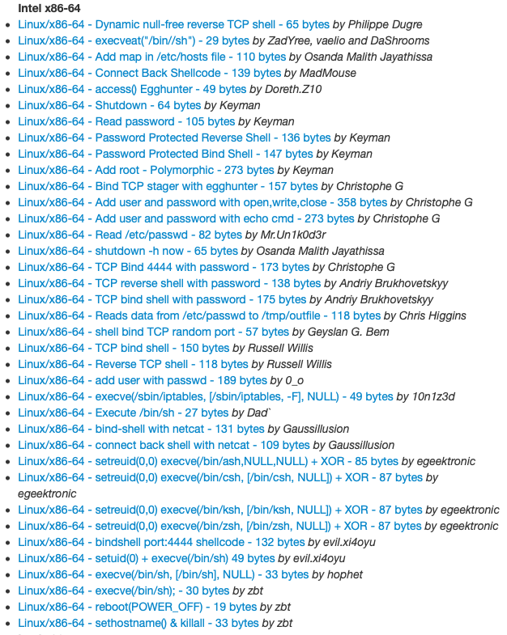
Shellcode
No longer ‘get_a_shell()’ in real attacks
Shellcode
Assembly code snippet that runs a shell (or more attacks)
We need to have
setregid(getegid(), getegid());
execve(“/bin/sh”, 0, 0);
http://shell-storm.org/shellcode/

Slide 13
How to Launch Shellcode?
Land your shellcode in the target program’s address space
As a part of your input
As program’s arguments
As program’s environmental variables
As the program’s name (argv[0])
Set the return address to your shellcode
Run
setregid(getegid(), getegid())
execve(“/bin/sh”, 0, 0);

Slide 14
Writing Shellcode: System Call
System call
Channel to talk to OS kernel
A function call to OS kernel
Context switch (expensive)
Eventual gateway to access system resources
File I/O, network I/O, memory allocation
Set/get permissions, run program
Many more
Varies for different systems and architectures
Check system call number table for 32 bit (x86) and 64 bit (AMD64)
Notes:
Need better source for system call table
Online assemblers and disassemblers
http://shell-storm.org/online/Online-Assembler-and-Disassembler/?opcodes=%5Cx31%5Cxc0%5Cx48%5Cxbb%5Cxd1%5Cx9d%5Cx96%5Cx91%5Cxd0%5Cx8c%5Cx97%5Cxff%5Cx48%5Cxf7%5Cxdb%5Cx53%5Cx54%5Cx5f%5Cx99%5Cx52%5Cx57%5Cx54%5Cx5e%5Cxb0%5Cx3b%5Cx0f%5Cx05&arch=x86-32&endianness=little&dis_with_addr=True&dis_with_raw=True&dis_with_ins=True#disassembly
https://www.exploit-db.com/
https://chromium.googlesource.com/chromiumos/docs/+/HEAD/constants/syscalls.md

Slide 15
System Call Calling Convention
You can see it as a calling convention between user-land and kernel-land

Slide 16
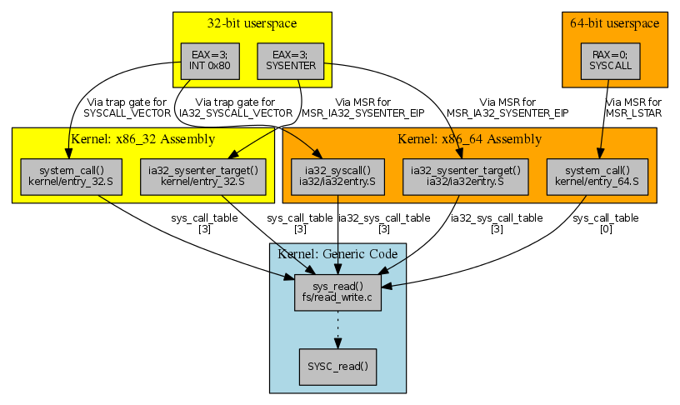
Invoking getuid(): x86
Set %eax as target system call number
mov $SYS_getegid, %eax // 0x32
Set arguments
1st arg: %ebx
2nd arg: %ecx
3rd arg: %edx
4th arg: %esi
5th arg: %edi
Run
int $0x80
32-bit way
Notes:
hello world assembly
https://tldp.org/HOWTO/Assembly-HOWTO/hello.html

Slide 17
Invoking getuid(): AMD64
Set %rax as target system call number
mov $SYS_getegid, %rax // 0x6c
Set arguments
1st arg: %rdi
2nd arg: %rsi
3rd arg: %rdx
4th arg: %r10
5th arg: %r8
Run
syscall
64-bit way
Notes:
hello world assembly
https://tldp.org/HOWTO/Assembly-HOWTO/hello.html

Slide 18
getegid(), setregid() : x86
Return value will be stored in %eax
mov $SYS_getegid, %eax
int $0x80
%eax will hold the return value of getegid()
How to run setregid(getegid(), getegid())?
mov %eax, %ebx // 1st arg
mov %eax, %ecx // 2nd arg
mov $SYS_setregid, %eax // syscall number
int $0x80
Notes:
http://shell-storm.org/online/Online-Assembler-and-Disassembler/?opcodes=%5Cx31%5Cxc0%5Cx48%5Cxbb%5Cxd1%5Cx9d%5Cx96%5Cx91%5Cxd0%5Cx8c%5Cx97%5Cxff%5Cx48%5Cxf7%5Cxdb%5Cx53%5Cx54%5Cx5f%5Cx99%5Cx52%5Cx57%5Cx54%5Cx5e%5Cxb0%5Cx3b%5Cx0f%5Cx05&arch=x86-32&endianness=little&dis_with_addr=True&dis_with_raw=True&dis_with_ins=True#disassembly

Slide 19
Calling EXECVE()
// execve(char* filepath, char** argv, char** envp)
execve(“/bin/sh”, NULL, NULL);
%eax = $SYS_execve
%ebx = address of “/bin/sh”
%ecx = 0
%edx = 0
int $0x80

Slide 20
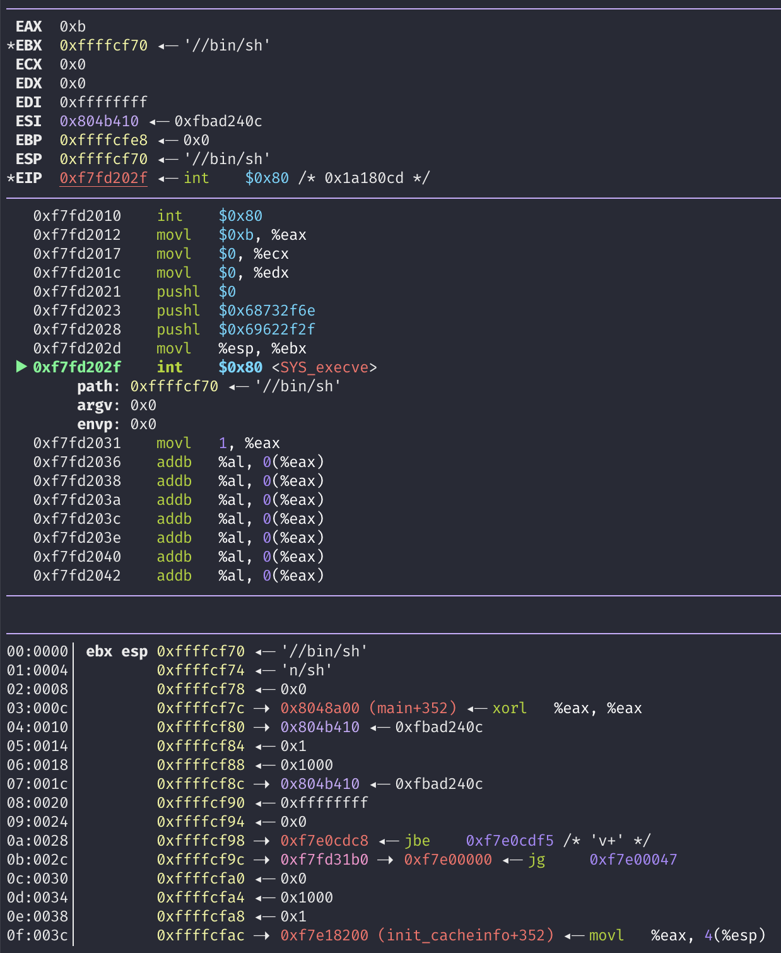
How to Create a String (‘/bin/sh’)?
%ebx = address of “/bin/sh”
Use Stack
push $0 // why?
push $0x67832f6e // “n/sh”
push $0x69622f2f // “//bi”
mov %esp, %ebx
Notes:
stack diagram

Slide 21
Controlling the Attack Surface
Limit/monitor the input channels to the program (or service)
Command-line
STDIN, input files
Environment variables
Limit/monitor the contents of the input
Are you string?
Are you too lengthy?
Do you contain any control characters? – e.g., “;”

Slide 22
Shellcode with Zero-bytes
push $0
Standard functions will cut off your shellcode
scanf(), strcpy(), fgets() …

Slide 23
Removing Zero from Your Shellcode
You still need Zeros for your code
Do do you create and use Zeros?

Slide 24
Many Tricks
mov $0x41414141, %eax
sub $0x41414141, %eax
xor %eax, %eax
mov %eax, %ebx
Try it from shell-storm
NOTE: shell-storm assembler/disassembler only understands ‘Intel’ syntax 😔
http://shell-storm.org/online/Online-Assembler-and-Disassembler/
Notes:
mov eax, 0x41414141
sub eax, 0x41414141
http://shell-storm.org/online/Online-Assembler-and-Disassembler/

Slide 25
Loading You Payload
Leverages program inputs
Many sanitizations for their inputs
E.g., how program cut string end?
Program will only accept
ASCII characters
Alphanumeric characters
Limits in input length
No escape characters …

Slide 26
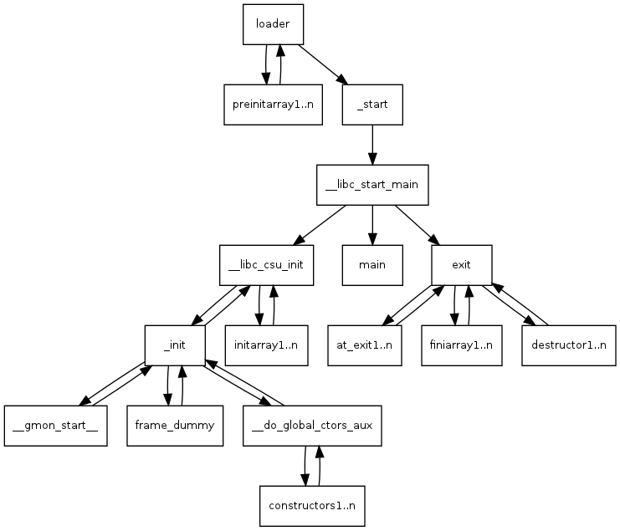
How Linux Runs a Program?

Slide 27
Stack for Communication
Used for
Storing local variables
Your input buffer could be here…
Passing function arguments
Storing return address
Storing frame (base) pointer (i.e., saved %ebp)
Chaining stack frames
What others?
filename, ARGV, ENVP, AUX

Slide 28
How Linux Runs a Program?
Reading:
How programs get run: ELF binaries
https://lwn.net/Articles/631631/
ELF (Executable and Linkable Format)
Basics:
execve(char *name, char** argv, char **envp)
execve(“program path”, argument_vectors, environment_pointers)
execve(“/bin/sh”, {“sh”, NULL}, {”SHELL=sh”, “TERM=xterm”, …, NULL});

Slide 29
How Linux Runs a Program?
Reading:
How programs get run: ELF binaries
https://lwn.net/Articles/631631/
ELF (Executable and Linkable Format)
Basics:
execve(char *name, char** argv, char **envp)
execve(“program path”, argument_vectors, environment_pointers)
execve(“/bin/sh”, {“sh”, NULL}, {”SHELL=sh”, “TERM=xterm”, …, NULL});

Slide 30
execve(char *name, char** argv, char **envp)
1. Program path: program to execute; could be an ELF file
/bin/sh , /bin/ls, /usr/bin/python
2. Argument vectors: list of arguments, each as string (char **argv)
When running “python a.py 1 2 3”,
argv[0] = “python”
argv[1] = “a.py”
argv[2] = “1”
argv[3] = ”2”
argv[4] = “3”
3. Environment Variables: list of environments variables, each as string (char **envp)
“TERM=xterm”
“SHELL=sh”
“EDITOR=/usr/bin/vim”

Slide 31
1. Load the Executable
From the program path (1st arg to execve), the kernel loads code and data to the memory space
execve(“/bin/sh”, ….)
Code section
Usually starts from 0x8048000 (32 bit), or 0x400000 (64 bit)
readelf -a /bin/sh
Will store the path name of the program at the bottom of the stack
Program Path
“/bin/sh”

Slide 32
2. Set Environment Variables
Program Path
“/bin/sh”
ENV1
ENV2
Set environmental variables to the current stack.
ENV3 …
ENV Ptrs

Slide 33
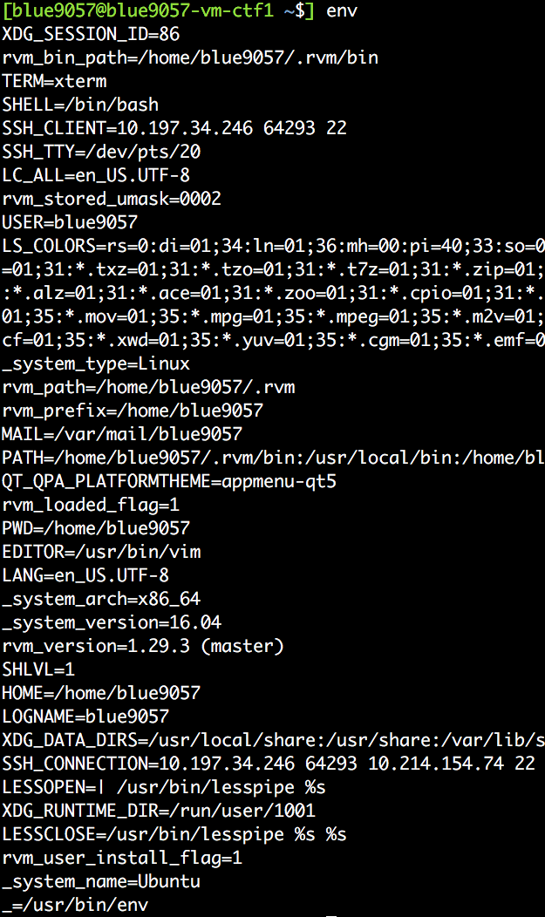
2. Set Environment Variables
Program Path
“/bin/sh”
ENV1
ENV2
Set environmental variables to the current stack.
ENV3
…
ENV Ptrs

Slide 34
3. Set Argument Vectors
Program Path
“/bin/sh”
ENV1
ENV2
Set argument vectors to the current stack.
When running “python a.py 1 2 3”,
argv[0] = “python”
argv[1] = “a.py”
argv[2] = “1”
argv[3] = ”2”
argv[4] = “3”
ENV3
…
ENV Ptrs
ARGV4
ARGV3
…
ARGV Ptrs

Slide 35
4. Call _start
readelf -a …

Slide 36
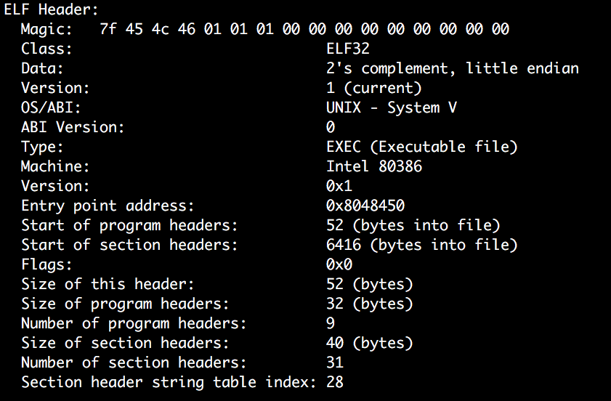
4. Call _start
readelf -a …
Addr of _start()

Slide 37
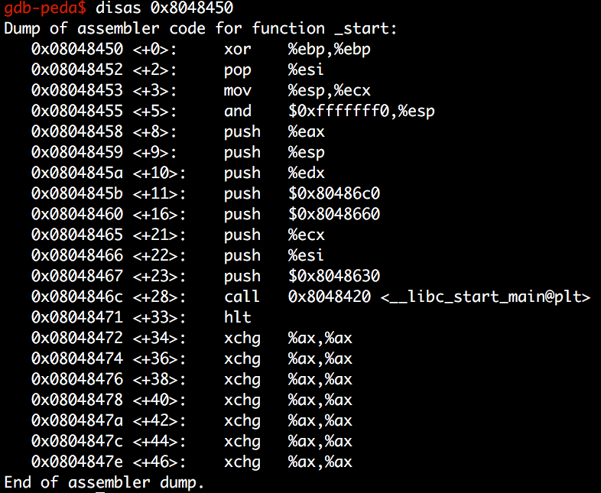
4. Call _start
readelf -a …
Addr of main()

Slide 38
4. Call _start
Program path
ENVS
readelf -a …
Calls __libc_start_main
And then, libc_start_main sets the address of argv, envp, then calls main(argc, argv, envp)
ENVP Ptrs
ARGs
ARGV Ptrs
…
ENVP
ARGV
ARGC
The stack of main() starts at here:

Slide 39
Check with GDB
b main
r
x/100x $esp

Slide 40
Backup

