Slide 1
CS4459.001 Cyber Attacks & Defense Lab
Arbitrary Read / Write and Format String Vulnerability
Apr 2, 2024

Slide 2
Unit-6
Challenges in the /home/labs/unit6 directory
Hosted in ctf-vm2
Serial Read, Arbitrary Read (AR), Arbitrary Write (AW)
Level 0 ~ 3
Format String Vulnerability (FSV) - 32 / 64 bits
Level 4/5, 6/7, 8/9, a/b, c/d
PIE-enabled binary
Level e (40 point)
Level f (bonus 50 point)

Slide 3
Unit-6
Serial Read (sr), Arbitary Read (ar), Arbitrary Write (aw)
0-sr-1, 1-ar-2: 15 pts
2-aw-1, 20 pt, 3-aw-2: 20 pts
Format string 32|64
4-fs-read-1-32, 5-fs-read-1-64, 20 pts
6-fs-read-2-32, 7-fs-read-2-64, 20 pts
8-fs-arbt-read-32, 9-fs-arbt-read-64, 25 pts
a-fs-arbt-write-32, b-fs-arbt-write-64, 30 pts
c-fs-code-exec-32, d-fs-code-exec-64, 30 pts
PIE challenges (bonuses)
e-fs-code-exec-pie-64, 40 pt
f-fs-no-binary-pie-64, 50 pt

Slide 4
Buffer Overflow (BoF) and Control Flow Hijacking (CFH)
BoF has been our primary attack vector
To hijack control flow and deviate
BoF: fill the buffer more than its size
Overwriting return address (saved %eip)
Overwriting frame pointer (saved %ebp)
Control Flow Hijacking
Return to shellcode: Run your own code
Return to some other functions: Code re-use attack
Return to ROP gadgets: Code re-use attack with ROP gadgets
shellcode
RETURN ADDR
DDDD
SAVED %ebp
COOKIE
CCCC
BUFFER
BBBB
BUFFER
AAAA
BUFFER

Slide 5
Control Flow Hijacking (CFH)
Entry points to CFH
RET / JMP / CALL to shellcode
RET / JMP / CALL to some other functions
RET / JMP / CALL to ROP gadgets
Targets to overwrite
Return address
Global offset table (GOT)
Function pointers
Jump table entry
Eventually we seek to gain control over %EIP / %RIP

Slide 6
ELF, PLT, GOT
PLT
printf()
strcpy()
The program
Calls a function
In PLT
read()
PLT jumps to GOT
Program
printf()
Libc
printf()
…
strcpy()
…
read()
…
_dl_dynamic_resolve
GOT
7fa174b06800
_resolve
_resolve
_resolve
GOT stores addr of _dl_dynamic_resolve

Slide 7
What is the Requirement for CFH?
Is buffer overflow the only way to achieve Control Flow Hijacking?
Overwriting return address (saved %eip)
Overwriting frame pointer (saved %ebp)
What we need is the capability to overwrite certain address
Arbitrary write!
Today we will learn arbitrary read/write
RETURN ADDR
RETURN ADDR
SAVED %ebp
SAVED %ebp
COOKIE
BUFFER
BUFFER
BUFFER

Slide 8
Attack Primitives
Arbitrary Read
Read from any address A, any number N of bytes
The attacker must know the address A
Example:
Read 100 bytes from 0xffffd100 (somewhere in the stack)
Read 100 bytes from 0x8048500 (somewhere in the code section)
Can this break:
Stack-Cookie?
ASLR?
DEP?
Notes:
KJEE: checkmark

Slide 9
Breaking Stack-Cookie
The cookie value is on the stack
Sequential read can break stack-cookie easily
RETURN ADDR
SAVED %ebp
COOKIE
BUFFER
BUFFER
BUFFER

Slide 10
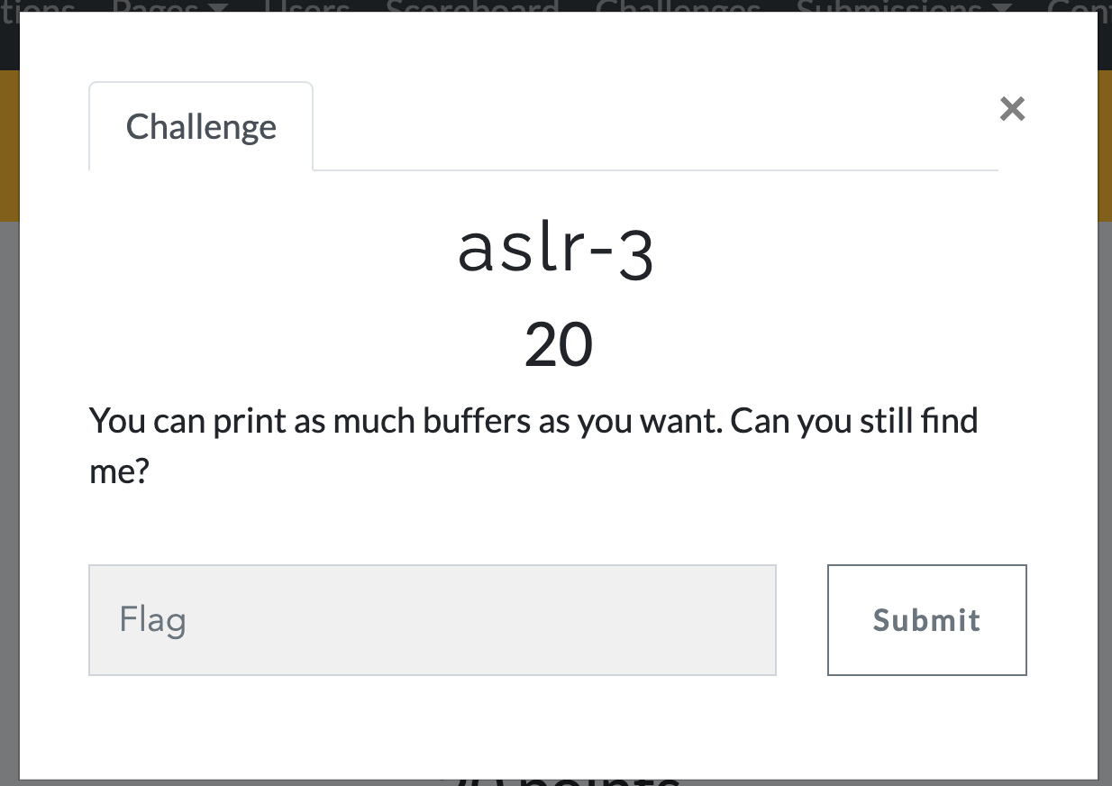
Sequential Read Example
ASLR-3
Leak addresses via sequential leaks from one point of the stack
We do not know ‘A’, but can specify ‘N’
Sometimes this is more powerful than arbitrary read
Notes:
KJEE: we may want to visualize stack

Slide 11
Breaking Stack-Cookie
The cookie value is on the stack
Arbitrary Read
Read where? → The address that the cookie is stored!
Then launch buffer overflow attack
You should know the address of the stack..
RETURN ADDR
SAVED %ebp
COOKIE
BUFFER
BUFFER
BUFFER

Slide 12
Breaking ASLR
Arbitrary Read
Read anywhere if you know the address…
Read where?
Non-PIE: Code section is fixed 0x8048000 ~ 0x804a000
0x401000 ~ and 0x601000 in 64 bit
Stack – random
Library – random
Heap – random
Code/data sections are the only fixed locations

Slide 13
Breaking ASLR + DEP
GOT stores address of libc functions
printf(), puts(), read(), etc.

Slide 14
Breaking ASLR + DEP
Read a value from GOT
Can get the address of puts()
Can you calculate the addresses of execve() or system() from puts?
Yes
Load libc and find offsets, diff, and calculate

Slide 15
Attacking Global Offset Table (GOT)
Read the address in GOT
Leak the address of puts()
Calculate the address of execve() or system() from the offset

Slide 16
Challenges: Unit6
sr-1
The program will perform a sequential read from the stack for you
Read addresses from the leak and exploit the vulnerability!
ar-2
You may perform arbitrary read
Can specify where to read and how many bytes to read
Read GOT of some functions to get the address of that function in libc
Call system(), execve(), whatever you want!

Slide 17
Attack Primitives
Arbitrary Write (AR)
Write on any address, any number of bytes
The attacker must know the address
Example:
Write 100 bytes of data to 0xffffd100 (somewhere in the stack)
Write 100 bytes of data to 0x8048500 (somewhere in the code section)
Can achieve Control Flow Hijacking
Overwrite return address
Overwrite frame pointer
Overwriting GOT

Slide 18
Attacking Global Offset Table (GOT)
Attack Outline
Read the address in GOT
Leak the address of printf()
Calculate the address of system() from the offset
Write that address system() to printf()’s GOT
What will happen a program calls printf() ?

Slide 19
ELF, PLT, GOT
PLT
printf()
strcpy()
The program
Calls a function
In PLT
read()
PLT jumps to GOT
Program
printf()
Libc
printf()
…
strcpy()
…
read()
…
GOT
libc_printf
libc_strcpy
libc_read
GOT stores libc addr

Slide 20
ELF, PLT, GOT
PLT
printf()
strcpy()
The program
Calls a function
In PLT
read()
PLT jumps to GOT
Program
printf()
Libc
printf()
…
strcpy()
…
read()
…
GOT
libc_SYSTEM
libc_printf
libc_strcpy
libc_read
GOT stores libc addr

Slide 21
Attacks with Arbitrary Write
GOT address is known for non-PIE
Choose one function that is called in the program
Overwrite the GOT of printf() to system()
What will happen?
system(“Writing %lu bytes to %p\n”); // ??
Notes:
KJEE: let’s see GOT addressing

Slide 22
Arbitrary-Write-1 (AR-1)
Change the GOT of printf() to to ‘please_execute_me()’ via arbitrary write capability!
printf() after the BoF vulnerability will run that function for you.

Slide 23
Arbitrary-Write-2 (AR-2)
Program contains both arbitrary-read (ar) and arbitrary-write (aw) vulnerabilities.
Exploit arbitrary-read (ar) to get the address of libc function
Then calculate the address of system()
Exploit arbitrary write to overwrite the GOT of printf() to system()
printf("Writing %lu bytes to %p\n”);
system(“Writing %lu bytes to %p\n”);

Slide 24
ONE GADGET
Notes:
https://github.com/lattera/glibc/blob/master/sysdeps/posix/system.c#L115

Slide 25
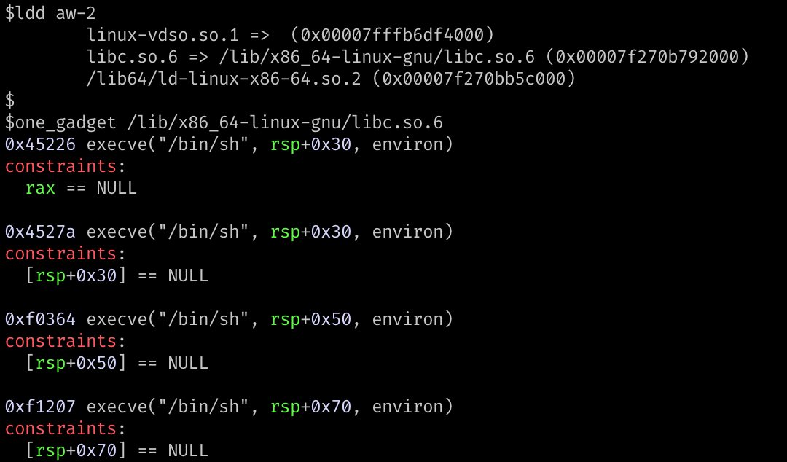
ONE GADGET
Or you may take a simpler approach

Slide 26
Why one_gadget exists?
system(“command”)
fork() // parent waits
execve(“/bin/sh”, [“sh”, “-c”, command, NULL], environ) // child
When we jump to the start of system()
Expects 1st arg is the command (either %rdi or 1st arg on the stack)
Run execve(“/bin/sh”, [“sh”, “-c”, command, NULL], environ);
When we jump in the middle of system()
Skip the part that set up arguments
Call execve(“/bin/sh”, rsp + 0x30, environ);
What if %rsp + 0x30 == 0?
Notes:
https://github.com/lattera/glibc/blob/master/sysdeps/posix/system.c#L115

Slide 27
Why one_gadget exists?
When we jump in the middle of system()
Skip the part that set up arguments
Call execve(“/bin/sh”, rsp+0x30, environ);
What if %rsp+0x30 == 0?
What if %rax == 0?
What if %rsp+0x50 == 0?
What if %rsp+0x70 == 0?
Use it with care…

Slide 28
one_gadget
(0x45281 + 7) + 0x147B8F = 0x18ce17

Slide 29
Format String Vulnerability

Slide 30
In ASLR-2
What kind of information this will print???
15 values of %p (print hexadecimal number as 0x????????, an addr)
No arguments…

Slide 31
Format String Vulnerability
Format String
printf(“%d %x %s %p %n\n”, 1, 2, “asdf”, 3, &i);
The vulnerability
char buf[512];
printf(“%s”, buf);
printf(buf);
If you can control a format string, you may inject arbitrary directives
%d %x %p %s %n etc.
Notes:
Highlight!!

Slide 32
Format String Vulnerability
Format String
printf(“%d %x %s %p %n\n”, 1, 2, “asdf”, 3, &i);
Can be exploited as:
Arbitrary READ (ar)
Arbitrary WRITE (aw)

Slide 33
The Format String
Usage
printf(“%d %x %s”, 0, 65, “asdf”);
→ variable number of arguments
This will print 0 (decimal), 41 (hexadecimal), and “asdf”
% parameters
% is a special identifier in the Format String
% seeks for an argument (corresponding to its order…)

Slide 34
Format String Parameters
%d
Expects an integer value as its argument and print a decimal number
%x
Expects an integer value as its argument and print a hexadecimal number
8048000
%p
Expects an integer value as its argument and print a hexadecimal number
0x8048000 # It’s pretty!
%s
Expects an address to a string (char *) and print it as a string

Slide 35
Format String Syntax
%1$08d
%[argument_position] $[length] [parameter]
Means
Print an integer as a decimal value
Justify its length to length (08)
Get the value from n-th (1) argument
Print 8-length decimal integer, with the value at the 1st argument (padded with 0) E.g., 00000001

Slide 36
Format String Parameters
%d : Integer decimal %x : Integer hexadecimal %s : String
printf(“%2$08d”, 15, 13, 14, “asdf”);
00000013
printf(“0x%3$08x”, 15, 13, 14, “asdf”);
0x0000000d
printf(“%3$20s”, 15, 13, 14, “asdf”);
printf(“%4$20s”, 15, 13, 14, “asdf”);
asdf

Slide 37
fs-read-1-(32|64)
Exploit a format string vulnerability to leak pointers from stack
Guess the random value correctly to get the shell!

Slide 38
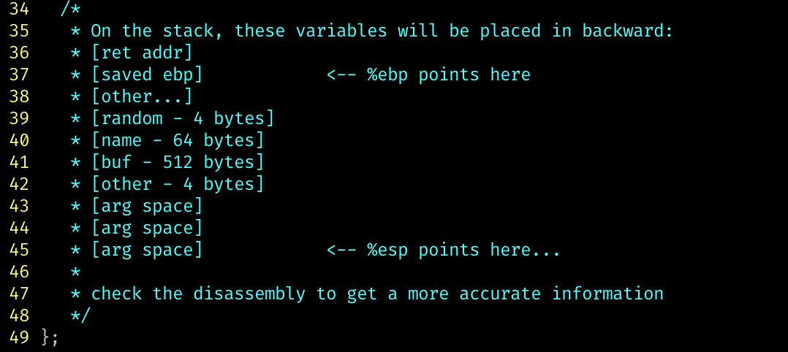
fs-read-2-(32|64)
Exploit a format string vulnerability to leak pointers from stack
You have limited size for your format string as your input
Use directives like %100$x
To skip some uninterested parts of the stack

Slide 39
Backup

Slide 40
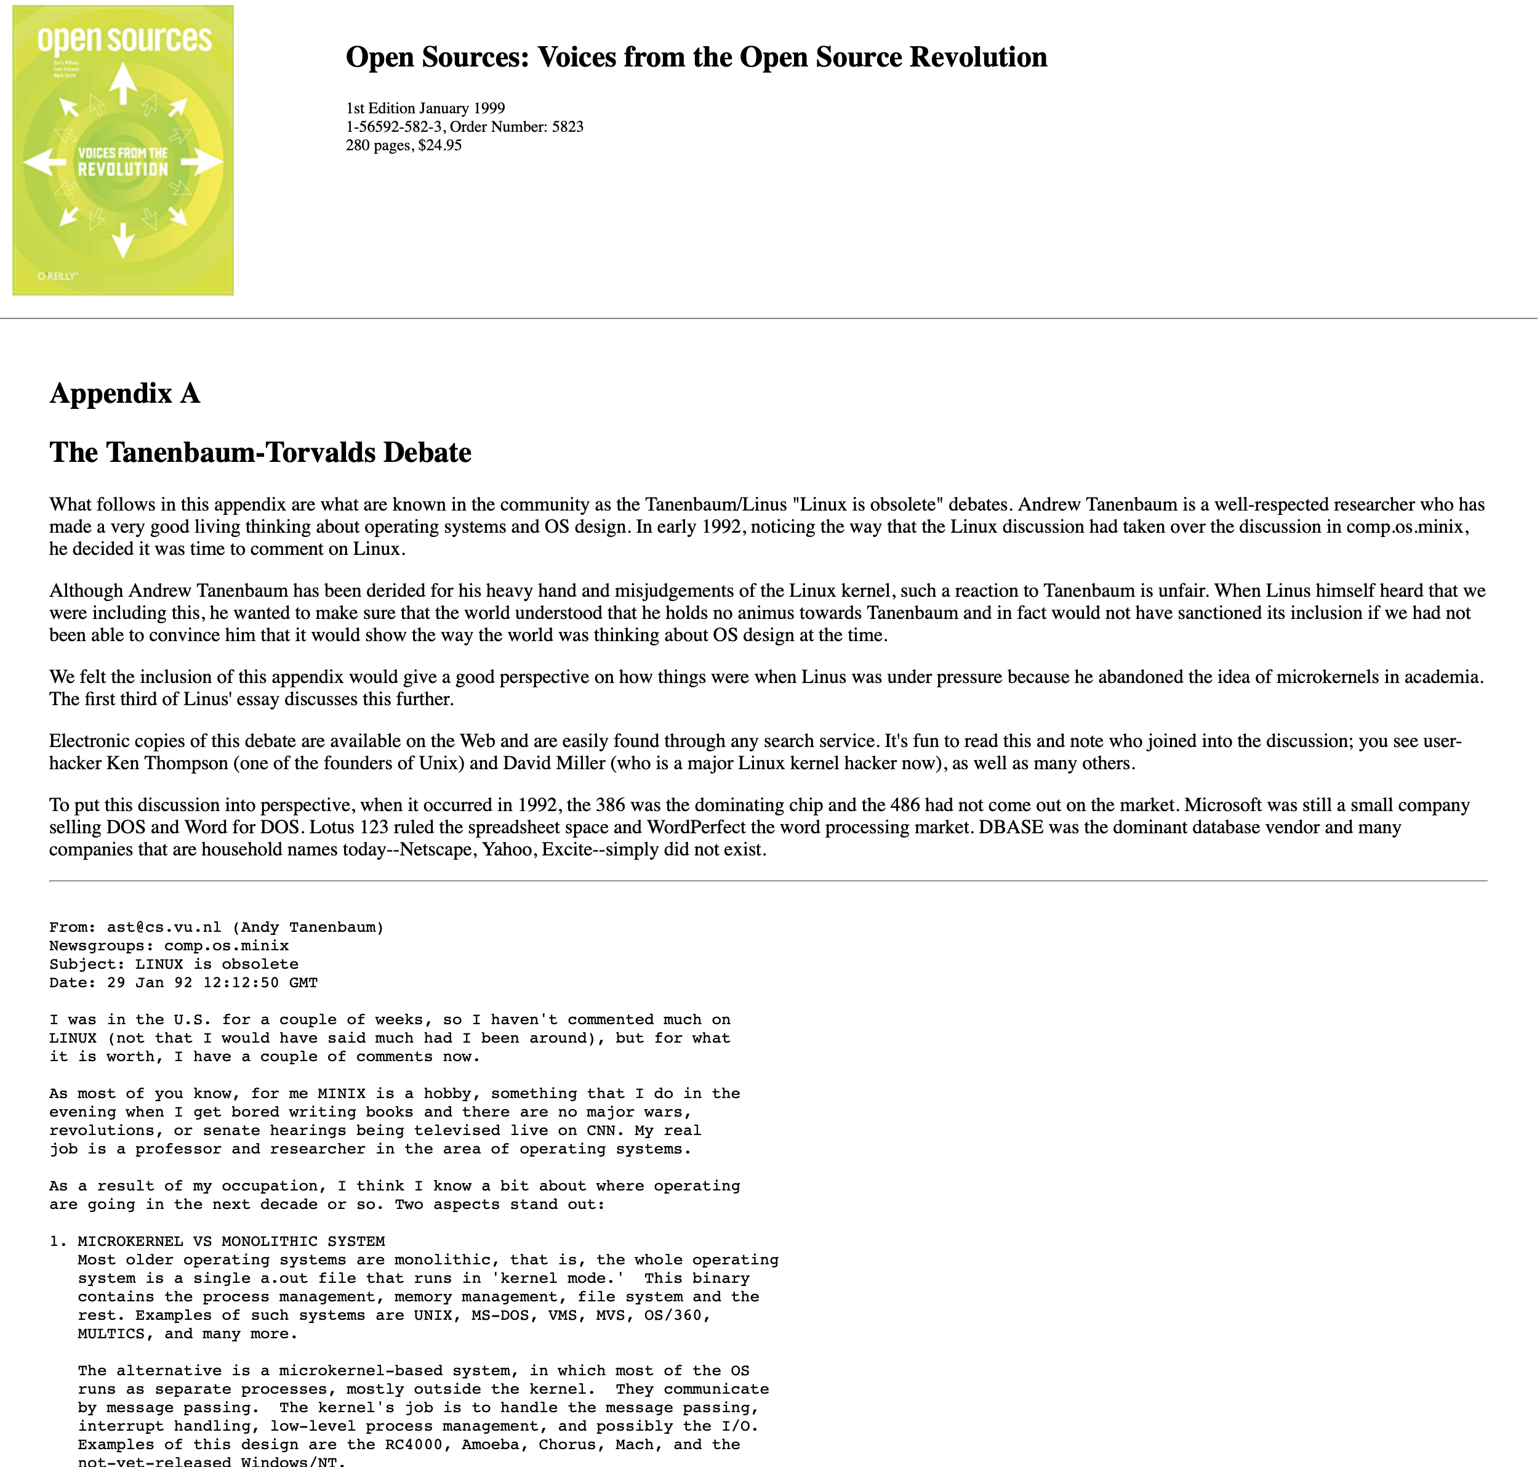
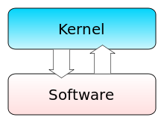
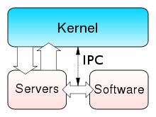
Tanenbaum–Torvalds Debate
Heard of it.
Professor Tanenbaum, Do you know Linux?
https://www.oreilly.com/openbook/opensources/book/appa.html
Notes:
https://softwareengineering.stackexchange.com/questions/140925/why-was-tanenbaum-wrong-in-the-tanenbaum-torvalds-debates

Slide 41
Who is Linus Torvalds?
Do I have to tell you?
Two major contributions to the world
Which one do you think is bigger?
From https://github.com/torvalds

Slide 42
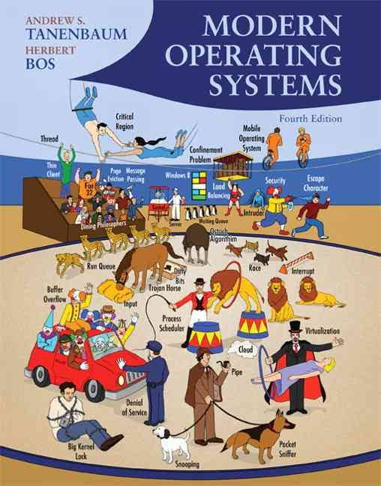
Who is Tanenbaum?
A Dutch
OS book
with Herbert Bos

Slide 43
Tanenbaum–Torvalds debate
Heard of it.
Professor Tanenbaum, Do you know Linux?
Micro-kernel vs. Monolithic kernel
Portability
Open-source model
Do we need to share the source?
https://www.oreilly.com/openbook/opensources/book/appa.html
Notes:
https://softwareengineering.stackexchange.com/questions/140925/why-was-tanenbaum-wrong-in-the-tanenbaum-torvalds-debates

