Slide 1
CS4459.001 Cyber Attacks & Defense Lab
Arbitrary Read / Write and Format String
April 9, 2023

Slide 2
ELF, PLT, GOT
PLT
printf()
strcpy()
The program
Calls a function
In PLT
read()
PLT jumps to GOT
Program
printf()
Libc
printf()
…
strcpy()
…
read()
…
_dl_dynamic_resolve
GOT
7fa174b06800
_resolve
_resolve
_resolve
GOT stores addr of _dl_dynamic_resolve

Slide 3
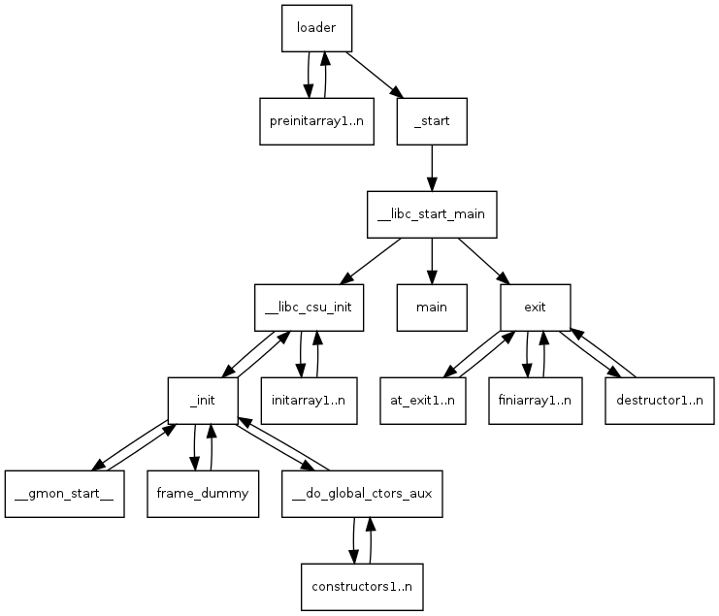
How DO We Get to “main()”?
Kernel (load_elf_binary()) Sets-up stack for you: argc, argv, envp, auxv
File descriptors: 0, 1, 2 (stdin, stdout, stderr)
pass control to ‘loader’
‘loader’
Relocates shared libraries
Calls ‘pre-initializer(s)’
Then, calls ‘_start()’
→ _start();
→ __libc_start_main();
→ main();
Notes:
https://lwn.net/Articles/631631/

Slide 4
sr-1
Libc
libc_start_main()
…
…
…
execl()
…
Leaking some bytes from the stack
This will contain the return address of main()
Leak somewhere in the middle of __libc_start_main()
You can calculate the offset to ‘execl()’
execl(const char* path, args, …);
Run execl(“@”, 0);
In ROPGadget, you will chain something like the following
setregid(getegid(), getegid()); execl(“sh”,0);
Notes:
KJEE: what is prog4?

Slide 5
ar-2
Libc
printf()
…
…
…
execl()
…
Leak the GOT of any function
printf()? puts()? ➔ Anything should work!
Calculate the distance from that function to “execl();”
Then run,
setregid(), execl(“@”, 0);
GOT_execl := GOT_printf - libc_printf + libc_execl
GOT
printf()
…
…
…
execl()
…

Slide 6
Attacks with Arbitrary Write
GOT address is known for non-PIE
Choose one function that is called in the program
Overwrite the GOT of printf() to system()
What will happen?
system(“Writing %lu bytes to %p\n”); // Fails…
Notes:
KJEE: let’s see GOT addressing

Slide 7
aw-1 and aw-2
aw-1
Write the address of please_execute_me() to the GOT of printf()
printf() will be replaced to please_execute_me();
aw-2
Leak the GOT of printf() with AR
Calculate the address of system() from printf()
Overwrite the GOT of printf() := system() system() will replace printf()
Notes:
Two stage

Slide 8
Format String Syntax
%1$08d
%[argument_position] $[length] [parameter]
Means
Print an integer as a decimal value
Justify its length to length (08)
Get the value from n-th (1) argument
Print 8-length decimal integer, with the value at the 1st argument (padded with 0) E.g., 00000001

Slide 9
Format String Parameters
%d – Integer decimal %x – Integer hexadecimal %s – String
printf(“%2$08d”, 15, 13, 14, “asdf”);
00000013
printf(“0x%3$08x”, 15, 13, 14, “asdf”);
0x0000000d
printf(“%3$20s”, 15, 13, 14, “asdf”);
printf(“%4$20s”, 15, 13, 14, “asdf”);
asdf

Slide 10
Format String Vulnerability

Slide 11
Format String Vulnerability
Format String
printf(“%d %x %s %p %n\n”, 1, 2, “asdf”, 3, &i);
The vulnerability
char buf[512];
printf(“%s”, buf);
printf(buf);
If you can control a format string, you may inject arbitrary directives
%d %x %p %s %n etc.
Notes:
Highlight!!

Slide 12
Format String Vulnerability
Format String
printf(“%d %x %s %p %n\n”, 1, 2, “asdf”, 3, &i);
Can be exploited as:
Arbitrary READ (ar)
Arbitrary WRITE (aw)

Slide 13
The Format String
Usage
printf(“%d %x %s”, 0, 65, “asdf”);
→ variable number of arguments
This will print 0 (decimal), 41 (hexadecimal), and “asdf”
% parameters
% is a special identifier in the Format String
% seeks for an argument (corresponding to its order…)

Slide 14
Format String Parameters
%d
Expects an integer value as its argument and print a decimal number
%x
Expects an integer value as its argument and print a hexadecimal number
8048000
%p
Expects an integer value as its argument and print a hexadecimal number
0x8048000 # It’s pretty!
%s
Expects an address to a string (char *) and print it as a string

Slide 15
Format String Syntax
%1$08d
%[argument_position] $ [length] [parameter]
Means
Print an integer as a decimal value
Justify its length to length (08)
Get the value from n-th (1st) argument
Print 8-length decimal integer, with the value at the 1st argument (padded with 0) E.g., 00000001

Slide 16
Format String Parameters
%d : Integer decimal %x : Integer hexadecimal %s : String
printf(“%2$08d”, 15, 13, 14, “asdf”);
00000013
printf(“0x%3$08x”, 15, 13, 14, “asdf”);
0x0000000d
printf(“%3$20s”, 15, 13, 14, “asdf”);
printf(“%4$20s”, 15, 13, 14, “asdf”);
asdf

Slide 17
Format String Vulnerability
Format String
printf(“%d %x %s %p %n\n”, 1, 2, “asdf”, 3, &i);
The vulnerability
char buf[512];
printf(“%s”, buf);
printf(buf);
// This will print some values from stack
printf(“%p %p %p %p %p %p”);

Slide 18
Format String Vulnerability
Format String
printf(“%d %x %s %p %n\n”, 1, 2, “asdf”, 3, &i);
Can be exploited as:
Arbitrary Read (AR)
Arbitrary Write (AW)

Slide 19
Format String Vulnerability
Useful identifiers
%x – value, print an argument as a hexadecimal value
%d – value, print an argument as a decimal value
%p – value, print an argument as a hexadecimal value with prefix 0x-
%s – pointer, print an argument as a string; print the data in the address
%n – pointer, write the number of printed bytes to the address

Slide 20
Format String Parameters
%n – store # of printed characters
int i;
printf(“asdf%n”, &i);
// i := 4
printf(“%12345x%n”, 1, &i);
// Print 1 as 12345 characters (“ ” * 12344 + “1”)
// Store 12345 to i

Slide 21
fs-read-1
Use many %p to dump the random value!
Practice %6$p, %7$p, etc..

Slide 22
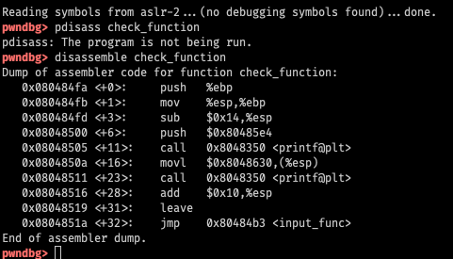
Stack
RETURN ADDR
8th
SAVED %ebp
7th
RESV
6th
RESV
5th
RESV
4th
RESV
3rd
RESV
2nd
0x80485e4 (1st)
1st

Slide 23
Stack Information Leak via FSV
printf(buf);
Type %p %p %p %p %p %p %p %p %p
This will eventually leak values in the stack

Slide 24
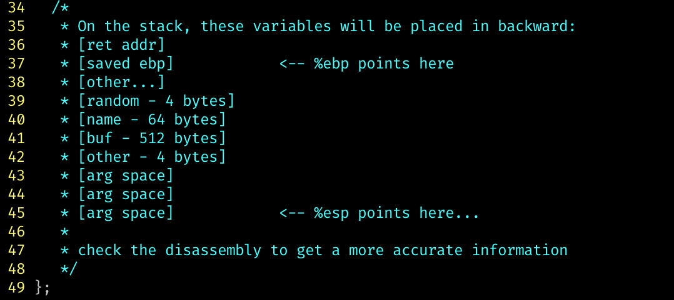
fs-read-2
Buffer is 64 bytes → You can put at most 32 ‘%p’
You cannot reach to the random value on the stack (too far)
Use gdb, to figure out
Values from which address %1$p prints? → [addr_a]
Which address stores the random value → [addr_b]
([addr_b] - [addr_a]) / 4 ; distance as # args
E.g., if that value is 77 → %77$p should reveal random

Slide 25
Where is the random in fs-read-1?
RETURN ADDR
SAVED %ebp
BUFFER
BUFFER
0x54
BUFFER
BUFFER
Random is at -0x50(%ebp)
random
6th
variable
5th
RESV
4th
RESV
3rd
RESV
2nd
Arg 1 of printf

Slide 26
Arbitrary Read via FSV
In fs-read-1
%p %p ….
Why?

Slide 27
Arbitrary Read via FSV
RETURN ADDR
SAVED %ebp
%p %
%p
The buffer is on the stack
Your input can also be treated as an argument
Can you exploit this to perform arbitrary read via FSV?
0x4c
p %p
%p %
random
6th
variable
5th
RESV
4th
RESV
3rd
RESV
2nd
Arg 1 of printf

Slide 28
Arbitrary Read via FSV (%s)
RETURN ADDR
SAVED %ebp
XXXX
XXXX
Put address to read on the stack
Suppose the address is 0x804a010 (GOT of printf)
Prepare the string input
“\x10\xa0\x04\x08%7$x” (print 0x804a010, test it first)
“\x10\xa0\x04\x08%7$s” (read the data!)
0x4c
%7$s
0x804a010
random
6th
variable
5th
RESV
4th
RESV
3rd
RESV
2nd
Arg 1 of printf

Slide 29
Arbitrary Read via FSV (%s)
Capability
Can read “string” data in the address
Read terminates when it sees “\x00”
Tricks to read more…
“\x10\xa0\x04\x08\x11\xa0\x04\x08\x12\xa0\x04\x08\x13\xa0\x04\x08”
“%7$s|%8$s|%9$s|%10$s”
You will get values separated by | (observing || means that it is a NULL string)
E.g., output “1|2||3” will indicate “12\x003”

Slide 30
Arbitrary Write via FSV (%n)
RETURN ADDR
SAVED %ebp
XXXX
XXXX
Put address to read on the stack
Suppose the address is 0x804a010 (GOT of printf)
Prepare the string input
“\x10\xa0\x04\x08%7$x” (print 0x804a010, test it first)
“\x10\xa0\x04\x08%7$n” (write the data!)
Will write 4, because it has printed “\x10\xa0\x04\x08”
before the %7$n parameter
0x4c
%7$s
0x804a010
random
6th
variable
5th
RESV
4th
RESV
3rd
RESV
2nd
Arg 1 of printf

Slide 31
Arbitrary Write via FSV (%n)
Can you write arbitrary values? Not just 4?
%10x – prints 10 characters regardless the value of argument
%10000x – prints 10000 characters…
%1073741824x – prints 2^30 characters …
How to write 0xfaceb00c?
%4207489484x
NO….

Slide 32
Arbitrary Write via FSV (%n)
Challenges…
Printing 4 billion characters is super SLOW…
Remote attack – you need to download 4GB…
What about 64bit machines – 48bit addresses?
A trick
Split write into multiple times (2 times, 4 times, etc.)

Slide 33
Arbitrary Write via FSV (%n)
Writing 0xfaceb00c to 0x804a010
0xfacebooc → 4 bytes
Prepare two addresses as arguments
“\x10\xa0\x04\x08\x12\xa0\x04\x08”
Printed 8 bytes
Write 0xb00c at 0x0804a010 [ %(0xb00c- 8)x%n] ➔ %45060x%n
This will write 4 bytes, 0x0000b00c at 0x804a010 ~ 0x804a014
Write 0xface at 0x804a012 [ %(0xface – 0xb00c)x%n] ➔ %19138x%n
This will write 4 bytes, 0x0000face at 0x804a012 ~ 0x804a016
What about 0x0000 at 0x804a014 ~ 0x804a016?
We do not care…

Slide 34
Arbitrary Write via FSV (%n)
Can we overwrite 0x12345678?
Write 0x5678 to the address
% (0x5678 – 8) n
Write 0x1234 to the (address + 2)
% (0x1234 – 0x5678) n
% (0x011234 – 0x5678) n
“\x10\xa0\x04\x08\x12\xa0\x04\x08%22128x%7$n%48060x%8$n

Slide 35
Arbitrary Write via FSV (%n) – amd64
Writing 0xfaceb00c to 0x60108c
Prepare two addresses as arguments
“\x8c\x10\x60\x00\x00\x00\x00\x00\x8e\x10\x60\x00\x00\x00\x00\x00”
Printed 16 bytes
Write 0xb00c at 0x60108c [ %(0xb00c-16)x%7n], %45052x%n
This will write 4 bytes, 0x0000b00c at 0x804a010 ~ 0x804a014
Write 0xface at 0x60108e [ %(0xface – 0xb00c)x%6n], %19138x%n
This will write 4 bytes, 0x0000face at 0x804a012 ~ 0x804a016
Will this work?

Slide 36
Arbitrary Write via FSV (%n) – amd64
Writing 0xfaceb00c to 0x60108c
Prepare two addresses as arguments
“\x8c\x10\x60\x00\x00\x00\x00\x00\x8e\x10\x60\x00\x00\x00\x00\x00”
printf will stop printing values if it sees any \x00 in the string
\x00 == NULL, NULL means the end of the string!
How to avoid this?

Slide 37
Arbitrary Write via FSV (%n)
Can we overwrite 0x12345678 to address 0x60108c?
Write 0x5678 to the address
% (0x5678) n ➔ %22136n
Write 0x1234 to the (address + 2)
% (0x1234 – 0x5678) n
% (0x011234 – 0x5678) n ➔ %48060n
“%22136x%10$n%48060x%11$nAA”
Why AA? To make the entire input 8-byte aligned (24 bytes)

Slide 38
Arbitrary Write via FSV (%n)
“%22136x%10$n%48060x%11$nAA”
Why AA? To make the entire input 8-byte aligned (24 bytes)
And then, we will attach 0x60108c
Why does this work?
printf() will process all colored parts and “\x8c\x10\x60”
it will stop printing once it sees \x00
But %10$n and %11$n works…
“%22136x%10$n%48060x%11$n\x8c\x10\x60\x00\x00\x00\x00\x00\x8e\x10\x60\x00\x00\x00\x00\x00”

Slide 39
Arbitrary Code Execution via FSV
Suppose we can control FSV twice
Use %s to read the GOT of puts
Calculate the address of system()
Use %n to write the GOT of printf()
To system()
printf() will become system()
system(“Welcome …”);

Slide 40
fs-arbt-read
Get the address of random value in global variable area
Use %s to leak the value
64bit: put the address at the end!
E.g., “%7$sBBBB\xaa\xdd\xdd\xdd\x00\x00\x00\x00”

Slide 41
fs-arbt-write
Get the address of the target global variable
Get target value: say, 0xfaceb00c
Calculate first and second print values
First: 0xb00c – 8
Second: 0xface - 0xb00c
Use %x to print that many characters, and use %n to overwrite value
64bit: put the addresses at the end!

Slide 42
fs-code-exec
2 printf() calls
Use 1st call as Arbitrary Read
Leak GOT of printf()
Use 2nd call as Arbitrary Write
Overwrite the GOT of printf() → system()

Slide 43
fs-code-exec-pie-64 (bonus 40pt)
PIE, NX, Stack-cookie; 3 printf() calls
Use 1st call as Sequential Read (%p %p %p %p %p %p…)
Leak code address of the program
Get the address of GOT by offsetting it!
Use 2nd call as Arbitrary Read
Leak GOT of printf()
Use 3rd call as Arbitrary Write
Overwrite the GOT of printf() → system()

Slide 44
Extra-credit: fs-no-binary-pie-64 (+50)
PIE, NX, Stack-cookie enabled
Remote challenge nc 10.176.150.33 60051
Two printf() calls
Use SR, AR and AW wisely
Leak binary program!
Understand what program does!
Get a shell!
Read the flag!
Hint: the program does not require setregid(getegid(), getegid()) for you.

